Slide 1

Chapter 2 ::
Programming Language Syntax
Programming Language Pragmatics
Michael L. Scott
Copyright © 2009 Elsevier

Slide 2
Parsing: recap
There are large classes of grammars for which we can build parsers that run in linear time
  The two most important classes are called
  LL and LR
LL stands for
'Left-to-right, Leftmost derivation'.
LR stands for
'Left-to-right, Rightmost derivation’
Copyright © 2009 Elsevier

Slide 3
Parsing
LL parsers are also called 'top-down', or 'predictive' parsers & LR parsers are also called 'bottom-up', or 'shift-reduce' parsers
There are several important sub-classes of LR parsers
  SLR
  LALR
(We won't be going into detail on the differences between them.)
Copyright © 2009 Elsevier

Slide 4
Parsing
You commonly see LL or LR (or whatever) written with a number in parentheses after it
  This number indicates how many tokens of look-ahead are required in order to parse
  Almost all real compilers use one token of look-ahead
The expression grammars we have seen have all been LL(1) (or LR(1)), since they only look at the next input symbol
Copyright © 2009 Elsevier

Slide 5
LL Parsing
Here is an LL(1) grammar that is more realistic than last week’s (based on Fig 2.15 in book):
program → stmt list $$$
stmt_list → stmt stmt_list
| ε
stmt → id := expr
| read id
| write expr
expr → term term_tail
term_tail → add op term term_tail
| ε
Copyright © 2009 Elsevier

Slide 6
LL Parsing
LL(1) grammar (continued)
10. term → factor fact_tailt
11. fact_tail → mult_op fact fact_tail
| ε
factor → ( expr )
| id
| number
add_op → +
| -
mult_op → *
| /
Copyright © 2009 Elsevier

Slide 7
LL Parsing
This one captures associativity and precedence, but most people don't find it as pretty as an LR one would be
  for one thing, the operands of a given operator aren't in a RHS together!
  however, the simplicity of the parsing algorithm makes up for this weakness
How do we parse a string with this grammar?
  by building the parse tree incrementally
Copyright © 2009 Elsevier

Slide 8
LL Parsing
Example (average program)
read A
read B
sum := A + B
write sum
write sum / 2
We start at the top and predict needed productions on the basis of the current left-most non-terminal in the tree and the current input token
Copyright © 2009 Elsevier

Slide 9
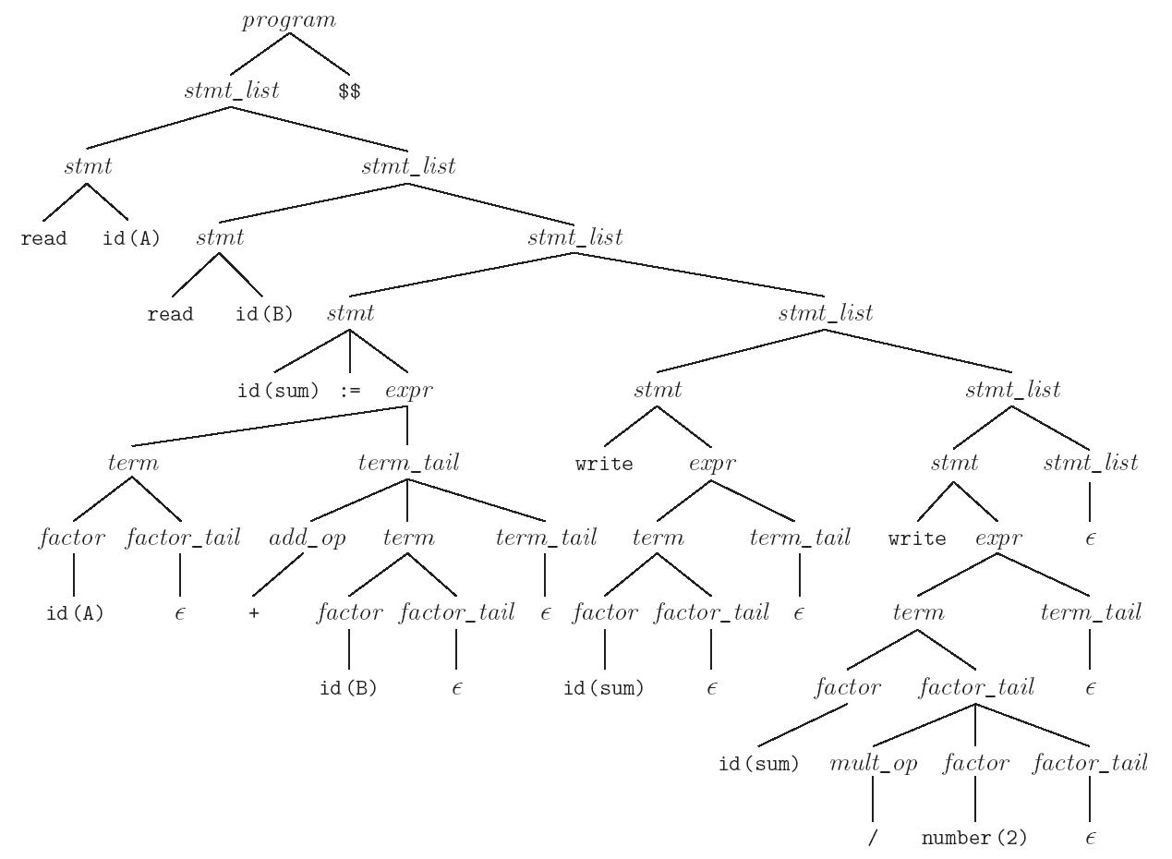
LL Parsing
Parse tree for the average program (Figure 2.17)
Copyright © 2009 Elsevier

Slide 10
LL Parsing: actual implementation
Table-driven LL parsing: you have a big loop in which you repeatedly look up an action in a two-dimensional table based on current leftmost non-terminal and current input token. The actions are
  (1) match a terminal
  (2) predict a production
  (3) announce a syntax error
Copyright © 2009 Elsevier

Slide 11
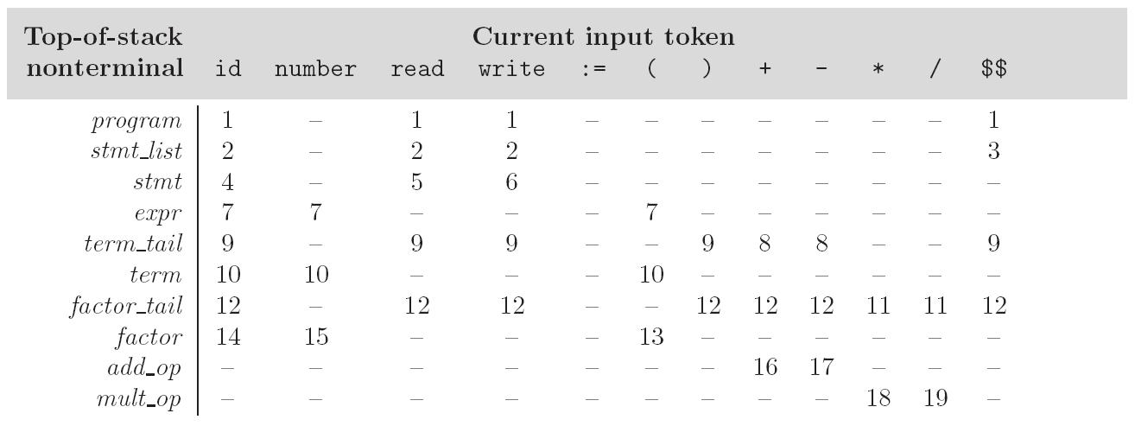
LL Parsing
LL(1) parse table for parsing for calculator language
Copyright © 2009 Elsevier

Slide 12
LL Parsing
To keep track of the left-most non-terminal, you push the as-yet-unseen portions of productions onto a stack
  for details see Figure 2.20
The key thing to keep in mind is that the stack contains all the stuff you expect to see between now and the end of the program
  what you predict you will see
Copyright © 2009 Elsevier

Slide 13
LL Parsing
The algorithm to build predict sets is tedious (for a "real" sized grammar), but relatively simple
It consists of three stages:
  (1) compute FIRST sets for symbols
  (2) compute FOLLOW sets for non-terminals
  (this requires computing FIRST sets for some strings)
  (3) compute predict sets or table for all productions
Copyright © 2009 Elsevier

Slide 14
LL Parsing
Algorithm First/Follow/Predict:
  FIRST(α) == {a : α →* a β}
  ∪ (if α =>* ε THEN {ε} ELSE NULL)
  FOLLOW(A) == {a : S →⁺ α A a β}
  ∪ (if S →* α A THEN {ε} ELSE NULL)
  Predict (A → X₁ ... X_{m}) == (FIRST (X₁ ... X_{m}) - {ε}) ∪ (if X₁, ..., X_{m} →* ε then FOLLOW (A) ELSE NULL)
Large example on next slide…
Copyright © 2009 Elsevier

Slide 15
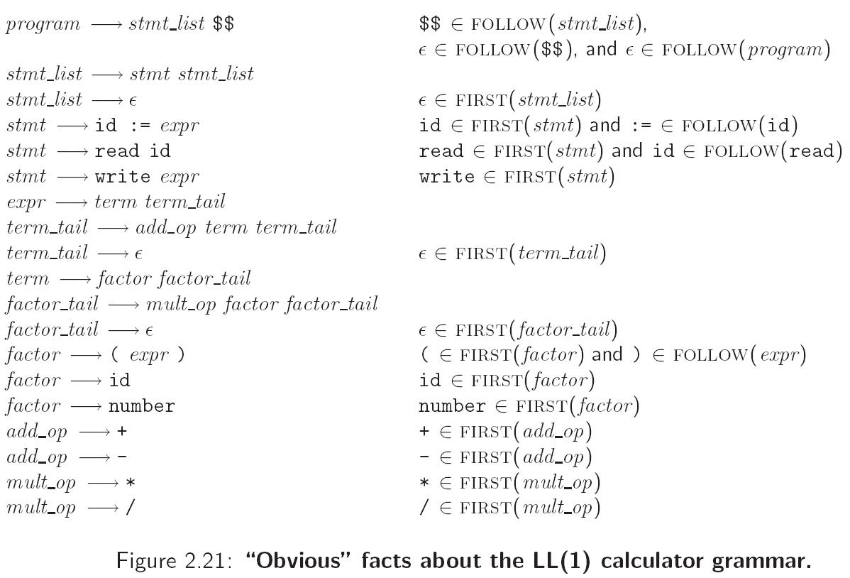
LL Parsing
Copyright © 2009 Elsevier

Slide 16
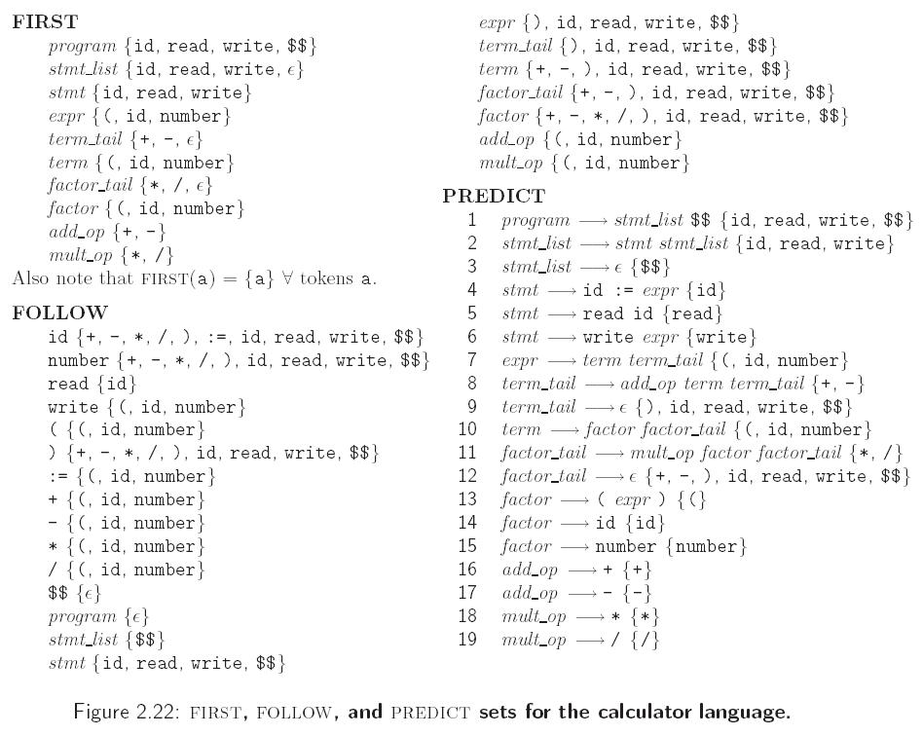
LL Parsing
Copyright © 2009 Elsevier

Slide 17
LL Parsing
If any token belongs to the predict set of more than one production with the same LHS, then the grammar is not LL(1)
A conflict can arise because
  the same token can begin more than one RHS
  it can begin one RHS and can also appear after the LHS in some valid program, and one possible RHS is ε
Copyright © 2009 Elsevier

Slide 18
LR Parsing
LR parsers are almost always table-driven:
  like a table-driven LL parser, an LR parser uses a big loop in which it repeatedly inspects a two-dimensional table to find out what action to take
  unlike the LL parser, however, the LR driver has non-trivial state (like a DFA), and the table is indexed by current input token and current state
  the stack contains a record of what has been seen SO FAR (NOT what is expected)
Copyright © 2009 Elsevier

Slide 19
LR Parsing
A scanner is a DFA
  it can be specified with a state diagram
An LL or LR parser is a Push Down Automata, or PDA
  a PDA can be specified with a state diagram and a stack
    the state diagram looks just like a DFA state diagram, except the arcs are labeled with <input symbol, top-of-stack symbol> pairs, and in addition to moving to a new state the PDA has the option of pushing or popping a finite number of symbols onto/off the stack
Copyright © 2009 Elsevier

Slide 20
LR Parsing
An LL(1) PDA has only one state!
  well, actually two; it needs a second one to accept with, but that's all
  all the arcs are self loops; the only difference between them is the choice of whether to push or pop
  the final state is reached by a transition that sees EOF on the input and the stack
Copyright © 2009 Elsevier

Slide 21
LR Parsing
An LR (or SLR/LALR) PDA has multiple states
  it is a "recognizer," not a "predictor"
  it builds a parse tree from the bottom up
  the states keep track of which productions we might be in the middle
The parsing of the Characteristic Finite State Machine (CFSM) is based on
  Shift
  Reduce
Copyright © 2009 Elsevier

Slide 22
LR Parsing: a simple example
To give a simple example of LR parsing, consider the grammar from last week
S’ → S
S → (L)
| a
L → L,S
| S
First question: Starting in state L, if we see an ‘a’, which rule? Two options: L -> S -> a, or L -> L,S -> a,S
Copyright © 2009 Elsevier

Slide 23
LR Parsing: a simple example
Key idea: Shift-Reduce
  We’ll extend our rules to “items”, and build a state machine to track more things
  “Item” = a production rule, along with a place holder that marks current position in the derivation
  (So NOT just based on next input plus current non-terminal)
  “Closure” = process of grouping items in the same placeholder position
  “Final states” = rules where we have no more possible matches, so have finalized a rule
Let’s go back to our example…
Copyright © 2009 Elsevier

Slide 24
LR Parsing: a simple example
Visual for an item:
  S’→ .S //about to derive S
  S’→ S. //just finished with S
Closure for S’.:
  S’→ .S
  S’→ .(L)
  S’→ .a
A final state: one where we finally have matched a rule
The machine will track current match, and when it hits a final state, it will “reduce” by that rule, simplifying input
Copyright © 2009 Elsevier

Slide 25
LR Parsing
To give a bigger illustration of LR parsing, consider the grammar (from Figure 2.24):
program → stmt list $$$
stmt_list → stmt_list stmt
| stmt
stmt → id := expr
| read id
| write expr
expr → term
| expr add op term
Copyright © 2009 Elsevier

Slide 26
LR Parsing
LR grammar (continued):
9. term → factor
| term mult_op factor
factor →( expr )
| id
| number
add op → +
| -
mult op → *
| /
Copyright © 2009 Elsevier

Slide 27
LR Parsing
This grammar is SLR(1), a particularly nice class of bottom-up grammar
  it isn't exactly what we saw originally
  we've eliminated the epsilon production to simplify the presentation
When parsing, mark current position with a “.”, and can have a similar sort of table to mark what state to go to
Copyright © 2009 Elsevier

Slide 28
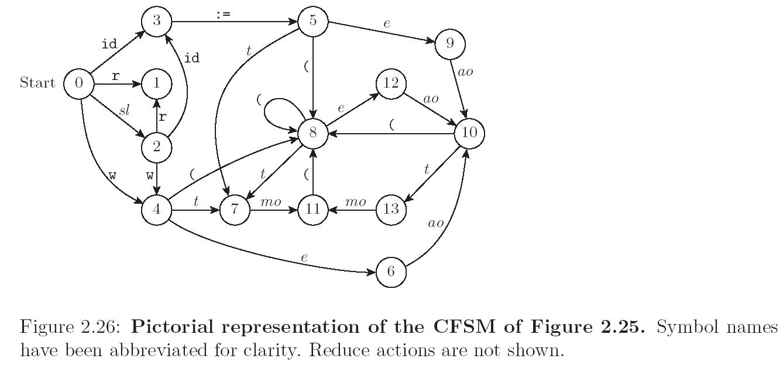
LR Parsing
Copyright © 2009 Elsevier

Slide 29
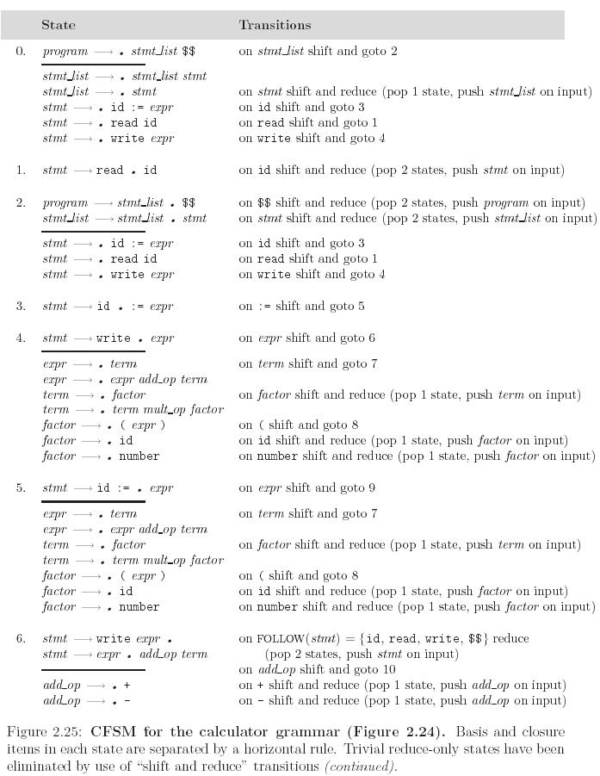
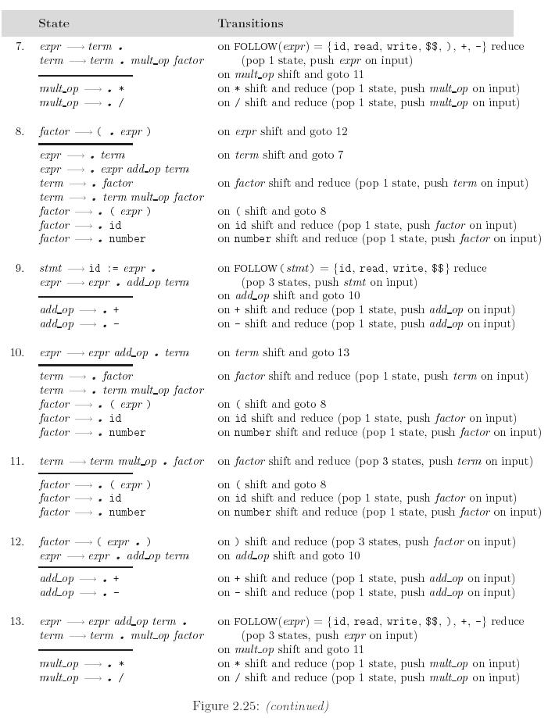
LR Parsing
Copyright © 2009 Elsevier

Slide 30
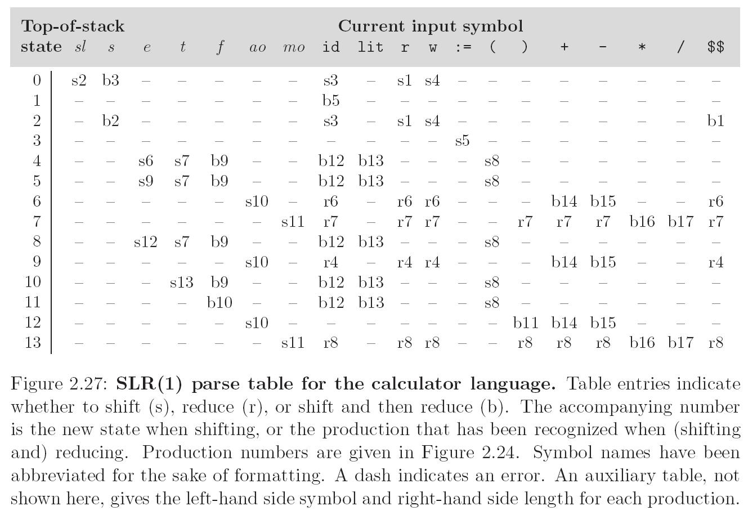
LR Parsing
Copyright © 2009 Elsevier

Slide 31
Syntax Errors
When parsing a program, the parser will often detect a syntax error
  Generally when the next token/input doesn’t form a valid possible transition.
What should we do?
  Halt and find closest rule that does match.
  Recover and continue parsing if possible.
Most compilers don’t just halt; this would mean ignoring all code past the error.
  Instead, goal is to find and report as many errors as possible.
Copyright © 2009 Elsevier

Slide 32
Syntax Errors: approaches
Method 1: Panic mode:
Define a small set of “safe symbols”.
  In C++, start from just after next semicolon
  In Python, jump to next newline and continue
When an error occurs, computer jumps back to last safe symbol, and tries to compile from the next safe symbol on.
  (Ever notice that errors often point to the line before or after the actual error?)
Copyright © 2009 Elsevier

Slide 33
Syntax Errors: approaches
Method 2: Phase-level recovery
  Refine panic mode with different safe symbols for different states
  Ex: expression -> ), statement -> ;
Method 3: Context specific look-ahead:
  Improves on 2 by checking various contexts in which the production might appear in a parse tree
  Improves error messages, but costs in terms of speed and complexity
Copyright © 2009 Elsevier

Slide 34
Beyond Parsing: Ch. 4
We also need to define rules to connect the productions to actual operations concepts.
Example grammar: E → E + T
E → E – T
E → T
T → T * F
T → T / F
T → F
F → - F
Question: Is it LL or LR?
Copyright © 2009 Elsevier

Slide 35
Attribute Grammars
We can turn this into an attribute grammar as follows (similar to Figure 4.1):
E → E + T E1.val = E2.val + T.val
E → E – T E1.val = E2.val - T.val
E → T E.val = T.val
T → T * F T1.val = T2.val * F.val
T → T / F T1.val = T2.val / F.val
T → F T.val = F.val
F → - F F1.val = - F2.val
F → (E) F.val = E.val
F → const F.val = C.val
Copyright © 2009 Elsevier

Slide 36
Attribute Grammars
The attribute grammar serves to define the semantics of the input program
Attribute rules are best thought of as definitions, not assignments
They are not necessarily meant to be evaluated at any particular time, or in any particular order, though they do define their left-hand side in terms of the right-hand side
Copyright © 2009 Elsevier

Slide 37
Evaluating Attributes
The process of evaluating attributes is called annotation, or DECORATION, of the parse tree [see next slide]
  When a parse tree under this grammar is fully decorated, the value of the expression will be in the val attribute of the root
The code fragments for the rules are called SEMANTIC FUNCTIONS
  Strictly speaking, they should be cast as functions, e.g., E1.val = sum (E2.val, T.val), cf., Figure 4.1
Copyright © 2009 Elsevier

Slide 38
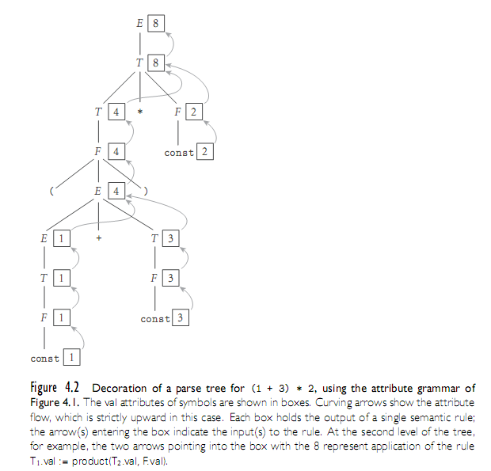
Evaluating Attributes
Copyright © 2009 Elsevier

Slide 39
Evaluating Attributes
This is a very simple attribute grammar:
  Each symbol has at most one
  attribute
    the punctuation marks have no attributes
These attributes are all so-called SYNTHESIZED attributes:
  They are calculated only from the attributes of things below them in the parse tree
Copyright © 2009 Elsevier

Slide 40
Evaluating Attributes
In general, we are allowed both synthesized and INHERITED attributes:
  Inherited attributes may depend on things above or to the side of them in the parse tree
  Tokens have only synthesized attributes, initialized by the scanner (name of an identifier, value of a constant, etc.).
  Inherited attributes of the start symbol constitute run-time parameters of the compiler
Copyright © 2009 Elsevier

Slide 41
Evaluating Attributes – Example
Attribute grammar in Figure 4.3:
E → T TT E.v =TT.v
TT.st = T.v
TT1 → + T TT2 TT1.v = TT2.v
TT2.st = TT1.st + T.v
TT1 → - T TT1 TT1.v = TT2.v
TT2.st = TT1.st - T.v
TT → ε TT.v = TT.st
T → F FT T.v =FT.v
FT.st = F.v
Copyright © 2009 Elsevier

Slide 42
Evaluating Attributes– Example
Attribute grammar in Figure 4.3 (continued):
FT1 → * F FT2 FT1.v = FT2.v
FT2.st = FT1.st * F.v
FT1 → / F FT2 FT1.v = FT2.v
FT2.st = FT1.st / F.v
FT → ε FT.v = FT.st
F1 → - F2 F1.v = - F2.v
F → ( E ) F.v = E.v
F → const F.v = C.v
Figure 4.4 – parse tree for (1+3)*2
Copyright © 2009 Elsevier

Slide 43
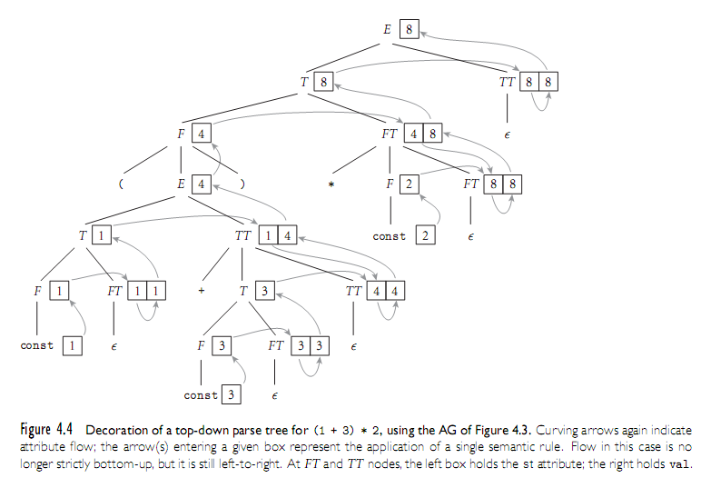
Evaluating Attributes– Example
Copyright © 2009 Elsevier

Slide 44
Bison
Bison does parsing, as well as allowing you to attribute actual operations to the parsing as it goes.
It naturally extends flex:
  Takes tokenized output
  Allows parsing of the tokens, and then execution of code defined by the parsing
Our simple example (which is still pretty long!) will be of a calculator language
  Similar to earlier grammars we say, where * (multiplication) has higher priority than +
For more examples, see flex/bison book by O’Reilly – “real” examples take several pages!

Slide 45
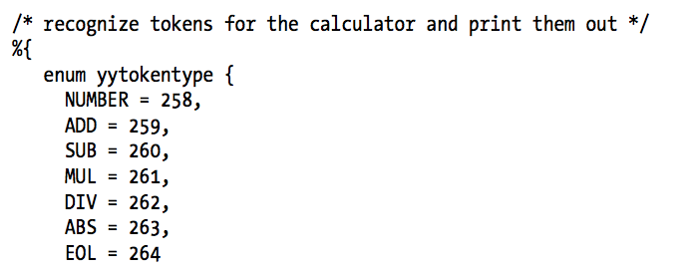
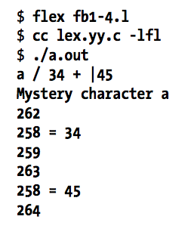
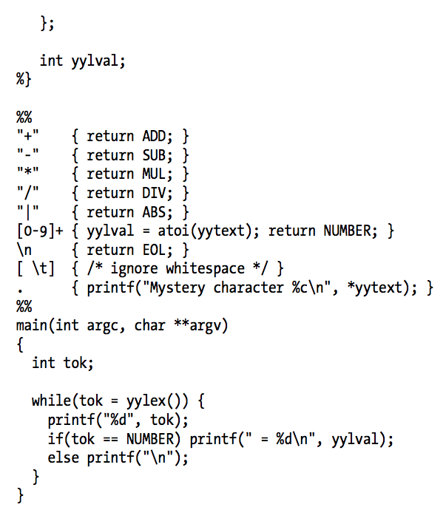
Using Bison: an example parser
Flex code:

Slide 46
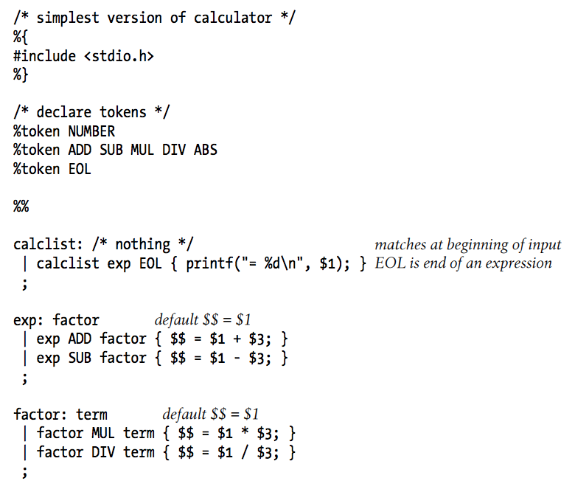
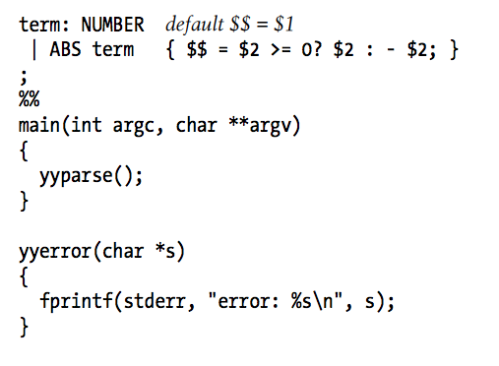
Now, the bison
Bison is then used to add the parsing (cont. on next slide):

Slide 47
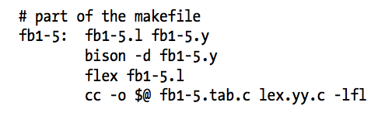
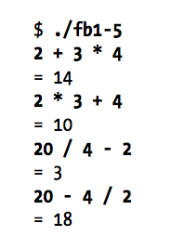
Bison example (continued)

