Slide 1

Chapter 9 :: Subroutines and Control Abstraction
Programming Language Pragmatics
Michael L. Scott
Copyright © 2009 Elsevier

Slide 2
Review Of Stack Layout
Stack recap: Each routine, as called, gets a new frame put on the top of the stack
  Contains arguments, return values, book-keeping info, local variables, and temporaries
Stack pointer: the address of either:
  last used location at the top of the stack
  First unused location
Frame pointer: address within the frame
  Objects in the frame are accessed via offset from the frame pointer
  Variable size things are towards top of the frame, since can’t be preset, with dope in fixed size part
Copyright © 2009 Elsevier

Slide 3
Review Of Stack Layout
If no variable-size objects, then everything has fixed offset from stack pointer
  In this case, frame pointer isn’t needed at all
  Frees up a register for use
Static and dynamic links maintained on stack:
  Static store context for scope purposes
  Dynamic store saved value of the frame pointer, so that it returns to correct calling method
Copyright © 2009 Elsevier

Slide 4
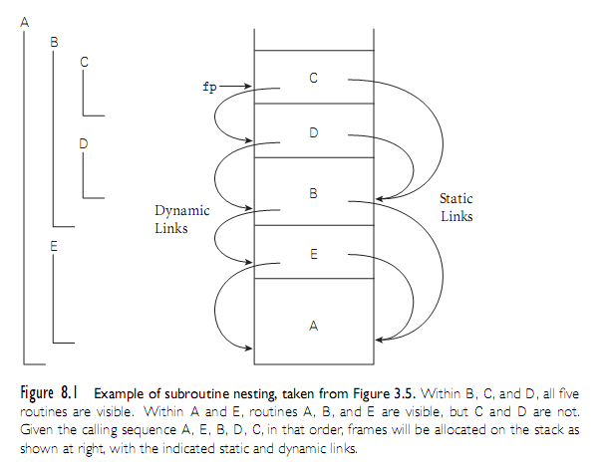
Review Of Stack Layout
Copyright © 2009 Elsevier

Slide 5
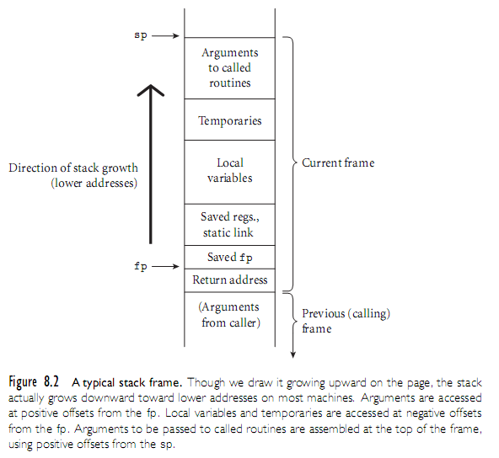
Calling Sequences
Copyright © 2009 Elsevier

Slide 6
Calling Sequences
The calling sequence (discussed in Ch. 3) is the code a caller executes to set up a new subroutine
Responsibilities:
  On the way in: Pass parameters, save return address, change program counter, change stack pointer, save registers that might be overwritten, changing frame pointer to new frame, and initializing code for new objects in the new frame
  On the way out: passing return parameters/values, executing finalization code for local objects, deallocating the stack frame, restoring registers, and restoring the PC
Copyright © 2009 Elsevier

Slide 7
Calling Sequences
Note: some of these things must be done by caller! They differ from call to call.
Others, however, can be done by either caller or by prolog/epilog of callee.
In general, space is saved if work is mostly done by callee:
  Anything done in callee appears only once in the target program
  Anything done by caller has to appear before and after every call in the final compiled code – which is every time function is called (often a lot!)
Copyright © 2009 Elsevier

Slide 8
Calling Sequences
Perhaps trickiest bit is who saves registers.
  Ideally, save only those that are in use in the caller and which would be overwritten in callee.
  This is almost impossible to do perfectly.
Simplest solution is either to save all registers in use (from caller) or save all registers that will be overwritten (from callee).
  However, this is usually a bit unnecessary – want to avoid extra overhead in general.
Copyright © 2009 Elsevier

Slide 9
Calling Sequences
A balance exists on many processors (MIPS and x86, among others):
  Two sets: caller responsibility and callee responsibility.
  Callee can assume that there is nothing of value in any of the caller saved register set.
  Caller can assume no callee will destroy contents in any of the callee-saves set.
  Compiler will then use callee-saves registers for local variables and other long-lived ones if possible, and caller-saves set for transient values, which won’t be needed across calls.
Copyright © 2009 Elsevier

Slide 10
Calling Sequences: RISC architecture
It is worth noting something about RISC architecture:
  Heavily optimized to support simple instructions, so that every operation takes one clock cycle
  Advantage is that pipelining is much easier in this setup
  Each command also requires less transistors of hardware space
In contrast, CISC architecture:
  Supports more complex operations: mult as well as add
  Advantage is that code size is much smaller, so less RAM needed
  In addition, less complexity in compiler
Copyright © 2009 Elsevier

Slide 11
Calling Sequences (C on MIPS)
Why RISC Matters to us:
  In general, RISC architecture forces more work to save registers
As an example, for C on MIPS, caller needs to:
  saves into the temporaries and locals area any caller-saves registers whose values will be needed after the call
  puts up to 4 small arguments into registers $4-$7 (a0-a3)
    it depends on the types of the parameters and the order in which they appear in the argument list
  puts the rest of the arguments into the arg build area at the top of the stack frame
  does jal, which puts return address into register ra and branches
    note that jal, like all branches, has a delay slot
Copyright © 2009 Elsevier

Slide 12
Calling Sequences (C on MIPS)
In prolog, Callee
  subtracts framesize from sp
  saves callee-saves registers used anywhere inside callee
  copies sp to fp
In epilog, Callee
  puts return value into registers (mem if large)
  copies fp into sp (see below for rationale)
  restores saved registers using sp as base
  adds to sp to deallocate frame
  does jra
Copyright © 2009 Elsevier

Slide 13
Calling Sequences (C on MIPS)
After call, Caller
  moves return value from register to wherever it's needed (if appropriate)
  restores caller-saves registers lazily over time, as their values are needed
All arguments have space in the stack, whether passed in registers or not
The subroutine just begins with some of the arguments already cached in registers, and 'stale' values in memory
Copyright © 2009 Elsevier

Slide 14
Calling Sequences (C on MIPS)
This is a normal state of affairs (especially in RISC); optimizing compilers keep things in registers whenever possible, flushing to memory only when they run out of registers, or when code may attempt to access the data through a pointer or from an inner scope
Copyright © 2009 Elsevier

Slide 15
Calling Sequences (C on MIPS)
Many parts of the calling sequence, prologue, and/or epilogue can be omitted in common cases
  particularly LEAF routines (those that don't call other routines)
    leaving things out saves time
    simple leaf routines don't use the stack - don't even use memory – and are exceptionally fast
Copyright © 2009 Elsevier

Slide 16
Inline expansion
In some languages, programmers can actually flag routines that should be expanded inline –stack overhead is avoided.
Example (in C++ or C99):
    inline int max(int a,int b)
    { return a > b ? a : b}
Ada does something similar, but keyword is:
pragma inline(max);
Note that both of these are just suggestions to the compiler – can’t be enforced, and may be done to other (not suggested) functions as well.
Note also that this can’t always be done – recursion is an obvious case with issues.
Copyright © 2009 Elsevier

Slide 17
Parameter Passing
Parameter passing mechanisms have three basic implementations
  value
  reference (aliasing)
  closure/name
Many languages (e.g., Pascal, Ada, Modula) provide different modes
Others have a single set of rules (e.g. C, Fortran, ML, Lisp)
Copyright © 2009 Elsevier

Slide 18
Parameter Passing
C/C++: functions
  parameters passed by value (C)
  parameters passed by reference can be simulated with pointers (C)
    void proc(int* x,int y){*x = *x+y } …
    proc(&a,b);
  or directly passed by reference (C++)
    void proc(int& x, int y) {x = x + y }
    proc(a,b);
Copyright © 2009 Elsevier

Slide 19
Parameter Passing
Passing by reference really gives two advantages:
  Allows callee to change something and have it persist
  Saves space/time copying
Unfortunately, the second isn’t really good in many cases – leads to buggy code, where changes are made that should not be allowed
  Hence, use of read only parameters: READONLY in Modula
  In C/C++, use const the same way
Does lead to some confusion with novices:
  Pragmatic issue: Does the implementation pass by value or reference?
  Semantic issues: Is the callee allowed to change the variable, and do these changes persist?
Copyright © 2009 Elsevier

Slide 20
Parameter Passing
In a language with a reference model of variables (Lisp, Clu), pass by reference (sharing) is the obvious approach
  You also saw this in Python – hence tons of discussion on if a list makes a deep or shallow copy
Some languages mix this up: Java, for example, does call-by-value for built-in types, but call-by-reference for user defined classes (all of which are references anyway)
C# also various – main difference from Java is that users can also make their own structs, which are essentially “built-in” types
Copyright © 2009 Elsevier

Slide 21
Parameter Passing
Ada goes for semantics: who can do what
  In: callee reads only
  Out: callee writes and can then read (formal not initialized); actual values is modified
  In out: callee reads and writes; actual modified
Ada in/out is always implemented as
  value/result for scalars, and either
  value/result or reference for structured objects
Copyright © 2009 Elsevier

Slide 22
Parameter Passing
The last option is closures: a reference to a subroutine, together with its referencing environment
Goal: whenever that function is called, want access to its referencing environment
  So even if called in a very different context, still get the information you need to run it correctly
Example: a function that takes a function as input and then applies it to list might look like:
  Declare the function apply_to_A(f, A)
  Then write a function later
  Then call the function on some list
Copyright © 2009 Elsevier

Slide 23
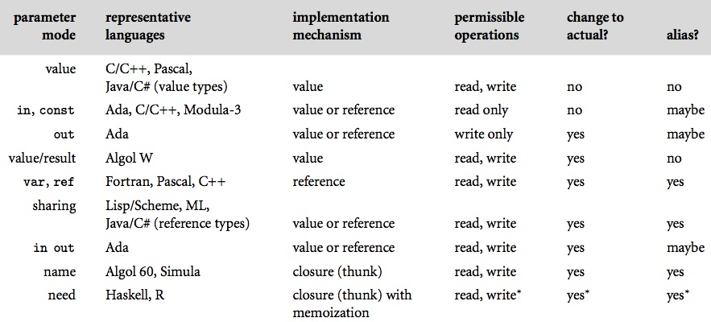
Parameter Passing
Figure 8.3 Parameter passing modes.
Copyright © 2009 Elsevier

Slide 24
Parameter Passing
A few final issues are addressed in the book, and must be considered when using/designing a language:
  Variable number of arguments – some allow, some don’t, and there is complexity in how to support it
    C example: int printf(char *format, …) {
    You then have to get at these and parse them somehow
    Java and C# also do this, but enforce more type safety
  Function returns
    Value of a function can be the value of its return or the value of its body (in more functional languages where expressions and statements are the same)
    Care is needed when scope is an issue – don’t return locals
    Return usually ends function, which is no always desirable
Copyright © 2009 Elsevier

Slide 25
Generic Subroutines and Modules
Generic modules or classes are particularly valuable for creating containers: data abstractions that hold a collection of objects
  Example: OS needs queues that can hold processes, memory descriptors, file buffers, etc.
  Often incorporates generics (you’d call them templates) or polymorphism
Copyright © 2009 Elsevier

Slide 26
Generic Subroutines and Modules
Generic subroutines (methods) are needed in generic modules (classes), and may also be useful in their own right
  For example, a min function that works on anything
These vary even more across languages – the book gives a nice overview
Copyright © 2009 Elsevier

Slide 27
Generic Subroutines and Modules
Implementation various:
  C++ and Ada make them static, so takes place at compile time, and makes separate copies for all possibilities
  Java 5, in contrast, guarantees that all instances will share the same code at run time – objects of class T are treated as instances of the standard base Object that Java supports
Copyright © 2009 Elsevier

Slide 28
Exception Handling
What is an exception?
  a hardware-detected run-time error or unusual condition detected by software
Examples
  arithmetic overflow
  end-of-file on input
  wrong type for input data
  user-defined conditions, not necessarily errors
Copyright © 2009 Elsevier

Slide 29
Exception Handling
Generally, we need the language to “unwind the stack” when exceptions happen
Basically, 3 options:
  Invent a value that can be used by caller when the real one can’t be returned.
    NO! Not good:
    Return an explicit status value to caller, which must be inspected after every call.
    Clunky and annoying. Also a source of common bugs, since many programmers forget or choose not to do this.
  Relay on the caller to pass a closure for error handling.
    Also clutters, and only works in more functional languages.
Copyright © 2009 Elsevier

Slide 30
Exception Handling
What is an exception handler?
  code executed when exception occurs
  may need a different handler for each type of exception
Why design in exception handling facilities?
  allow user to explicitly handle errors in a uniform manner
  allow user to handle errors without having to check these conditions
  explicitly in the program everywhere they might occur
Copyright © 2009 Elsevier

Slide 31
Exception Handling
Examples:
  Try in C++
If the exception is not handled in the calling routine, it is handed back up the dynamic chain.
  If not handled in the main routine, then a predefined outermost handler usually just kills the program.
Usually 3 goals:
  Compensate if possible in order to continue execution.
  Declare a local handler to clean up local resources and then reraise execution in order to pass along up the chain, where hopefully recovery can happen.
  Print some sort of error if recovery is not possible.
Copyright © 2009 Elsevier

Slide 32
Exception Handling
Defining is a mix:
  In C++ or Lisp, all are programmer defined
  In PHP, set_error_handler can be used to turn semantic errors into ordinary exceptions
  In Ada, exception is a built-in type, and so you can easily make your own:
    declare empty_queue : exception;
  In Modula-3, exceptions are just another object, like constants or variables
Most languages allow a throw or raise in an if to raise an exception
Copyright © 2009 Elsevier

Slide 33
Coroutines
Coroutines are execution contexts that exist concurrently, but that execute one at a time, and that transfer control to each other explicitly, by name
Coroutines can be used to implement
  iterators (Section 6.5.3)
  threads (to be discussed in Chapter 12)
Because they are concurrent (i.e., simultaneously started but not completed), coroutines cannot share a single stack
Copyright © 2009 Elsevier

Slide 34
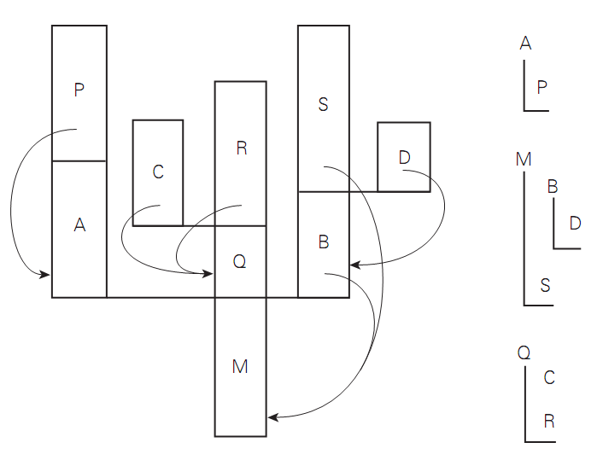
Coroutines
Figure 8.6 A cactus stack. Each branch to the side represents the creation of a coroutine ( A, B, C, and D). The static nesting of blocks is shown at right. Static links are shown with arrows. Dynamic links are indicated simply by vertical arrangement: each routine has called the one above it. (Coroutine B, for example, was created by the main program, M. B in turn called subroutine S and created coroutine D.)
Copyright © 2009 Elsevier

