Slide 1
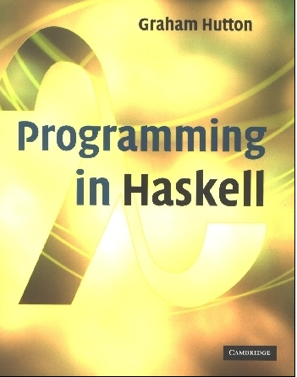
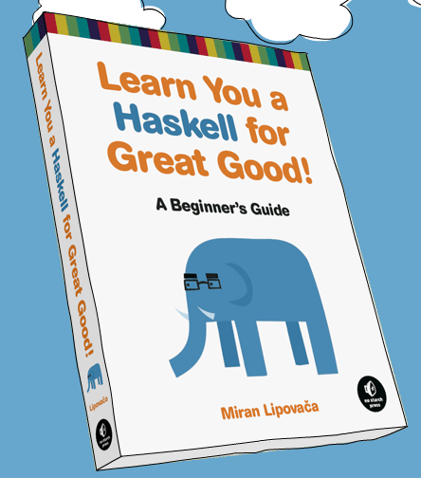
PROGRAMMING IN HASKELL
Odds and Ends, and Type and Data definitions
Based on lecture notes by Graham Hutton
The book “Learn You a Haskell for Great Good”
(and a few other sources)

Slide 2
Lambda Expressions
Functions can be constructed without naming the functions by using lambda expressions.
λx → x+x
the nameless function that takes a number x and returns the result x+x.

Slide 3
Note:
The symbol λ is the Greek letter lambda, and is typed at the keyboard as a backslash \.
In mathematics, nameless functions are usually denoted using the  symbol, as in x  x+x.
In Haskell, the use of the λ symbol for nameless functions comes from the lambda calculus, the theory of functions on which Haskell is based.

Slide 4
Lambda expressions are useful when defining functions that return functions as results.
For example:
const :: a → b → a
const x _ = x
is more naturally defined by
const :: a → (b → a)
const x = \_ → x

Slide 5
Lambda expressions can be used to avoid naming functions that are only referenced once.
For example:
odds n = map f [0..n-1]
where
f x = x*2 + 1
can be simplified to
odds n = map (\x → x*2 + 1) [0..n-1]

Slide 6
Sections
An operator written between its two arguments can be converted into a curried function written before its two arguments by using parentheses.
For example:
> 1+2
3
> (+) 1 2
3

Slide 7
This convention also allows one of the arguments of the operator to be included in the parentheses.
For example:
> (1+) 2
3
> (+2) 1
3
In general, if ⊕ is an operator then functions of the form (⊕), (x⊕) and (⊕y) are called sections.

Slide 8
Why Are Sections Useful?
Useful functions can sometimes be constructed in a simple way using sections. For example:
(1+)
- successor function
(1/)
- reciprocation function
(*2)
- doubling function
(/2)
- halving function

Slide 9
Exercise
Consider a function safetail that behaves in the same way as tail, except that safetail maps the empty list to the empty list, whereas tail gives an error in this case. Define safetail using:
(a) a conditional expression;
(b) guarded equations;
(c) pattern matching.
Hint: the library function null :: [a] → Bool can be used to test if a list is empty.

Slide 10
Higher order functions
Last time we started discussing higher order functions, or functions that take other functions are input.
These are heavily useful, and are one of the strengths of Haskell!
Let’s see a few more…

Slide 11
The Foldr Function
A number of functions on lists can be defined using the following simple pattern of recursion:
f [] = v
f (x:xs) = x ⊕ f xs
f maps the empty list to some value v, and any non-empty list to some function ⊕ applied to its head and f of its tail.

Slide 12
For example:
sum [] = 0
sum (x:xs) = x + sum xs
v = 0
⊕ = +
product [] = 1
product (x:xs) = x * product xs
v = 1
⊕ = *
v = True
⊕ = &&
and [] = True
and (x:xs) = x && and xs

Slide 13
The higher-order library function foldr (fold right) encapsulates this simple pattern of recursion, with the function ⊕ and the value v as arguments.
For example:
sum = foldr (+) 0
product = foldr (*) 1
or = foldr (||) False
and = foldr (&&) True

Slide 14
Foldr itself can be defined using recursion:
foldr :: (a → b → b) → b → [a] → b
foldr f v [] = v
foldr f v (x:xs) = f x (foldr f v xs)
However, it is best to think of foldr non-recursively, as simultaneously replacing each (:) in a list by a given function, and [] by a given value.

Slide 15
For example:
sum [1,2,3]
=
foldr (+) 0 [1,2,3]
=
foldr (+) 0 (1:(2:(3:[])))
=
1+(2+(3+0))
=
6
Replace each (:)
by (+) and [] by 0.

Slide 16
For example:
product [1,2,3]
=
foldr (*) 1 [1,2,3]
=
foldr (*) 1 (1:(2:(3:[])))
=
1*(2*(3*1))
=
6
Replace each (:)
by (*) and [] by 1.

Slide 17
Other Foldr Examples
Even though foldr encapsulates a simple pattern of recursion, it can be used to define many more functions than might first be expected.
Recall the length function:
length :: [a] → Int
length [] = 0
length (_:xs) = 1 + length xs

Slide 18
For example:
length [1,2,3]
=
length (1:(2:(3:[])))
=
1+(1+(1+0))
=
3
Replace each (:) by λ_ n → 1+n and [] by 0.
Hence, we have:
length = foldr (λ_ n → 1+n) 0

Slide 19
Now recall the reverse function:
reverse [] = []
reverse (x:xs) = reverse xs ++ [x]
For example:
Replace each (:) by λx xs → xs ++ [x] and [] by [].
reverse [1,2,3]
=
reverse (1:(2:(3:[])))
=
(([] ++ [3]) ++ [2]) ++ [1]
=
[3,2,1]

Slide 20
Hence, we have:
reverse =
foldr (λx xs → xs ++ [x]) []
Finally, we note that the append function (++) has a particularly compact definition using foldr:
Replace each (:) by (:) and [] by ys.
(++ ys) = foldr (:) ys

Slide 21
Why Is Foldr Useful?
Some recursive functions on lists, such as sum, are simpler to define using foldr.
Properties of functions defined using foldr can be proved using algebraic properties of foldr, such as fusion and the banana split rule.
Advanced program optimizations can be simpler if foldr is used in place of explicit recursion.

Slide 22
Other Library Functions
The library function (.) returns the composition of two functions as a single function.
(.) :: (b → c) → (a → b) → (a → c)
f . g = λx → f (g x)
For example:
odd :: Int → Bool
odd = not . even

Slide 23
The library function all decides if every element of a list satisfies a given predicate.
all :: (a → Bool) → [a] → Bool
all p xs = and [p x | x ← xs]
For example:
> all even [2,4,6,8,10]
True

Slide 24
Dually, the library function any decides if at least
one element of a list satisfies a predicate.
any :: (a → Bool) → [a] → Bool
any p xs = or [p x | x ← xs]
For example:
> any isSpace "abc def"
True

Slide 25
The library function takeWhile selects elements from a list while a predicate holds of all the elements.
takeWhile :: (a → Bool) → [a] → [a]
takeWhile p [] = []
takeWhile p (x:xs)
| p x = x : takeWhile p xs
| otherwise = []
For example:
> takeWhile isAlpha "abc def"
"abc"

Slide 26
Dually, the function dropWhile removes elements while a predicate holds of all the elements.
dropWhile :: (a → Bool) → [a] → [a]
dropWhile p [] = []
dropWhile p (x:xs)
| p x = dropWhile p xs
| otherwise = x:xs
For example:
> dropWhile isSpace " abc"
"abc"

Slide 27
Type Declarations
In Haskell, a new name for an existing type can be defined using a type declaration.
type String = [Char]
String is a synonym for the type [Char].

Slide 28
Type declarations can be used to make other types easier to read. For example, given
type Point = (Int,Int)
we can define:
origin :: Point
origin = (0,0)
left :: Point → Point
left (x,y) = (x-1,y)

Slide 29
Like function definitions, type declarations can also have parameters. For example, given
type Pair a = (a,a)
we can define:
mult :: Pair Int → Int
mult (m,n) = m*n
copy :: a → Pair a
copy x = (x,x)

Slide 30
Type declarations can be nested:
type Point = (Int,Int)
type Trans = Point → Point
However, they cannot be recursive:
type Tree = (Int,[Tree])

Slide 31
Data Declarations
A completely new type can be defined by specifying its values using a data declaration.
data Bool = False | True
Bool is a new type, with two new values False and True.

Slide 32
Note:
The two values False and True are called the constructors for the type Bool.
Type and constructor names must begin with an upper-case letter.
Data declarations are similar to context free grammars. The former specifies the values of a type, the latter the sentences of a language.

Slide 33
Values of new types can be used in the same ways as those of built in types. For example, given
data Answer = Yes | No | Unknown
we can define:
answers :: [Answer]
answers = [Yes,No,Unknown]
flip :: Answer → Answer
flip Yes = No
flip No = Yes
flip Unknown = Unknown

Slide 34
The constructors in a data declaration can also have parameters. For example, given
data Shape = Circle Float
| Rect Float Float
we can define:
square :: Float → Shape
square n = Rect n n
area :: Shape → Float
area (Circle r) = pi * r^2
area (Rect x y) = x * y

Slide 35
Note:
Shape has values of the form Circle r where r is a float, and Rect x y where x and y are floats.
Circle and Rect can be viewed as functions that construct values of type Shape:
Circle :: Float → Shape
Rect :: Float → Float → Shape

Slide 36
Not surprisingly, data declarations themselves can also have parameters. For example, given
data Maybe a = Nothing | Just a
we can define:
safediv :: Int → Int → Maybe Int
safediv _ 0 = Nothing
safediv m n = Just (m `div` n)
safehead :: [a] → Maybe a
safehead [] = Nothing
safehead xs = Just (head xs)

