Slide 1
NFAs, scanners, and flex

Slide 2
Admin stuff
Homework due next Wednesday
Handwritten (or scanned or typed, but pdf please!)
Email or submit by start of class
Next homework: programming assignment, coding a scanner-like program using flex, which we’ll discuss today
Likely due the following Wednesday (since we’re on a roll)
Note that this will be the first assignment submitted via git! I’ll go over instructions for this course git next week, and will have the homework posted early in the week

Slide 3
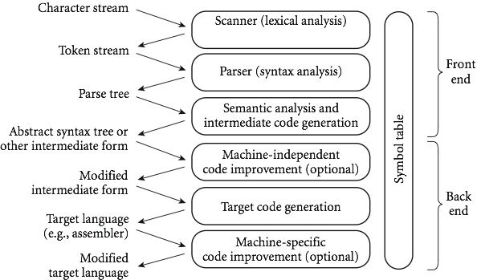
Recap
We’re looking at compilers:

Slide 4
So far:
Focusing on scanning, the top level
Scanning is recognizing a regular language
Connected to DFAs and NFAs, which we saw a bunch of the last 2 classes
Today:
Coding scanners
Flex, a c-style scanner
Later this week: parsing and CFGs, which are stronger than DFAs/scanning

Slide 5
More on why do we care?
You may ask: why do we care about regular expressions, DFAs and NFAs?
Well, in terms of defining a scanner, we usually start with regular expressions.
We then need a DFA (since NFAs are harder to code).
However, getting from a regular expression to a DFA in one step is difficult.
Instead, programs convert to an NFA, and THEN to a DFA.
Somewhat un-intuitively, this winds up being easier to code.

Slide 6
Constructing NFAs
The construction process for NFAs is pretty easy.
Recall how a regular expression is defined:
A single character or ε
Concatenation
An “or”
Kleene star
So all we need to do is show how to do each of these in an NFA (and how to combine them)

Slide 7
Constructing NFAs
Easy first step: What is the NFA for a single character, or for the empty string?
Now: what if I have NFAs for 2 regular expressions, and want to concatenate?

Slide 8
Constructing NFAs
A bit harder: what about an “or” or Kleene star?

Slide 9
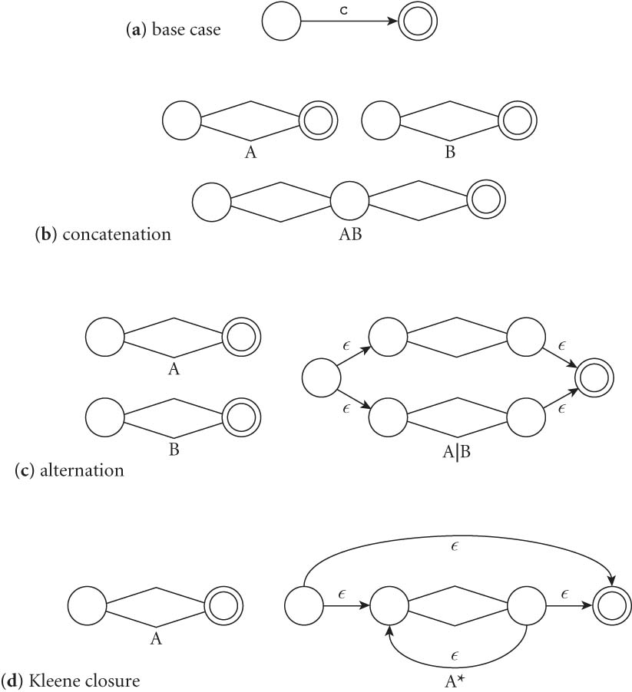
Constructing NFAs
Final picture (2.7 in book):

Slide 10
An example: decimals
Let d = [0-9], then decimals are: d* (.d | d. ) d*

Slide 11
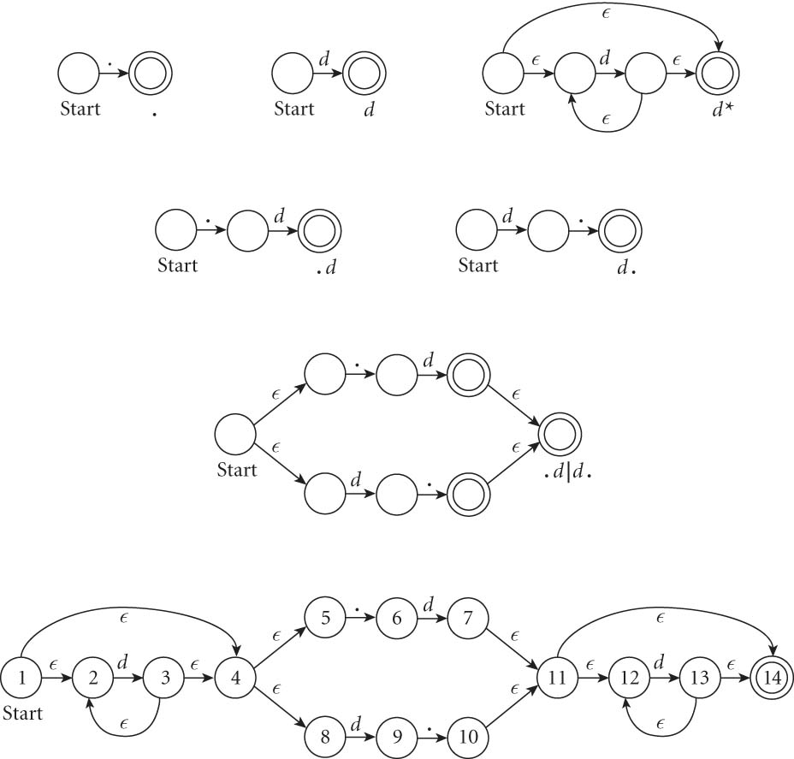
An example: decimals
Let d = [0-9], then decimals are: d* (.d | d. ) d*

Slide 12
From NFAs to DFAs
Next, a scanning program needs to go from this NFA to a DFA
Mainly because “guessing” the right transition if there are multiple ones is really hard to code
Much easier to convert to DFA, even though it can get bigger.
(Side note: how much bigger?)
Let’s go back to our decimal example on the board…

Slide 13
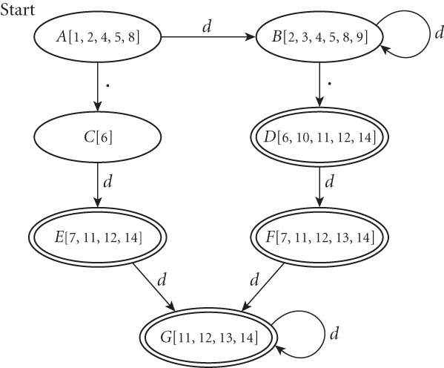
From NFAs to DFAs
If we automate this conversion on our last NFA (of decimals), we get:

Slide 14
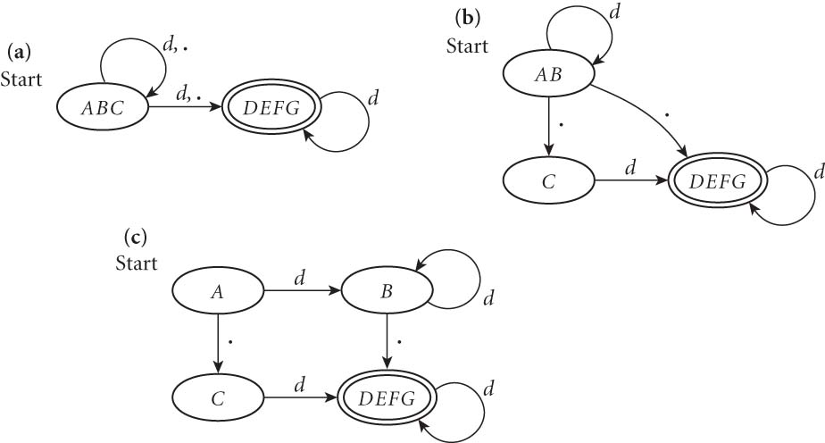
Minimizing DFAs
In addition, scanners take this final DFA and minimize.
(We won’t do this part by hand – I just want you to know that the computer does it automatically, to speed things up later.)

Slide 15
Coding DFAs (scanners)
Then, given a DFA, code can be implemented in 2 ways:
A bunch of if/switch/case statements
A table and driver
Both have merits, and are described further in the book.
We’ll mainly use the second route in homework, simply because there are many good tools out there.

Slide 16
Scanners
Writing a pure DFA as a set of nested case statements is a surprisingly useful programming technique
though it's often easier to use perl, awk, sed
for details see Figure 2.11
Table-driven DFA is what lex and scangen produce
lex (or really flex) does this in the form of C code – this will be an upcoming homework
scangen makes these in the form of numeric tables and a separate driver (for details see Figure 2.12)

Slide 17
lex & flex
lex is a tool to generate a scanner
written by Mike Lesk and Eric Schmidt
not really used anymore
Flex: fast lexical analyzer generator
free and open source alternative
our software of choice this semester – on hopper, as well as the lab machines

Slide 18
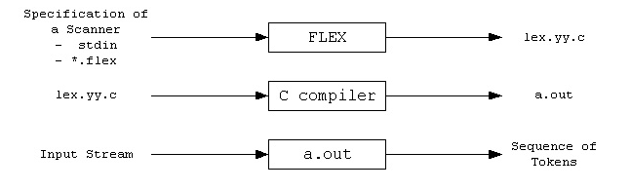
Flex overview
First, FLEX reads a specification of a scanner either from an input file *.lex, or from standard input, and it generates as output a C source file lex.yy.c.
Then, lex.yy.c is compiled and linked with the "-lfl" library to produce an executable a.out.
Finally, a.out analyzes its input stream and transforms it into a sequence of tokens.

Slide 19
Flex intro (cont)
Flex reads given input files or standard input, and tokenizes the input according to the rules you specify
As output, it generates a function yylex()
(This is why you use –lfl option, so that it links to the flex runtime library)
When you run the final executable, it analyzes input for occurrences of regular expressions
If found, executes the matching C code
Also can track states, to mimic a DFA

Slide 20
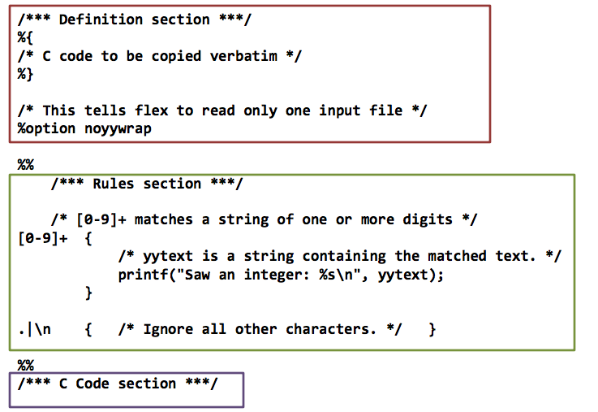
Format of a flex file
Three main sections of any flex file:

Slide 21
First section: definitions
The first section is mainly for definitions that will make coding easier.
Form: name definition
Examples:
digit [0-9]
ID [a-z][a-z0-9]*
Note: these are regular expressions!

Slide 22
Definitions section (cont.)
An indented comments (starting with /*) is copied verbatim to the output, up to the next matching */
Any indented text or text enclosed in %{}% is copied verbatim (with the %{}% removed)
%top makes sure that lines are copied to the top of the output C file
usually used for #include

Slide 23
The rules section
The second section is essentially specifying a DFA’s transition function
Format: pattern action where pattern is unindented and action is on the same line
Any indented line or line surrounded by a %{}% can be used to declare variables, etc.
Note: deviations from this format cause compile issues!

Slide 24
Rules section: allowed patterns
Patterns are what encode the regular expressions that are recognized
Examples:
‘x’ - match the character x
‘.’ - any character except a newline
‘xyz’ - matches x, y, or z
‘abj-oZ’ - matches a,b,j,k,l,m,n,o, or Z
‘[^A-Z]’ – characters OTHER than A-Z (negation)

Slide 25
More patterns
‘[a-z]{-}[aeiou]’ – any lower case consonant
‘r*’ - 0 or more of expression r
‘r+’ – 1 or more of expression r
‘r?’ – 0 or 1 r’s
‘r{2-5}’ – between 2 and 5 r’s
‘r{4}’ – exactly 4 r’s
‘{name}’ – expansion of some name from your definitions section
‘r$’ – r at the end of a line

Slide 26
A simple example
%%
username printf( "%s", getlogin() );
Explanation:
The first section is blank, so no definitions
The third section is missing, so no C code in this simple example either
The middle is rules: by default, flex just copies input to the output if it doesn’t match a rule, so that’s what will happen here for most input
The only exception is that if it encounters “username”, it will then run this c code and replace that with the username expanded

Slide 27
Another simple example
int num_lines = 0, num_chars = 0;
%%
\n ++num_lines; ++num_chars;
. ++num_chars;
%%
main()
{
yylex();
printf( "# lines = %d, # chars = %d\n",
num_lines, num_chars );
}

Slide 28
Things to note from last slide
Two global variables are declared at the beginning
Both are accessible in yylex and in main
Only two rules:
First matches newline
Second matches any character other than newline
Order of precedence matters – takes the first and longest possible match

Slide 29
How matching happens
Input is analyzed to find any match to one of the patterns
If more than one, will take the longest
If two are equal, takes the first one
Once matched, text corresponding to this matc is put in global character pointer yytext, and its length is in yyleng
The action is then executed
If nothing matches, default action is to match one character and copied to standard output

Slide 30
Actions
Actions can be any C code, including returns
If action is a vertical bar (|), then it executes the previous rule’s action
If action is empty, then the input is discarded
Simple example to illustrate:
%%
"zap me"

Slide 31
Another simple example
This program compresses multiple spaces and tabs to a single space, and throws away any white space at the end of a line:
%%
[ \t]+ putchar( ’ ’ );
[ \t]+$ /* ignore this token */

Slide 32
Special actions
ECHO copies yytext to the scanner’s output
BEGIN followed by name of a start condition puts scanner in a new state (like a DFA – more on that next time)
REJECT directs scanner to go to “second best” matching rule
Note: this one REALLY slows the program down, even if it is never matched
There are even commands to append or remove rules from the rules section

