Slide 1
Prolog
Based on: Chapter 12 of PLP
“Seven languages in seven weeks”
Various links (see schedule page)

Slide 2
Last time
Saw a bit more syntax
First bit of lists
Today: try to get to some more complex and recursive structures
Note: again, some examples for you to work out, so email me AT THE END OF CLASS with some proof of your work
Working with a partner is fine if you don’t have a computer, but be sure to give these a try yourself later! No substitute for actual programming…

Slide 3
Math in Prolog
Arithmetic: The '=' operator determines whether its operands can be unified ?- A = 37. A = 37 yes ?- 2 = 2. yes Math operators are functors (structure names), not functions ?- (2+3) = 5 no

Slide 4
Math (cont)
For math we use the built-in operator is ?- is(X, 1+2). X = 3 yes ?- X is 1+2. X = 3 yes % LHS of 'is' must be as-yet uninstantiated ?- 1+2 is 4-1. no % RHS of 'is' must already be instantiated ?- X is Y. <error>

Slide 5
Starting with an exercise
I want you each to start a genealogical database to use for the in class exercises today.
My file: lists my kids, me, my parents, and my grandparents
Some queries to try:
Confirm a parent relationship such as parent(erin, grace)
Find someone's parent such as parent(X, jesse)
Find someone's children such as parent(susan, X)
List all parent-children such as parent(X,Y)

Slide 6
Back to Recursion
We actually saw some recursive definitions last time, but let’s look a little closer at one.
child(anne,bridget).
child(bridget,caroline).
child(caroline,donna).
child(donna,emily).
descend(X,Y) :- child(X,Y).
descend(X,Y) :- child(X,Z), descend(Z,Y).
This final rule allows the “child” relationship to chain indefinitely when unifying – which is the correct notion to use for descendants!

Slide 7
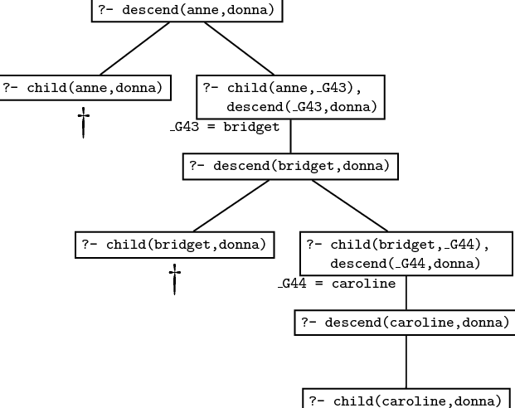
Recursion (again)
How the solution is determined depends on order in the database, as well as order in which you list the constraints.
So – order matters!!

Slide 8
How does order matter? I have the two rules:
descend(X,Y) :- child(X,Y).
descend(X,Y) :- child(X,Z), descend(Z,Y).
If I swap the two rules, it will still work correctly (if less efficiently).
However, if I change the second to be:
descend(X,Y) :- descend(Z,Y), child(X,Z).
Then infinite loops will abound, since Prolog will attempt to go down an infinitely long tree of descends.
(Look back at that tree again…)

Slide 9
Another example
Be careful of ordering!
Consider this example describing paths in graphs:
edge(a, b). edge(b,c). edge(c,d).
edge(d, e). edge(b, e). edge(d, f).
path(X, X).
path(X, Y):- edge(Z, Y), path(X, Z).
If the two terms on the last clause were reversed, the program would be less efficient. Why?

Slide 10
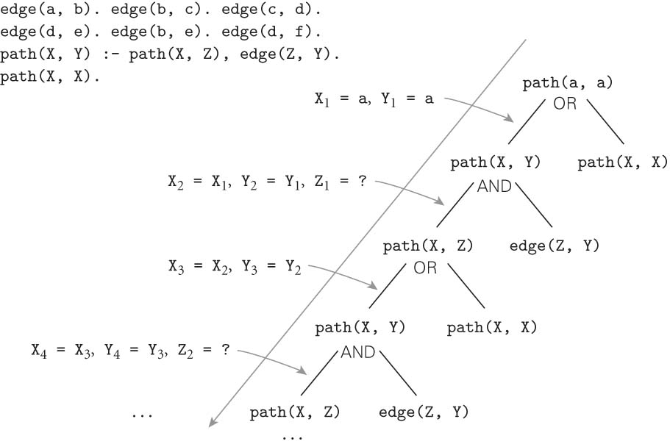
Same path example
If we were to flip order of the last 2 clauses, things get even worse!

Slide 11
Exercise
Pull up your genealogy database, and add the predicate to find descendants (see previous slide), but using the parent predicate (since we didn’t make a child one).
Then, test your predicate. Do they work, or do you see infinite loops even for simple queries like: descend(erin,grace).?
If so, check your rules and re-order some things!

Slide 12
Lists
We also saw lists last time:
Structure: [] is the empty list, and . is a built in concatenation (like : in Haskell). So a list is:
.(a, .(b, .(c, [])))
?- append([a, b, c], [d, e], L).
L = [a, b, c, d, e]

Slide 13
List exercise
Now, add the following to your genealogy file:
ancestor(A,D,[A]) :- parent(A,D).
ancestor(A,D,[X|Z]) :-
parent(X,D),
ancestor(A,X,Z).
Now test a few ways. I did:
ancestor(jesse,erin,X).
ancestor(erin,jesse,X).
ancestor(clarice,jesse,X).
ancestor(X,jesse,Y).

Slide 14
Takeaway
PROLOG IS NOT PURELY DECLARATIVE
The ordering of the database and the left-to-right pursuit of sub-goals gives a deterministic imperative semantics to searching and backtracking
Changing the order of statements in the database can give you different results
It can lead to infinite loops
It can certainly result in inefficiency

