Slide 1
Prolog
Based on: Chapter 12 of PLP
“Seven languages in seven weeks”
Various links (see schedule page)

Slide 2
Last time
A longer exercise
Homework for prolog is posted, due next Friday via git
We’ll finish prolog today
Two random topics next week, then overview lecture
Review on last day of class
Final is stupid early on 1st day of finals
SET AN ALARM

Slide 3
Conclusion from last time:
PROLOG IS NOT PURELY DECLARATIVE
So how was I lying when I introducted the language?
As we saw, he ordering of the database and the left-to-right pursuit of sub-goals gives a deterministic imperative semantics to searching and backtracking.
If it were purely declarative, then “truth” would not depend on ordering in the code.

Slide 4
Imperative Control Flow
We can use this to actually alter the flow of control! Recall this example: member(X, [X | _]). member(X, [_ | T]) := member(X,T).
If a given atom a is in the list n times, the the goal ?- member(a,L)can succeed n times.
This can be very inefficient, since we may have some other goal to satisfy that could fail:
prime_candidate(X) := member(X, candidates),prime(X).
(Here, if a is in the list of candidates more than once, we’ll waste time checking for it that number of times, when we already “know” that prime(a) will just fail.)

Slide 5
Control flow - the cut
We can save time by cutting off all future searches for a after the first time it is found: member(X, [X | _]) :- !. member(X, [_ | T]) := member(X,T).
The cut is the ! on the right hand side. This says that if X is the head of L, we should not attempt to unify member(X,L)with the left-hand side of the second rule. Essentially, the cut forces us to commit to the first rule only.

Slide 6
Control flow: \=
Another option is to force the first element of the list to not be equal to X in the second rule: member(X, [X | _]) :- !. member(X, [H | T]) := X \= H, member(X,T).
The statement X \= H is equivalent to the statement \+(X = H). In essence, \+ is a bit like a not (which is how it is written in some versions of Prolog).

Slide 7
Control flow: back to the cut
One really interesting use of ! is as an equivalent to if-then-else statements: statement := condition, !, then_part. statement := else_part.
Here, the cut commits us to the first part if condition is true, which means we will never go to the second rule.
However, if the condition comes back as false (i.e. no derivation is found to make it true), then we’ll move onto the second rule and try to find if it can be satisfied.

Slide 8
Control flow: the fail predicate
The fail predicate always fails.
It can be quite useful to force certain actions. For example, the \+ can be implemented using fail and !: =\+(X=H) :- (X=H), !, fail.
It can also be used to generate a type of “looping” behavior. As an example, recall our append code:
append([], A, A).
append([H | T], A, [H | L]) :-
append(T, A, L).
If we write append(A,B,L) where L is instantiated but A and B are not, we can use this to generate possible lists.

Slide 9
Control flow: the fail predicate
If we write append(A,B,L) where L is instantiated by A and B are not, we can use this to generate possible lists:
print_lists(L) :-
append(A,B,L), write(A),
write(‘ ‘), write(B),
nl, fail.
The output if we call print_lists([a, b, c]) will be:
[] [a, b, c]
[a] [b, c]
[a, b] [c]
[a, b, c] []
No

Slide 10
Looping and unbounded generators
The following generates all of the natural numbers:
natural(1).
natural(N) :- natural(M), N is M+1.
We can then use this to print out the first n numbers:
my_loop(N) := natural(I),
write(I), nl,
I = N, !.
So long as I is less than N, the equality predicate will fail and backtracking will pursue another alternative for natural. If I is equal to N, then the cut will execute, committing us to the final value of I and terminating this loop.

Slide 11
Looping and unbounded generators
This programming idiom - an unbounded generator with a test-cut terminator - is know as generate-and-test.
This combination is generally used with side effects, such as I/O or modification of the database.
For example, we could use such a construct to add values to the database until some threshold is met.

Slide 12
I/O in prolog
Prolog provides several I/O predicates, such as:
write and nl for output, read for input
see and tell can redirect input and output to different files.
get and put read individual characters.
consult and reconsult add database clauses from a file, so that they don’t have to be entered by hand.

Slide 13
Database Manipulation
Prolog is homoiconic: it can represent itself (like Scheme).
It can also modify itself:
?- rainy(X)
X = seattle ;
X = rochester ;
No
?- assert(rainy(syracuse)).
Yes
?- retract(rainy(rochester)).
Yes
?- rainy(X)
X = seattle ;
X = syracuse ;
No

Slide 14
Additional predicates
The goal functor(T, F, N) succeeds if and only if T is a term with functor F and arity N:
?- functor(foo(a,b,c), foo, 3).
Yes
?- functor(foo(a,b,c), F, N).
F = foo
N = 3
?- functor(T, foo, 3).
T = foo(_10, _37, _24)
The goal arg(N, T, A) succeeds if and only if its first two arguments are instantiated, N is a number, and A is the Nth argument of T:
?- arg(3, foo(a,b,c), A).
A = c

Slide 15
Using arg and functor
We can use these together to create an arbitrary term:
?- functor(T, foo, 3), arg(1, T, a), arg(2, T, b), arg(3, T, c)
T = foo(a, b, c)
We can also use =.. for this:
?- T =.. [foo, a, b, c]
T = foo(a,b,c)
?- foo(a,b,c) =.. [F, A1, A2, A3]
F = foo
A1 = a
A2 = b
A3 = c

Slide 16
Dynamic goals
Taken together, we can attempt to satisfy goals that are created at run-time only:
param_loop(L, H, F) :- natural(I), I >= L,
G =.. [F, I], call(G), I=H, !.
Then calling:
?- param_loop(5, 10, write).
5678910
Yes

Slide 17
An example: DFAs
As a more interesting example, prolog is also really good and simulating DFAs and NFAs.
We’ll talk about DFAs
My example: taken from
https://www.cpp.edu/~jrfisher/www/prolog_tutorial/2_14.html
Things to note:
This prints for you!
The transition function takes an input and moves along an “arrow”
For NFAs, your job will be to add multiple possible transitions and empty transitions

Slide 18
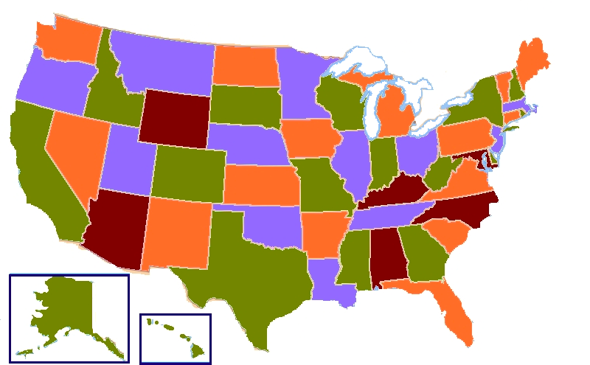
Another example to recap
Consider 4 coloring a map.
Classical example of an NP-Hard problem, so the best we can hope for is exponential time.
NOT easy to code in many languages:
http://www.cplusplus.com/forum/general/123813/
https://handcraftsman.wordpress.com/2015/06/21/four-coloring-a-graph-of-u-s-states-with-python-and-a-ga/
http://www.sanfoundry.com/java-program-graph-coloring-algorithm/
Copyright © 2009 Elsevier

Slide 19
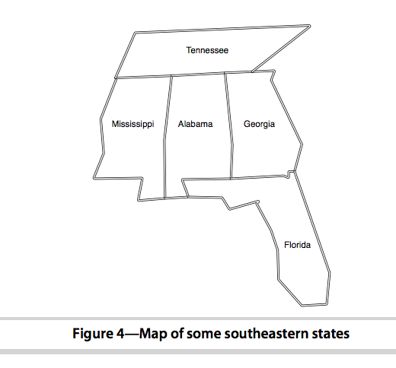
Prolog – 3 coloring:
Let’s try a small example of this in prolog
Extending bigger is easy, since will just need more predicates for neighbors
Base assertions will just be that colors need to be different, and neighbors can’t be the same
See code on webpage

Slide 20
Prolog – 4 coloring:
There are also other ways to do this, that pull in more logic like what we saw in the first part of lecture.
See (for example):
https://bernardopires.com/2013/10/try-logic-programming-a-gentle-introduction-to-prolog/
https://www.cpp.edu/~jrfisher/www/prolog_tutorial/2_1.html
Copyright © 2009 Elsevier

Slide 21

My favorite example (in textbook)
It is worth reiterating that prolog is NOT really a traditional language which executes statements in a von Neumann-like way.
Prolog does provide some mechanisms for this, but they can be very inefficient (especially if you’re not used to the language).
sort(L1, L2) := permutation(L1, L2), sorted(L2).
permutation([], []).
permutation(L, [H | T]) :-
append(P, [H | S], L),
append(P, S, W),
permutation(W,T).
If this looks confusing, don’t worry. We’re essentially saying L2 is a sorted version of L1 if it’s a permutation of L1 and it is sorted.
This version takes exponential time. Why?
Copyright © 2009 Elsevier

Slide 22
Sorting: quicksort
Implementing something like quick sort is possible:
quicksort([], []).
quicksort([A, L1], L2) :- partition(A, L1, P1, S1),
quicksort(P1, P2), quicksort(S1, S2),
append(P2, [A | S2], L2).
partition(A, [], [], []).
partition(A, [H | T], [H | P], S) :- A >= H, partition(A, T, P, S).
partition(A, [H | T], [P], [H | S]) :- A =< H, partition(A, T, P, S).
Copyright © 2009 Elsevier

Slide 23
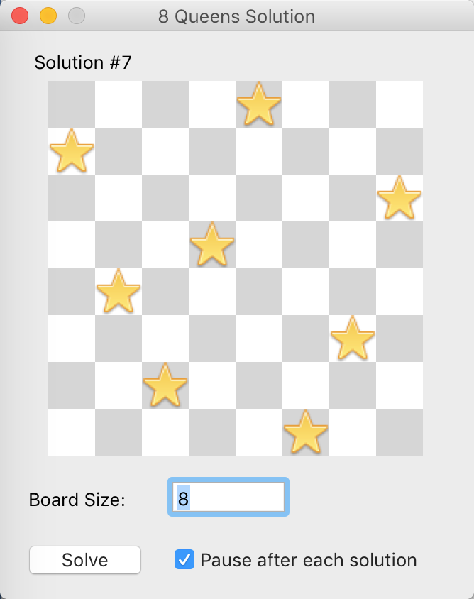
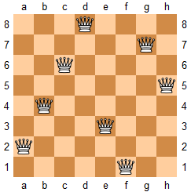
Another example: queen’s challenge
Set n queens on an n by n chess board so that no queen can “take” any other

Slide 24
Implementing it
When can a queen “take” another?
Diagonal
Vertical
Horizontal
So: at most one per row (or column)
Would then need to check if they are diagonal from each other

Slide 25
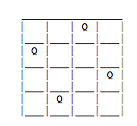
So: use lists
We’ll represent a board as a list, where position i will be the location of the queen in row I
Example: [3,1,4,2]
How to check diagonals?
(Note: simple math trick…)

Slide 26
Solution:
/* prolog tutorial 2.11 Chess queens challenge puzzle */
perm([X|Y],Z) :- perm(Y,W), takeout(X,Z,W).
perm([],[]).
takeout(X,[X|R],R).
takeout(X,[F|R],[F|S]) :- takeout(X,R,S).
solve(P) :-
perm([1,2,3,4,5,6,7,8],P),
combine([1,2,3,4,5,6,7,8],P,S,D),
all_diff(S),
all_diff(D).
combine([X1|X],[Y1|Y],[S1|S],[D1|D]) :-
S1 is X1 +Y1,
D1 is X1 - Y1,
combine(X,Y,S,D).
combine([],[],[],[]).
all_diff([X|Y]) :- \+member(X,Y), all_diff(Y).
all_diff([X]).

Slide 27
Solution:
| ?- [chess].
P = [5,2,6,1,7,4,8,3] ? ;
P = [6,3,5,7,1,4,2,8] ? ;
…
| ?- setof(P,solve(P),Set), length(Set,L).
L = 92
Set = [[1,5,8,6,3,7,2,4],[1,6,8,3,7,4,2,5],[1,7,4,6,8,2,5,3],[1,7,5,8,2,4,6,3],[2,4,6,8,3,1,7,5],[2,5,7,1,3,8,6,4],….

Slide 28
Conclusions
Bigger examples are everywhere online
I really like the Sudoku example in your recommended text, “7 languages in 7 weeks” (you can find this chapter online for free, in fact), but it was really too long for class.
First used for language processing, but good also for games, web analysis, AI, scheduling, and other things.
Often really found in a larger applications, not solo.
Weaknesses:
Not general purpose – definitely a niche language.
Computationally intensive, so not good on big data.
Can be hard to manage recursion (even more so than functional).

Slide 29
Conclusions
Two major steps:
Build a knowledge base
Compile this base and ask questions
Core computation is unification, as opposed to variables or functions.
Serious learning curve! We’ve only tasted it briefly, so use this cautiously.
Lots of people say this takes years to get good at, but finding places it can be applied can make life much easier.
My takeaway for you: some models of computation are just very different, but have their unique strengths.

