Slide 1
CSCI 3200: Programming Languages
Instructor: Dr. Erin Wolf Chambers
Office: 301 Ritter Hall
Email: erin.chambers@slu.edu

Slide 2
Today:
Syllabus overview (boring but necessary)
HW 1 is posted – due next Wednesday
An intro to programming languages

Slide 3
First Question:
What programming languages have you used before?
Python
C++/C
Java?
Matlab?
Others?

Slide 4
Categories of langauges
There are many ways to categorize programming languages.
Main starting point: High level versus low level
Examples?
In fact, initially, there only were extremely low level languages: each machine architecture had its own built in language.

Slide 5
High level languages
This began to change in the 1950s with Fortran, when people realized it would make more sense to have common languages and then translate them for the machine
This is the advent of the notion of compilation.
The idea was slow to catch on, since compiled code was usually slower to run.

Slide 6
Why so many?
Programming languages are still very much evolving:
Structured programming (using loops and function calls) was developed in the late 1960’s.
Object orientation was only introduced in the 1980’s.
Modern scripting languages (Ruby, Python, etc.) are often less than 20 years old
Functional programming is seeing a huge push in recent years

Slide 7
Why so many? (cont)
Special purpose languages are very common:
C is good for low level coding, like OS development.
Prolog is good for logical relationships and AI applications.
Awk is good for character and string manipulations.
Python and perl are good for scripting.

Slide 8
Other issues:
Ease of use
Learning curve
Standardization
Open source
Good compliers available
Economics and hisotry
Pure inertia

Slide 9
Paradigms of computing
The major paradigms we’ll discuss this semester are:
Declarative languages: focus is on what the computer should do.
Imperative languages: focus is on how the computer should do something. (This is the dominant paradigm.)

Slide 10
Imperative language categories
von Neumann: Fortran, C, etc.
- based on computation with variables
Scripting languages: bash, awk, perl, etc.
- subset of von Neumann, but tailored for ease of expression over speed
Object oriented:
- traces back to Simula 67, and descended from von Neumann, but focus is on objects rather than pure variables

Slide 11
Declarative language categories
1. Functional languages: Lisp, Scheme, Haskell, etc.
based on recursive definitions of functions
Inspired by lamba calculus
2. Logic based: prolog
computation is based on attempts to find values that satisfy specified relationships
3. Data flow: id, val
flow of information (tokens) among nodes

Slide 12
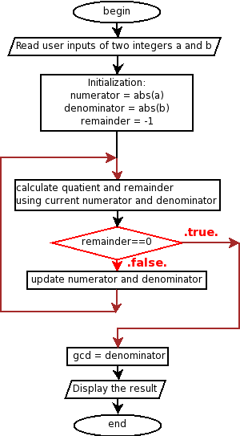
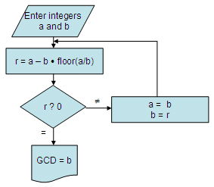
Some examples:
Consider the gcd algorithm (finding the greatest common divisor)
Euclid’s algorithm:

Slide 13
GCD in C
int main() {
int i = getint(), j = getint();
while (i != j) {
if (i > j)
i = i - j;
else
j = j - i;
}
putint(i);
}

Slide 14
GCD in Haskell
Haskell is based entirely on function calls – there is essentially no such thing as a variable in this language.
selfGCD :: Integral f =>
f -> f -> f
selfGCD a b =
if b == 0 then a
else selfGCD b (mod a b)

Slide 15
GCD in prolog
Prolog is all about stating true axioms, and then evaluating for something to be true based off these
gcd(X,Y,Z):- X>=Y, X1=X-Y, gcd(X1,Y,Z).
gcd(X,Y,Z):- X<Y, X1=Y- X, gcd(X1,X,Z).
gcd(0,X,X):- X>0.

Slide 16
A note on outcomes (or: why the heck study this?)
Professionally, choosing an appropriate language is a key skill
Studying language design will make learning new languages easier
This also establishes a common terminology for comparison of languages
It is difficult to understand hidden “features” of various languages – we’ll look at a lot of them.
Need to understand actual implementation cost.

Slide 17
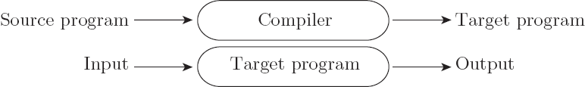

So: diving in
A first distinction is compilation versus interpretation
Compilation:
Interpretation:

Slide 18
Compilation vs. Interpretation
In reality, the difference is not so clear cut.
These are not opposites, and most languages fall somewhere in between on the spectrum
In general, interpretation gives greater flexibility (think python), but compilation gives better performance (think C++)

Slide 19
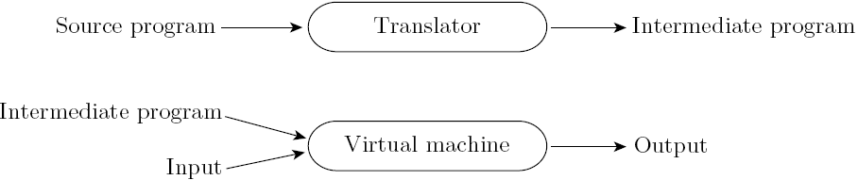
Compilation vs. Interpretation
Most languages do include a mix of these:
Note that compilation doesn’t have to produce machine code – just a translation to another language
Think of Java, for example

Slide 20
Implementation of compilation
Preprocessing:
removes white space and comments
groups characters into tokens
expands abbreviations
identifies higher level syntactic structures – i.e. loops and subroutines
This is often known as scanning – we’ll spend the first few weeks talking about it.

Slide 21
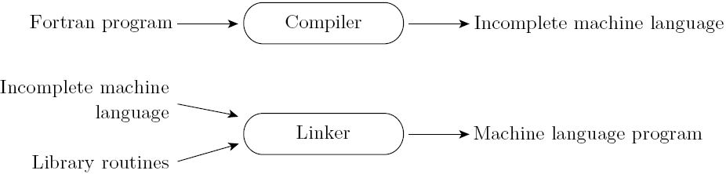
Compiling (cont.)
Next: routines and linking
Compiler uses a linker program add subroutines from a library
You’ve done this if you ever used a #include from the standard template library

Slide 22
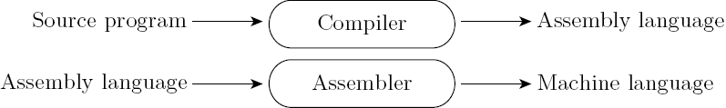
Compilers (cont)
Post-compilation assembly output: why??
Makes debugging and optimizing easier, since assembler is MUCH easier than machine code
Isolates compiler from low level machine changes – many architectures can use the same assembly, but machine level code is very specific

Slide 23
Compilers (cont)
In interpreted languages, the compiler still generates code.
But assumptions about inputs are not finalized.
At runtime, checks assumptions.
If valid, runs quickly.
If not, a dynamic check reverts to the interpreter.

Slide 24
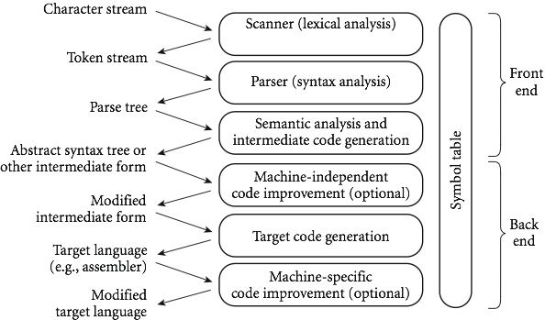
Phases of compilation

Slide 25
Next time
We’ll be spending our first few weeks on compilers, since a basic understanding of this helps to understand programming language design.
Remember, compilers is usually a class all by itself! We’ll be covering just enough of the basics to get us by.
We won’t even really get to the lower level stuff from the previous slide – go take a compilers course to cover that.
Next up: scanning and tokenizing

