Slide 1
Intro to compilers
Based on end of Ch. 1 and start of Ch. 2 of textbook, plus a few additional references

Slide 2
Announcements
Homework 1 due Wednesday
Email pdf or submit paper copy in class
Moodle is up! First (hopefully very easy) quiz is due Sunday by 11:59pm
We’ll have quizzes weekly from here on out
No class next Monday

Slide 3
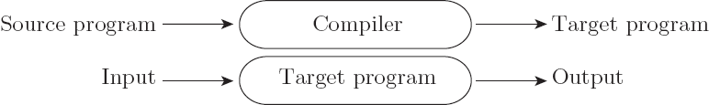

So: diving in
A first distinction in programming languages is compilation versus interpretation
Compilation:
Interpretation:

Slide 4
Compilation vs. Interpretation
In reality, the difference is not so clear cut.
These are not opposites, and most languages fall somewhere in between on the spectrum
In general, interpretation gives greater flexibility (think python), but compilation gives better performance (think C++)

Slide 5
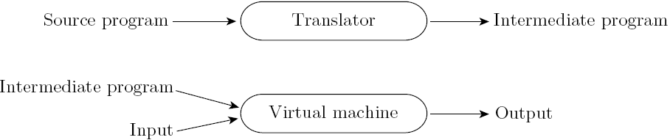
Compilation vs. Interpretation
Most languages do include a mix of these:
Note that compilation doesn’t have to produce machine code – just a translation to another language
Think of Java, for example

Slide 6
Compilation vs. Interpretation
In interpreted languages, the compiler still generates code.
But assumptions about inputs are not finalized.
At runtime, checks assumptions.
If valid, runs quickly.
If not, a dynamic check reverts to the interpreter.

Slide 7
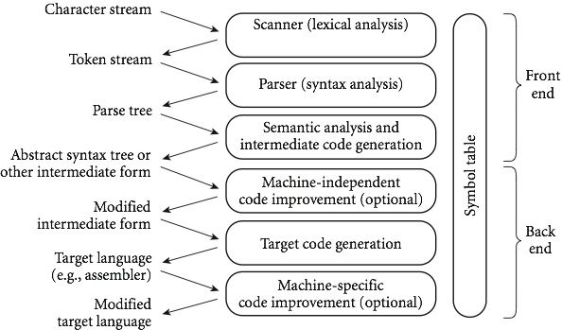
Compilation phases

Slide 8
Front end phases
The first 3 phases are known as the “front end”, where the goal is to figure out the meaning of the program
The last 3 are the “back end”, and are used to construct an equivalent target program in the output language
These are split to make things independent:
The front end can be shared between different systems
The back end can be shared between different source languages

Slide 9
First phase: scanning
Divides the program into "tokens", which are the smallest meaningful units; this saves time, since character-by-character processing is slow
We can tune the scanner better if its job is simple; it also saves complexity (lots of it) for later stages
You can design a parser to take characters instead of tokens as input, but it isn't pretty
Theoretically, scanning is recognition of a regular language, e.g., via a deterministic finite automata (or DFA)

Slide 10
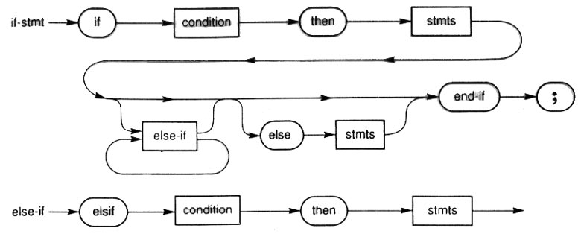
Phase 2: parsing
Parsing is recognition of a context-free language, done via something called a push down automata (or PDA)
Parsing discovers the "context free" structure of the program
Informally, it finds the structure you can describe with syntax diagrams

Slide 11
Phase 3: semantic analysis
Semantic analysis is the discovery of meaning in the program
The compiler actually does what is called STATIC semantic analysis. That's the meaning that can be figured out at compile time
Some things (e.g., array subscript out of bounds) can't be figured out until run time. Things like that are part of the program's DYNAMIC semantics

Slide 12
Phase 4: intermediate form
Intermediate form (IF) is done after semantic analysis (if the program passes all checks)
IFs are often chosen for machine independence, ease of optimization, or compactness
Note: these are somewhat contradictory!
They often resemble machine code for some imaginary idealized machine; e.g. a stack machine, or a machine with arbitrarily many registers
Many compilers actually move the code through more than one IF

Slide 13
Bottom phases
Optimization takes an intermediate-code program and produces another one that does the same thing faster, or in less space
The optimization phase is optional, but is often key for speed
Code generation phase produces assembly language or (sometime) machine language

Slide 14
Bottom phases (cont)
Certain machine-specific optimizations (use of special instructions or addressing modes, etc.) may be performed during or after target code generation
Symbol table: all phases rely on a symbol table that keeps track of all the identifiers in the program and what the compiler knows about them
This symbol table may be retained (in some form) for use by a debugger, even after compilation has completed

Slide 15
An Overview of Compilation
Lexical and Syntax Analysis: back to our GCD Program (in C)
int main() {
int i = getint(), j = getint();
while (i != j) {
if (i > j) i = i - j;
else j = j - i;
}
putint(i);
}
Copyright © 2009 Elsevier

Slide 16
An Overview of Compilation
Lexical and Syntax Analysis
GCD Program Tokens
Scanning (lexical analysis) groups characters into tokens, the smallest meaningful units of the program
int main ( ) {
int i = getint ( ) , j = getint ( ) ;
while ( i != j ) {
if ( i > j ) i = i - j ;
else j = j - i ;
}
putint ( i ) ;
}
Copyright © 2009 Elsevier

Slide 17
An Overview of Compilation
Context-Free Grammar and Parsing
Parsing organizes tokens into a parse tree that represents higher-level constructs in terms of their constituents
Potentially recursive rules known as a context-free grammar define the ways in which these tokens can combine
Copyright © 2009 Elsevier

Slide 18
An Overview of Compilation
Context-Free Grammar and Parsing
Example (while loop in C)
iteration-statement → while ( expression ) statement
statement, in turn, is often a list enclosed in braces:
statement → compound-statement
compound-statement → { block-item-list opt }
where
block-item-list opt → block-item-list
or
block-item-list opt → ϵ
and
block-item-list → block-item
block-item-list → block-item-list block-item
block-item → declaration
block-item → statement
Copyright © 2009 Elsevier

Slide 19
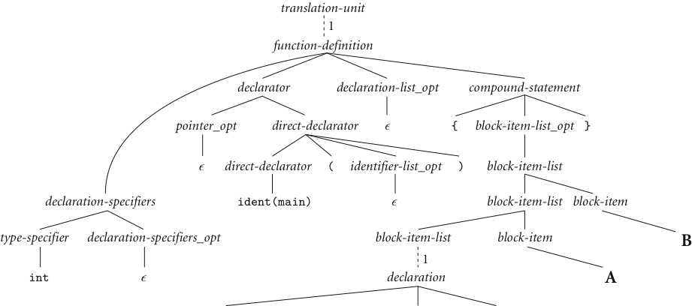
An Overview of Compilation
Example: Our GCD Program Parse Tree
B
A
Copyright © 2009 Elsevier
next slide

Slide 20
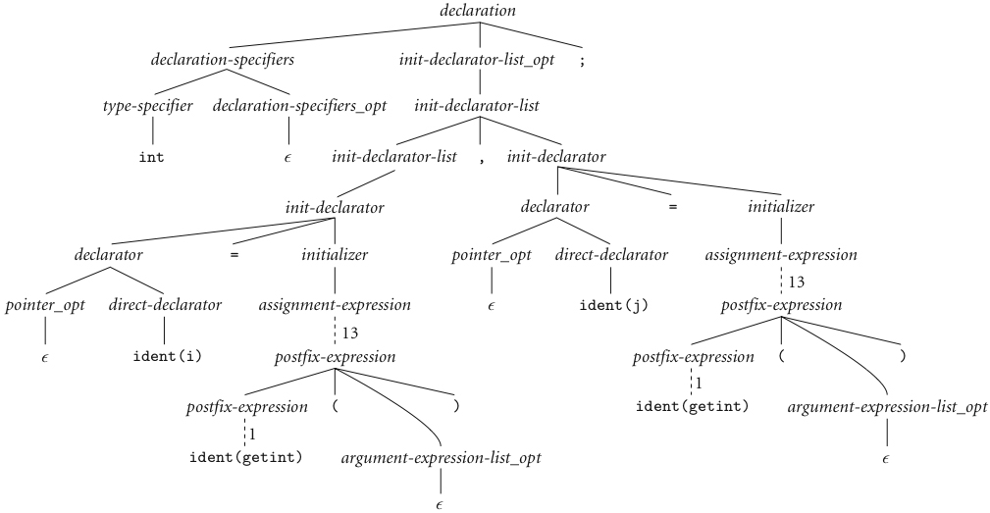
An Overview of Compilation
Context-Free Grammar and Parsing (continued)
Copyright © 2009 Elsevier

Slide 21
An Overview of Compilation
Context-Free Grammar and Parsing (continued)
A
B
Copyright © 2009 Elsevier

Slide 22
Ch. 2 – intro to compilers
We’ll take a deeper look at scanning and parsing, the two parts of the “front end” of this process
Each has deeper ties to theoretical models of computation, and useful concepts like regular expressions
You may have seen these if you’ve done string manipulations.

Slide 23
Regular expressions
A regular expression is defined (recursively) as:
A character
The empty string, ε
2 regular expressions concatenated
2 regular expressions connected by an “or”, usually written x | y
0 or more copies of a regular expression – written *, and called the Kleene star

Slide 24
Regular languages
Regular languages are then the class of languages which can be described by a regular expression
Example: L = 0*10*
Another: L = (1|0)*

Slide 25
More regular languages
Exercise: Give the regular expression for the language of binary strings that begin with a 0 and end with a 1
Exercise (a bit harder): Give the regular expression for the language of binary strings that start with a 0 and have odd length

Slide 26
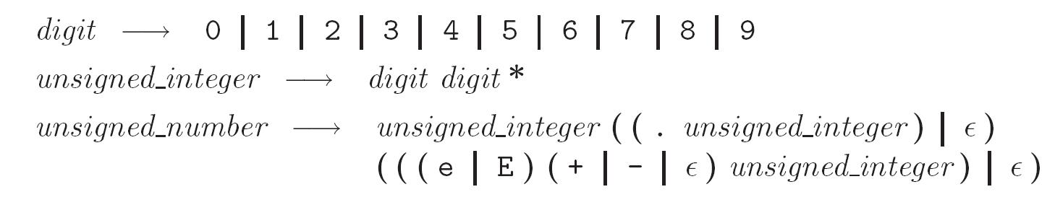
A more realistic example
Unsigned integers in Pascal:
Examples: 4, or 82.3, or 5.23e-26
Formally:

Slide 27
Another view: DFAs
Regular languages are also precisely the set of strings that can be accepted by a deterministic finite automata (DFA)
Formally, a DFA is:
a set of states
an input alphabet
a start state
a set of accept states
a transition function: given a state and input, outputs another state

Slide 28
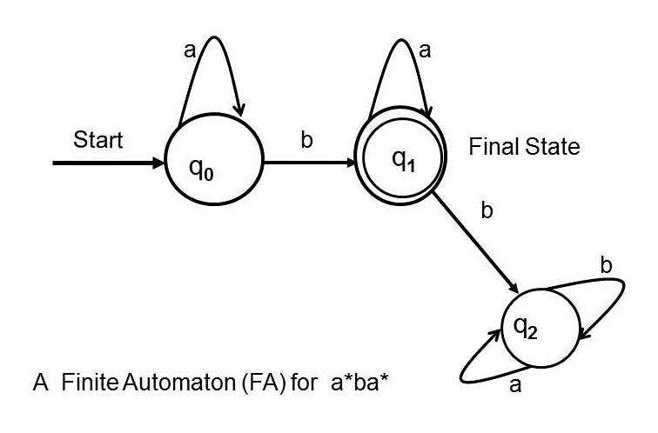
DFAs
More often, we’ll just draw a picture (like in graph theory)
Example:

Slide 29
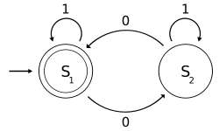
DFAs
What regular language does the following DFA accept?

Slide 30
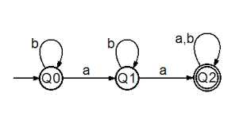
DFA examples
What’s the DFA for the regular language: 1(0|1)*0
What’s the regular language accepted by this DFA?

Slide 31
Scanning
Recall scanner is responsible for
tokenizing source
removing comments
(often) dealing with pragmas (i.e., significant comments)
saving text of identifiers, numbers, strings
saving source locations (file, line, column) for error messages
Copyright © 2009 Elsevier

Slide 32
Scanning
Suppose we are building an ad-hoc (hand-written) scanner for Pascal:
We read the characters one at a time with look-ahead
If it is one of the one-character tokens { ( ) [ ] < > , ; = + - etc } we announce that token
If it is a ., we look at the next character
If that is a dot, we announce .
Otherwise, we announce . and reuse the look-ahead
Copyright © 2009 Elsevier

Slide 33
Scanning
If it is a <, we look at the next character
if that is a = we announce <=
otherwise, we announce < and reuse the look-ahead, etc
If it is a letter, we keep reading letters and digits and maybe underscores until we can't anymore
then we check to see if it is a reserve word
Copyright © 2009 Elsevier

Slide 34
Scanning
If it is a digit, we keep reading until we find a non-digit
if that is not a . we announce an integer
otherwise, we keep looking for a real number
if the character after the . is not a digit we announce an integer and reuse the . and the look-ahead
Copyright © 2009 Elsevier

Slide 35
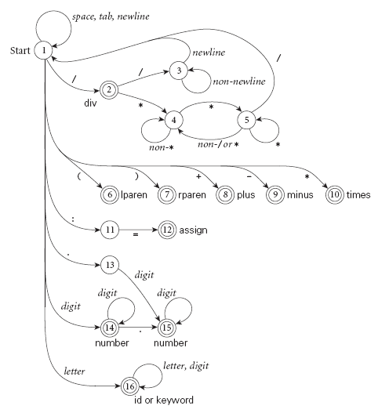
Scanning
Pictorial representation of a scanner for calculator tokens, in the form of a finite automaton
Copyright © 2009 Elsevier

Slide 36
Coding DFAs (scanners)
That’s all well and good – but how to we program this stuff?
A bunch of if/switch/case statements
A table and driver (flex or other tools)
Both have merits, and are described further in the book.
We’ll mainly use the second route in homework, simply because there are many good tools out there.

Slide 37
Scanners
Writing a pure DFA as a set of nested case statements is a surprisingly useful programming technique
though it's often easier to use perl, awk, sed
for details see Figure 2.4 in text
Table-driven DFA is what lex and scangen produce
lex (flex) in the form of C code – this will be an upcoming homework
scangen in the form of numeric tables and a separate driver (for details see Figure 2.12)

Slide 38
Next week
We’ll see a bit more about scanning: DFAs, and introduce NFAs.
This is the rest of section 2.2, if you want to look ahead a bit.
By the end of the week, we’ll move to discussing one table-driven DFA, flex.
Expect one pen and paper homework, and one programming assignment on this topic – more details to come next week.

