Slide 1
More on scanning: NFAs and Flex

Slide 2
Overview
Essay 1: due now
Next HW: pen and paper (over DFAs and NFAs), due next Wednesday

Slide 3
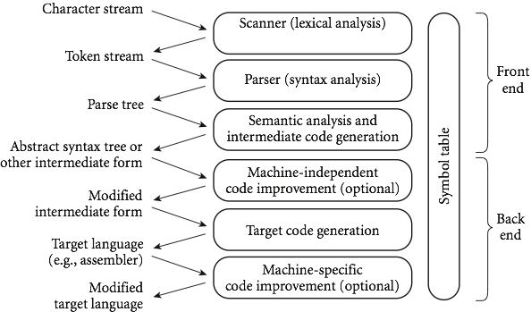
Last time

Slide 4
Last time
Scanners: the first step in compilation
Divides the program into tokens, or smallest meaningful units
This makes later parsing much simpler
Theory end of things: tokenizing is equivalent to specifying a DFA, which recognizes a regular language

Slide 5
Scanning
In more detail, a scanner is responsible for
tokenizing source
removing comments
(often) dealing with pragmas (i.e., significant comments)
saving text of identifiers, numbers, strings
saving source locations (file, line, column) for error messages
Copyright © 2009 Elsevier

Slide 6
Scanning
Suppose we are building an ad-hoc (hand-written) scanner for Pascal:
We read the characters one at a time with look-ahead
If it is one of the one-character tokens { ( ) [ ] < > , ; = + - etc } we announce that token
If it is a ., we look at the next character
If that is a dot, we announce .
Otherwise, we announce . and reuse the look-ahead
Copyright © 2009 Elsevier

Slide 7
Scanning
If it is a <, we look at the next character
if that is a = we announce <=
otherwise, we announce < and reuse the look-ahead, etc
If it is a letter, we keep reading letters and digits and maybe underscores until we can't anymore
then we check to see if it is a reserve word
Copyright © 2009 Elsevier

Slide 8
Scanning
If it is a digit, we keep reading until we find a non-digit
if that is not a . we announce an integer
otherwise, we keep looking for a real number
if the character after the . is not a digit we announce an integer and reuse the . and the look-ahead
Copyright © 2009 Elsevier

Slide 9
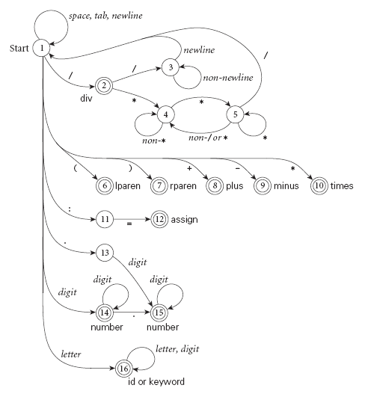
Scanning
Pictorial representation of a scanner for calculator tokens, in the form of a finite automaton
Copyright © 2009 Elsevier

Slide 10
Regular expressions
A regular expression is defined (recursively) as:
A character
The empty string, ε
2 regular expressions concatenated
2 regular expressions connected by an “or”, usually written x | y
0 or more copies of a regular expression – written *, and called the Kleene star

Slide 11
Regular languages
Regular languages are then the class of languages which can be described by a regular expression
Example: L = 0*10*
Another: L = (1|0)*

Slide 12
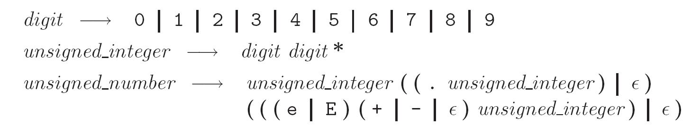
A more realistic example
Unsigned integers in Pascal:
Examples: 4, or 82.3, or 5.23e-26
Formally:

Slide 13
Another view: DFAs
Regular languages are also precisely the set of strings that can be accepted by a deterministic finite automata (DFA)
Formally, a DFA is:
a set of states
an input alphabet
a start state
a set of accept states
a transition function: given a state and input, outputs another state

Slide 14
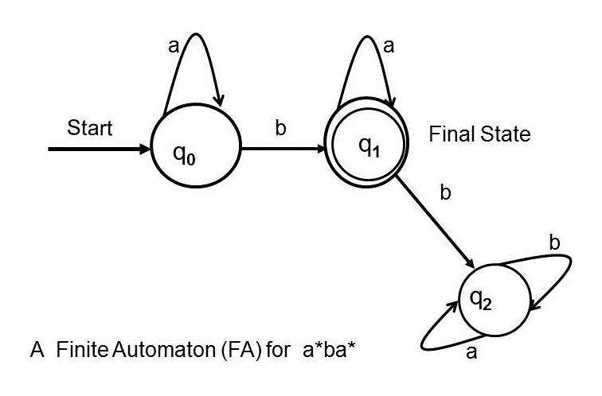
DFAs
More often, we’ll just draw a picture (like in graph theory)
Example:

Slide 15
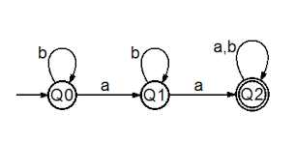
DFA examples
What’s the DFA for the regular language: 1(0|1)*0
What’s the regular language accepted by this DFA?

Slide 16
Regular expression recap
Write a DFA that recognizes any 0,1 string that has the number of 0’s in the string equal to 0 mod 3:

Slide 17
NFAs
Nondeterministic finite automata (NFA) are a variant of DFAs.
DFAs do not allow for any ambiguity:
if a character is read, there can only be 1 arrow showing where to go
No empty string transitions, so must read a character in order for the transition function to move to a new state
If instead we have multiple options, it is called an NFA

Slide 18
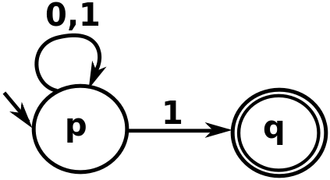
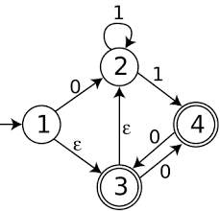
NFA Examples
What do the following NFAs accept?

Slide 19
More NFAs
Some things are easier with NFAs than DFAs:
unsigned_number -> unsigned_int (ε | .unsigned_int)
unsigned_int -> [0-9]
Question: why is this an NFA??

Slide 20
NFAs
Essentially, when parsing a stream of characters, we can think of an NFA as modeling a parallel set of possibilities
Theorem: Every NFA has an equivalent DFA.
(And so both recognize regular languages, even though NFAs seem more powerful.)

Slide 21
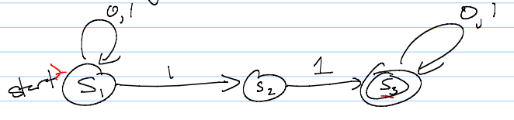
Converting NFAs to DFAs
To convert, mimic set of possible states given an input
A state is an accept state if any state in it is an accept state – that means the string could have ended in an accept state, and so is in the language

Slide 22
Why do we care?
You may ask: why do we care about NFAs?
Well, in terms of defining a parser, we usually start with regular expressions.
We then need a DFA (since NFAs are harder to code).
However, getting from a regular expression to a DFA in one step is difficult.
Instead, programs convert to an NFA, and THEN to a DFA.
Somewhat un-intuitively, this winds up being easier to code.

Slide 23
Constructing NFAs
The construction process for NFAs is pretty easy.
Recall how a regular expression is defined:
A single character or ε
Concatenation
An “or”
Kleene star
So all we need to do is show how to do each of these in an NFA (and how to combine them)

Slide 24
Constructing NFAs
Easy first step: What is the NFA for a single character, or for the empty string?
Now: what if I have NFAs for 2 regular expressions, and want to concatenate?

Slide 25
Constructing NFAs
A bit harder: what about an “or” or Kleene star?

Slide 26
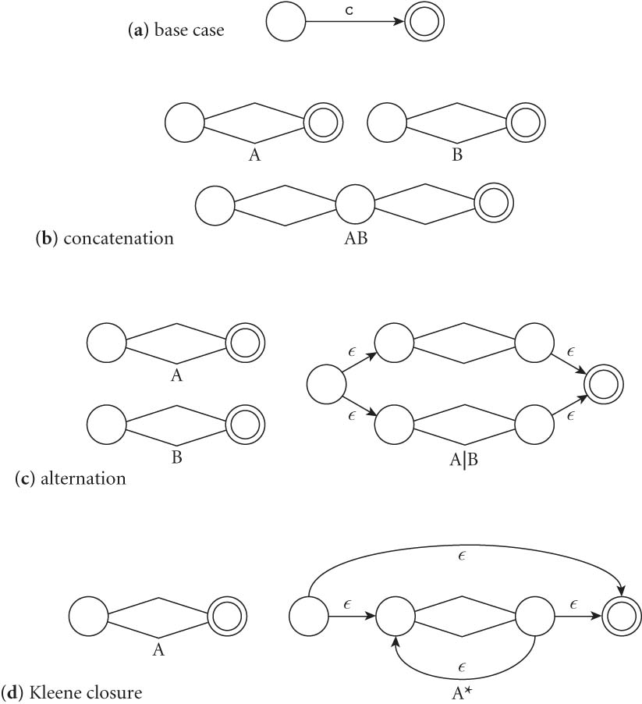
Constructing NFAs
Final picture (2.7 in book):

Slide 27
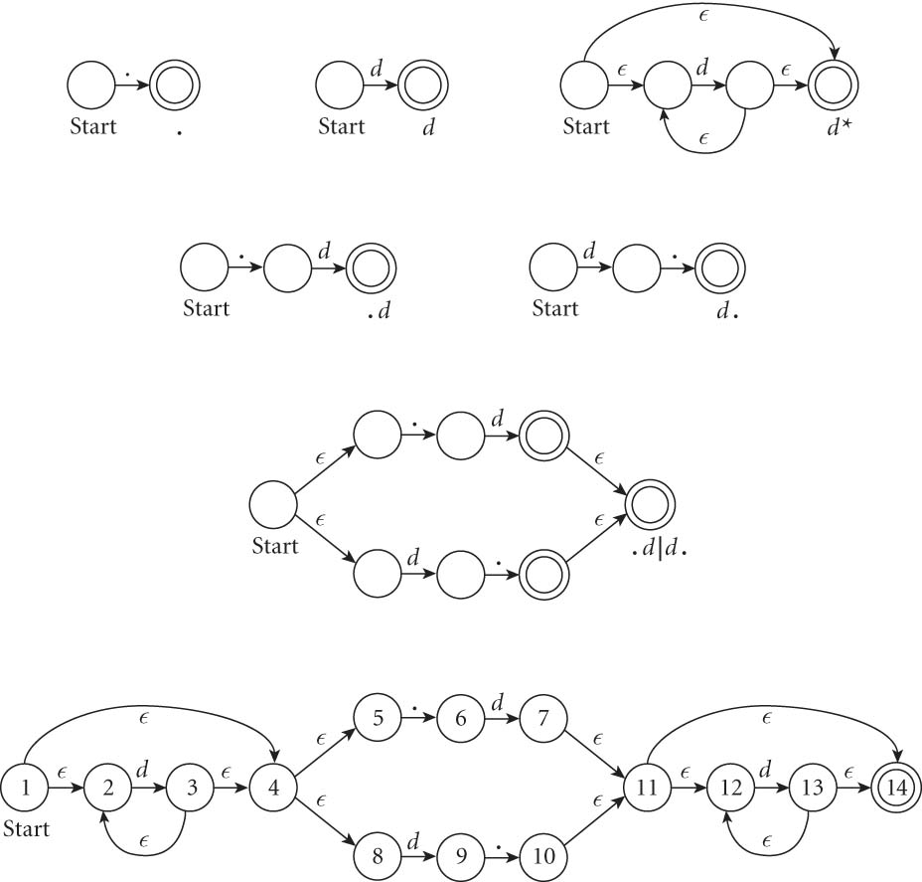
An example: decimals
Let d = [0-9], then decimals are: d* (.d | d. ) d*

Slide 28
From NFAs to DFAs
Next, a scanning program needs to go from this NFA to a DFA
Mainly because “guessing” the right transition if there are multiple ones is really hard to code
Much easier to convert to DFA, even though it can get bigger.
(Side note: how much bigger?)

Slide 29
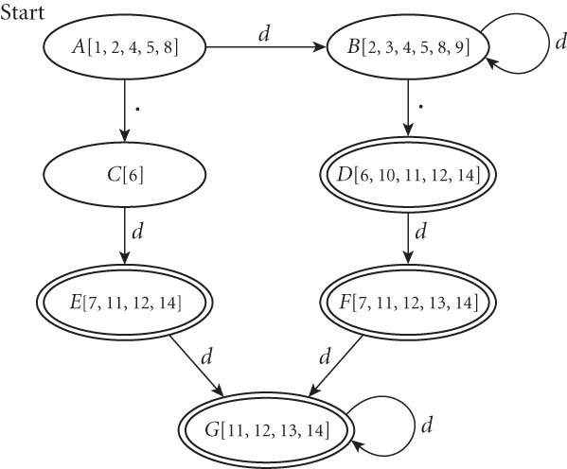
From NFAs to DFAs
If we automate this conversion on our last NFA (of decimals), we get:

Slide 30
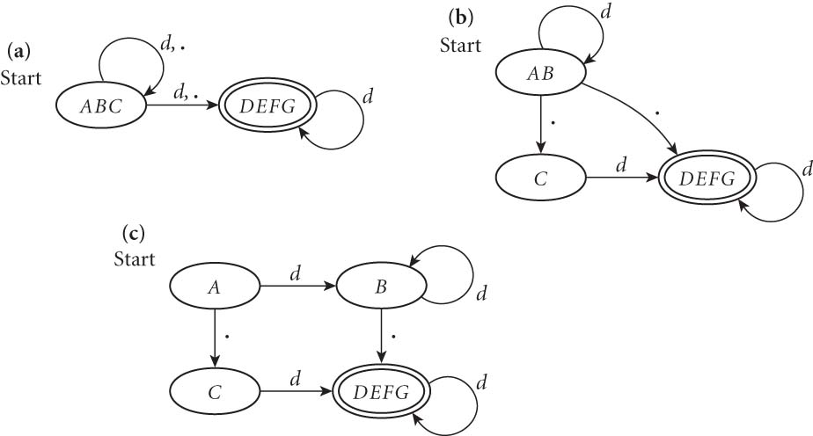
Minimizing DFAs
In addition, scanners take this final DFA and minimize.
(We won’t do this part by hand – I just want you to know that the computer does it automatically, to speed things up later.)

Slide 31
Coding DFAs (scanners)
So, given a DFA, code can be implemented in 2 ways:
A bunch of if/switch/case statements
A table and driver
Both have merits, and are described further in the book.
We’ll mainly use the second route in homework, simply because there are many good tools out there.

Slide 32
Scanners
Writing a pure DFA as a set of nested case statements is a surprisingly useful programming technique
though it's often easier to use perl, awk, sed
for details see Figure 2.11
Table-driven DFA is what lex and scangen produce
lex (flex) in the form of C code – this will be an upcoming homework
scangen in the form of numeric tables and a separate driver (for details see Figure 2.12)

Slide 33
Limitations of regular languages
Certain languages are simply NOT regular.
Example: Consider the language 0^{n}1^{n}
How would you do a regular expression of DFA/NFA for this one?

Slide 34
Beyond regular expressions
Unfortunately, we need things that are stronger than regular expressions.
A simple example: we need to recognize nested expressions
expr -> id | number | -expr |
(expr)| expr op expr
op -> + | - | * | /
Regular expressions can’t quite manage this, since could do ((((x + 7) * 2) + 3) - 1)

Slide 35
Next time
Flex, a c-style scanner
Later this week: parsing and CFGs, which are stronger than DFAs/scanning

