Slide 1
NFAs, scanners, and flex

Slide 2
Admin stuff
Homework due next Wednesday
Sub: Next Friday 1/31 through Friday 2/7
Be nice, and yes, you’ll get a HW over what he does!
Next homework: programming assignment, coding a scanner-like program using flex, which we’ll discuss today/Monday
Likely due Feb. 9 or 10
(I’ll be back by the 7th^{st}, and my sub can help with this assignment)
Note that this will be the first assignment submitted via git! I’ll go over instructions for this course git next week, and will have the homework posted early in the week

Slide 3
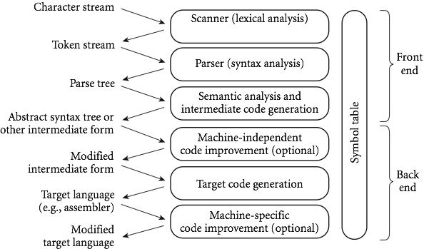
Recap
We’re looking at compilers:

Slide 4
So far:
Focusing on scanning, the top level
Scanning is recognizing a regular language
Connected to DFAs and NFAsToday:
Two types
Coding scanners
Flex, a c-style scanner
Later next week: parsing and CFGs, which are stronger than DFAs/scanning

Slide 5
NFAs
Nondeterministic finite automata (NFA) are a variant of DFAs.
DFAs do not allow for any ambiguity:
if a character is read, there can only be 1 arrow showing where to go
No empty string transitions, so must read a character in order for the transition function to move to a new state
If instead we have multiple options, it is called an NFA

Slide 6
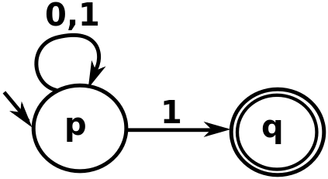
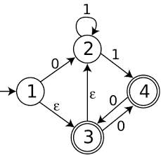
NFA Examples
What do the following NFAs accept?

Slide 7
More NFAs
Some things are easier with NFAs than DFAs:
unsigned_number -> unsigned_int (ε | .unsigned_int)
unsigned_int -> [0-9]
Question: why is this an NFA??

Slide 8
NFAs
Essentially, when parsing a stream of characters, we can think of an NFA as modeling a parallel set of possibilities
Theorem: Every NFA has an equivalent DFA.
(And so both recognize regular languages, even though NFAs seem more powerful.)

Slide 9
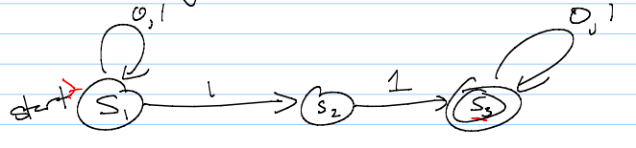
Converting NFAs to DFAs
To convert, mimic set of possible states given an input
A state is an accept state if any state in it is an accept state – that means the string could have ended in an accept state, and so is in the language

Slide 10
Why do we care?
You may ask: why do we care about NFAs?
Well, in terms of defining a parser, we usually start with regular expressions.
We then need a DFA (since NFAs are harder to code).
However, getting from a regular expression to a DFA in one step is difficult.
Instead, programs convert to an NFA, and THEN to a DFA.
Somewhat un-intuitively, this winds up being easier to code.

Slide 11
Constructing NFAs
The construction process for NFAs is pretty easy.
Recall how a regular expression is defined:
A single character or ε
Concatenation
An “or”
Kleene star
So all we need to do is show how to do each of these in an NFA (and how to combine them)

Slide 12
Constructing NFAs
Easy first step: What is the NFA for a single character, or for the empty string?
Now: what if I have NFAs for 2 regular expressions, and want to concatenate?

Slide 13
Constructing NFAs
A bit harder: what about an “or” or Kleene star?

Slide 14
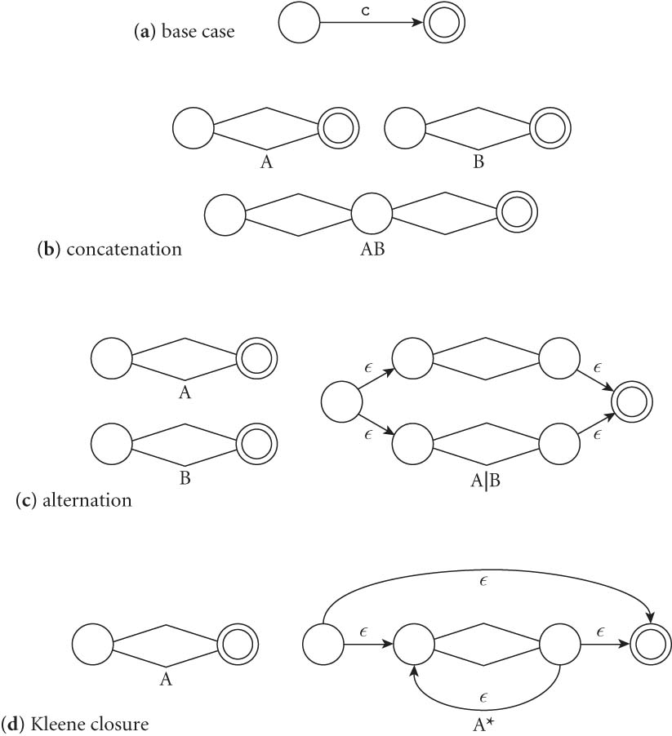
Constructing NFAs
Final picture (2.7 in book):

Slide 15
An example: decimals
Let d = [0-9], then decimals are: d* (.d | d. ) d*

Slide 16
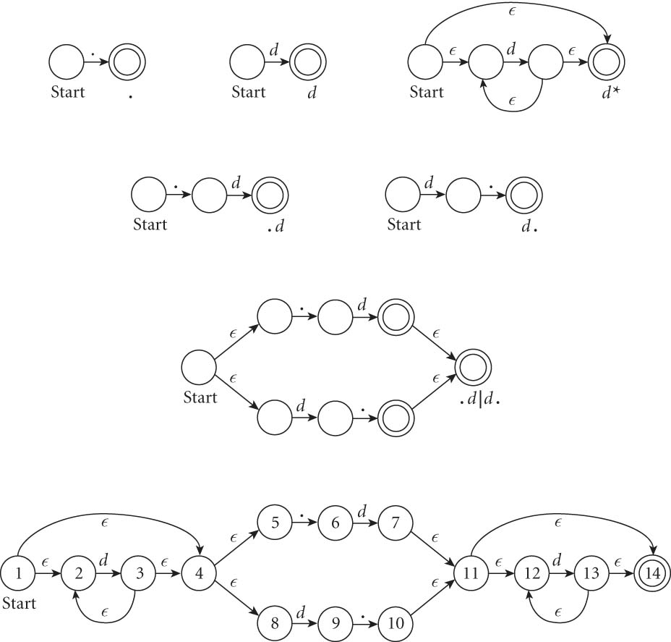
An example: decimals
Let d = [0-9], then decimals are: d* (.d | d. ) d*

Slide 17
From NFAs to DFAs
Next, a scanning program needs to go from this NFA to a DFA
Mainly because “guessing” the right transition if there are multiple ones is really hard to code
Much easier to convert to DFA, even though it can get bigger.
(Side note: how much bigger?)
Let’s go back to our decimal example on the board…

Slide 18
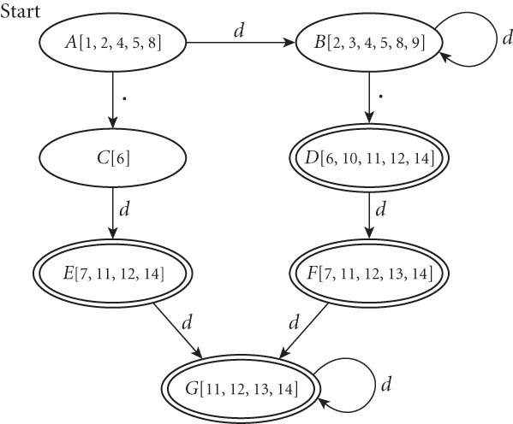
From NFAs to DFAs
If we automate this conversion on our last NFA (of decimals), we get:

Slide 19
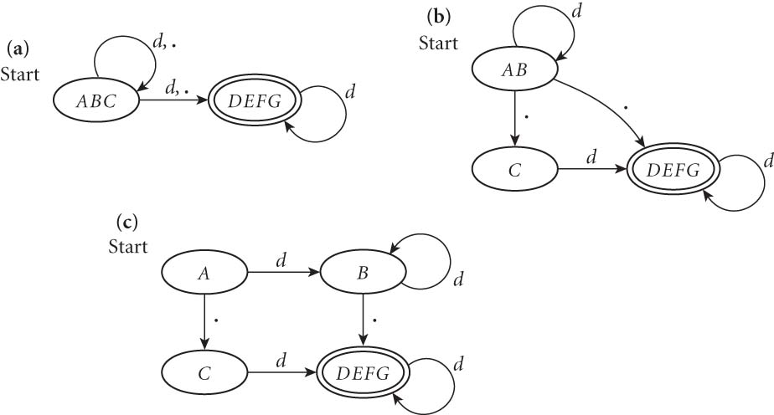
Minimizing DFAs
In addition, scanners take this final DFA and minimize.
(We won’t do this part by hand – I just want you to know that the computer does it automatically, to speed things up later.)

Slide 20
Coding DFAs (scanners)
Then, given a DFA, code can be implemented in 2 ways:
A bunch of if/switch/case statements
A table and driver
Both have merits, and are described further in the book.
We’ll mainly use the second route in homework, simply because there are many good tools out there.

Slide 21
Scanners
Writing a pure DFA as a set of nested case statements is a surprisingly useful programming technique
though it's often easier to use perl, awk, sed
for details see Figure 2.11
Table-driven DFA is what lex and scangen produce
lex (or really flex) does this in the form of C code – this will be an upcoming homework
scangen makes these in the form of numeric tables and a separate driver (for details see Figure 2.12)

Slide 22
lex & flex
lex is a tool to generate a scanner
written by Mike Lesk and Eric Schmidt
not really used anymore
Flex: fast lexical analyzer generator
free and open source alternative
our software of choice this semester – on hopper, as well as the lab machines

Slide 23
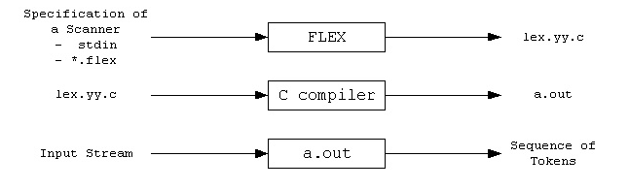
Flex overview
First, FLEX reads a specification of a scanner either from an input file *.lex, or from standard input, and it generates as output a C source file lex.yy.c.
Then, lex.yy.c is compiled and linked with the "-lfl" library to produce an executable a.out.
Finally, a.out analyzes its input stream and transforms it into a sequence of tokens.

Slide 24
Flex intro (cont)
Flex reads given input files or standard input, and tokenizes the input according to the rules you specify
As output, it generates a function yylex()
(This is why you use –lfl option, so that it links to the flex runtime library)
When you run the final executable, it analyzes input for occurrences of regular expressions
If found, executes the matching C code
Also can track states, to mimic a DFA

Slide 25
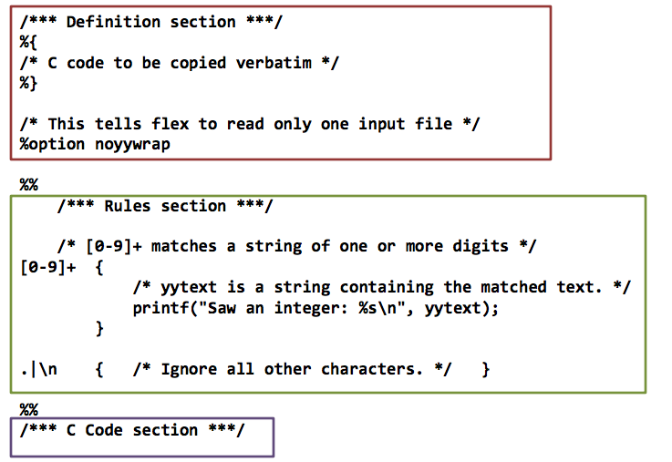
Format of a flex file
Three main sections of any flex file:

Slide 26
First section: definitions
The first section is mainly for definitions that will make coding easier.
Form: name definition
Examples:
digit [0-9]
ID [a-z][a-z0-9]*
Note: these are regular expressions!

Slide 27
Definitions section (cont.)
An indented comments (starting with /*) is copied verbatim to the output, up to the next matching */
Any indented text or text enclosed in %{}% is copied verbatim (with the %{}% removed)
%top makes sure that lines are copied to the top of the output C file
usually used for #include

Slide 28
The rules section
The second section is essentially specifying a DFA’s transition function
Format: pattern action where pattern is unindented and action is on the same line
Any indented line or line surrounded by a %{}% can be used to declare variables, etc.
Note: deviations from this format cause compile issues!

Slide 29
Rules section: allowed patterns
Patterns are what encode the regular expressions that are recognized
Examples:
‘x’ - match the character x
‘.’ - any character except a newline
‘xyz’ - matches x, y, or z
‘abj-oZ’ - matches a,b,j,k,l,m,n,o, or Z
‘[^A-Z]’ – characters OTHER than A-Z (negation)

Slide 30
More patterns
‘[a-z]{-}[aeiou]’ – any lower case consonant
‘r*’ - 0 or more of expression r
‘r+’ – 1 or more of expression r
‘r?’ – 0 or 1 r’s
‘r{2-5}’ – between 2 and 5 r’s
‘r{4}’ – exactly 4 r’s
‘{name}’ – expansion of some name from your definitions section
‘r$’ – r at the end of a line

Slide 31
A simple example
%%
username printf( "%s", getlogin() );
Explanation:
The first section is blank, so no definitions
The third section is missing, so no C code in this simple example either
The middle is rules: by default, flex just copies input to the output if it doesn’t match a rule, so that’s what will happen here for most input
The only exception is that if it encounters “username”, it will then run this c code and replace that with the username expanded

Slide 32
Another simple example
int num_lines = 0, num_chars = 0;
%%
\n ++num_lines; ++num_chars;
. ++num_chars;
%%
main()
{
yylex();
printf( "# lines = %d, # chars = %d\n",
num_lines, num_chars );
}

Slide 33
Things to note from last slide
Two global variables are declared at the beginning
Both are accessible in yylex and in main
Only two rules:
First matches newline
Second matches any character other than newline
Order of precedence matters – takes the first and longest possible match

Slide 34
How matching happens
Input is analyzed to find any match to one of the patterns
If more than one, will take the longest
If two are equal, takes the first one
Once matched, text corresponding to this matc is put in global character pointer yytext, and its length is in yyleng
The action is then executed
If nothing matches, default action is to match one character and copied to standard output

Slide 35
Actions
Actions can be any C code, including returns
If action is a vertical bar (|), then it executes the previous rule’s action
If action is empty, then the input is discarded
Simple example to illustrate:
%%
"zap me"

Slide 36
Another simple example
This program compresses multiple spaces and tabs to a single space, and throws away any white space at the end of a line:
%%
[ \t]+ putchar( ’ ’ );
[ \t]+$ /* ignore this token */

Slide 37
Special actions
ECHO copies yytext to the scanner’s output
BEGIN followed by name of a start condition puts scanner in a new state (like a DFA – more on that next time)
REJECT directs scanner to go to “second best” matching rule
Note: this one REALLY slows the program down, even if it is never matched
There are even commands to append or remove rules from the rules section

