Slide 1
More on NFAs, and intro to flex

Slide 2
Admin stuff
Homework due Wednesday
Sub: Friday 1/31 through Friday 2/7
Be nice, and yes, you’ll get a HW over what he does!
Next homework: programming assignment, coding a scanner-like program using flex, which we’ll discuss today/Monday
Likely due Feb. 9
(I’ll be back by the 1st, and my sub can help with this assignment)
Note that this will be the first assignment submitted via git! I’ll go over instructions for this course git next week, and will have the homework posted early in the week

Slide 3
Recap
Scanners: the first phase of compilation
Responsible for “tokenizing”
Boils down to recognizing a regular expression, which are defined recursively:
Single character or empty string
Any two regular expressions which are concatenated or “OR”-ed together
Kleene star: any regular expression repeated 0 or more times

Slide 4
Alternatively
Regular expressions can be recognized by two (theoretical) constructions:
DFA
NFA
Both are essentially tiny computers with no memory: they accept input and transition between states, and can accept (or reject) based on the state which the automata ends in

Slide 5
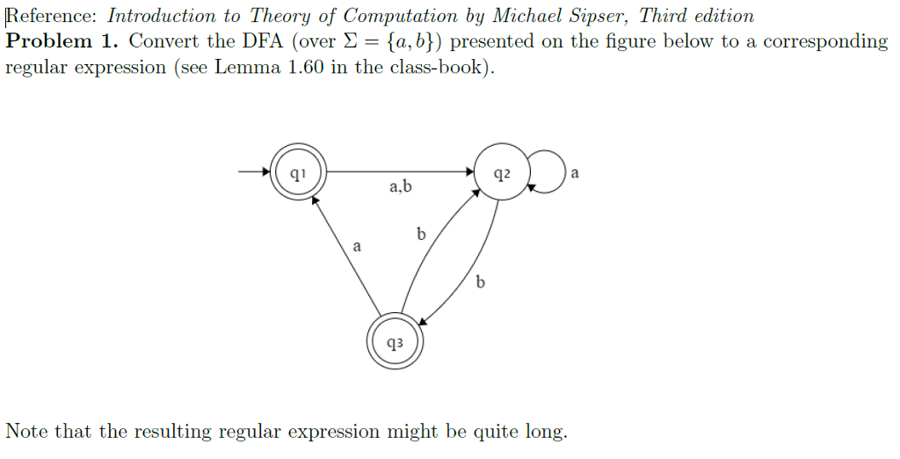
HW tip: how to get started??
1024 × 522

Slide 6
HW tip: how to get started??
Give the regular expression to recognize any binary string that begins with a 0 and ends with a 1

Slide 7
Last time
Computer generation of DFAs.
Why??
NFAs and regular expressions are harder for computers!

Slide 8
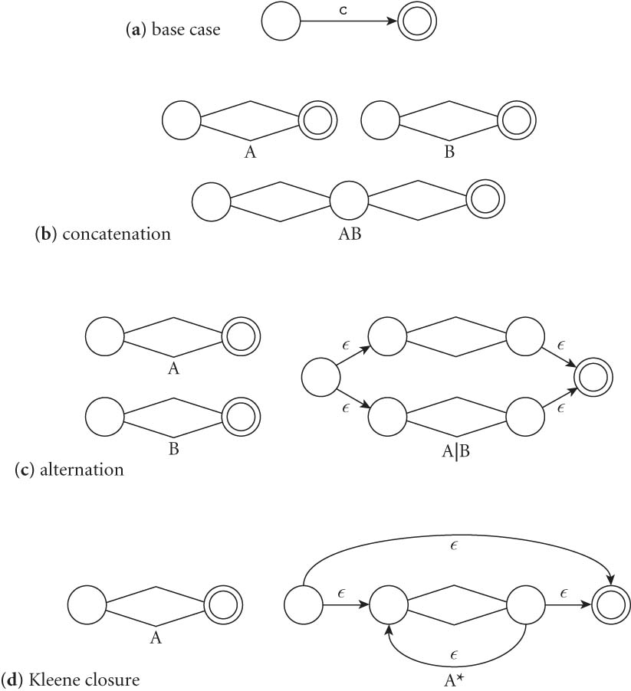
Last time
So: from a regular expression, build an NFA:

Slide 9
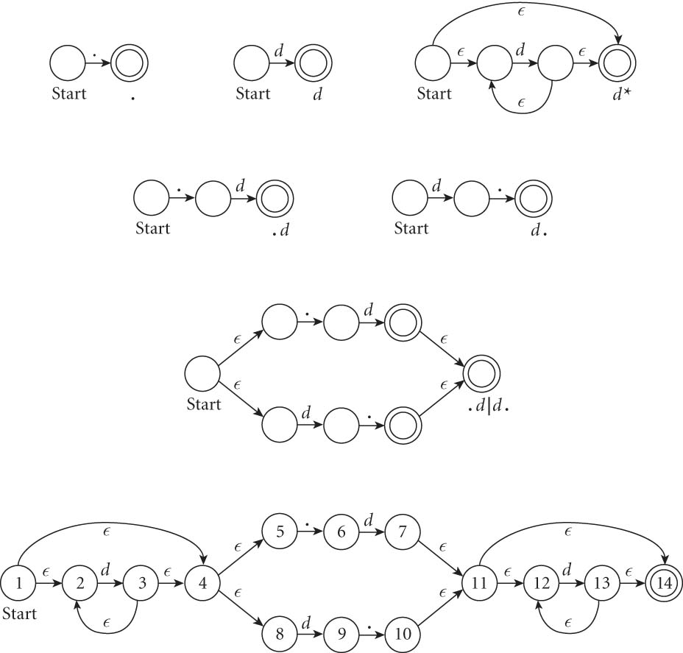
An example: decimals
Let d = [0-9], then decimals are: d* (.d | d. ) d*

Slide 10
From NFAs to DFAs
Next, a scanning program needs to go from this NFA to a DFA
Mainly because “guessing” the right transition if there are multiple ones is really hard to code
Much easier to convert to DFA, even though it can get bigger.
(Side note: how much bigger?)
Let’s go back to our decimal example on the board…

Slide 11
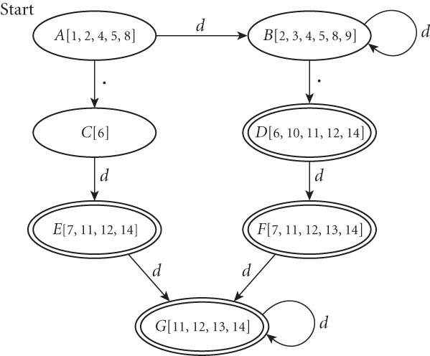
From NFAs to DFAs
If we automate this conversion on our last NFA (of decimals), we get:

Slide 12
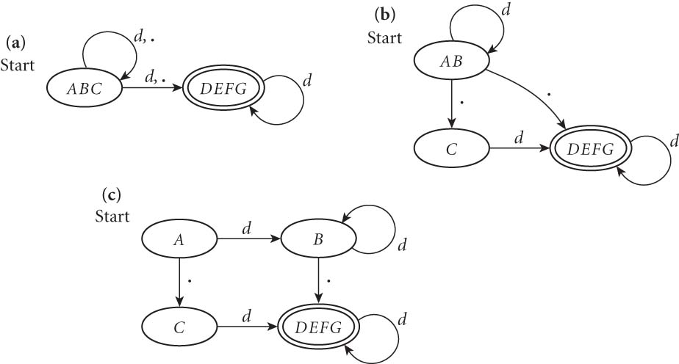
Minimizing DFAs
In addition, scanners take this final DFA and minimize.
(We won’t do this part by hand – I just want you to know that the computer does it automatically, to speed things up later.)

Slide 13
Coding DFAs (scanners)
Then, given a DFA, code can be implemented in 2 ways:
A bunch of if/switch/case statements
A table and driver
Both have merits, and are described further in the book.
We’ll mainly use the second route in homework, simply because there are many good tools out there.

Slide 14
Scanners
Writing a pure DFA as a set of nested case statements is a surprisingly useful programming technique
though it's often easier to use perl, awk, sed
for details see Figure 2.11
Table-driven DFA is what lex and scangen produce
lex (or really flex) does this in the form of C code – this will be an upcoming homework
scangen makes these in the form of numeric tables and a separate driver (for details see Figure 2.12)

Slide 15
lex & flex
lex is a tool to generate a scanner
written by Mike Lesk and Eric Schmidt
not really used anymore
Flex: fast lexical analyzer generator
free and open source alternative
our software of choice this semester – on hopper, as well as the lab machines

Slide 16
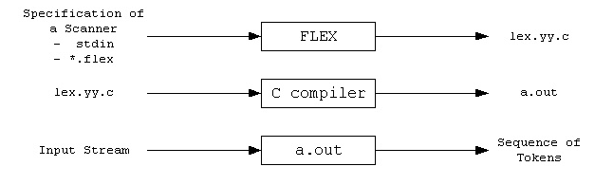
Flex overview
First, FLEX reads a specification of a scanner either from an input file *.lex, or from standard input, and it generates as output a C source file lex.yy.c.
Then, lex.yy.c is compiled and linked with the "-lfl" library to produce an executable a.out.
Finally, a.out analyzes its input stream and transforms it into a sequence of tokens.

Slide 17
Flex intro (cont)
Flex reads given input files or standard input, and tokenizes the input according to the rules you specify
As output, it generates a function yylex()
(This is why you use –lfl option, so that it links to the flex runtime library)
When you run the final executable, it analyzes input for occurrences of regular expressions
If found, executes the matching C code
Also can track states, to mimic a DFA

Slide 18
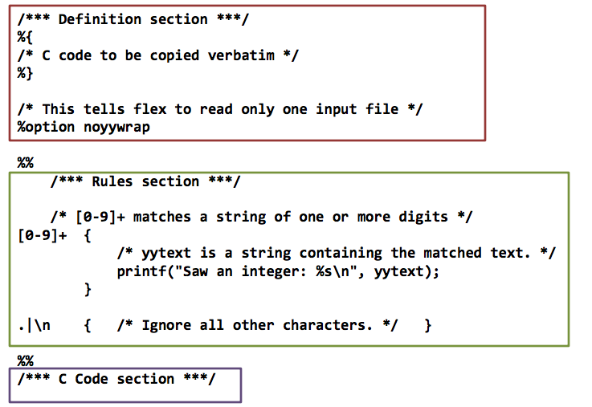
Format of a flex file
Three main sections of any flex file:

Slide 19
First section: definitions
The first section is mainly for definitions that will make coding easier.
Form: name definition
Examples:
digit [0-9]
ID [a-z][a-z0-9]*
Note: these are regular expressions!

Slide 20
Definitions section (cont.)
An indented comments (starting with /*) is copied verbatim to the output, up to the next matching */
Any indented text or text enclosed in %{}% is copied verbatim (with the %{}% removed)
%top makes sure that lines are copied to the top of the output C file
usually used for #include

Slide 21
The rules section
The second section is essentially specifying a DFA’s transition function
Format: pattern action where pattern is unindented and action is on the same line
Any indented line or line surrounded by a %{}% can be used to declare variables, etc.
Note: deviations from this format cause compile issues!

Slide 22
Rules section: allowed patterns
Patterns are what encode the regular expressions that are recognized
Examples:
‘x’ - match the character x
‘.’ - any character except a newline
‘xyz’ - matches x, y, or z
‘abj-oZ’ - matches a,b,j,k,l,m,n,o, or Z
‘[^A-Z]’ – characters OTHER than A-Z (negation)

Slide 23
More patterns
‘[a-z]{-}[aeiou]’ – any lower case consonant
‘r*’ - 0 or more of expression r
‘r+’ – 1 or more of expression r
‘r?’ – 0 or 1 r’s
‘r{2-5}’ – between 2 and 5 r’s
‘r{4}’ – exactly 4 r’s
‘{name}’ – expansion of some name from your definitions section
‘r$’ – r at the end of a line

Slide 24
A simple example
%%
username printf( "%s", getlogin() );
Explanation:
The first section is blank, so no definitions
The third section is missing, so no C code in this simple example either
The middle is rules: by default, flex just copies input to the output if it doesn’t match a rule, so that’s what will happen here for most input
The only exception is that if it encounters “username”, it will then run this c code and replace that with the username expanded

Slide 25
Another simple example
int num_lines = 0, num_chars = 0;
%%
\n ++num_lines; ++num_chars;
. ++num_chars;
%%
main()
{
yylex();
printf( "# lines = %d, # chars = %d\n",
num_lines, num_chars );
}

Slide 26
Things to note from last slide
Two global variables are declared at the beginning
Both are accessible in yylex and in main
Only two rules:
First matches newline
Second matches any character other than newline
Order of precedence matters – takes the first and longest possible match

Slide 27
How matching happens
Input is analyzed to find any match to one of the patterns
If more than one, will take the longest
If two are equal, takes the first one
Once matched, text corresponding to this matc is put in global character pointer yytext, and its length is in yyleng
The action is then executed
If nothing matches, default action is to match one character and copied to standard output

Slide 28
Actions
Actions can be any C code, including returns
If action is a vertical bar (|), then it executes the previous rule’s action
If action is empty, then the input is discarded
Simple example to illustrate:
%%
"zap me"

Slide 29
Another simple example
This program compresses multiple spaces and tabs to a single space, and throws away any white space at the end of a line:
%%
[ \t]+ putchar( ’ ’ );
[ \t]+$ /* ignore this token */

Slide 30
Special actions
ECHO copies yytext to the scanner’s output
BEGIN followed by name of a start condition puts scanner in a new state (like a DFA – more on that next time)
REJECT directs scanner to go to “second best” matching rule
Note: this one REALLY slows the program down, even if it is never matched
There are even commands to append or remove rules from the rules section

Slide 31
Example
In the following, we count words but also call the function special whenever frob is seen
Without REJECT, ‘frob’ wouldn’t be counted as a word
int word_count = 0;
%%
frob special(); REJECT;
[^ \t\n]+ ++word_count;

Slide 32
States and flex
Perhaps the most powerful feature, though is the use of states
Can specify states with %s at the beginning
Then, a rule can match and put you into a new state
We can then add rules that only match when you are in a particular state, as opposed to matching all the time

Slide 33
Flex - compiling
Let’s compile one of our simple examples from last time
Log into hopper (you can do this later)
Copy count.lex from the schedule page into a file on your account
Also look at it again and be sure you remember the basic syntax
Compile (and check the .c output!):
flex count.lex
gcc lex.yy.c –lfl
./a.out > somefile

Slide 34
States
States are activated using BEGIN
INITIAL is the default state
The rest are defined in the first section, using %s or %x
%s is inclusive, where patterns not marked with a state can also match
%x is usually more useful
When the scanner is in a particular state, patterns will only match that have that state next to them in the rules section

Slide 35
Example
Consider a scanner which recognizes (and discards) C comments while maintaining a count of the current input line
%x comment
%%
int line_num = 1;
"/*" BEGIN(comment);
<comment>[^*\n]* /* eat anything that's not a '*' */
<comment>"*"+[^*/\n]* /* eat up '*'s not followed by '/'s */
<comment>\n ++line_num;
<comment>"*"+"/" BEGIN(INITIAL);

Slide 36
Next homework
Your next homework will dive into this
To warm up, the first part is for you to understand a more complex program, a Swedish Chef translator
Part 2 asks you to use flex to translate text or IM-speak
i.e. if you scan LOL, replace it with “laugh out loud”
Part 3 asks you to add capitalization
Will need states to understand when you’re inside a sentence

Slide 37
Limitations of regular languages
Certain languages are simply NOT regular.
Example: Consider the language 0^{n}1^{n}
How would you do a regular expression of DFA/NFA for this one?

Slide 38
Beyond regular expressions
So: we need things that are stronger than regular expressions
A simple (but more real world) example of this:
consider 52 + 2**10
Scanning or tokenizing will recognize this
But how to we add order precedence?
(Ties back to those parse trees we saw last week)

Slide 39
Beyond regular expressions
Generalizing: we need to recognize nested expressions
expr -> id | number | -expr |
(expr)| expr op expr
op -> + | - | * | /
Regular expressions can’t quite manage this, since could do ((((x + 7) * 2) + 3) - 1)
At its heart, this is the 0^{n}1^{n}, since need to match parenthesis on any input

Slide 40
Context Free Languages
CFGs are this stronger class we need for parsing
Described in terms of productions
Called Backus-Normal Form, or BNF
Formally:
A set of terminals T
A set of non-terminals N
A start symbol S (always non-terminal)
A set of productions

Slide 41
An example: 0^{n}1^{n}, n > 0
My terminals: 0 and 1
Usually these are the tokens in the language
Non-terminal: only need one, S
Rules:
S -> 0S1
S -> 01
How we parse: apply rules and see if can get to the final string via these rules
Demo on board…

Slide 42
Another
How would we alter this previous example to show that the set of all binary palindromes can be recognized by a CFG?

Slide 43
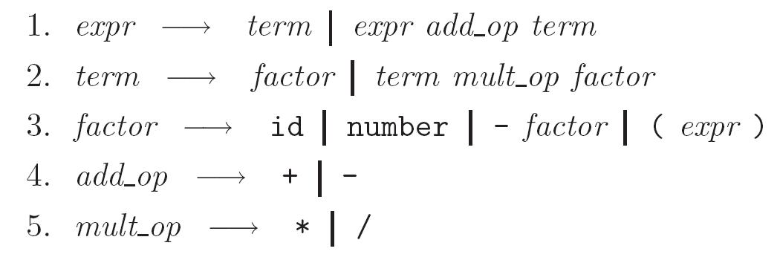
An example from the book:
Expressions in a simple math language
Goal: capture that multiplication and division happen AFTER + and –
Example: 3 + 4 * 5

Slide 44
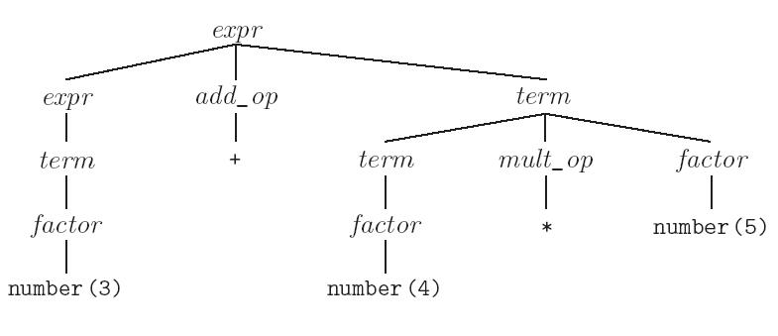
Resulting parse tree
Note that the final parse tree captures precedence:

