Slide 1
Metabolic results of retrorsine and clivorine in vitro

Slide 2
Incubation systems
 | Present system | Reported system
 | Retrorsine | lasiocarpine | riddelline
 | Final conc.(final volume 300μL) | Final conc.(final volume 100μL) | Final conc.(final volume 100μL)
Subcellular fraction | 2mg/mL microsome | 0.04mg/mL microsome | 0.5mg/mL microsome
NADPH | 1 mM | 20mM | 20mM
Buffer(Mixture of K2HPO4 and KH2PO4) | 100 mM | 0.1M K2HPO4 | 0.1M K2HPO4
GSH | 2 mM | -- | --
Retrorsine | From 6.25 to 600 μM | From 0 to 200 μM | From 0 to 400 μM
Note: reported system from :https://doi.org/10.1016/j.fct.2018.04.012

Slide 3
Experiment procedure
Pre-incubation in a shaking water bath at 37℃
Add 600 μL pre-ice methanol to stop the reaction and mix by vortex μL
Thaw microsome quickly at 37℃ in the water bath incubation and place it on ice
Centrifuge all samples at 10000g for 5min, 4℃
Add buffer , Microsome, RTS and ddwater to reach concentration: 6.25, 12, 35, 50, 75, 100, 150, 200, 400 and 600 μM
Store the supernatant for LC-MS analysis
T=30min
N=4
T=0min
N=3
Add 30μL GSH and NADPH to start the reactions (without GSH as control )
Without 30μL GSH and NADPH (add 600 μL ice methanol )
Mix the sample well by vortex and incubate at 37℃ for 30 min

Slide 4
Data analysis procedure
The amount of depletion of retrorsine = C0 mins – after C30 mins
CONC.(μM) | Sample1.(μM) | Sample2.(μM) | Sample3.(μM) | Sample4.(μM) | Mean | SD
6.25 | 0.00 | 0.00 | 0.00 | 0.00 | 0.00 | 0.00
12.5 | 0.00 | 0.00 | 0.00 | 0.00 | 0.00 | 0.00
35 | 17.25 | 24.21 | 22.34 | 23.48 | 21.82 | 3.14
50 | 40.39 | 34.03 | 18.10 | 33.67 | 31.55 | 9.48
75 | 53.39 | 39.19 | 46.70 | 52.46 | 47.94 | 6.54
100 | 53.32 | 44.75 | 62.01 | 44.68 | 51.19 | 8.27
150 | 74.29 | 55.35 | 110.65 | 63.03 | 75.83 | 24.48
200 | 59.96 | 76.92 | 42.71 | 59.31 | 59.73 | 13.97
400 | 53.15 | 12.81 | 73.30 | 84.42 | 55.92 | 31.52
600 | 80.94 | 137.02 | 68.67 | 71.16 | 89.45 | 32.15
The data for the retrorsine concentration-dependent rate of retrorsine depletion thus obtain are fitted to the standard Michaelis–Menten equation using GraphPad Prism software
V=Vmax×[S]/(Km+[S])
In vitro Vmax in nmol/min/mg microsomal protein, Km in μM, catalytic efficiency in ml/min/mg microsomal protein ( calculated as Vmax/Km). The values are mean ± SD of four independent experiments

Slide 5
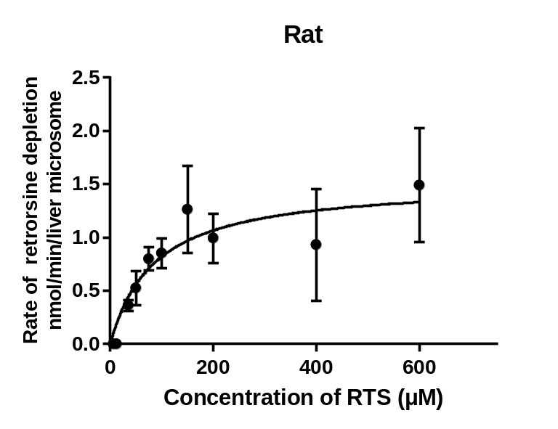
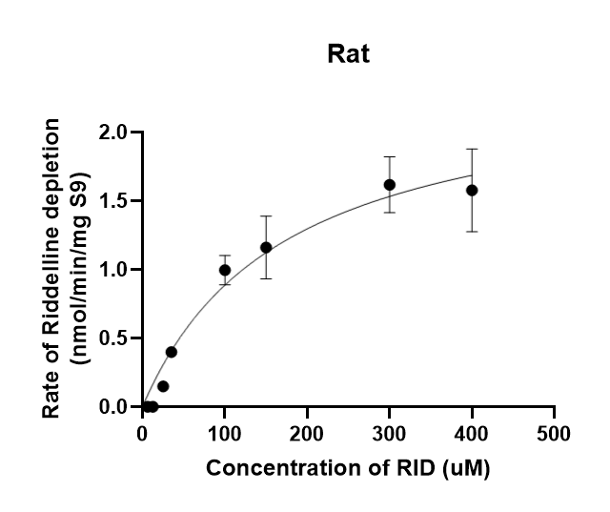
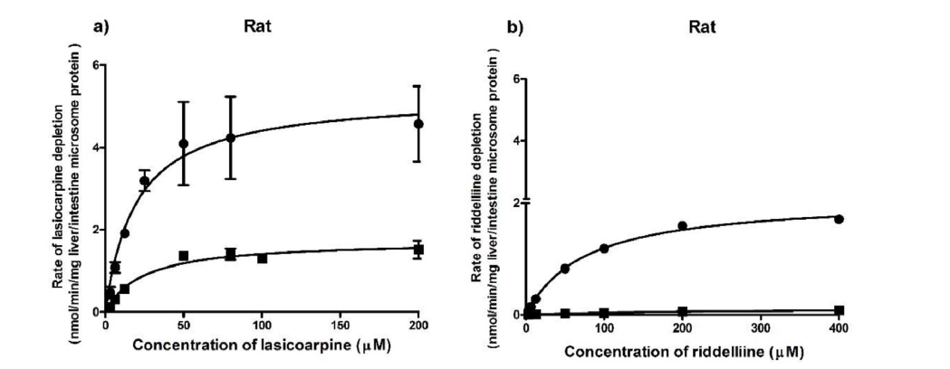
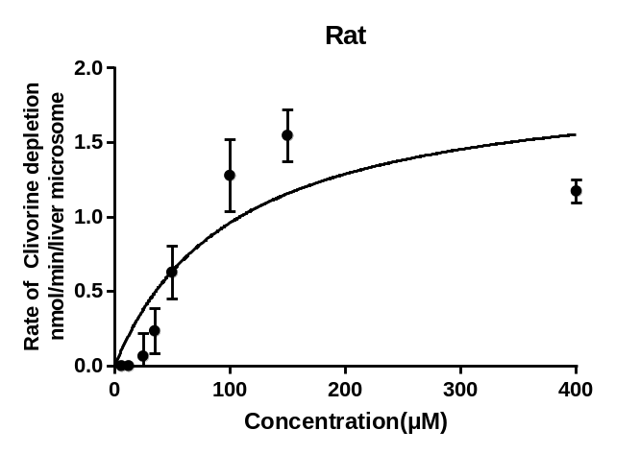
Becky’s results
Reported results
Present results
Riddelline ranging from 6.25 to 400μM.
lasiocarpine ranging from 0 to 200 μM
Riddelline ranging from 0 to 400 μM
 | PA | Species | Vmax(nmol/min/mg/microsomal protein) | Km(μmol) | Catalytic efficiency
Present results | Retrorsine | Rat | 1.522±0.1771 | 85.29±28.82 | 0.018
 | Clivorine | Rat | 1.958±0.328 | 103.5±38.49 | 0.019
Becky’s results | Riddelliine | Rat | 2.45±0.32 | 178.97±42.59 | 0.013
Reported results | Riddelliine | Rat | 2.1 ± 0.1 | 75.7 ± 7.4 | 0.028
 | Lasiocarpine | Rat | 5.3 ± 0.6 | 19.5 ± 7.7 | 0.27
Retrorsine ranging from 6.25 to 600μM.
The values are mean ± SD
Note: reported results from :https://doi.org/10.1016/j.fct.2018.04.012

Slide 6
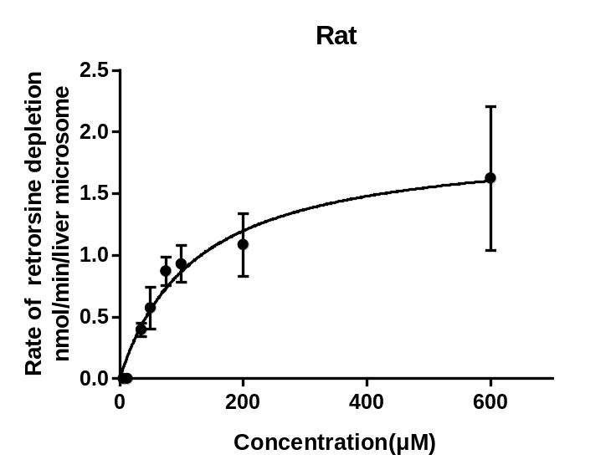
Becky’s results
Reported results
Final results
Riddelline ranging from 6.25 to 400μM.
lasiocarpine ranging from 0 to 200 μM
Riddelline ranging from 0 to 400 μM
Retrorsine ranging from 6.25 to 600μM(delete 150 and 400 μM ).
 | PA | Species | Vmax(nmol/min/mg/microsomal protein) | Km(μmol) | Catalytic efficiency
Present results | Retrorsine | Rat | 1.522±0.1771 | 85.29±28.82 | 0.018
 | Clivorine | Rat | 1.958±0.328 | 103.5±38.49 | 0.019
Becky’s results | Riddelliine | Rat | 2.45±0.32 | 178.97±42.59 | 0.013
Reported results | Riddelliine | Rat | 2.1 ± 0.1 | 75.7 ± 7.4 | 0.028
 | Lasiocarpine | Rat | 5.3 ± 0.6 | 19.5 ± 7.7 | 0.27
The results show that the deleption of RTS and CLI are converted in a concentration-dependent manner;
The conversion efficiency of RTS and CLI are lower than that of RID and LAS compared with pervious report;
Clivorine ranging from 6.25 to 600μM(delete 200 and 600 μM ).
The values are mean ± SD
Note: reported results from :https://doi.org/10.1016/j.fct.2018.04.012

Slide 7
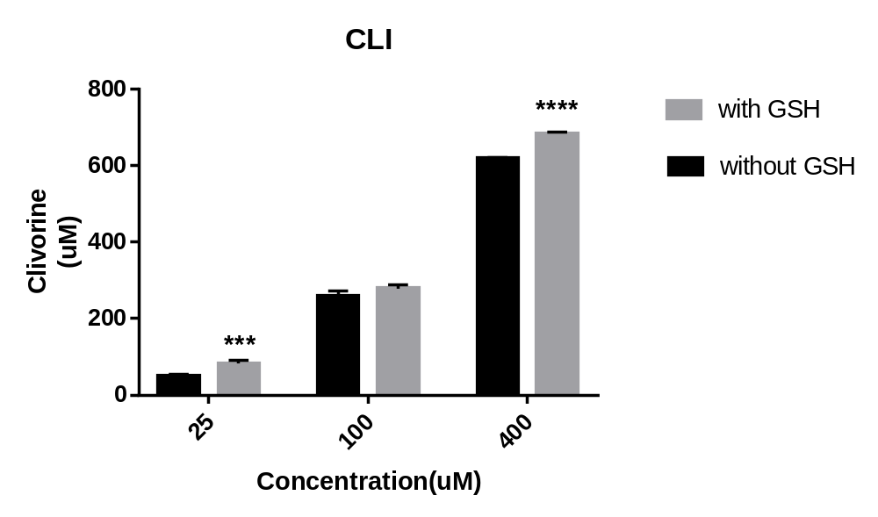
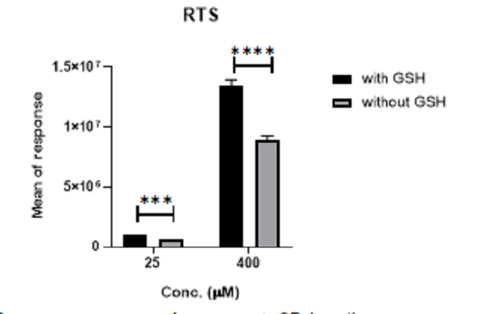
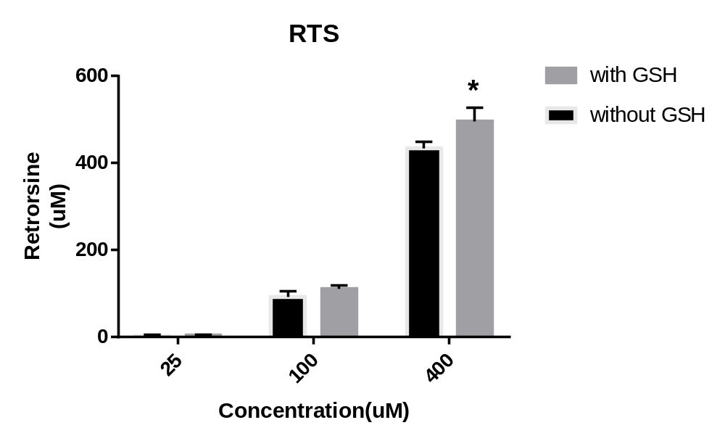
Present results
Becky’s results
More PAs were found in GSH group than without GSH group, either in present results or in Becky’s results
We need to read other papers in order to find reason possibly
The values are mean ± SD(n=4)

