Slide 1
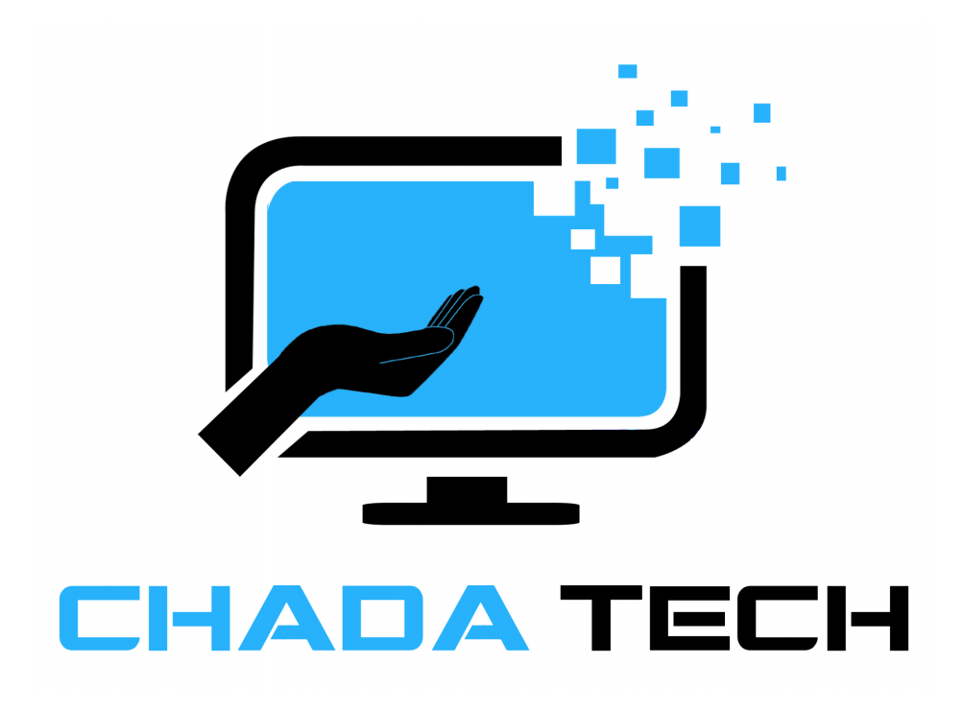
Chada Tech Agile Shift
Presentation made by Cary Dakota Wolfe

Slide 2
What is Agile?

Slide 3
The Agile Methodology Explained
The Agile Methodology is a dynamic software development process that prioritizes flexibility, and collaboration, while remaining customer-centric.
Key Facets of the Agile Approach:
Sprints - Projects are divided into smaller chunks known as sprints.
Dynamic - Agile encourages and adapts to change.
Scrum Meetings - Daily meetings amongst the team are of high importance.
Customer-Centric - There is a high priority placed on satisfying the customer.

Slide 4
How do Agile and Waterfall compare?
Agile
Waterfall
Both
Non-linear approach - Work completed in sprints, additional work for the sprint may be completed after the sprint ends.
Highly adaptable and encourages change.
High priority on customer involvement.
Continuous testing.
Linear approach - each phase must be complete before moving to the next, no moving to previous phases.
Minimum flexibility. Certain changes may not be possible.
Testing at the end of development cycle.
End goal is typically the same.

Slide 5
The Roles of an Agile Team
Product Owner
Works as the intermediate between the customer and the development team.
High priority on customer satisfaction.
Scrum Master
Responsible for managing the scrum process and sprint planning.
Developer(s)
Primarily responsible for developing the software behind the project.
Tester(s)
Works with the development team to ensure software meets base level requirements.

Slide 6
SDLC in an Agile Approach

Slide 7
The Phases of the SDLC in an Agile Approach
Meeting with Stakeholders
The product owner meets with the stakeholders to discuss requirements.
Development Plan
The team meets to discuss what to prioritize for the given sprint.
Sprints
The team works on implementing features previously discussed.
Daily scrum meetings also take place.
Review Meeting
The team, and the stakeholders, go over the work completed for the previous sprint.
The product owner approves, or denies, the work completed.
Retrospective Meeting
The team meets to discuss areas of improvement regarding the previous sprint.

Slide 8
Compared to the Waterfall Approach
Requirements
Requirements are gathered from the stakeholders and documented.
Design
The layout of the project is completed.
Implementation
The software of the project is implemented according to the design previously laid out.
Testing
The software is tested to ensure it meets requirements.
Deployment
The finished product is provided to the customer.
Maintenance
The finished product is monitored for further issues.

Slide 9
Choosing Agile vs Waterfall
Static or Dynamic?
If your project is static (pre-defined, no changes are expected) then waterfall may work better.
If your project is dynamic, or there is even a possibility of change, then the agile approach is undoubtedly the better choice.
Customer Involvement
If keeping the customer involved in the development process is a high priority, agile is the better choice.
Small Teams or Large Teams?
The agile methodology places a focus on smaller, more focused teams.
While the waterfall method works in a more traditional format, with larger teams and a hierarchical structure.

Slide 10
References
https://www.atlassian.com/agile#:~:text=What%20is%20the%20Agile%20methodology,planning%2C%20executing%2C%20and%20evaluating.
https://business.adobe.com/blog/basics/waterfall#:~:text=The%20waterfall%20methodology%20is%20a,detailed%20documentation%2C%20and%20consecutive%20execution.
https://www.forbes.com/advisor/business/agile-vs-waterfall-methodology/

Slide 11
Thanks!

