Slide 1
Using neural networks to predict seismic moment release in California
Franklin Wolfe
EPS ML 268

Slide 2
Outline
Outstanding scientific question and potential impact of solution
Data selection and curation
Algorithm explanation and methods
Computation and implementation
Performance assessment
Evaluating success and limitations of approach

Slide 3
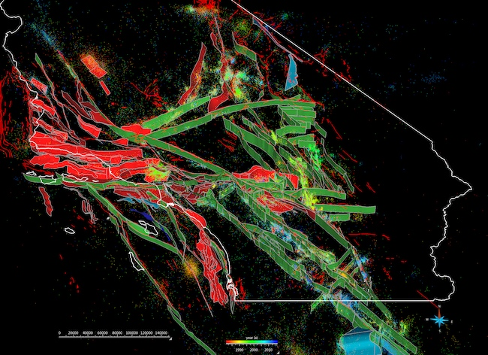
Question: Can we detect patterns in seismic moment release in California?
Visualization of the SCEC Community Fault Model
Impact:
Plate boundary-scale fault and earthquake dynamics
Earthquake prediction
Novel insights from newly minted dataset too large to manually interpret
Simplification of complex, dynamic, interrelated earth systems
Earthquake physics
Plesch et al., 2007
Notes:
Problem:
Earthquake prediction remains uncertain and unreliable
This is important because:
Damage from earthquakes in last 30 years: Over 120 deaths, 500 Injuries, $15 billion in damage
How might we tackle this problem:
What we know:
Complex plate boundary interaction
Seismic moment release is clustered in space and time around active faults
If we understand patterns of seismic moment release on faults, we can understand this plate boundary interaction and seismic hazard
Why this is difficult:
Just in So. California, 479 active fault segments have been mapped and included into seismic hazard maps
Complex relationship between faults – transfers of stress
Complex geometries and fault patches within one segment
Timing and variations in fluid pressure and its effect on the strength of the fault zone
Well data throughout show that local stress states not representative of plate boundary motions
Heterogeneities in the crustal composition
If this was simply one ‘perfectly behaving’ fault in a vacuum, we could apply two fundamental theories of earthquake science:
Elastic rebound theory – earth’s crust will bend and deform under intense stress until it breaks under the strain, allowing the rock on each side to rebound to a less-deformed state and release the stored energy, allowing the accumulating strain to begin anew
Characteristic earthquake – earthquake-generating faults seem to have distinct segments that rupture to produce earthquakes of similar magnitude after accumulating a similar amount of strain in the intervening period between earthquakes
In 1985, this framework led earthquake scientists to believe the Parkfield segment of the San Andreas Fault was overdue and the most sophisticated monitoring effort in the world was deployed to capture it in action. Scientists stated confidently that an event would hit by 1993 at the latest. It came a decade later and without any warnings.
6 earthquakes at regular intervals from 1857-1966
Parkfield Weirdness and Earthquake Precursors:
Infra Red anomalous phenomena – latent heat released due to air ionization by radon and consequent water vapor condensation on newly formed ions
Air conductivity
Magnetic pulsations – compression of rock breaks bonds in crystals freeing electrons and creating charges holes within rock mass
Animal behavior
Ground and soil level
Groundwater levels
Foreshocks

Slide 4
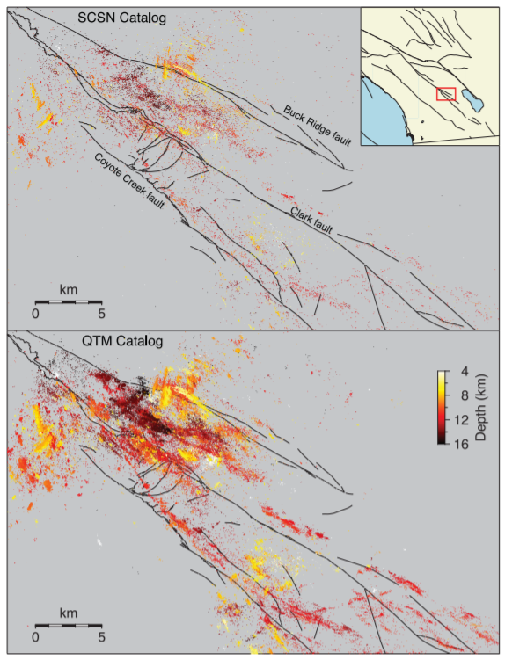
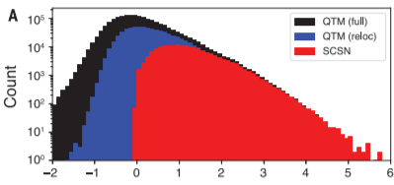
Data Selection
Mapped seismicity in the San Jacinto Fault Zone
Ross et al. (2019)
Quake Template Matching (QTM) seismicity catalog for southern California.
2008-2017
~900,000 earthquakes
Detection threshold of 12 times the median absolute deviation (min Mag <-1.95)
Frequency-magnitude distribution
Ross et al., 2019
Notes:
Template-matching detection technique to the entire waveform archive of the regional seismic network of Southern California.
Exploits the similarity of earthquake waveforms between nearby events by using the seismograms of previously identified earthquakes as templates, which are then cross-correlated against continuous waveform data.
Motivation:
Earthquakes follow a well-known power-law size relation with smaller events occurring much more often than larger events and dominating the counts of catalogs
Many of these seem to be missing in current state-of-the-art catalogs
Result: 1.81 million earthquakes – 10-fold increase
These can be downloaded and converted to a csv file for analysis
Facilitate next generation of analyses of earthquakes and faults (geometry of fault zones, foreshock and nucleation process, and earthquake-triggering mechanisms)
FMD
Higher peak by orders of magnitude and much greater coverage of negative magnitude events
SJFZ Map
Black lines indicate mapped late Quaternary faults. The structural complexities of the fault zone are imaged with much higher resolution in the QTM catalog (bottom panel) than in the SCSN catalog (top panel). The inset map shows the location of the study area.
Sharp lineations, cross-cutting features, and unmapped structures

Slide 5
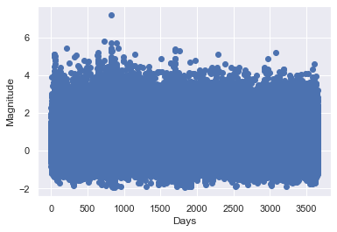
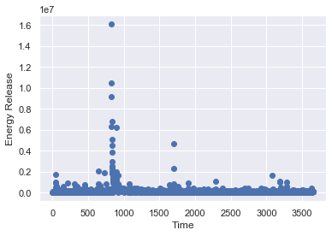
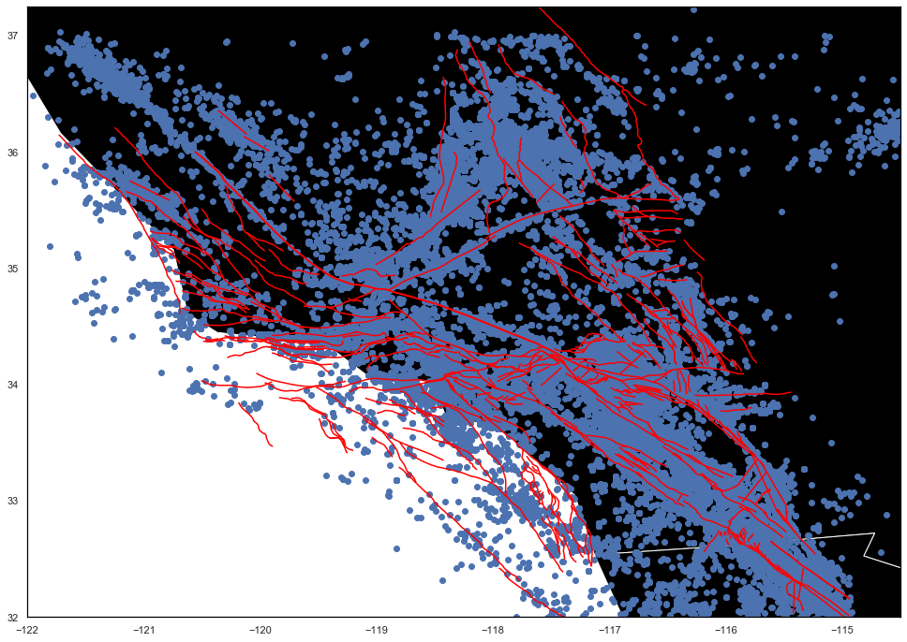
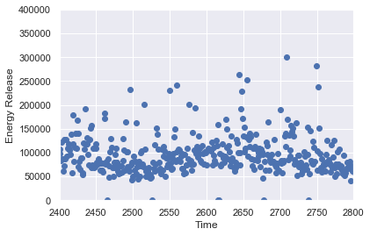
Data Curation
Earthquake Time Series
Built time series for earthquake data
Bin data on energy release per time
Full earthquake catalog plotted with CFM faults
Data and faults from Plesch et al. (2007) and Ross et al. (2019) plotted
Notes:
Converted the earthquake event data into a time series grouping the earthquakes that occurred during each day of the catalog (10 years total)
Used the magnitude of each event to determine the seismic energy released during each event; summed to get total energy released per day

Slide 6
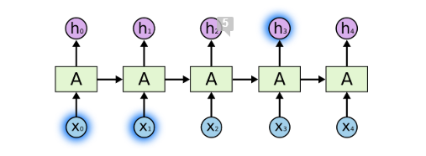
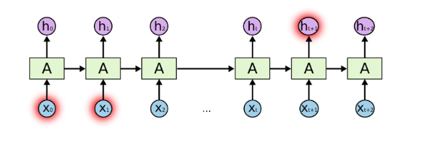
Recurrent Neural Network
When the gap between the relevant information and the place that it is needed is small (e.g., “the clouds are in the ____”), the RNN is enough.
Chain-like nature make them the natural architecture for sequence and list data (such as earthquake time series data)
Can be thought of as multiple copies of the same network, each passing a message to a successor
Connect previous information to the present task
When the gap is larger, (e.g., “I grew up in France… I speak fluent ____.” This is more difficult. Recent information suggests the next word is probably a language, but which one?
Olah’s blog, 2015
Notes:
RNN are networks with loops built in so that previous info can impact decision of network
That’s why these are used with sequences
For example, the network can use previous video frames to inform the understanding of the present or future frames
Traditional RNNs have an issue with long-term memory

Slide 7
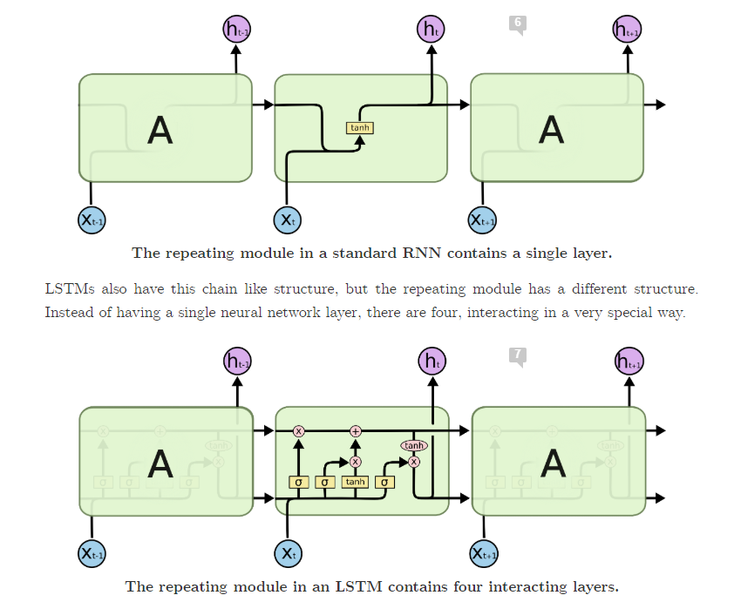
Long Short-Term Memory (LSTM)
A special kind of recurrent neural network capable of learning long-term dependencies
Consists of a chain like structure, like RNNs, but also contains a four-component neural network within the repeating module.
This module has ‘gates’ that can add or remove information to the cell state, a ‘conveyer-belt-like layer that moves information forward in network, based on the long-term memory of the system.
Olah’s blog, 2015
Notes:
A neural network that solves the long-term dependency problem and allows information to be stored

Slide 8
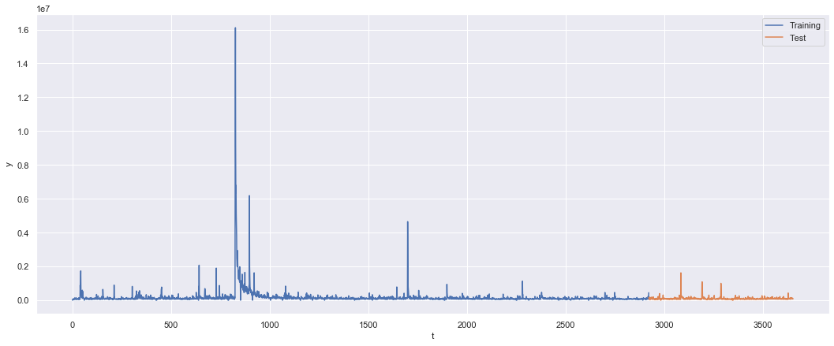
Methods
Data Inputs
Train Examples | 2922
Test Examples | 731
Train-Test Split
Notes:
Attempt to give ample data to the network
See some days have spikes – largest spike for the El Mayor-Cucapah earthquake 2010

Slide 9
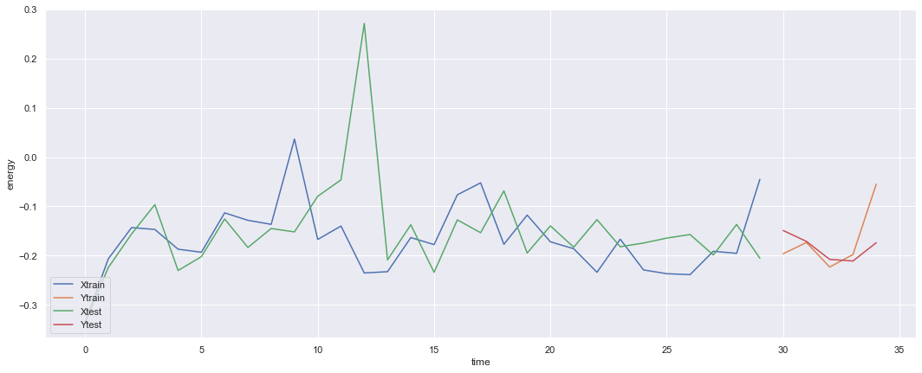
Methods
Data Inputs
Input Window | 30
Output Window | 5
Stride | 2
No. Train Windows | 1444
No. Test Windows | 349
Standardized-Windowed Data Slice

Slide 10
Computation
Hidden size: The most relied upon empirically-derived-rule-of-thumb is choose a number between the input and output size
Input = 30
Output = 5
No. Epochs: Chosen to be large to give the algorithm sufficient time to learn the complex ‘patterns’ of the data
Batch Size: Common value of 32 chosen. Allows the algorithm to see numerous samples before updating internal model parameters
Teacher Forcing Rate: Set high to speed convergence and reduce instability
Learning Rate: Chosen to be small to allow for subtle changes over many epochs
Algorithm Inputs
Hidden Size | 15
No. Epoch | 1000
Batch Size | 32
Teacher Forcing Rate | 0.5
Learning Rate | 0.01
Seconds / Iteration | 3
Total Time (Minutes) | 50
Machine Learning Mastery; StackExchange
Notes:
If data is not linearly separable, then a hidden layer is generally needed. There are very few situations in which performance improves with a second or third hidden layer.
Number of epochs is a hyperparameter that defines the number of times the learning algorithm will work through the entire dataset
Batch Size is a hyperparameter that defines the number of samples to work through before updating the internal model parameters
Teacher forcing uses ground truth from a prior time step as input – addresses slow convergence and instability when training recurrent networks
Learning rate is a hyperparameter that controls how much to change the model in response to the estimated error each time the model weights are updated.

Slide 11
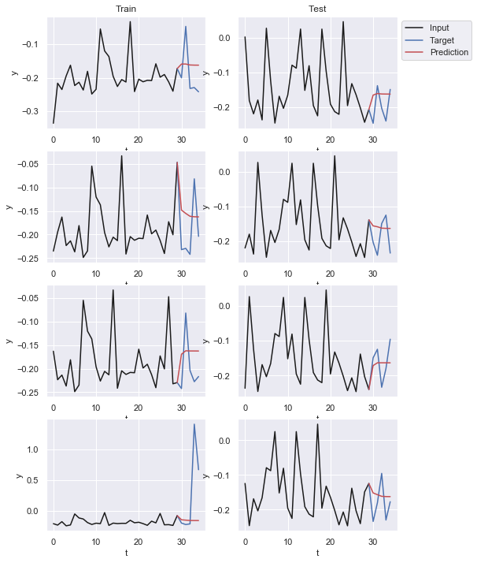
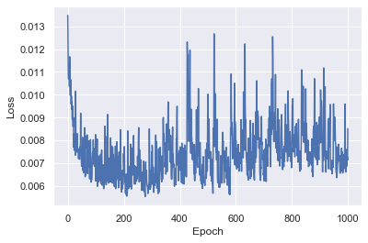
Performance
Loss Curve
Notes:
Initial drop in loss
Trough at around 200 epochs
Seems to have found a set value (mean) and is scared to predict further

Slide 12
Limitations
Possible that there are no patterns to find
System too complex
Dynamic triggering
Patches or segments act uniquely
Local patterns may exist
Need to find specific faults and isolate seismicity for each to the justify the use of LSTM
Data can be ‘non-stationary’ and prone to ‘regime changes’ which may render older data less relevant for prediction
E.g., major earthquakes drastically change the stress state within the crust
Possible improvement - Exponential Moving Average – weights time series by recency
We do not have a complete dataset
Earthquakes not detected
Time series too short
Dynamic system larger than domain of network coverage
Too time intensive to identify the appropriate hyper parameter combination – needs manual intervention
Notes:
El Mayor-Cucapah Earthquake in 2010 – changed seismicity rate in a statistically significant way for 2 years out to 175 km away from the fault zone

Slide 13
Works Referenced
Ross et al., Science 364, 767-771 (2019)
Plesch et al., BSSA 97, 1793-1802 (2007)
Olah, Christopher, Understanding LSTM Networks, Olah’s Blog, Github, (2015)
Numerous articles on www.machinelearning.com
Numerous articles on www.towardsdatascience.com
Numerous articles on www.medium.com
“The Parkfield, California, Earthquake Experiment”. USGS: Science for a Changing World Website. Web.
Laura Kulowski

