Slide 1
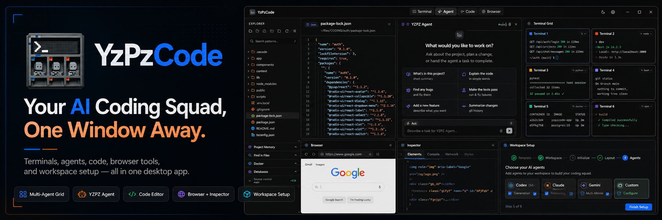
YZPZCODE / THE UNIFIED WORKSPACE FOR AI CODING AGENTS
01 / 16
26
AI coding agents.
One native window.
Windows | macOS | Linux
Apache-2.0
Run 26 external AI coding CLIs, 10 developer tool CLIs and graphical
workspace extensions from one native desktop application.
Tauri v2 + Rust
In plain words: AI helpers that write software for you , plus a Presentation Studio, a Writing Studio and extensions.
Notes:
Start with the number: twenty-six AI coding agents, and one native window to hold them. In plain words, these agents are AI helpers that write software for you, and YzPzCode is the single desktop app where you meet all of them. It runs on Windows, macOS and Linux under Apache-2.0, and besides the coding workspace it also holds a Presentation Studio, a Writing Studio and extensions, which we will see later. Before we look at how it works, let's start with the problem it was built to solve.

Slide 2

YZPZCODE / THE PROBLEM
AI-assisted development has become
a shuffle between eight windows
8+
01
Dozens of terminal tabs, scattered coding agents,
disconnected browsers, IDEs and ad-hoc CLI tools.
02
Constant Alt+Tab context switching.
disconnected
terminal windows
03
Isolated AI chats with lost context.
02 / 16
Notes:
Start with the picture everyone in this room already recognizes: a desk full of screens, terminals and browsers. Count the windows a typical AI-assisted session needs and you land at eight or more, each one holding a different agent, tool or chat. The cost is not the windows themselves but the constant Alt+Tab switching and the context that gets lost between isolated chats. That is the tension the next page resolves with one command center.

Slide 3
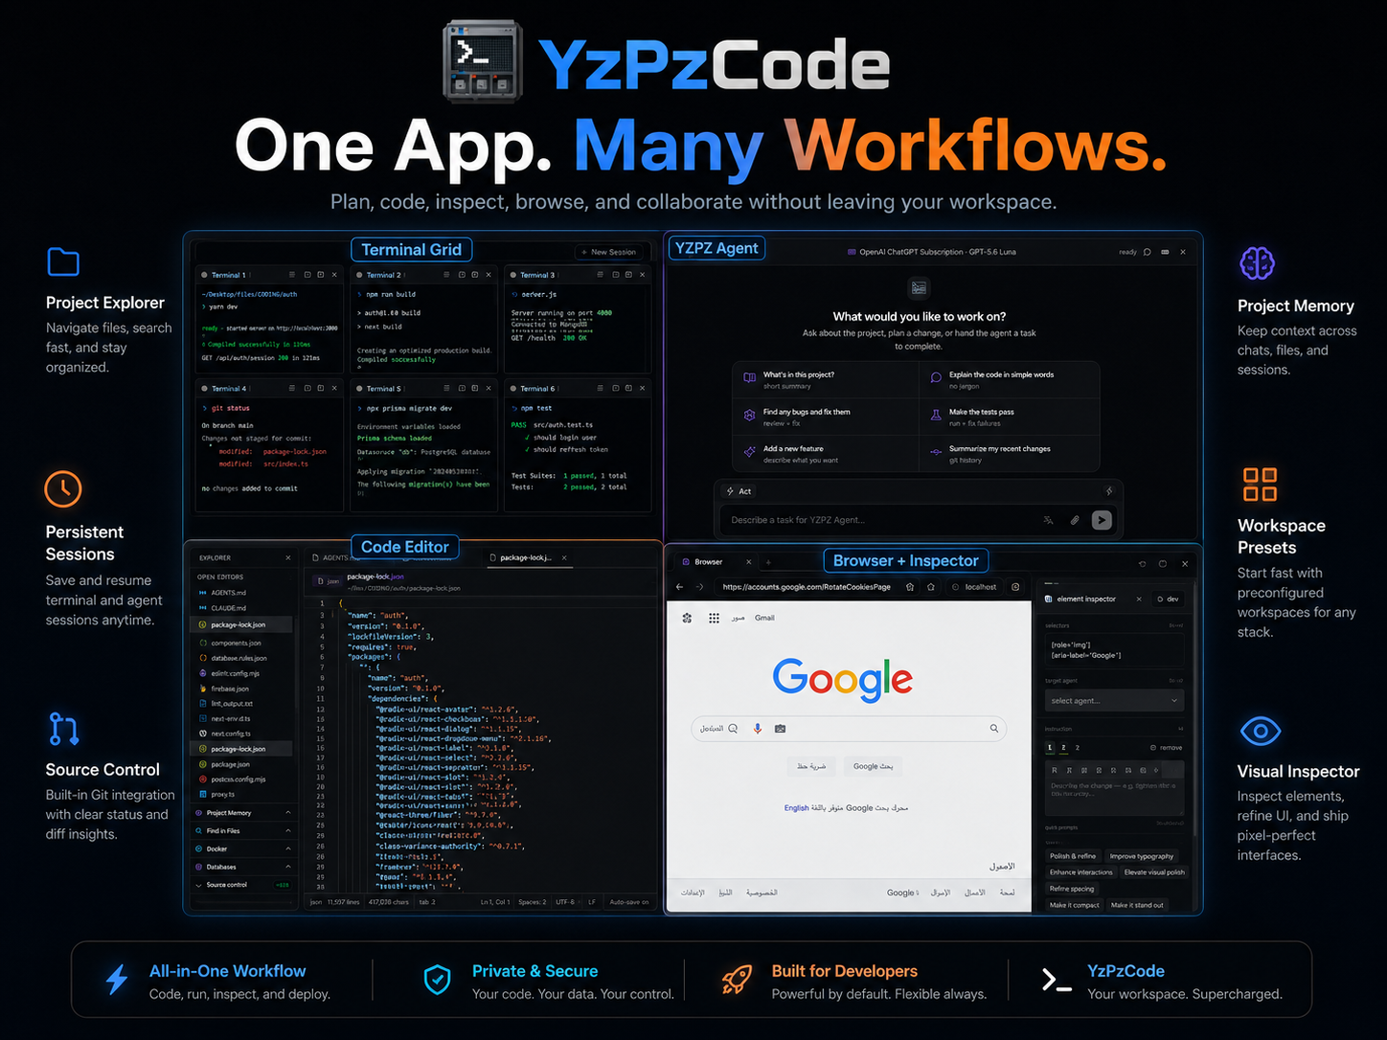
YZPZCODE / THE RESOLUTION
03 / 16
YzPzCode replaces the window juggling
with one command center
BEFORE
AFTER
01
8+ disconnected
terminal windows
One native workspace
with layouts you arrange yourself
02
Constant Alt+Tab
switching
A side-by-side terminal grid
every session stays live (PTY)
03
Extension panels locked
in external IDEs
Extensions inside the grid
graphical tools right beside agents
04
Manual build scripts and
fragmented run commands
Smart run & build system
auto-detects 15+ ecosystems
05
A separate browser
for UI validation
In-app browser
with a CSS / visual inspector
8+ windows → 1 workspace
FIG. 03
ONE APP
THREE STUDIOS
Coding Workspace
run AI agents in a terminal grid
Writing Studio
draft documents with AI help
Presentation Studio
turn a brief into a slide deck
Notes:
This is the turn in the story, and you can read it left to right as plain before-and-after. Eight loose terminal windows become one workspace you arrange yourself, and constant Alt+Tab becomes a grid where every session stays live. Extra tools no longer live in other editors, because they open right beside your agents. The app finds how to run and build more than fifteen kinds of projects by itself, and the built-in browser lets you check how a page looks without leaving. Finally, the same window is not only for coding: it also holds a Writing Studio and a Presentation Studio, which we come back to later. Next, we look at the agents themselves and how they are detected and launched.

Slide 4
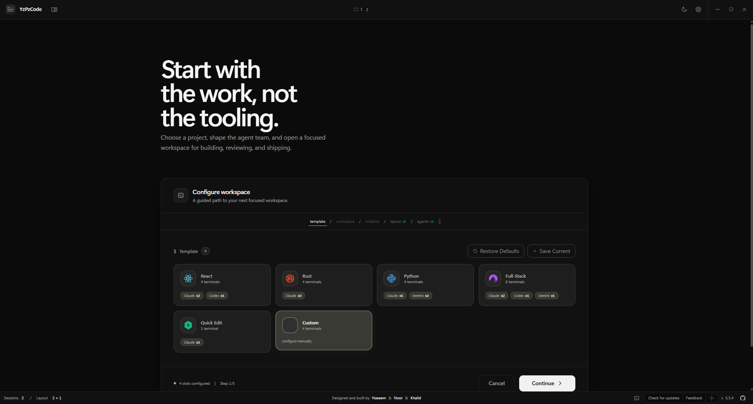
YZPZCODE / AGENT ROSTER
04 / 16
Nine core agents, 26 in total,
detected and launched from one dialog
Claude Code
Antigravity CLI
Codex CLI
$ claude
$ agy
$ codex
Deep thinker that
reworks big projects
Runs tasks on its own,
powered by Google AI
Precise code, plus
tests that check it
OpenCode
Cursor CLI
Kilo
$ opencode
$ cursor
$ kilo
Open-source, fully
customizable, local
Edits files itself,
indexes your codebase
Fast, works natively
in the terminal
Searchable spawn dialog with
real-time status badges
Hermes
Pi
Command Code
$ hermes
$ pi
$ cmd / cmdc
IN PLAIN WORDS
Compact assistant
that works on its own
Minimalist harness,
with extension hooks
Coordinates commands
and scripts
An agent is an AI assistant that writes
and fixes software for you. One dialog
finds it, starts it, keeps it running.
Not affiliated with or endorsed by the vendors.
Notes:
Think of an AI coding agent as a skilled assistant that writes and fixes software for you. There are many of them, each made by a different company, and these nine are the core of what YzPzCode supports, 26 in total. The small tag on each tile is the short command that starts that agent. On the right is the launcher: you search, see which agents are ready, and start one in a single step. We are not affiliated with these vendors. Next we look at the other agents and tools that sit beyond this core nine.

Slide 5
YZPZCODE / DETECTED AGENTS & CLIS
05 / 16
Beyond the core nine: 17 more agents
and 10 service CLIs, tracked in one place
CLI = a program you run by typing a short command. The tag beside each name is that command.
26
10
AI coding CLIs
developer tool CLIs
9 core + 17 listed below
install + auth tracked
Assistants that write code for you
Connect your app to online services
CL
Cline CLI
cline
GK
Grok CLI
grok
GH
GitHub CLI
gh
DV
Devin for Terminal
devin
TR
Trae CLI
traecli
SB
Supabase
supabase
KM
Kimi Code CLI
kimi
QD
Qoder CLI
qoder
ST
Stripe
stripe
CP
GitHub Copilot CLI
copilot
KR
Kiro CLI
kiro-cli
VC
Vercel
vercel
MV
Mistral Vibe
vibe
DT
DeepSeek TUI
deepseek
VL
Valyu
valyu-cli
AD
Aider
aider
AM
Amp
amp
PH
PostHog
posthog-cli
RX
DeepSeek Reasonix
reasonix
CB
CodeBuddy Code
codebuddy
EL
ElevenLabs
elevenlabs
DH
DeepSeek Harness
dsh
AC
AtomCode CLI
atomcode
GW
Google Workspace
gws
MM
MiMo Code
mimo
AM
AgentMail
agentmail-cli
RP
Ramp
ramp
Automatic detection, 1-click install and auth tracking: install status, executable path, authentication state.
Notes:
Quick translation first: a CLI is simply a helper you start by typing a short command, and the small tag next to each name is exactly that command. Every name now sits next to its own icon tile, so you can recognise an agent at a glance, the way you do in the launcher. The launcher showed nine core agents, but YzPzCode knows 26 AI coding assistants in total, so 17 more are listed here, plus ten everyday developer tools such as GitHub, Supabase, Stripe and Vercel. For every one of them the app finds it automatically, installs it in one click, and tracks whether it is installed, where it lives and whether you are signed in. Now that everything is set up, let's watch these agents actually work side by side.

Slide 6
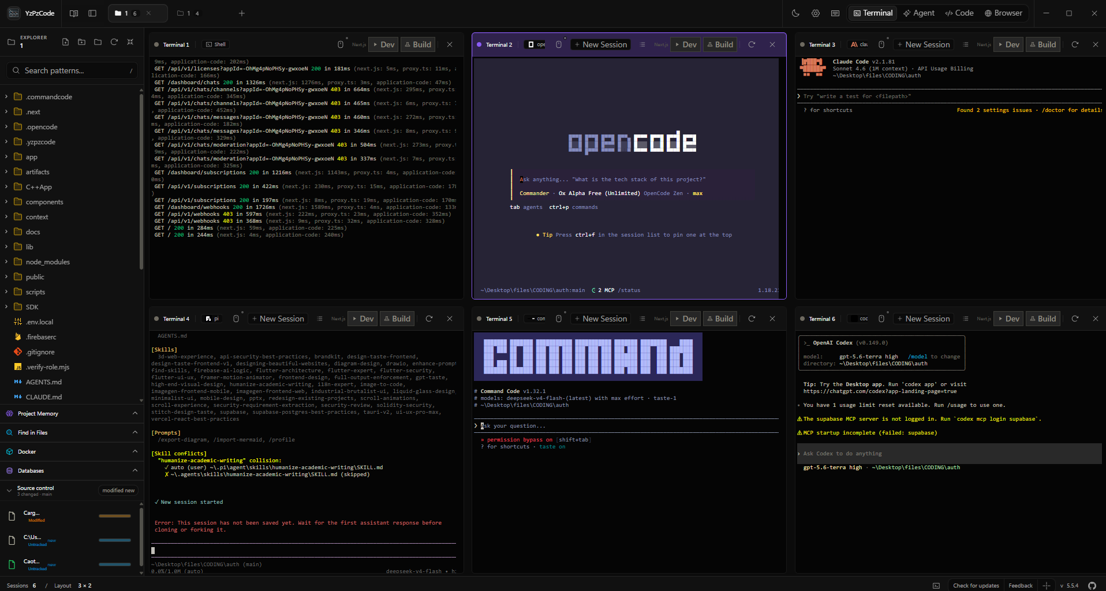
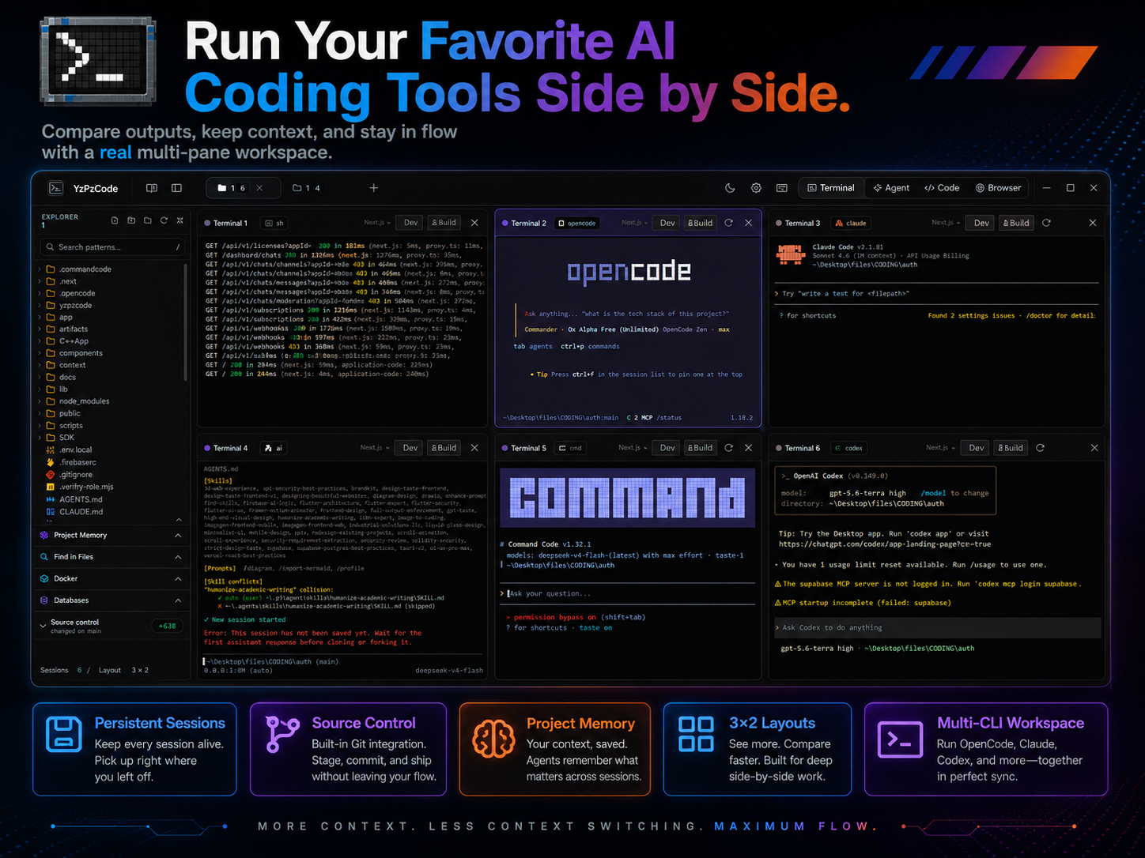
YZPZCODE / TERMINAL GRID & WORKSPACE EXPLORER
06 / 16
Every agent runs side by side
in a real terminal grid
A terminal is the window where an AI agent
types and works. Here, six share one screen.
TERMINAL GRID / WORKSPACE EXPLORER
Sessions 6 | Layout 3 × 2
Full mouse support · xterm mouse reporting
01 REAL PTY BACKEND
02 HARDWARE RENDERING
03 WORKSPACE SCOPING
04 EXTERNAL TILING
A true terminal engine inside:
xterm.js 6 frontend on a Rust
portable-pty backend.
Canvas/WebGL drawing on the GPU,
with dirty-rectangle updates:
only what changed is redrawn.
Each project gets its own space:
sessions are isolated per
project, never mixed up.
Prefer your own terminal? It
auto-tiles Windows Terminal,
macOS Terminal, Linux consoles.
Notes:
A terminal is just the text window where an AI agent does its work, and normally each one lives in its own separate window. Here you can see six of them running at the same moment in a single grid, with the project's files listed on the left. Under the surface it is a genuine terminal engine, drawn smoothly by the graphics chip, and every project keeps its own sessions so nothing gets mixed up. If someone prefers their usual terminal, the app can arrange those windows neatly on screen as well. Next, we look at the graphical assistants that join this same grid.

Slide 7
YZPZCODE / EXTENSIONS CATALOGUE
07 / 16
Fourteen graphical AI assistants
mount straight into the same grid
Extensions are add-on assistants: pick one from the catalogue and it opens as a panel.
1
Side-by-side layouts
OPEN WITH
Ctrl
+
Shift
+
X
or the Extensions icon in the header
Drag-and-drop to reorder, resize, or use
focus-left and focus-right presets.
Google Antigravity
Google
Kilo Code
Kilo
2
Zero-config runtime
Cline
Cline
OpenAI Codex
OpenAI
Just works: no external VS Code or Node.
Verified VSCodium reh-web, pinned SHA-256
digests and Open VSX packages.
Claude Code
Anthropic
Continue
Continue
3
Hardened sandbox
Amazon Q Developer
AWS
Tabby
TabbyML
Each assistant is sealed in its own box
and cannot call Tauri host commands.
Isolated child webview on its own
panel-uuid.localhost origin.
Windsurf Plugin
Windsurf
Mistral Vibe
Mistral AI
Roo Code
Roo Code
Qoder CN
Alibaba Cloud
4
Remembered per workspace
Augment
Augment Code
Nexrall Code
Nexrall
Workspace trust and state persist, so
reopening picks up where you left off.
Notes:
Think of extensions as apps for your workspace: you open the catalogue with Ctrl+Shift+X or the Extensions icon in the header, pick an assistant such as Claude Code, Cline or OpenAI Codex, and it opens as a panel in the same grid. Fourteen of them are ready to go. On the right is why that is safe and simple: it works out of the box with nothing extra to install, each assistant is sealed in its own sandbox and cannot touch the app itself, and the layout and trust settings are remembered for every workspace. Next we look at the code editor and Git version control that sit beside all of these assistants.

Slide 8
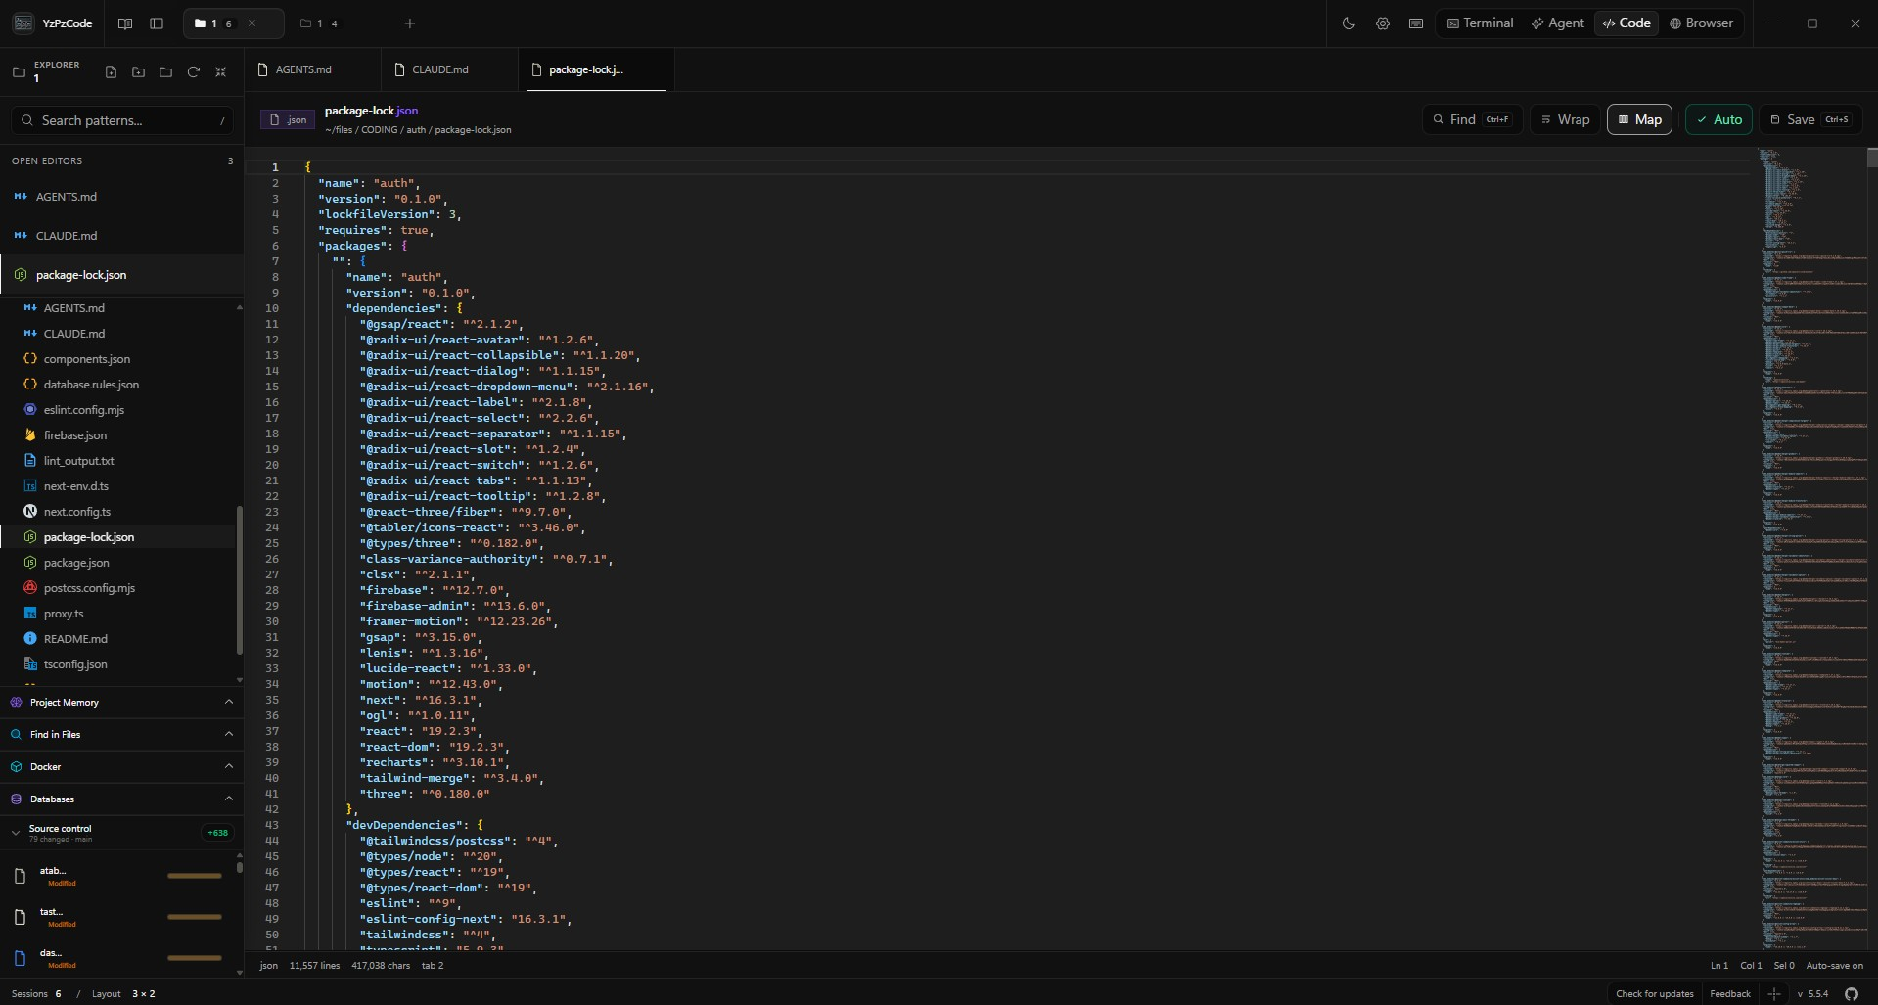
YZPZCODE / EDITOR + GIT
08 / 16
A Monaco editor and Git history
live beside the agents
MULTI-TAB
Split views to see two files side
by side. Close others, tabs to the
right, or saved ones.
RICH PREVIEWS
Open documents, not just code:
Markdown, PDF, CSV, Excel, Word
and Draw.io, readable in place.
TRANSACTIONAL SYNC
A recursive file watcher keeps
open tabs in sync when an agent
or another IDE edits a file.
GIT
A history of every change. Switch
branches, see diff stats, stage
files or hunks, commit, remote sync
Monaco is the editor engine behind VS Code. Git is the version history of a project.
Notes:
Think of this as the place where you read and fix what an agent has written, without leaving the window. Tabs and split views let you keep several files open, and documents such as PDFs, spreadsheets and diagrams show up as readable previews instead of raw code. A background watcher refreshes everything the moment an agent or another program changes a file, so you never look at stale work. Git adds a safety net: a history of every change that you can review, save as a snapshot and sync. Next, we look at how the workspace runs almost any project with zero configuration.

Slide 9
YZPZCODE / ZERO-CONFIG RUN & BUILD
09 / 16
Run or build almost any project
with zero configuration
$ cargo run
$ go run .
$ flutter run
Press Run. YzPzCode reads the project's files, works out the right command, and starts it for you.
15+
PROJECT TYPE
WHAT IT LOOKS FOR AND RUNS
Python
.py, main.py, Django manage.py, Flask, FastAPI; prefers .venv
JavaScript / TypeScript
package.json scripts via npm, pnpm, Yarn or Bun by lockfile
Rust / Go / Flutter
cargo run, go run ., flutter run
C / C++
finds main(), compiles with GCC or Clang into .yzpz-run/
ecosystems auto-detected
from manifests and
entry points
CMake
File API, Debug targets in .yzpz-build/
C# (.NET)
runnable .csproj in projects and solutions
Java
single-file source on JDK 11+
Ecosystem = a programming
language and its tools.
Ruby, PHP, Dart, Swift, Lua, Perl, R
system interpreters, Rails and Laravel commands
One-click Run & Build
Type into a running app
Your app, found for you
Custom run configs
from the terminal header
Interactive stdin pipe for
input(), scanf,
Console.ReadLine()
Localhost auto-discovery
with 1-click preview
Settings → Application runs,
global or per workspace
Notes:
Think of this as a Play button for any software project. You don't tell YzPzCode which language you're using or how to start it; it looks at the project's files, recognises more than fifteen kinds of projects, and picks the right command by itself. Run down the table quickly, since the point is simply that Python, JavaScript, Rust, C++, Java and the rest all work the same way. The bottom strip covers what happens once it is running: one click to run or build, a way to type answers into a running program, your app found and previewed automatically, and your own settings if you ever want control. That automatic preview leads straight into the next page, where we look at the running app without leaving the workspace.

Slide 10
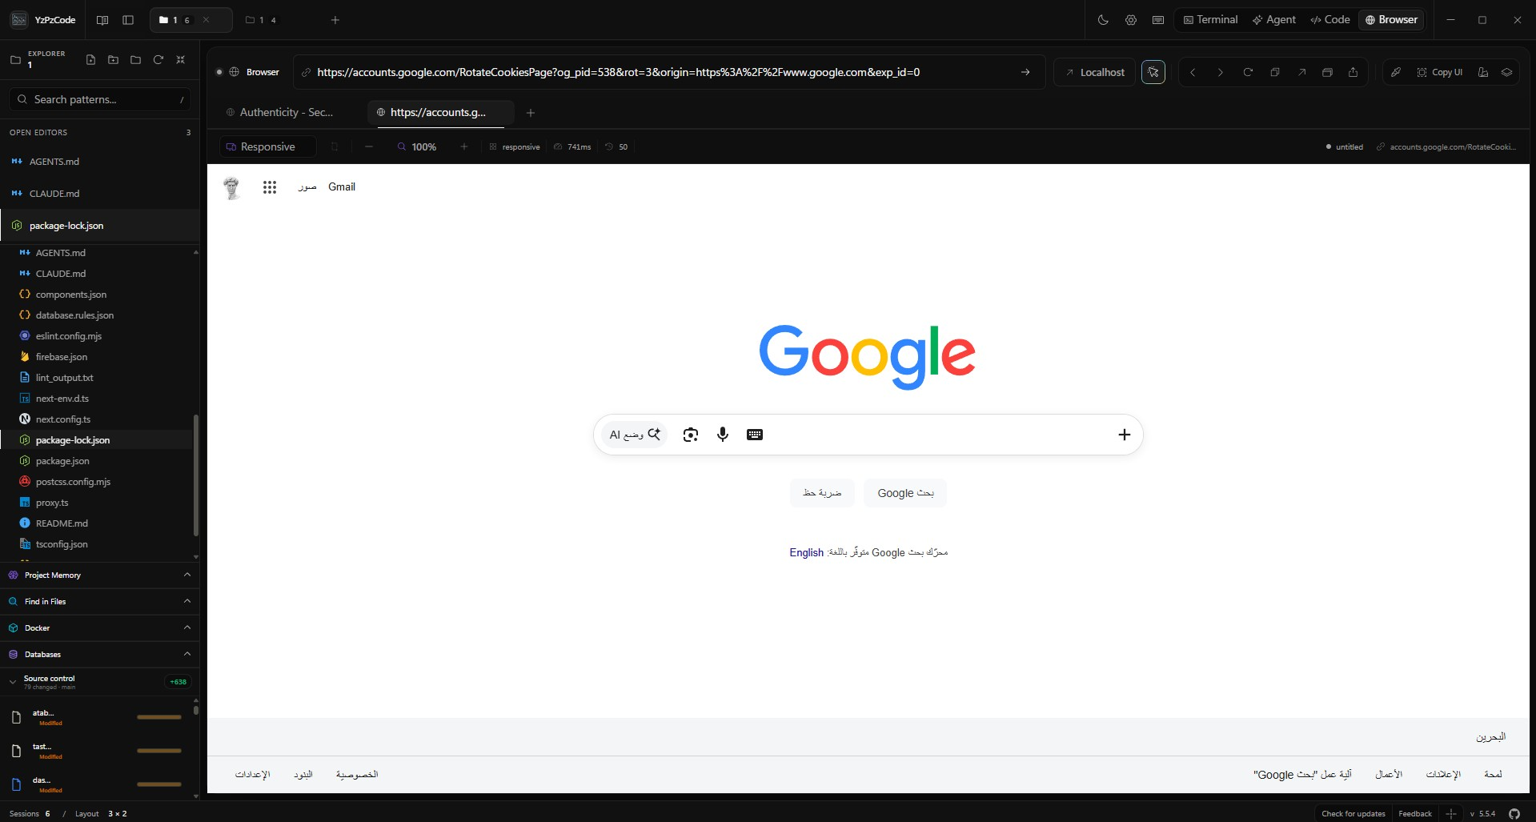
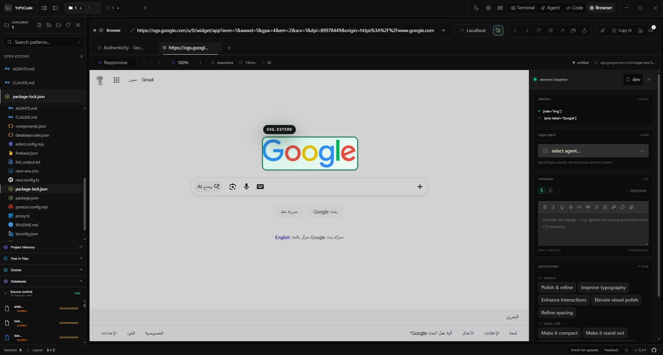
YZPZCODE / BROWSER PREVIEW + INSPECTOR
10 / 16
Preview and inspect the running app
without leaving the workspace
PICK AN ELEMENT
Click any item on the page.
The inspector then shows how
it is built and styled, like
a look under the hood.
A
Integrated multi-tab webview browser
Your running app opens in a tab,
right inside the workspace.
B
Deep visual element & style inspector
DEVICE PRESETS
INSPECTOR
STYLE PICKER
See it on a phone or a tablet.
See how any part of the page is built.
Copy a look, and undo any step.
iPhone, iPad, responsive desktop,
portrait / landscape
Computed CSS, pseudo-elements,
box model, DOM hierarchy
Copy styles, generate atomic CSS
classes, full undo stack
A dev server prints a localhost URL, and a 1-click preview button appears in the browser bar.
Notes:
Once your AI agents are working, you want to see what they are building, and you can do it right here. The app opens in a browser tab inside the workspace, so there is no switching to another window. Click any item on the page and the inspector shows how it is built and styled, a bit like lifting the bonnet of a car. You can also check how it looks on a phone or tablet, and copy a style you like with a full undo. Next, we meet the built-in agent, the AI designer and the image editor that share this same window.

Slide 11
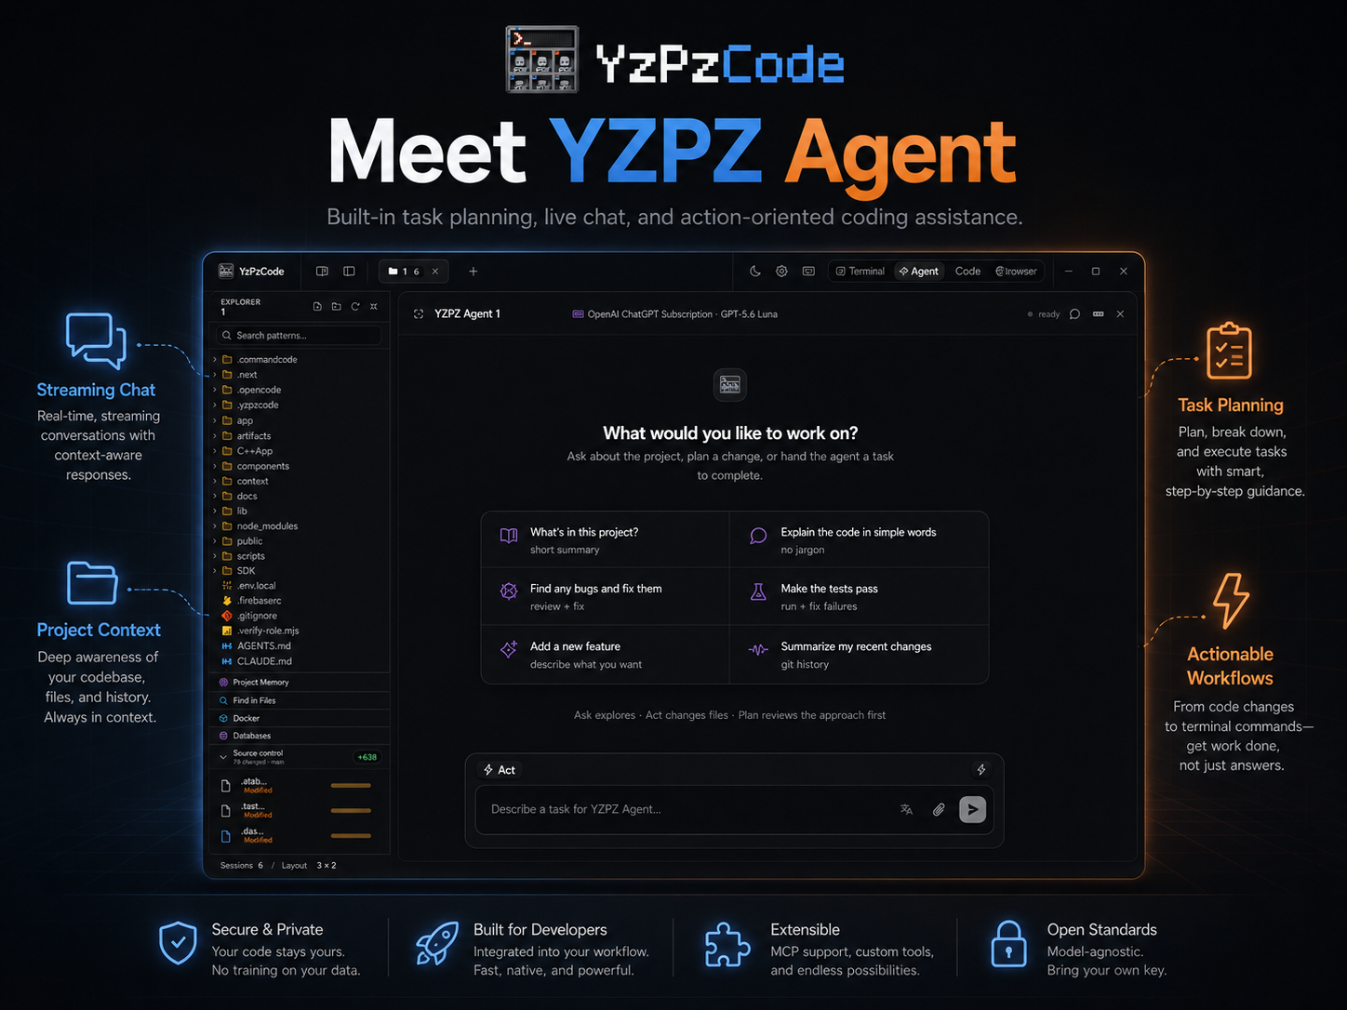
YZPZCODE / BUILT-IN TOOLS
11 / 16
built-in tools, one window
AI DESIGNER
PROMPT → UI
Describe a screen in plain words and get a working
HTML/CSS/JS interface that fits any screen size.
LAYERED IMAGE EDITOR
IMAGES
Layers for pictures, shapes and text, 16 blend modes,
masks and history. Exports PNG, JPG, SVG and 5 more.
PRESENTATION STUDIO
SLIDES
Turns a topic into a designed slide deck with AI,
page by page, ready to edit in PowerPoint.
WRITING STUDIO
DOCUMENTS
Drafts and polishes reports, articles and documents
with AI help. No code needed.
EXTENSIONS
Add-ons for the coding workspace
ASK / ACT / PLAN
Notes:
Besides running other companies' coding assistants, YzPzCode ships its own creative tools in the same window. There is our own agent that plans a job and retries when something fails, a designer that turns a plain-language description into a working screen, and an image editor with layers. Two studios go beyond code: the Presentation Studio builds slide decks and the Writing Studio drafts reports and articles, so no programming is needed to benefit. Extensions let the coding workspace keep growing with new add-ons. Next I'll show what is underneath: the technology that makes all of this one fast native app.

Slide 12
YZPZCODE / ARCHITECTURE
12 / 16
A Rust core hosts the terminals, a React shell
draws the grid, Tauri IPC joins them
In plain words: a screen you use, an engine that does the work, and outside tools it drives.
WHAT YOU SEE
THE ENGINE ROOM
THE TOOLS IT DRIVES
React 19 + TypeScript
frontend (Vite 6)
Tauri v2 + Rust
core host
External runtime
Terminal grid
xterm.js 6
Tauri IPC command router
Outside tools that YzPzCode
plugs into and drives
Tauri IPC
async invokes
+ events
passes requests both ways
Code editor
Monaco
raw PTY stream
PTY & run engine
portable-pty
External AI & tool CLIs
Browser & inspector
the screen asks,
the engine acts
a real terminal for every agent
live text feed
Claude, Antigravity, gh...
Image editor
Konva
Extension host manager
VSCodium reh-web
keeps add-ons running
loopback HTTP /
child webview
Open VSX host
Workspace extensions
File & Git watcher
notify
External IDEs
notices every file change
stays on this PC
VS Code, Cursor, Zed
Presentation studio
IDE / CLI detector
PTY path
Writing studio
finds the tools you already have
IPC / loopback
Studios & add-ons
ALSO USED
Tailwind CSS v4
Framer Motion
Zustand 5
CodeMirror 6
tokio
pdfjs
xlsx
mammoth
Notes:
Think of YzPzCode as three layers. On the left is the screen you actually use: the terminal grid, the code editor, the browser and image editor, plus the workspace extensions and the Presentation and Writing studios in violet. In the middle is the engine room, a Rust core that gives every agent a real terminal, watches your files and keeps add-ons running; the screen asks and the engine acts through Tauri IPC. On the right are the outside tools it drives, such as Claude, Antigravity and your existing editors, and the orange line is the live text feed from those agents. Next, what this design means for your code and your privacy.

Slide 13
YZPZCODE / LOCAL-FIRST SECURITY
Your code stays on your machine,
by design.
1
SOURCE · LOCAL
STAYS ON YOUR MACHINE
Local
Your code stays local
No project files or source code are uploaded to
third-party servers by YzPzCode itself.
2
KEYS · LOCAL
Secrets stay local
API keys and tokens, the passwords your AI tools
use, are stored exclusively on your own computer.
3
AI · DIRECT
Extensions added to the workspace are
sandboxed: they cannot call the host app's
commands. Open source under Apache-2.0;
under active development.
Direct provider connections
Requests to Anthropic, OpenAI or other LLMs go
straight to their official endpoints.
13 / 16
Notes:
This is the trust beat, and it now stays in the same dark control-room look as the rest of the deck. Three plain promises: YzPzCode does not upload your project files, the keys that let your AI tools log in stay on your own computer, and every request to an AI company goes straight to that company's own address. The caption is honest about the limits: extensions you add are sandboxed so they cannot call the app's commands, and the project is open source under Apache-2.0 and still under active development. From here we go back into the product and show how much of it you can make your own.

Slide 14
YZPZCODE / APPEARANCE
14 / 16
Make it yours: eight accents,
a living aurora, three densities
Dark / Light modes
across the whole UI
Default
Blue
Purple
Green
Orange
Red
Pink
Cyan
01
02
03
Workspace Aurora
Density
Terminal & Accessibility
A GPU-accelerated glow behind your work.
Presets: gemini, sage, accent, custom.
Tune intensity, speed, blur and opacity.
How tightly everything is packed on screen.
Shape the text window agents work in:
fonts, ligatures, cursor styles,
mouse tracking modes and opacity.
Settings → Appearance →
Workspace Aurora
Disable animations
Compact
Comfortable
Spacious
Custom cursor
EXTENSIONS
Add new abilities to the coding workspace, like add-ons for a web browser.
Notes:
This page is about making the workspace feel like yours. You pick one of eight accent colours, and orange is the one we ship with. Below that you can add a softly moving glow behind your work, choose how tightly things are packed, and tune the text window and accessibility switches, including turning animation off. Finally, extensions let you add new abilities to the workspace, much like add-ons for a web browser. With the tour finished, the next page is how to get it running.

Slide 15
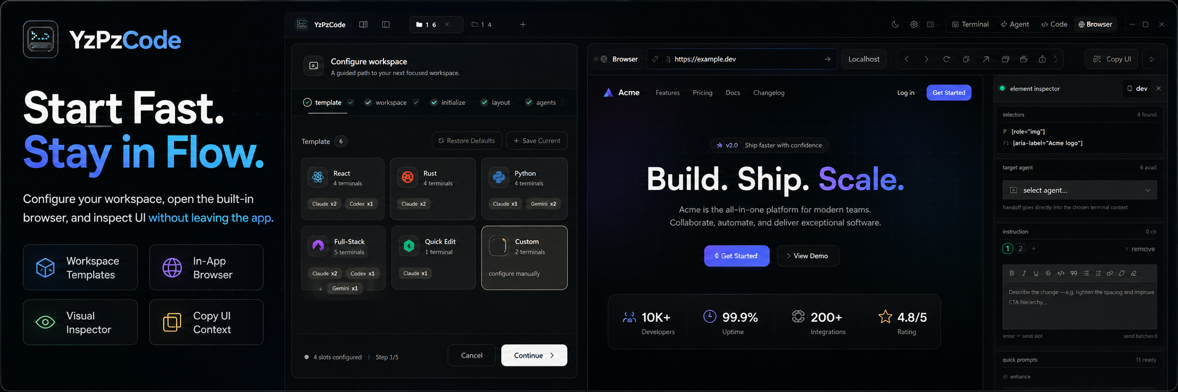
GET YZPZCODE / INSTALLERS + SOURCE
Grab an installer for your platform,
or build it from source
REQUIRES
Node.js 22.x+
Rust stable
C++ build tools
FOR EVERYONE · DOWNLOAD AND INSTALL
FOR DEVELOPERS
~/YzPzCode/app
Pick your system, open the file, follow the prompts.
01
git clone https://github.com/wolfenazz/YzPzCode.git
&& cd YzPzCode/app
Windows
.msi / .exe
x86_64
download the code
macOS
.dmg
Apple Silicon (aarch64)
Intel (x86_64)
02
npm install
fetch the parts it needs
03
npm run tauri dev
try it live
TIP
Unsigned build: Right Click → Open
04
npm run tauri build
make the app file
Linux
.deb / .AppImage
x86_64
# binaries land in app/src-tauri/target/release/bundle/
Latest release: github.com/wolfenazz/YzPzCode/releases/latest
Not a developer? Use the downloads on the left.
15 / 16
Notes:
There are two ways in, and most people only need the first. Download one file for your system, open it like any other app, and you are done: a Windows installer, a Mac disk image for Apple Silicon or Intel, or a Linux package. On a Mac the first launch needs a right click and Open, because the build is unsigned. The second path is for developers who want to build it themselves: install Node, Rust and the C++ build tools, then run four short commands. Either way you get the whole workspace we have walked through, so let me close with where this is heading.

Slide 16
Hand-drawn slides, exported as
native, editable PowerPoint shapes
$ export --pptx
STUDIO — DECK / PAGE 02
01
1
1280 × 720
ANIMATION
3
26 AI coding agents.
One native window.
01
title
fade
after
02
02
cards
fly left
click
2
03
01
02
03
03
chart
wipe
click
04
TERMINAL
EDITOR
PREVIEW
rect · 120 × 72
04
key number
zoom
click
02 / 22
PLAY
4 entries
01
Drawn as one SVG
02
Native, editable shapes
03
Motion follows the story
Each page is hand-written: real text,
grouped units, one idea per slide.
PowerPoint receives real shapes and text,
not a picture of the slide.
Fade, fly, wipe, zoom: one idea per
click, listed in the animation pane.
YZPZCODE · PRESENTATION STUDIO
16 / 22
Notes:
This is how the studio itself works, shown as the studio window. On the left is the filmstrip, in the centre a single page drawn as one hand-written SVG with its shapes still selectable, and on the right the animation pane that directs how the page plays. The point to land is that nothing is flattened: PowerPoint receives real shapes, real text and real animation entries you can keep editing. Use this page as the overview, and the next two pages can open up the editable export and the animation direction in turn.

Slide 17
STUDIO · EXPORT
Every SVG page lands in PowerPoint
as native, editable shapes
slide-17.svg
slide-17.pptx · editable
<svg viewBox="0 0 1280 720">
<rect width="1280" fill="#0A0B0D"/>
<g id="title-block">
26 agents.
One native window.
<text font-size="44">
Text box
26 agents. One native window.
EXPORT
</text>
SVG → PPTX
</g>
EDITABLE
<rect x="668" height="125"/>
Chart = 4 rects.
Recolour any bar.
<circle cx="1140" r="36"/>
</svg>
UTF-8 · 1280 × 720 · SVG
rect × 4
Hand-written SVG in, native shapes out.
<rect> → Shape
<text> → Text box
<path> → Freeform
17 / 22
Notes:
This is the export feature in one picture. On the left is a page written by hand as plain SVG, and on the right is the same page opened in PowerPoint, where the title is a real text box with selection handles and the chart is four ordinary rectangles you can recolour. Nothing is flattened into a picture, so you keep full control after export. Next, we look at how those pages move once they are in the show.

Slide 18
Presentation Studio: from brief
to native, animated slides
SVG → native PPTX shapes
01 / BRIEF
02 / DESIGN
03 / ANIMATE
brief.md
slide-18.svg
animation pane
Pitch YzPzCode · 22 pages
Play slideshow
4 effects · 3 clicks
One command center
1 title
fade · after
OUTLINE
01
Cover
2 cards
fly · click
02
The problem
3 number
zoom · click
03
One command center
drawing
SELECTED text · title
04
Proof, screen by screen
font Bahnschrift 44 bold
4 rule
wipe · click
05
Install
position x 78 · y 118
native · editable
0.0s
2.4s
Brief in, outline out
One SVG per page
Motion that follows the story
Describe the pitch once; the studio
lays out the story, page by page.
Each slide is a hand-built vector,
exported as native, editable shapes.
Title first, then one idea a click,
with fades, flies, zooms and wipes.
YzPzCode · Presentation Studio
18 / 22
Notes:
This page shows the Presentation Studio in three beats. You write the brief and get an outline, each page is then built as a single vector drawing that exports to native, editable PowerPoint shapes, and finally the motion is directed click by click. The mock windows are deliberately drawn like the real panes, so the audience sees what they would actually work in. From here, move on to the next page and show how the finished deck plays back.

Slide 19
Writing Studio: where documents
and reports take shape
DOCUMENT
REPORT
AI AGENT
report.md · Writing Studio
SAVED
WORKFLOW
01
Outline
OUTLINE
AGENT
Shape the structure first:
sections, headings, running order.
1 Summary
Findings
Draft the findings
section from my notes
2 Background
3 Findings
$ draft --section 3
02
Draft
4 Recommendations
FIG. 1
Write on the page with an AI
agent working in the side panel.
5 Appendix
● drafting 3 / 5
Tighten tone
Add a summary
03
Review & export
3 / 5 SECTIONS
Refine the wording and hand off
the finished report.
Ask the agent…
YZPZCODE / WRITING STUDIO
19 / 22
Notes:
Writing Studio brings the same single-window idea to documents and reports: an outline on the left, the page in the middle, and an AI agent in a side panel, all in one workspace. Walk the audience through the three stages on the right: outline the structure, draft with the agent beside the page, then review and export. The next two slides go deeper into how each stage works.

Slide 20
From outline to finished report,
in one writing workspace
quarterly-report · Writing Studio
THE PAGE, STEP BY STEP
OUTLINE
FINDINGS · DRAFT 3
1
Outline first
1 Summary
Plan sections in the left rail;
the page follows that order.
2 Findings
1
Findings at a glance
3 Metrics
2
Draft on a real page
2
4 Risks
Headings and paragraphs stay fully
editable, right where you write.
5 Next steps
Adoption by quarter
Share by channel
3
Charts from real numbers
3
4
Bars, rings and tables are drawn from
your data, never pasted as pictures.
Web 60%
Docs 25%
API 15%
4
Hand over the report
Export a document your readers can
open without the studio.
Q1
Q2
Q3
Q4
5 sections
YZPZCODE · WRITING STUDIO
20 / 22
Notes:
This is the report page in the writing studio: the outline sits on the left, and the document grows on a real page in the centre. The blue numbers on the mock-up match the four steps on the right, so you can follow the path from planning sections to drafting, adding charts from real data, and handing over a finished document. The point is that nothing leaves the workspace, so the report and the code it describes stay in one place. Next, we look at how those finished documents are presented.

Slide 21
Writing Studio: from first outline to
a finished report, charts included
Outline
report.md — Writing Studio
PAGE 2 / 6
01
Lay out headings and sections
before the first sentence.
OUTLINE
INSERT FIGURE
1 Summary
02 · FINDINGS
Usage grew every
quarter this year
02
Draft
2 Findings
BAR
LINE
Write in the editor with your
agents one pane away.
3 Method
Draft and figure sit on the same page,
so the numbers never drift from the text.
4 Next steps
03
Illustrate
DONUT
TABLE
Place charts, tables and figures
drawn from real numbers.
Series A
Series B
Export
12
18
26
34
46
Series C
04
Hand over one finished,
shareable document.
Q1
Q2
Q3
Q4
Q5
FIGURES STAY EDITABLE
Figure 1 · Illustrative data
Export report
4 SECTIONS
YZPZCODE / WRITING STUDIO
21 / 22
Notes:
This is where the writing workspace pays off. The process on the left runs outline, draft, illustrate and export, and the third step is the one that changes a plain document into a report people actually read. On the right you see the same workspace: the outline rail, the page itself and the figure panel, so a chart is placed beside the sentence it supports and stays editable. Once the report is finished, one export hands it over, and that leads into the call to action.

Slide 22

YZPZCODE / THE UNIFIED WORKSPACE FOR AI CODING AGENTS
Build with your AI agents,
not around them.
Download the latest release
github.com/wolfenazz/YzPzCode/releases/latest
Read the user guide
docs/userguid.md
Report a bug or request a feature
on GitHub Issues
ALSO BUILT IN
Presentation Studio
Writing Studio
Extensions
Watch the full 45-second showreel
with sound
Naz — Creator & Lead Architect, github : @wolfenazz
Apache-2.0 · under active
development, feedback welcome
16 / 16
Notes:
So the whole story comes down to one line: build with your AI agents, not around them. If you want to try it, the three steps on the left are all you need: download the release, read the guide, or tell the team what is broken or missing. Beyond coding, the workspace also includes a Presentation Studio, a Writing Studio and an Extensions system, so it grows with the way you work. Naz and Noor are the people behind it, the project is open under Apache-2.0, and feedback genuinely shapes what comes next. The showreel on the right shows it all in 45 seconds. Thank you, and I'm happy to take questions.

