Slide 1
Rating Variation for Providers
Trevor Wolfe

Slide 2
Child Care Aware Washington
Suggested Improvements
Child
Care
Quality
Baseline
Notes:
Confidential data containing provider information
Any data or predictions show are using fake data
Rating is for government subsidies and the early achievers program
Child care aware washington goes out and gives providers a baseline rating. They work with the provider and provide feedback to improve their ratings
University of Washington then sends someone to conduct an official rating.
Originally going to predict their average official rating, but instead I am using several models to predict what categories of ratings to possibly focus on.

Slide 3
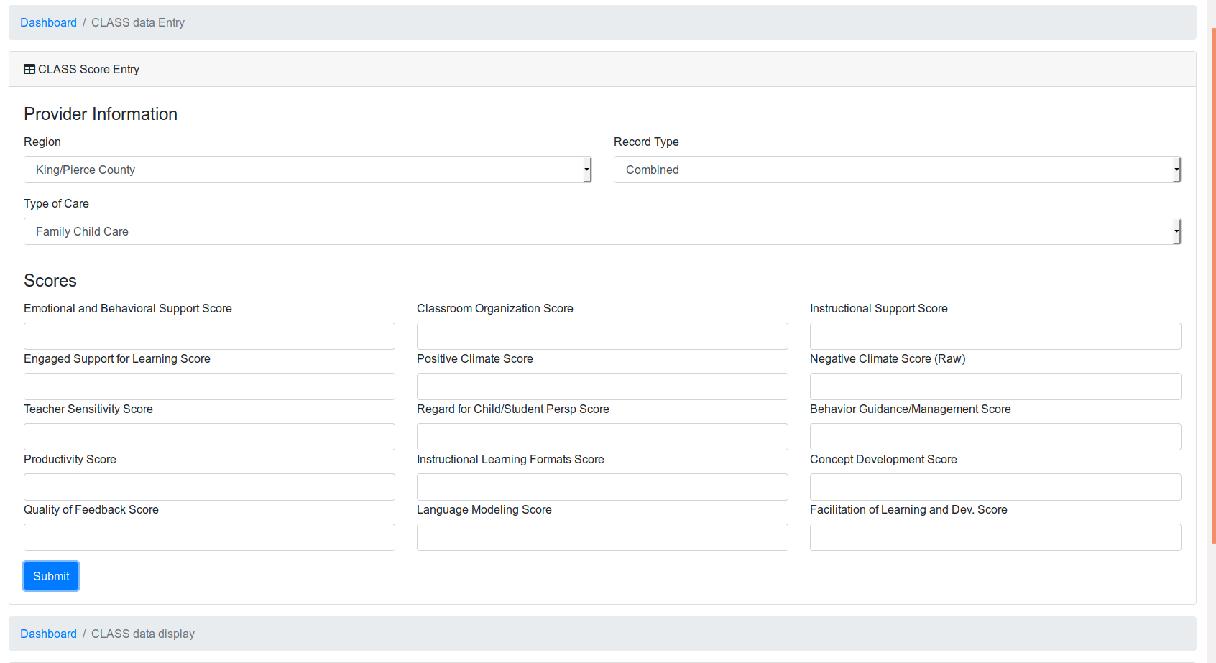

Slide 4
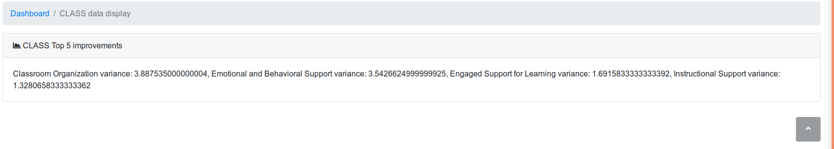
Dashboard Output

Slide 5
Data Information
Provider information
Scoring information
Notes and feedback
Notes:
Got data from child care aware washington about providers
Included id, location, type of care, record type, and the scores for each test
Dropped notes and feedback for each scoring

Slide 6
Feature
Engineering
CLASS & ERS
Assumptions
43 models
400-1000 data points
Notes:
Split up the model
Dirt data
Dropped data too near an official rating
Took earliest official rating from the CCQB
CLASS ratings go down to like 5 things because of how the columns are. They don’t seem to match up very much.
Created a model for each piece. Some of the models had as few as 400 data points
Dropped nans in target data and lost a lot of data

Slide 7

Cross Validation Process
Model
Random Forest
MSE
1 to 4
Notes:
Used random forest and tuned the parameters.
Most models got between 1 and 4 MSE
Didn’t have a lot of time to do more cross validation on the new models.

Slide 8
Results
Sample Output
Nature/science - Difference: 1.12
Blocks - Difference: 1.10
Music/movement - Difference: 1.09
Prom. acceptance of diversity - Difference: 0.87
Group Time - Difference: 0.87
Notes:
Show some results like in the demo
Talk again about what it’s showing and what it means

Slide 9

Future Aspriations:
Cleaner Data / More Data
More Model Testing
Improved Dashboard
Notes:
can’t continue using data
Would be nice to improve the dataset or have a longer discussion with the people that run the data to learn what all of it might mean
More data would help too. Some of the score sets were down to around 400 datapoints
Testing other models and parameters to see if it can be improved would be nice

Slide 10



Trevor Wolfe
Trevo1992@gmail.com
trevor-wolfe
wolfers

