Slide 1
Implementing Local Caching Strategies for Web Applications
Michael Stunes
Wolfe Styke
Frances Zhang

Slide 2
Problem
Loading data from server storage is slow
Programming local caching for web applications is a complicated, manual process
Different caching strategies required for different applications
Big models vs. small models
Many models vs. few models

Slide 3
Approach
Develop our own API to automate local caching strategies using Backbone.js
Store one key per model
Store one key per collection
Create test applications to evaluate load time performance under different conditions
from local store vs. server
Small size vs. big size models
Many models vs. few models

Slide 4
Solution: Backend
Use Backbone.js to implement local caching
Event listeners per model and collection
Employ two caching strategies
Store one key per model
Store one key per collection

Slide 5
Solution: Frontend
Built 3 client-side applications to evaluate 2 caching strategies for various sized models of different numbers:
Loading documents (e.g. Google Docs)
Large-size model
Loading emails (e.g. Gmail)
Medium-size model
Loading notes (e.g. List-it)
Small-size model

Slide 6
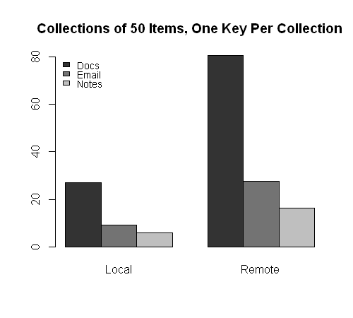
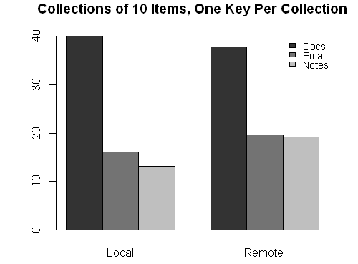
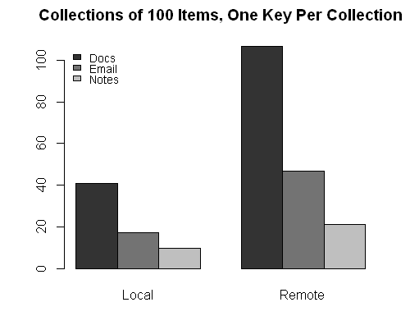
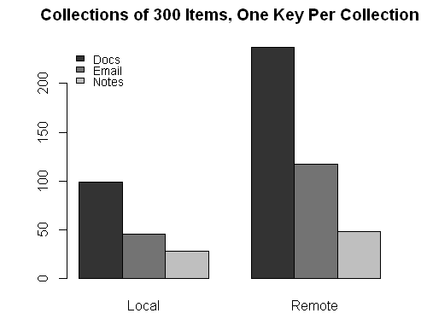
Results

Slide 7
Summary
Loading from local cache is significantly faster than loading from server (obvious)
Loading data as individual models is slow for both local and server storage
Loading from local cache most advantageous when loading models as collections of medium number (e.g. 50) of models of large size (e.g. docs application)

