Slide 1
Implementing Local Caching Strategies for Web Applications
Michael Stunes
Wolfe Styke
Frances Zhang

Slide 2
Problem
Loading data from server storage is slow
Programming local caching for web applications is a complicated, manual process
Different caching strategies required for different applications
Big models vs. small models
Many models vs. few models

Slide 3
Backbone.JS
Backbone – a widely used free & open-source MVC web application framework.
Offers Models, Collections, Views, and Events.

Slide 4
Approach
Develop our own API to automate local caching strategies using Backbone.js
Associate one key per collection
Associate one key per model in a collection
Create test applications to evaluate load time performance under different conditions
Local vs. Remote
Small vs. Large model size
Few vs. Many models

Slide 5
Solution: Augment Backbone
Backbone – a widely used free & open-source MVC web application framework.
Add local caching of collections.
Reduce load time, server load, and network costs.

Slide 6
Solution: Implementation
NodeJS: Serves dynamically generated data.
Use Backbone.js to implement local caching
Event listeners per model and collection
Employ two caching strategies
Store one key per model
Store one key per collection

Slide 7
Evaluation
Built 3 client-side applications to evaluate 2 caching strategies for models of various sizes and quantities:
Loading documents (e.g. Google Docs)
Large-size model
Loading emails (e.g. Gmail)
Medium-size model
Loading notes (e.g. List-it)
Small-size model

Slide 8
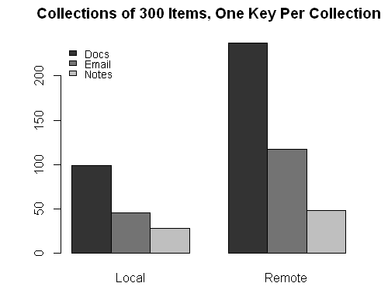
Results

Slide 9
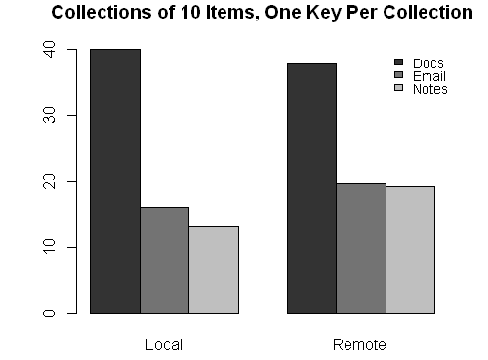
Results

Slide 10
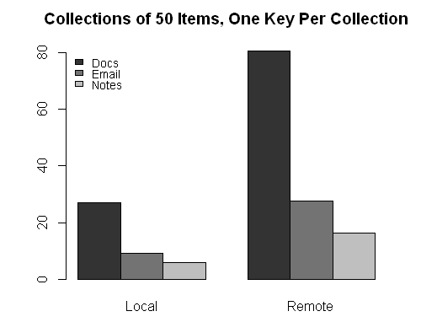
Results

Slide 11
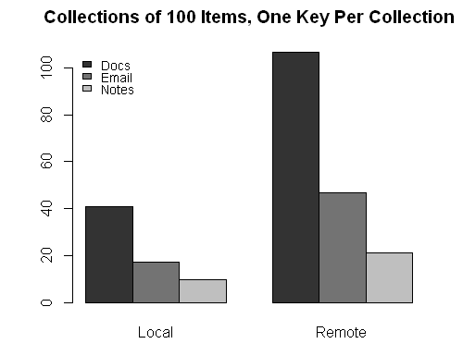
Results

Slide 12
Summary
Local cache is faster than server load time.
Loading local models individually increases time to load all models. Can seem faster if a few models fill page.
Local cache optimal when remote load time > 100ms (perceivable lag).
For 300+ items:
emails (1 paragraph)
documents (5 paragraphs)

