Slide 1
Automating Local Caching for Web Applications
Michael Stunes
Wolfe Styke
Frances Zhang

Slide 2
Problem
Loading data from server storage is slow
Programming local caching for web applications is a complicated, manual process
Different caching strategies required for different applications
Big models vs. small models
Few models vs. many models

Slide 3
Previous Work

Slide 4
Approach
Develop our own API to automate local caching strategies using Backbone.js
Store one key per model
Store one key per collection
Create three test applications to test load time performance
from local store vs. server
Small size vs. big size models
Many models vs. few models

Slide 5
Solution: Backend
Use Backbone.js to implement local caching
Event listeners per model and collection
Employ two caching strategies
Store one key per model
Store one key per collection

Slide 6
Solution: Frontend
Built 3 client-side applications to test optimal caching strategy for various size models:
Loading documents (e.g. Google Docs)
Large-size model
Loading emails (e.g. Gmail)
Medium-size model
Loading notes (e.g. List-it)
Small-size model

Slide 7
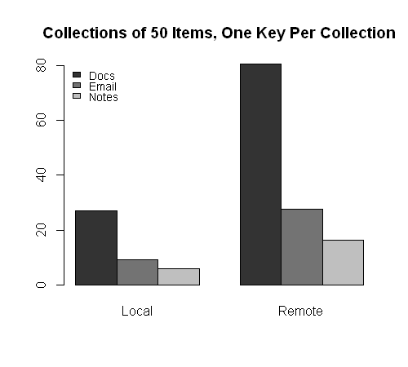
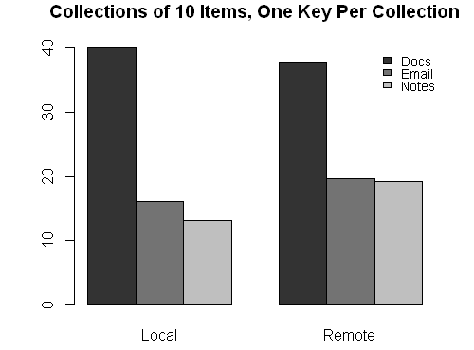
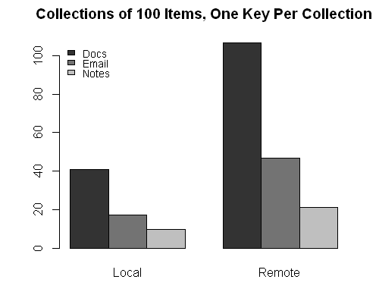
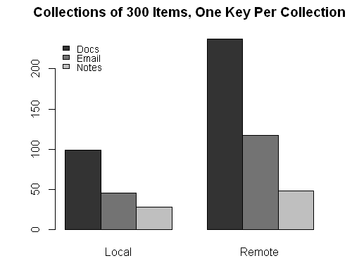
Results

Slide 8
Summary
Loading from local cache is significantly faster than loading from server (obvious)
Loading from local cache most advantageous when loading models as collections from local cache for applications with many models of small size (e.g. notes application)

