Slide 1


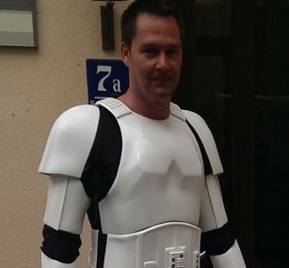
Files in CodeCommit
Wolfgang Unger
AWS Solutions Architect | Instructor

