Slide 1


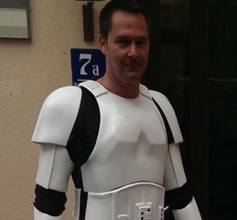
Triggers and webhooks
Wolfgang Unger
AWS Solutions Architect | Instructor

