Slide 1

Status Report:
D-Cinema Technology Committee
(DC 28)
ITEA Seminars
Los Angeles
January 2001

Slide 2
Why Standards?
Need to Ensure
  Interoperability
  Compatibility
  Performance
  Extensibility
Desired by Many, Demanded by
  Content Owners
  Exhibitors

Slide 3
Why SMPTE?
Neutral Cross-Industry Technical Forum
Established Track Record
SMPTE provides a host function, to help the industry figure out D-Cinema
The SMPTE end product will be standards, but the early assessment phase is broader

Slide 4
DC 28 Technology Committee
Due Process Committee
  Can Write Standards, But Has Not Yet Done So
  Has Fairly Strict Guidelines & Procedures
Management
  Curt Behlmer - Chair
  Bob Rast – Vice Chair
  Mark Hyman – Secretary

Slide 5
Committee Scope
DC 28 includes
  Mastering
  Distribution (transport)
  Exhibition
DC 28 does not include
  Capture
  Production

Slide 6
DC 28 Mission Statement
Provide Industry Technical Forum for D-Cinema
Identify Key Systems & Technology Issues
Develop a Recommended Approach to Standards
Identify, Establish and Coordinate Necessary Groups to Achieve Overall Objectives
(Future) Write the SMPTE Standards

Slide 7
Study Groups
Considering that
  SMPTE is a host for the industry
  The initial need is broader than just SMPTE standards
We created study groups initially
  Not due process working groups
  Broader charter, but don’t write standards
  Can evolve to working groups, write standards

Slide 8
D-Cinema System
Theater System
Studio / Distributor
Compression
Decompression
Encryption
Transport
Storage
Decryption
Mastering
Decryption?
Projection
&
Audio
Encryption/
Image
Audio
Metadata

Slide 9
Study Groups at January 2001
28.1 Steering/Systems Curt Behlmer
28.2 Mastering Jerry Pierce
28.3 Compression Matt Cowan
28.4 Conditional Access Harrison/McMannis
28.5 Transport Storozum/Garsha
28.6 Audio Gary Margolis
28.7 Theater Systems John Wolski
28.8 Projection Al Barton

Slide 10
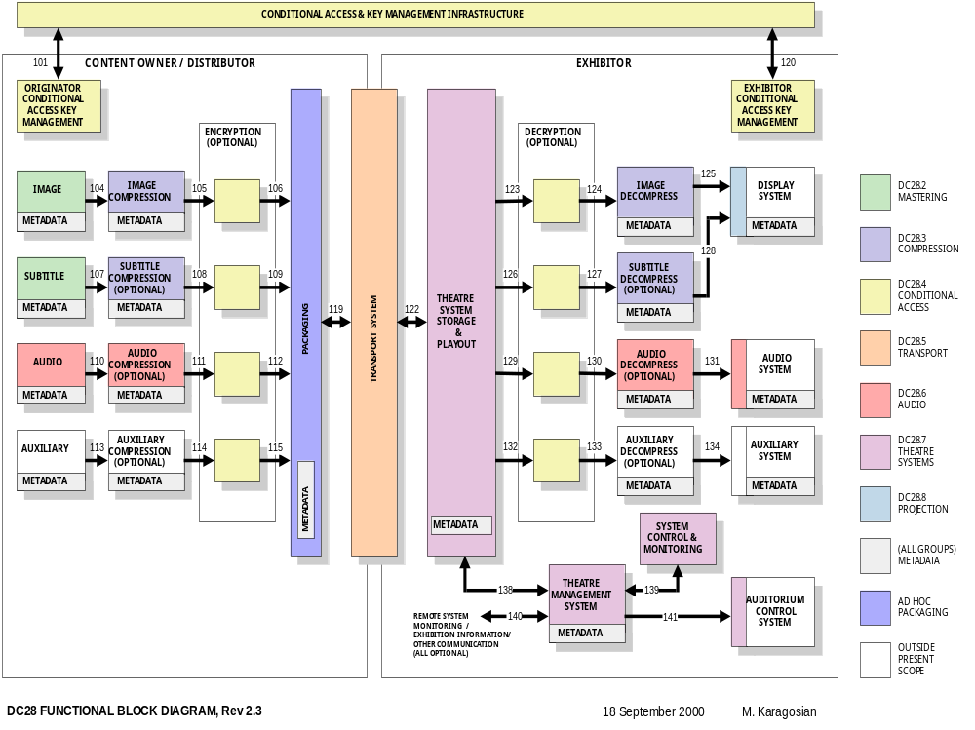

Slide 11
Ad Hoc Groups
Two formed to date
Colorimetry Fred Van Roessel
  Previously Worked with P3
  Mastering & Projection Coordination
Packaging Chuck Garsha
  Recently formed
  Affects a number of groups
  Likely to become a study or working group

Slide 12
Liaison with Industry Organizations
Representation
  NATO
  MPAA
  ITEA
  USC / ETC
  ICIA
  AES
  MPEG
Outreach
  ASC
  Cinematographer’s Guild
  DGA
  AMPAS
  International

Slide 13
Status Report
Three Meetings of Technology Committee to Date
12 Months of Work
Study Groups Continuing to Meet Monthly
Significant Effort
  Over 250 people, 100 Companies
Outreach Effort Continues

Slide 14
Interim Report
Each Study Group Now Completing Interim Reports
  Key Issues, Considerations and Recommendations
To be integrated into a DC 28 interim report
  Overview, System Assessment & Glossary
  Available now on-line
Currently an internal management document
  Expect holes and substantial variability
Expect to publish summary in February 2001 SMPTE Journal

Slide 15
Outlook
DC 28 is Necessary, But Not Sufficient
Working Groups in Near Future
Beyond SMPTE
  Market Trials
  Performance Testing (e.g., USC / ETC)
DC 28 to Document Conclusions

Slide 16
How Do You Get Involved ?
Statement of Participation
  http://www.smpte.org/engr/sop.html
  (Reference DC28)
Email Reflector
  http://smpte.vwh.net/cgi-bin/majordomo
FTP Site
  ftp://smpte.vwh.net
Notes:
Individuals not companies
Press
Identify for secretary

Slide 17
Resources
Meeting Calendar
  ftp://smpte.vwh.net/pub/dc28/DC28.0-Technology_Committee/Meeting_Calendar
Interim Reports (early November)
  ftp://smpte.vwh.net/pub/dc28/DC28.0-Technology_Committee/Interim_Report
Notes:
Individuals not companies
Press
Identify for secretary

Slide 18
D-Cinema Technology Committee
(DC 28)

Slide 19
Study Group Reports
Mastering (DC28.2)
  Jerry Pierce & Howard Lukk
Compression (DC28.3)
  Matt Cowan
Conditional Access / Encryption (DC28.4)
  Chuck Harrison, Bill McMannis & Michael Karagosian
Theater Systems (DC28.7)
  John Wolski & Michael Karagosian

Slide 20
Study Group Reports
Transport / Delivery Systems (DC28.5)
  Dick Stumpf & Chuck Garsha
Audio (DC28.6)
  Tom Scott & Garry Margolis
Projection (DC28.8)
  Al Barton

Slide 21
SMPTE DC28.2
Mastering Committee

Slide 22
Digital Cinema is Five Areas
Digital
Capture
Digital Cinema
Digital
Production
Big “Avid”
Digital
Master
Cinema, Home
Video, Trailers,
Test Screenings
Distribution
Satellite, Fiber,
Packaged
Exhibition
Digital Projector
Security

Slide 23
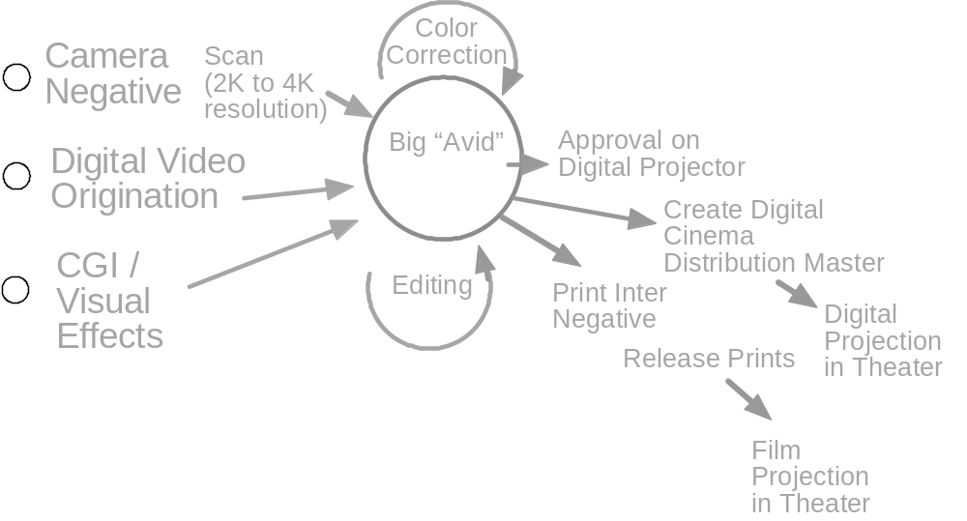
Digital Cinema Flow

Slide 24
Mastering Committee
First step in conversion to D-Cinema Presentation
Will impact future way we make a movie (digital version at same time as film version)
Evolutionary design of flow
Goal is to set the standards for delivery to theater without interfering with the creative way we make a movie

Slide 25
Goals of Mastering
Digital presentation should do no harm. All versions of D-Cinema should be equivalent or better experience to projected film
The standard should have functionality of film (plays anywhere in the world)
Should not be limited to 35mm film temporal restrictions (24fps) but able to convey other experiences, if desired
A better and more consistent experience for the consumer
More tools for the filmmaker in making stories

Slide 26
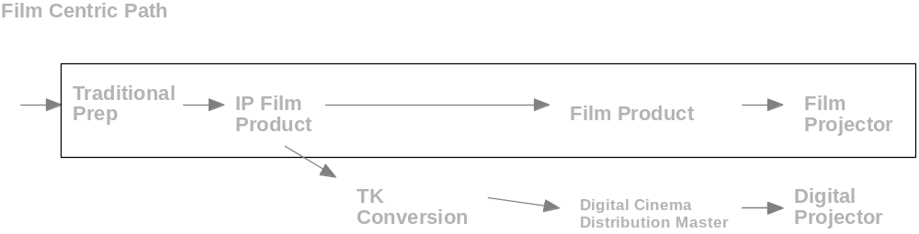
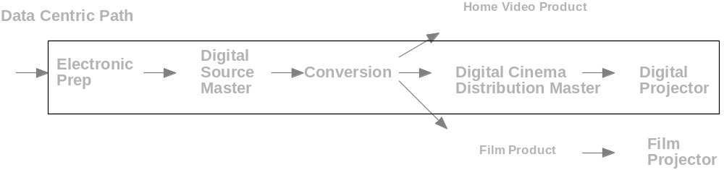
Mastering Flows

Slide 27
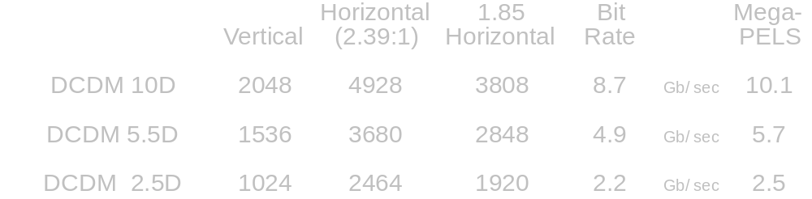
The (Tentative) Answer
DCDM Distribution Master (not the editing master)
Square PELS 10 bit log color, New color primaries, white point 5500, 4:4:4, Frame rates 24P, 48P, (60P), (72P), Fixed vertical variable width

Slide 28
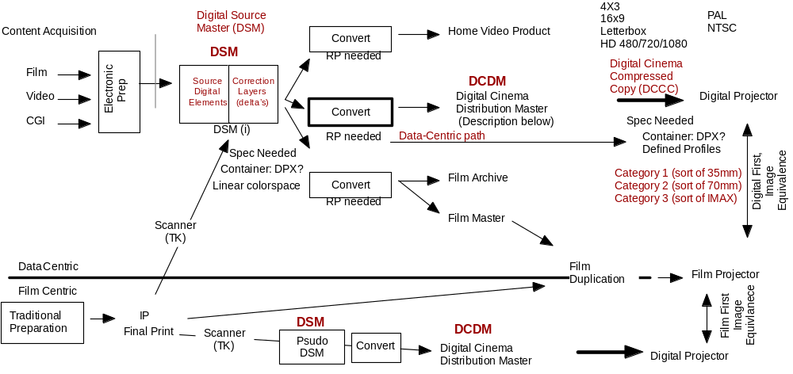
FUTURE MASTERING AND DISTRIBUTION FLOWS

Slide 29
DC28.3 Compression
Study Group
Matt Cowan, Chairman

Slide 30
Objectives
To define image compression requirements
To determine how to specify requirements
To identify standards and recommended practices
To examine how to test image compression quality

Slide 31
Process
Meet approx. monthly
About 100 participants
  core group of 20
Prepared report summarizing study group activities
Preparing to enter Working Group phase

Slide 32
Compression Requirements
Visually Lossless
Forward - Backward compatible
Economic
Open standard
High efficiency
Compatible with other system elements
  encryption, watermarking,

Slide 33
Achieved:
Requirements
General test issues
Needed Standards and RP’s identified
To be Completed:
Comprehensive testing program

Slide 34
Difficulties in Study Group
Compression is I/P intensive
  Current players have large investments in I/P
  Unwillingness to share I/P in working group phase
Unable to penetrate the “heart” of compression issues

Slide 35
Recommendations
Finish test program under study group
Enter working group for writing compression standard
  Gives ability to call for technology proposals

Slide 36
SMPTE STUDY GROUP DC28.4
CONDITIONAL ACCESS & ENCRYPTION
Chuck Harrison <chuck_harrison@iname.com> Co-Chair
Bill McMannis <bmcmannis@gqti.com> Co-Chair
Phil Lelyveld <phil.lelyveld@disney.com> Secretary
Contact co-chair to participate
Monthly meetings at AMPTP
Biweekly conference call
DC28.4 E-mail reflector

Slide 37
INTRODUCTION & SCOPE
Title: - DC28.4 Study Group on Conditional Access
& Encryption
Reality: - Content Protection (encryption/decryption)
- Conditional Access
- Key Management
- Watermarking & Fingerprinting
- Audit Trail
- And a bit more

Slide 38
OUR INPUTS
Studios – individually and through MPAA
Theatre Owners
Distribution
Equipment manufacturers
Security experts

Slide 39
REQUIREMENTS EXPRESSED TO US
Content Owners
End-to-end security
Renewability, upgradeability
Traceability for anti-piracy enforcement
Precise control of authorized use (per rental agreements)
Worldwide compatibility
Single inventory
Exhibitors
Reliability & Maintainability
Ease of use
Flexibility in scheduling
Multivendor interoperability
Field reconfigurability
Everyone
Affordable
Early rollout

Slide 40
SECURITY “BAG OF TRICKS”
Encryption algorithms for content
  AES (Rijndael), 3DES, others
Authentication techniques
  for people, communications, and equipment
  may use public key certificates
Key management
  Exchange or generate keys, secure from eavesdroppers
Systems may be on-line or off-line
  online: private networks, modem, internet
  offline: smartcards, crypto tokens, disks, etc.

Slide 41
SOME WORK ITEMS
Audit system for usage tracking
  ensures every showing is logged
  completely separate from boxoffice systems
Standard way to specify “authorized use” conditions
Watermarking (forensic)
  trace distribution path and time/place of piracy
  DCinema performance goals are very demanding
Security within the theatre
  must defend against possible “hackers” in booth
  no exposed plaintext
  tamper response: equipment “self defense”
  maintainability without introducing security holes

Slide 42
DC28.4 SUMMARY
It can be done, but needs careful execution.
  - Full-performance watermarking may be delayed.
We have developed a fairly complete set of requirements.
  - Refinements will continue.
Some proven cryptographic tools are available.
We need additional input from Digital Cinema equipment designers and security experts in order to continue.
Working Group should convene early 2001. We want participation from all sectors of the business.

Slide 43
STUDY GROUP DC28.4
CONDITIONAL ACCESS
This Presentation Can Be Found In The
Conditional Access/Presentations Folder
ftp://smpte.vwh.net/pub/dc28/

Slide 44
DC28.5 Study Group
On
Transport & Delivery Systems
Richard Stumpf

Slide 45
DC28.5 Study Group
On
Transport & Delivery Systems
Purpose:
  Receive content files from Compression/Encryption processes
  Provide for a variety of transport mechanisms
    Physical Media
    Satellite
    Terrestrial Networks
  Provide common interfaces at input and output transport link

Slide 46
DC28.5 Study Group
On
Transport & Delivery Systems
  Group held 10 monthly meetings since January 2000
  Total membership – 77
  Co Chairs – Chuck Garsha, Dick Stumpf
  Secretary – Ira Lichtman

Slide 47
DC28.5 Study Group
On
Transport & Delivery Systems
  Study Group Investigated:
  Current practice in film and digital cinema distribution
  Suitable digital transport methods, physical media, terrestrial & satellite
  Transport link input and output gateway coordination
  Ways to provide common interface at input and output of transport link

Slide 48
DC28.5 Study Group
On
Transport & Delivery Systems
  Key Findings
  Digital cinema demands on transport are unique in terms of
      Payload capacity
      Multicast requirement
      Time sensitivity
      Transparency/robustness
  Adhere to OSI Model to meet industry demands for openness & interoperability
  Provide for management of conditional access, transport configuration & management data

Slide 49
DC28.5 Study Group
On
Transport & Delivery Systems
  Key Findings
  A conversion facility or “Gateway” is recommended at input and output of the transport link
    Conform content, ancillary & supervisory data to range of transports links
    Perform transcoding and multiplexing to conform to needs of various types of links

Slide 50
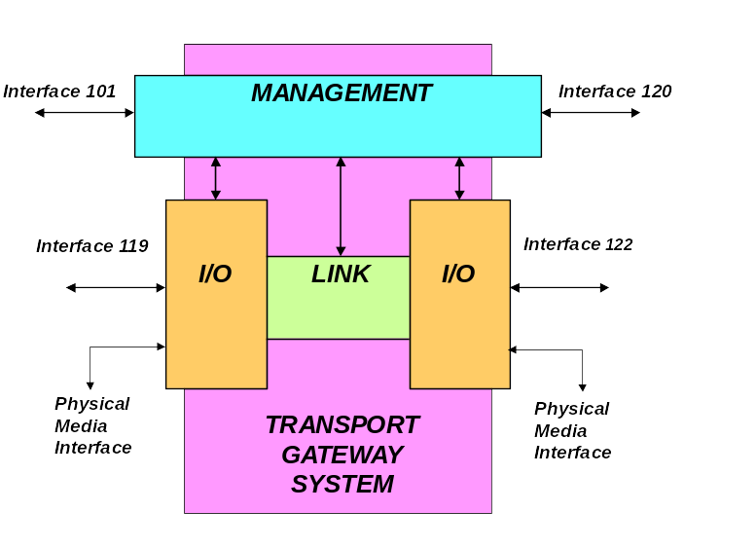
DC28.5 Study Group
On
Transport & Delivery Systems

Slide 51
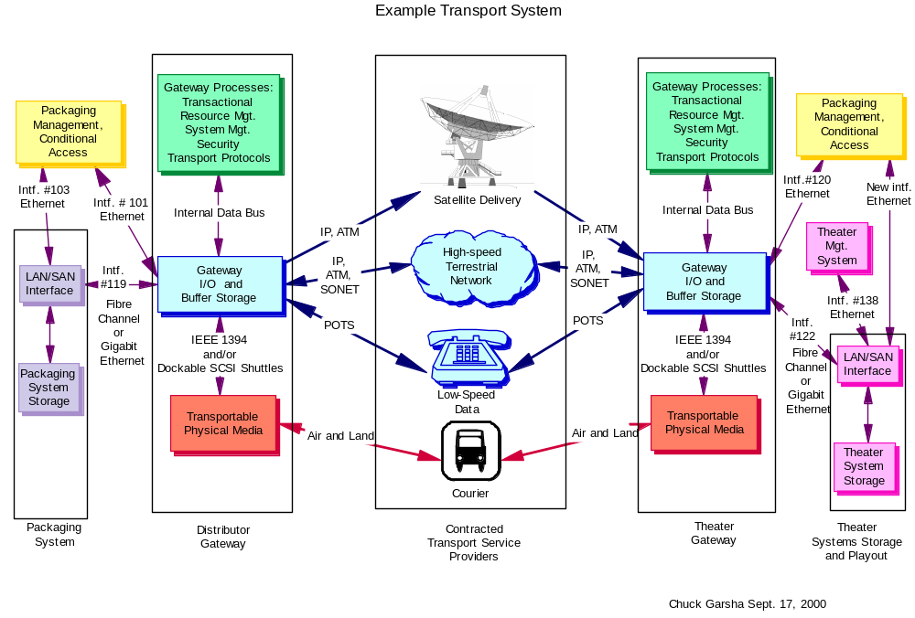

Slide 52
DC28.5 Study Group
On
Transport & Delivery Systems
  Key Findings
  The need was defined for a Packaging Working Group to:
    Recommend a unified approach to organizing and cross-referencing the various types on content, ancillary and management data
    Make recommendations on structure of wrapper or container for DC distribution
    Form Working Group to standardize interfaces between Digital Cinema Packaging, Transport & Theater Systems

Slide 53

Digital-Cinema Transport
SMPTE Study Group (DC28.6) Audio
Interim Report
Tom Scott, ednet, inc.
Notes:
1

Slide 54
Digital Cinema Background:
Transition from Analog to Digital well under way in 2000
Digital Sound already in theatres
Notes:
8

Slide 55
D-Cinema System Audio Assumptions
File Based System
Transport methodology is immaterial
Local storage in theatres
Audio and image are separate files
Live event streaming is not central to Digital Cinema
Legacy material must be accommodated
Notes:
7

Slide 56
Digital Sound on Film
As linear as film
Analog backup on the film
Several different formats have evolved
Copies must be individually produced, transported, warehoused, recycled...
Notes:
7

Slide 57
Digital Cinema Sound
A file or collection of files
Synchronized to Image by Theatre System
Spliceable to make up show
Able to carry additional tracks
  Commentary, Hearing Impaired
Notes:
7

Slide 58
DCDM Audio
Twelve channel capacity
24 bits at 48 kHz sampling
Mappable to individual theatre speaker setup
Notes:
7

Slide 59
Compression in
Current Systems
Required in current systems because of film resolution and playback technology
Does not improve quality
Considered by most a burdensome complexity
Notes:
7

Slide 60
Compression in
Digital Cinema
Do we still need compression?
May be required during transition years
ITUR 5 transparency must be achieved
Notes:
7

Slide 61
Encryption and Watermarking
Required to protect intellectual property
ITUR 5 rating must be observed
Notes:
7

Slide 62
Theatre Playback
Twelve channel capacity
5.1 channel minimum delivery to speakers
Channel to speaker routing via metadata
Notes:
7

Slide 63
New Capabilities for Digital Cinema Sound
Multiple versions (languages and ratings) as allowed by content owner
Additional “tracks” for Hearing Impaired
Commentary for Visually Impaired
Notes:
7

Slide 64
Recommendations for
Working Groups
DCDM Master Standards
Digital Cinema Audio Quality Issues
Digital Cinema Audio Systems Issues
Digital Cinema Packaging Issues
Notes:
7

Slide 65
SMPTE DIGITAL CINEMA
DC28.7 THEATRE SYSTEMS
STUDY GROUP
John Wolski Chairman
Michael Karagosian Vice-Chairman
Kevin Wines Secretary

Slide 66
INTRODUCTION & SCOPE
Scope: Operational Issues
Maintenance Issues
Interoperability / Scalability /
Extensibility
Meet: Typically Once Monthly
20 - 30 Attendees

Slide 67
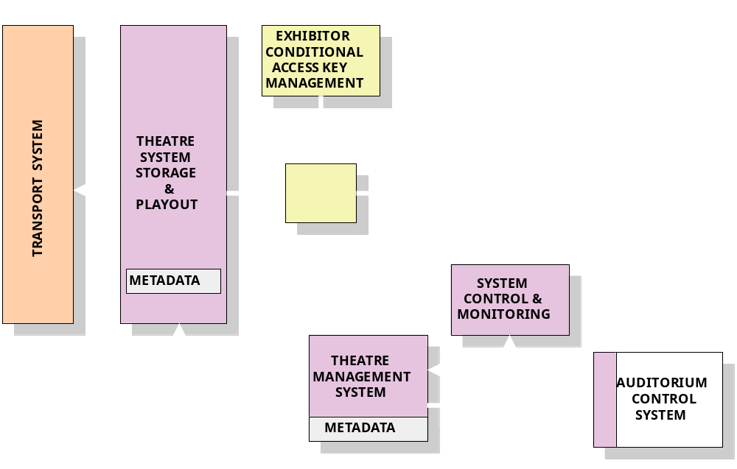
BLOCK DIAGRAM

Slide 68
SYSTEM ELEMENTS
Storage / Playback
  Transport Communication
  Interface to Physical Media
  File Storage
  Playback (Streaming Data)

Slide 69
SYSTEM ELEMENTS
Theatre Management System
  Operator Identification
  Assembly of Shows
  Automation Console
  Control & Monitoring Console

Slide 70
SYSTEM ELEMENTS
Control & Monitoring
  Status & Fault Monitoring
  Component and Automation Controls
  Remote Monitoring
  Confidence Monitoring
  Metadata

Slide 71
KEY FINDINGS
Standard Networks and Busses
  Interoperability / Scalability / Extensibility
  Support for both IP and Streaming Data (examples:)
    IEEE 1394a/b
    FibreChannel

Slide 72
KEY FINDINGS
Standard Protocols
  SNMP for control and monitoring
Use OSI when describing transports
  “EIA 232” is not good enough

Slide 73
KEY FINDINGS
Standard method for assembling shows
  Metadata flags can point to splice points and automation events

Slide 74
MOVING FORWARD
Recommend 4 New Working Groups:
  Application Protocols Working Group
  Data Transport Working Group
  DC Metadata Working Group
  Data Packaging Working Group

Slide 75
MOVING FORWARD
Continue Theatre Systems Study Group
  Interface to the Exhibition Community

Slide 76
SMPTE DIGITAL CINEMA
DC28.7 THEATRE SYSTEMS
STUDY GROUP
This Presentation Can Be Found In The
Theatre Systems/Documents Folder
ftp://smpte.vwh.net/pub/dc28/

Slide 77
DC28.8
Digital Cinema Projection S G
Chair: Al Barton
Vice-Chair: Dave Lund
Secretary: Dave Schnuelle
ftp://smpte.vwh.net/pub/dc28/DC28.8-projection
dc28-projection-list@smpte.vwh.net

Slide 78
DC28.8
Digital Cinema Projection S G
SG meets once a month*
SG has been meeting since January 2000
SG attendance averages 20~30 people
SG members include: exhibition, manufacturers, studios, etc.
*except October

Slide 79
DC28.8
Digital Cinema Projection S G
Two main discussion areas:
  Projection Systems
    Interfaces
    Security
    Minimum specifications
  Projected Image
    Minimum specifications

Slide 80
DC28.8
Digital Cinema Projection S G
Projection System Interfaces
  There must be a common interface for the DCDM
    Must also support direct interface with mastering for QC and QA
  The implementation of this interface must not preclude interfaces for Live Events, Computer Presentations, Video Conferencing, PPV, etc.

Slide 81
DC28.8
Digital Cinema Projection S G
Projection System Security
  Must be “tamper proof”
  Must allow for maintenance
  Must allow for fingerprinting
  Must allow for CA deployment
  Might need to allow for decode an decryption processing inside the console

Slide 82
DC28.8
Digital Cinema Projection S G
Projection System Minimum Specifications
  Must have 2K x 1K or greater imager
  Must handle 24Hz frame rate
  Must map to colorimetry used for mastering
  Must reproduce image with no visible degradation if scaling is used

Slide 83
DC28.8
Digital Cinema Projection S G
Projected Image Minimum Specifications
  Minimum of 12ftL on screen
  Minimum geometric distortion
  Minimum viewing distance
  Maximum uniformity deviation
    Brightness
    Color
  Minimum contrast ratio

Slide 84
DC28.8
Digital Cinema Projection S G
Items still under discussion:
  White Point - D55 vs. D65
  Test and measurement methods
  How to handle subtitles

Slide 85
DC28.8
Digital Cinema Projection S G
SG is now ready to move to a WG
  Write standards for DC projection
  Write recommended practices for implementation of today’s technologies
Need input from ALL aspects of the industry

