Slide 1


CITY HUB
by ~
Hari charan:01FB16ECS128
Jaswanth:01FB16ECS145
Hemanth M:01FB16ECS133
Lakshmitha:01FB16ECS177
WEB TECHNOLOGY PROJECT

Slide 2
TECHNOLOGIES USED
PERIODIC REFRESH :
It is a design pattern
Describes the process of checking for new server information in specific intervals
This approach is also called polling
Used to increase user experience
Notify users of updated information

Slide 3
Predictive fetch
logic We used predictive fetch to to showcase the latest announcements on the webpage.
It relies on a POST rather than GET, are fetching JSON data and using client side templates to display it, and have many pages of results so don’t preload them all; they employ some logic to maximise the benefit whilst avoiding being over-eager in pre-fetching and caching.

Slide 4
MACHINE LEARNING COMPONENT
AJAX FRAMEWORK
combination of a browser built-in XMLHttpRequest object (to request data from a web server) JavaScript and HTML DOM (to display or use the data)
AJAX allows web pages to be updated asynchronously by exchanging data with a web server behind the scenes. This means that it is possible to update parts of a web page, without reloading the whole page.

Slide 5
ARTIFICIAL COMPONENT
We built a AI system that used API calls to fetch results from New York times and wikipedia regarding the search query and display the same on the webpage.

Slide 6
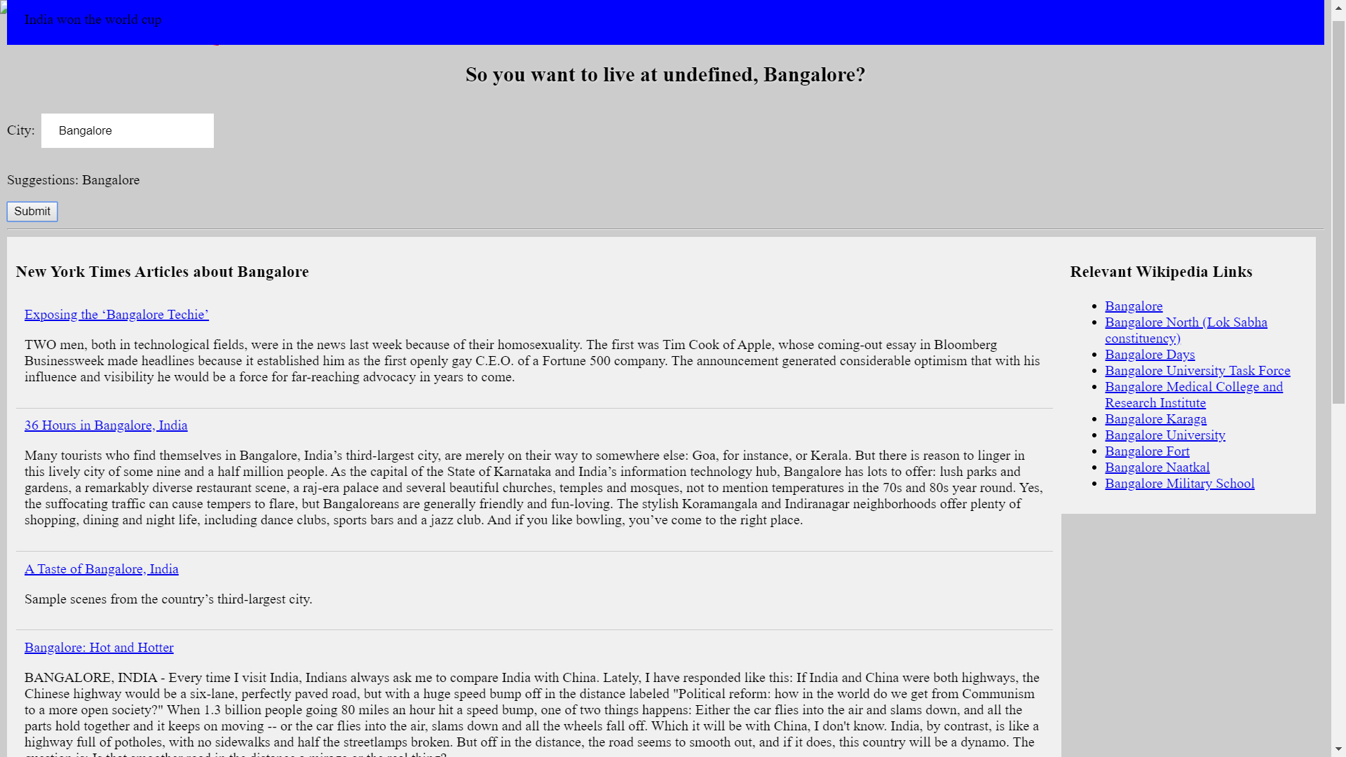

Slide 7
THANK YOU

