Slide 1
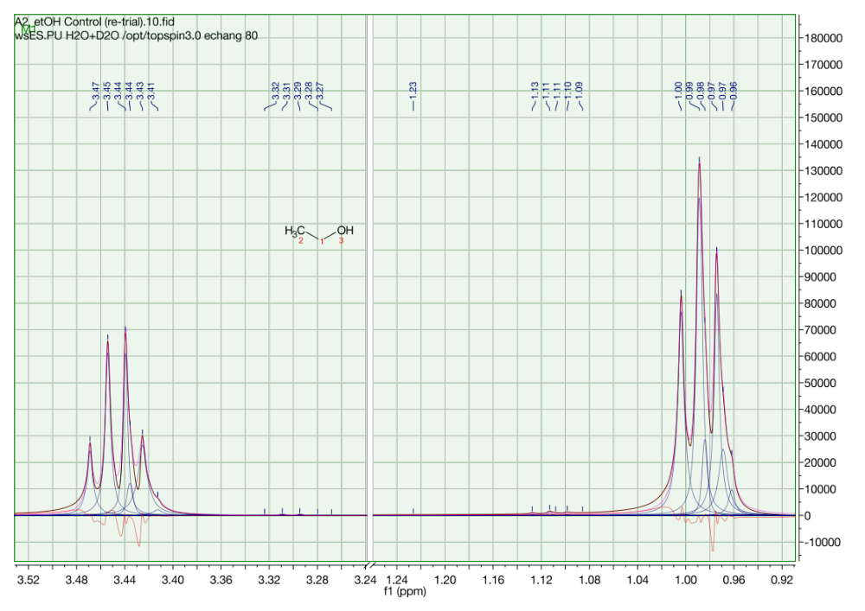
¹H NMR (D₂O, 500 MHz)
(1)
(1)
(1)

