Slide 1
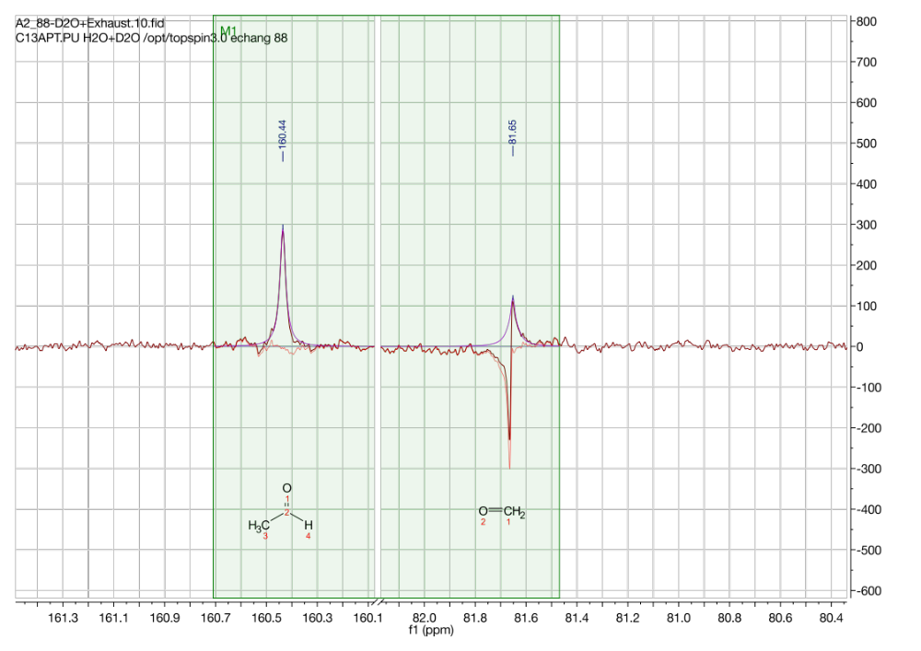
¹³C NMR (D₂O, 500 MHz)
(2)
(1)
(2)
(1)

