Slide 1

SRM INSTITUTE OF SCIENCE AND TECHNOLOGY Ramapuram, Chennai – 600 089 DEPARTMENT OF COMPUTER SCIENCE AND ENGINEERING
21CSC203P - Advanced Programming Practice
CHAOTIC IMAGE ENCRYPTION TECHNIQUES
Batch Number : I-15
Team Members | Supervisor
P KIRAN :RA2311003020532 S SUJAN :RA2311003020537 S MUNI AJEY :RA2311003020541 | Mr. Madhu A, Assistant Professor

Slide 2
Problem Statement
With the increasing importance of data privacy and security, it has become essential to protect sensitive data, including multimedia content like images. In this project, you are required to develop an Image Encryption system using Java.

Slide 3
Objective
The main Objective was to provide a Image encryption mechanism which provides high security level, less computational time and power in reliable and efficient way to deal with balky, difficult and intractable data.

Slide 4
Introduction
The conventional cryptographic algorithms are mainly based on discrete mathematics.
chaos-based cryptography is relied on the complex dynamics of nonlinear systems .
The image encryption algorithm includes two steps:
Firstly, the image fusion is completed between the original-image and the key-image.
Then the pixel values of the fusion image are encrypted by Henon chaotic system.

Slide 5
Proposed Solution
Proposed system provides a solution to existing system by extending its facilities. The proposed study aims to explore the possibility of using chaotic or chaos-based encryption techniques to protect remote sensing satellite images and provides high level of security in efficient and reliable way.
Chaos based cryptographic scheme provides high security level, less computational time and power in reliable and efficient way to deal with balky, difficult and intractable data that why many researchers recommends that it is more suitable for multimedia data, especially for images. Chaos-based system have many properties to achieve high security level, such as sensitivity to change initial conditions and parameters, periodicity (a system that tends in probability to a limiting form that is independent of the initial conditions), random behavior and unstable periodic orbits with long periods. It has very high diffusion and confusion properties that are desirable for cryptosystem.

Slide 6
Modules
Administrative
Encryption Module
Decryption Module
File Transfer Module

Slide 7
Module Descriptions
Administrative
Maintains the user accountability
Controls the user activities
Encryption Module
Selects the image
Providing key for Encryption
Decryption Module
Enter the key for Decryption
File Transfer Module
Which transfer file in Networking

Slide 8
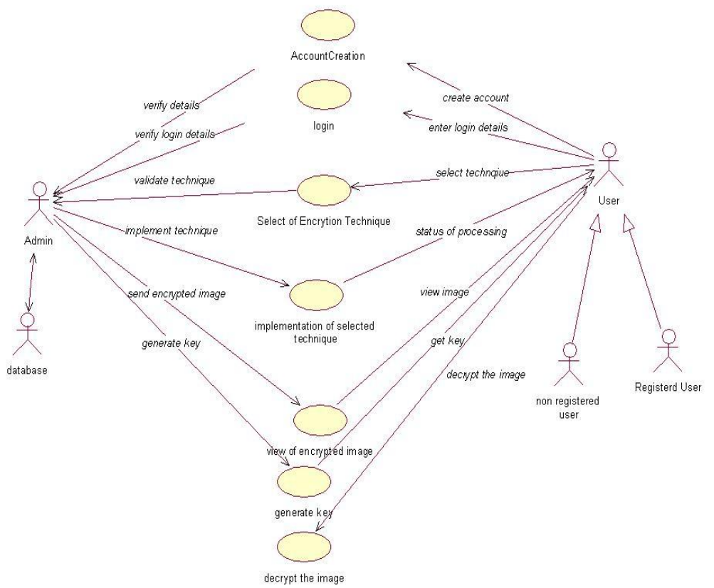
Use-Case Diagram

Slide 9
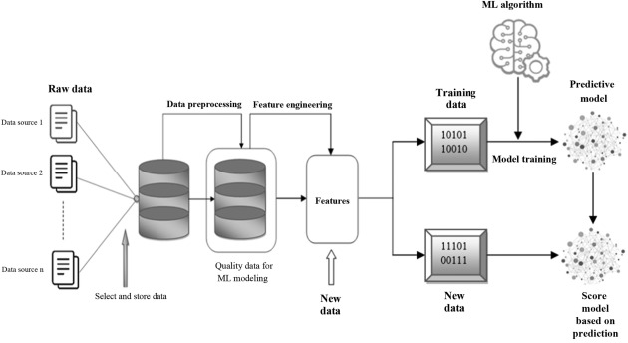
System Architecture

Slide 10
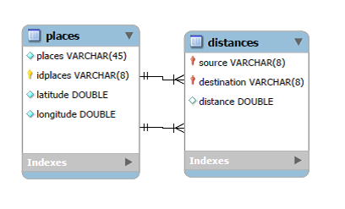
Entity Relationship Diagram

Slide 11
Technology Stack
Category | Technologies
Programming Languages | Java
Interface | Java Swing
Database | MySQL
Database Connectivity | JDBC
IDE | Java: Eclipse IDE

Slide 12
Implementation: User Interface
Name of the file | Usage
ClientGUI.java | Usage of the file “ClientGUI”, is to serve as a graphical user interface (GUI) application for encrypting image files and optionally sending them over a network.
ImageDecryptor.java | Usage of the file “ImageDecryptor”, is to serve as a graphical user interface (GUI) application that enables users to decrypt encrypted image files.

Slide 13
Implementation: Server Side
Name of the package | Usage
java.io | Used for file handling and data input/output
java.net | Used for network communication through sockets.
Package: com.srm.util
Class | Methods | Description
java.io | void close() | This package provides classes for input and output through data streams, serialization, and the file system.

Slide 14

Results
Fig: User Interface of Image Encryption

Slide 15
Conclusion
Advances in space science, data analysis, and communication technologies present new opportunities for users to increase productivity, reduce cost, facilitate innovation, and create virtual collaborative environments for addressing new challenges. In such processes data sharing is usually based on CD/DVD-ROM hardcopy or shared network environment (Internet, LAN, WAN, etc), so there exists an inherent security risk of unauthorized access or use of the product. To fulfill such security and privacy needs in various applications, encryption of such data is essential to minimize malicious attacks from unauthorized parties and to safeguard sensitive data. From the study of the above traditional and chaos-based image encryption techniques; it is quite clear that conventional image encryption techniques DES, Triple-DES, and IDEA have some limitations such as these algorithms have high-security levels under CBC mode but require large data size, and long computational time and high computing power. On the other hand chaos-based cryptographic scheme provides a high-security level, less computational time, and energy reliably and efficiently to deal with balky, difficult, and intractable data that is why many researchers recommend that it is more suitable for multimedia data, especially for images. Chaos-based systems have many properties to achieve high-security levels, such as sensitivity to change initial conditions and parameters, ergodicity (a system that tends in probability to a limiting form that is independent of the initial conditions), random behavior, and unstable periodic orbits with long periods. It has very high diffusion and confusion properties that are desirable for cryptosystems.

Slide 16
References
Yen J. C. and Guo J. I., “A new chaotic image encryp-tion algorithm,” Proceeding of National Symposium on Telecommunications, pp. 358-362, December 1998.
Jui-Cheng Yen and J. I. Guo, “A New Chaotic Mirror-Like Image Encryption Algorithm and its VLSI Archi-tecture”, Pattern Recognition and Image Analysis, vol.10, no.2, pp.236-247, 2000.
Jui-Cheng Yen and J. I. Guo, “Efficient Hierarchical Chaotic Image Encryption Algorithm and Its VLSI Re-alization”. IEEE Proceeding Vis. Image Signal Process, vol. 147, no. 2, pp. 167-175,2000

