Slide 1
rdfs:label
Rdf:type mo:MusicArtist
DBTune
(musicbrainz mapping)
owl:sameAs
musicbrainz-Dump
(als Fallback)
musicbrainzID
DBpedia
echoNest
(API)
Songkick
Spotify

Slide 2
rdfs:label &
dbpedia-owl: MusicArtist /
dbpedia-owl: Band /
dbpedia-owl: Artist /
rdfs:label
Rdf:type mo:MusicArtist
For: current & former members
dbpedia-owl: currentMember
dbpedia-owl: formerMember
dbpedia-owl: producer
dbpedia-owl: writer
dbpedia-owl:composer
// often also with other onotolgies
owl:sameAs
DBTune
(musicbrainz mapping)
DBpedia
musicbrainzID
// Each relation is ranked
musicbrainzID
echoNest
(API)
Recommendation
musicbrainz-Dump
(als Fallback)
Familiarity
Dbpedia-owl:wikiPageRank
Spotify
Songkick
(Konzerte)
Dbpedia-Pageranks

Slide 3
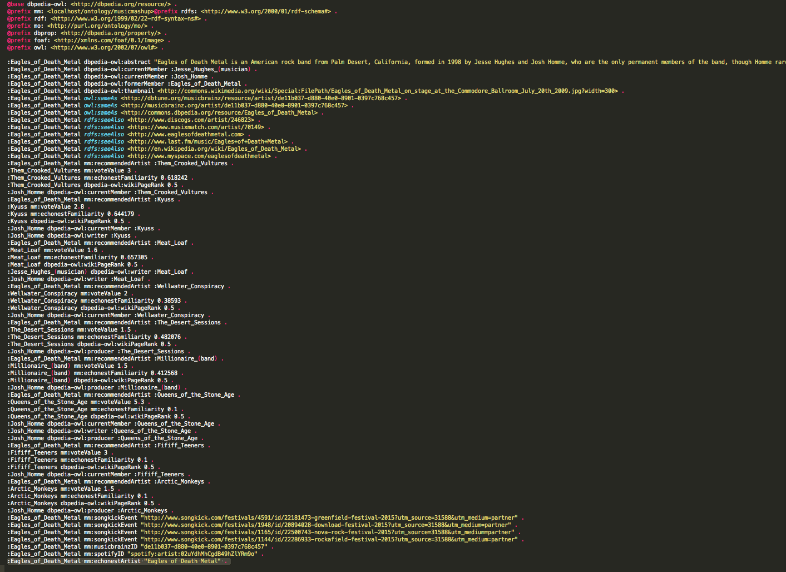
Turtle-File für jeden gesuchten Artist
Wenn bereits vorhanden → Laden aus lokalem Cache
Eigene MusicMashup- Ontology
Lokaler Cache

