Slide 1
Python for the Lab
Day 1

Slide 2
This Workshop
Quickly learn about Python
Introduction to message based devices
Structuring the project with the MVC pattern
Perform an experiment from the command line
  Learn about Threads
Build a user interface for the experiment
  Learn about Qt, Signals, Slots and QThreads
Point you into the right direction

Slide 3
Today
Intro of ourselves
Quick intro to Python
  Dictionaries and classes
Acquaintance with the device you are going to program
Acquire data through the device
Lay out the foundations for a full program

Slide 4
Quick Presentation
Who are we?
What experiment do we do?
How can I benefit from the course

Slide 5
Quick Presentation
Haoran:
  imaging system, which requires the correlation between a detector and a 3D translation stage
Ludwig:
  ?
Simone:
  We have a TIRF & Darkfield + Spectroscope. Focus Lock system.
Joong Bum:
  Microfluidics setup with Raspberry Pi so I need python to launch some commands for taking pictures with the camera
Florian:
  CW laser, stage, spectrometer
Julián:
  Confocal scanning and single particle spectrometry.

Slide 6
Quick Presentation
Me
  PhD in Leiden (Netherlands)
    Confocal microscope/Optical Tweezers/Spectroscopy
  Started Uetke (and Python For The Lab)
    Built software for:
      Real Time Nanoparticle tracking, Optical Tweezers, Laser Scanning, Network Control of Devices, Wide-Field Microscope Control
  Currently building a spinoff: Nanoparticle tracking in hollow fibers

Slide 7
Difference with ‘just’ software
Things can (and will) break
  Devices have limits
Data will make no sense
  Bandwidth, rate limits
You really need to understand the hardware
  Manuals are your BEST (and only) friend.

Slide 8
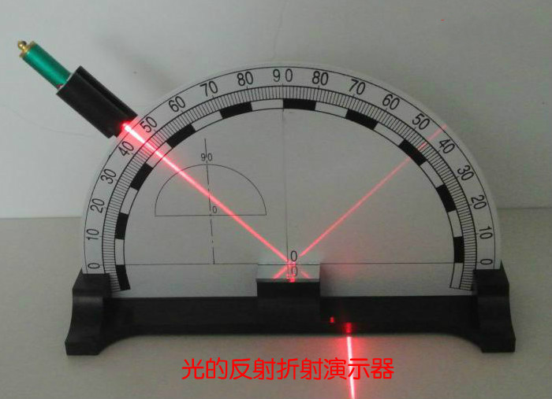
Understanding the experiment

Slide 9
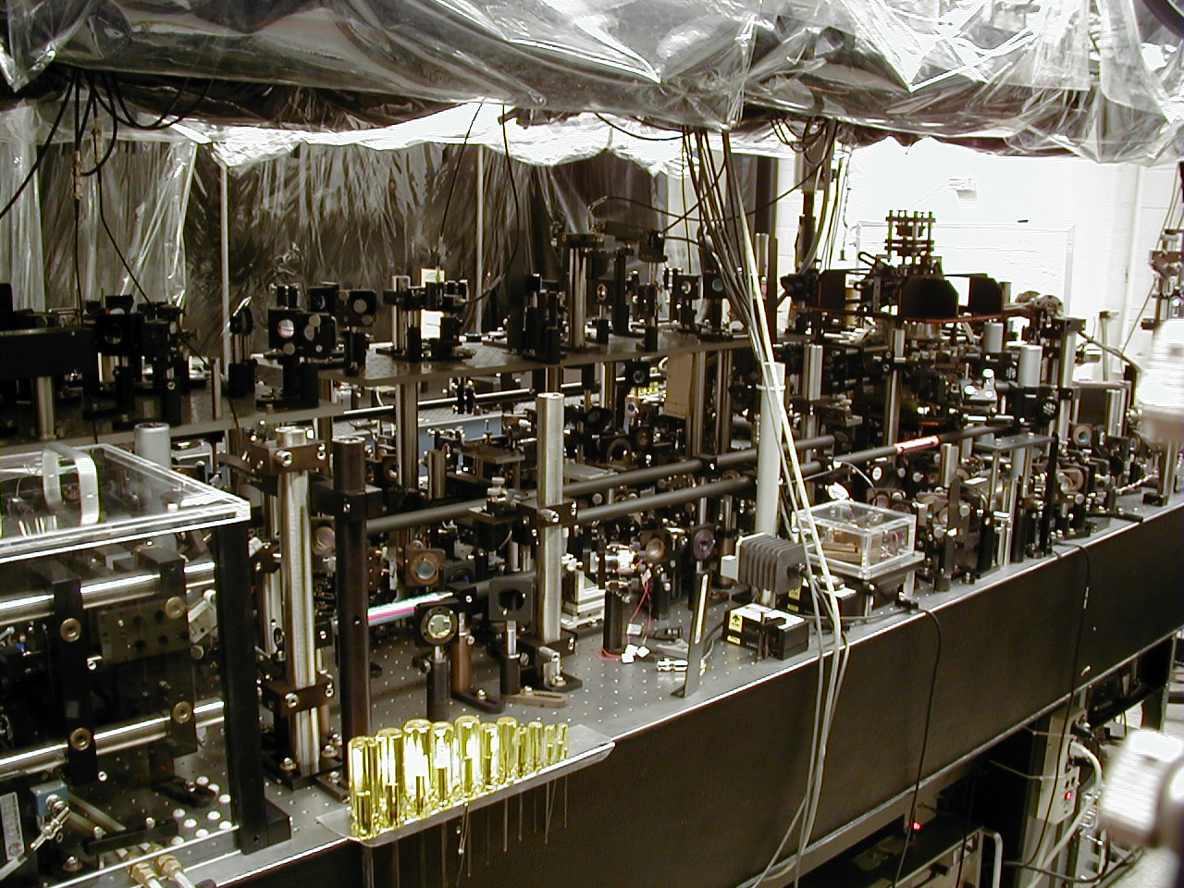
Understanding the experiment

Slide 10
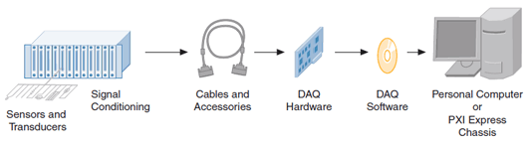
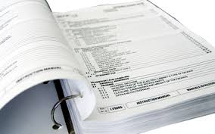
Understanding the experiment

Slide 11
Quick intro to Python
Python is an interpreted, object-oriented, high-level programming language with dynamic semantics.
Different Implementations:
  CPython
  Anaconda (backed by a commercial provider)
  PyPy (Just-In-Time)
  Jython (Java Python)
  Intel Python
  ...

Slide 12
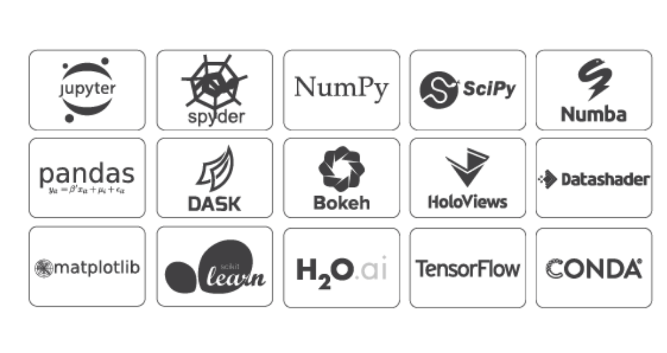
About Anaconda

Slide 13
About Anaconda
Not needed for this project
It may be very useful for more complex scenarios
It doesn’t hurt

Slide 14
Quick intro to Python
Open a Terminal/Command Prompt
Trigger Python: $ python

Slide 15
Quick intro to Python
>>> 2+3
5
>>> a = [1, 2, 3, 4]
>>> for i in range(4):
>>> print(a[i])
1
2
3
4
>>> a = [1, 2, 3, 4]
>>> for i in range(len(a)):
>>> print(a[i])

Slide 16
Quick intro to Python
>>> a = [1, 'a', 1.1]
>>> a = [1, 'a', 1.1]
>>> for element in a:
>>> print(element)
>>> print(type(element))
>>> a = [i for i in range(100)]
>>> b = [i**2 for i in range(100)]
>>> c = [i for i in range(100) if i%2==0]
Given a list like:
b = [1, 2, ‘a’, 3, 4, ‘b’, 5, ‘c’, ‘d’]
create another list with only the elements of type string.

Slide 17
Intro to Python
Dictionaries
>>> a = {'first': 1, 'second': 2}
>>> a['first']
1
>>> b = [1, 2, 3, '4', 5.1]
>>> a = {'first': 1, 'second': b}
>>> a['second']
>>> triangle = {'base': 2, 'height': 1}
>>> area = triangle['base']*triangle['height']/2

Slide 18
Intro to Python
>>> for key in a:
>>> print(key)
>>> print(a[key])
>>> if 'first' in a:
>>> print('First is in a')
>>> a = {'first': 1, 'second': 2, 'third': 3}
>>> new_values = {'first': 5, 'second': 6, 'fourth': 4}
>>> a.update(new_values)
>>> a['first']
>>> a['third']
>>> a['fourth']
Given two dictionaries,
a = {‘first’: 1, ‘second’: 2, ‘third’: 3}
B = {‘fourth’: 4, ‘fifth’: 5}
merge the second into the first one.

Slide 19
Intro to Python
Why lists if dictionaries are more powerful?
>>> from sys import getsizeof
>>> a = [i for i in range(100)]
>>> b = {i:i for i in range(100)}
>>> print(getsizeof(a))
912
>>> print(getsizeof(b))
4704
Write a simple for loop that prints the ratio of the memory usage of a
list and of a dictionary as a function of the length of each.

Slide 20
Intro to Python
Now it is time to switch to PyCharm

Slide 21
Intro to Python
Classes
It is the core idea behind Object-Oriented-Programming (OOP)
class Person:
def __init__(self, name, last_name):
self.name = name
self.last_name = last_name
me = Person('Aquiles', 'Carattino')
print(me.name)
print(me.last_name)

Slide 22
OOP
class Person:
def __init__(self, name, last_name):
self.name = name
self.last_name = last_name
def give_full_name(self):
return self.name + ' ' + self.last_name
me = Person('Aquiles', 'Carattino')
full_name = me.give_full_name()
print(full_name)

Slide 23
Inheritance
class Student(Person):
def __init__(self, name, last_name, course):
super().__init__(name, last_name)
self.course = course
me = Student('Aquiles', 'Carattino', 'Math')
print(me.course)
print(me.give_full_name())

Slide 24
Advantages of Classes
The true power comes with the self:
  Storing the state
The true difficulty is deciding when not to use classes
It is easy to make reusable code
It is easy to allow others to expand on one’s work

Slide 25
Part 2

Slide 26
Why Python?
What do you think?

Slide 27
Why Python?
What do I think?
  It is free
  It is open
  Great community
  It is easy and quick
  Enhances employability

Slide 28
Our Experiment
Measure the I-V curve of a diode
  What is a diode?
  What is I?
  What is V?

Slide 29
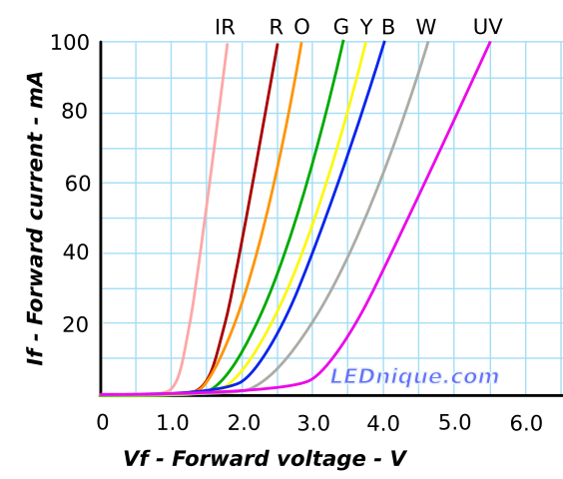
What do we want to achieve
Measure I-V curve of a Diode
What is the usefulness?
Can you relate to your experiment?
What do you need?

Slide 30
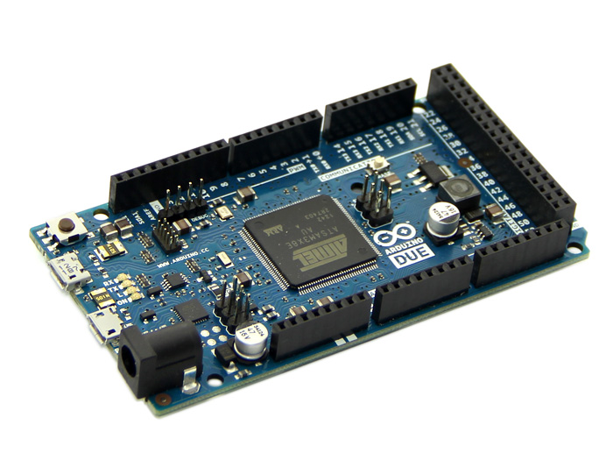
What do we want to achieve
DAQ Card:
Based on Arduino
2 Analog Outputs
12 Analog Inputs
An Arduino is ‘similar’ to an Adwin box:
It can be programmed and run independently from a PC
Normal DAQ card (e.g. NI-DAQ) are already programmed and do not work independently from a computer
This card was already programmed, in order to simulate what you would normally find in your lab.

Slide 31
Step 1: Think
How can you measure the I-V curve?
And specifically with this device?

Slide 32
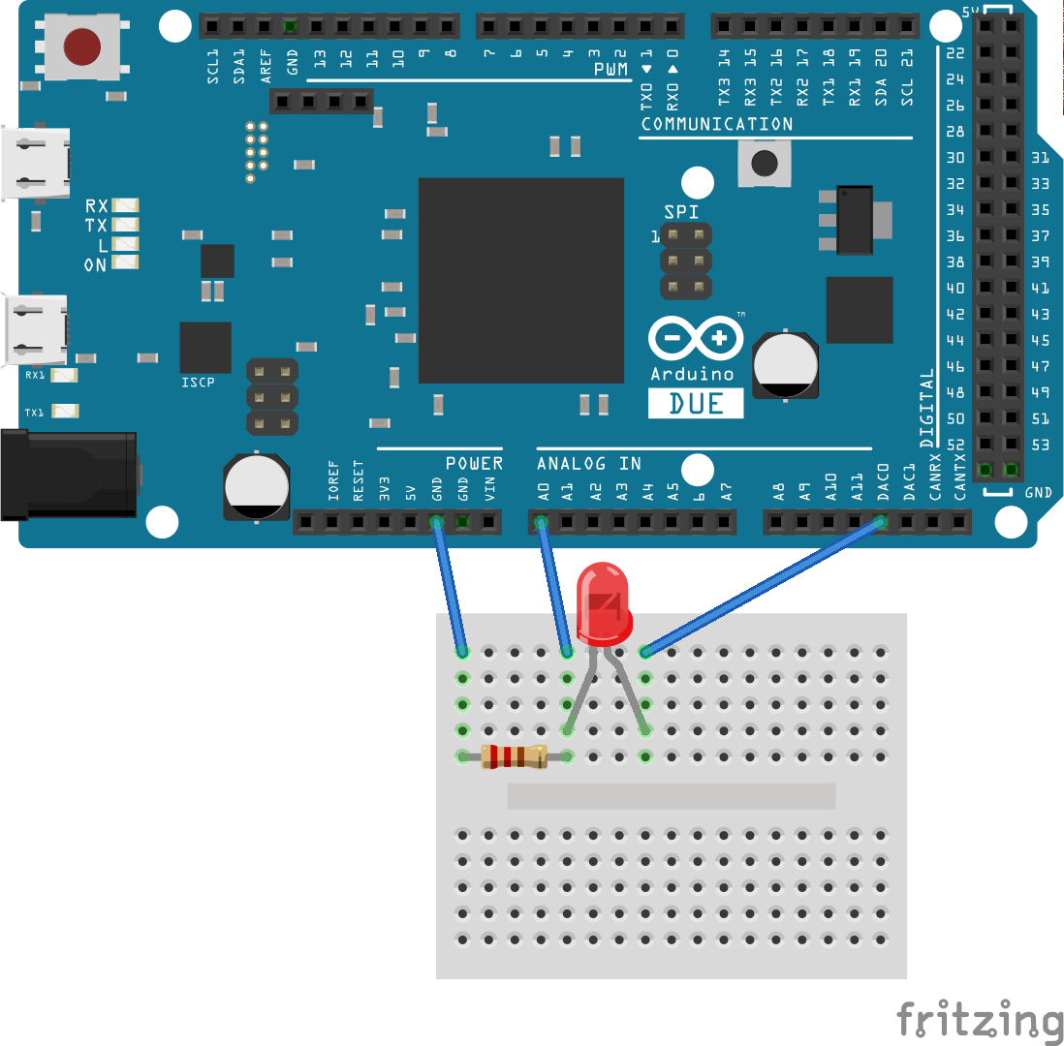
Building the circuit

Slide 33
How to communicate with devices
Message based devices
  Exchange text messages back and forth
  Two basic operations: Write and Read
  The manual specifies the operations
    e.g: https://www.tek.com/oscilloscope/tds1000-manual
  SCPI Standard
    Standard Commands for Programmable Instruments

Slide 34
Windows 7
Get the drivers from:
  https://uetke.com/arduino_driver.zip

Slide 35
Communicating in Python
$ python -m serial.tools.list_ports
>>> import serial
>>> device = serial.Serial('/dev/ttyACM0')
>>> device.write(b'IDN\n')
>>> answer = device.readline()
>>> print('The answer is: {}'.format(answer))
>>> device.close()
What happens if you use read() instead of readline()? What
happens if you call readline() before writing the IDN command?
If the program freezes (most likely sooner or later you are going to
break things up), you can stop the execution by pressing Ctrl+C
What happens if you try to write to the device after you have closed it?

Slide 36
Structure of the project
Working with files instead of in the command line
  Create a file communicate_with_device.py
import serial
device = serial.Serial('/dev/ttyACM0')
device.write(b'IN:CH0\n')
value = device.readline()
print('The value is: {}'.format(value))
device.close()
$ python communicate_with_device.py
Does it work?

Slide 37
Does it work?
from time import sleep
import serial
device = serial.Serial('/dev/ttyACM0')
device.write(b'IN:CH0\n')
sleep(1)
value = device.readline()
print('The value is: {}'.format(value))
device.close()
Read the manual of the PFTL DAQ and find a way to set an analog
output to 1 Volt.
Read the manual of the PFTL DAQ and find a way to read an analog input.

Slide 38
Now that you know how to set values and how to read values. Acquire
the I-V curve of the diode.
This is a difficult exercise, aimed at showing you that it doesn’t take a long time to be able to achieve a very important goal.

Slide 39
Why to continue?
The onion principle:
  Do not optimize prematurely
  Build in such a way that you can improve later
  Make clear code that others can understand
  Develop in layers, building in complexity

Slide 40
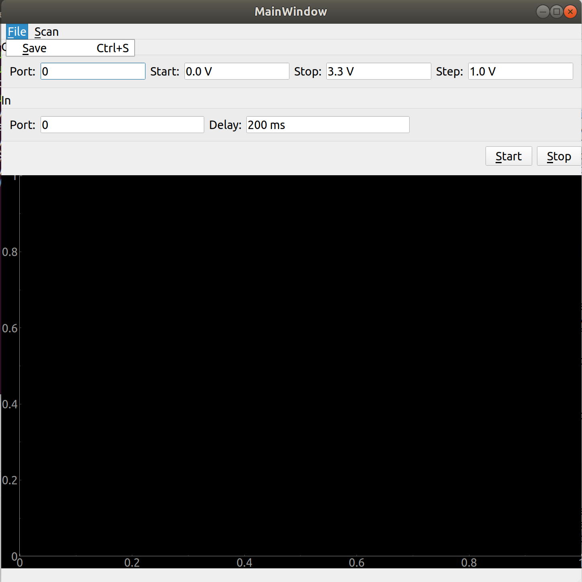
Why to continue?
Think about what do you have so far
  Can others use your code?
  Can you easily change parameters?
  Can you use your code for a confocal microscope, tune a laser, etc.?

Slide 41
Higher-Level: Classes
simple_daq.py
import serial
class Device():
def __init__(self, port):
self.rsc = serial.Serial(port)
def idn(self):
self.rsc.write(b'IDN\n')
return self.rsc.readline()
Start Python in the same folder where you created the file
>>> from simple_daq import Device
>>> dev = Device(‘/dev/ttyACM0’)
>>> print(dev.idn())

Slide 42
Simple-daq.py
dev = Device('/dev/ttyACM0')
serial_number = dev.idn()
print("The device serial number is: \ #← Continue below
{}".format(serial_number))
Write a method get_analog_value which takes two arguments:
self and channel and that returns the value read from the specified channel.
Write a method set_analog_value which takes three arguments:
self, channel and value
and that sets the output value to the specified channel.

Slide 43
General methods to simplify the code
Identify common patterns, transform them into a new method/function
Identify repeating constants, transform them into a set of parameters
What are the repeating elements in the previous examples?

Slide 44
class Device():
DEFAULTS = {'write_termination': '\n',
'read_termination': '\n',
'encoding': 'ascii',
}
rsc = None
def __init__(self, port):
[...]

Slide 45
def __init__(self, port):
self.port = port
def initialize(self):
self.rsc = serial.Serial(self.port)
sleep(0.5)

Slide 46
def write(self, message):
msg = message + self.DEFAULTS['write_termination']
msg = msg.encode(self.DEFAULTS['encoding'])
self.rsc.write(msg)
Improve the write method in order to check whether the communication with the device has been initialized.

Slide 47
Making descriptive errors
If you don’t add an error message, this happens:
AttributeError: 'NoneType' object has no attribute 'write'
It could look like this:
Exception: Forgot to initialize the Device driver at port COM1
Add the following to your code and try again:
raise Exception("Trying to write to device before initializing")

Slide 48
def read(self):
line = "".encode(self.DEFAULTS['encoding'])
read_termination = self.DEFAULTS['read_termination'] \
.encode(self.DEFAULTS['encoding'])
while True:
new_char = self.rsc.read(size=1)
line += new_char
if new_char == read_termination:
break
return line.decode(self.DEFAULTS['encoding'])
You may have seen that we have added a read_timeout to our class,
but we didn’t use it yet. Find a way to stop the loop of the
read_timeout is reached and issue a Warning.
Hint: the package time will give you the current time with a high degree of accuracy. You can import it using
from time import time
and use it with
time()

Slide 49
def query(self, message):
self.write(message)
return self.read()
Re-write the idn and get_analog_value methods to make use of the new query method.

Slide 50
There is one important method missing
def finalize(self):
if self.rsc is not None:
self.rsc.close()

Slide 51
Time to do something in the real-world
def set_analog_value(self, channel, value):
write_string = 'OUT:CH{}:{}'.format(channel, value)
self.write(write_string)

Slide 52
Write a method that allows you to linearly increase an analog output in a given range for a given number of steps. Don’t forget to add a delay between each update of a value.
Write a method that is able to record a given analog input while an analog output increases linearly.
Make a plot of your results.

Slide 53
Adding Units
Why would you like to add units to the program?
On September 23, 1999, communication with The Mars Climate Orbiter spacecraft, a 338-kilogram robotic space probe launched by NASA, was lost, due to ground-based computer software which produced output in non-SI units of pound-force seconds (lbf·s) instead of the SI units of newton-seconds (N·s) specified in the contract between NASA and Lockheed.
The spacecraft encountered Mars on a trajectory that brought it too close to the planet, causing it to pass through the upper atmosphere and disintegrate.
https://en.wikipedia.org/wikiMars_Climate_Orbiter

Slide 54
Adding Units
>>> import pint
>>> ur = pint.UnitRegistry()
>>> meter = ur('meter')
>>> b = 5*meter
>>> print(b)
5 meter
>>> c = b.to('inch')
>>> print(c)
196.8503937007874 inch

Slide 55
>>> d = c*b
>>> print(d.to('m**2'))
25.0 meter ** 2
>>> print(d.to('in**2'))
38750.07750015501 inch ** 2
>>> t = 2.5*ur('s')
>>> v = c/t
>>> print(v.to('in/s'))
78.74015748031496 inch / second
>>> current = 5*ur('A')
>>> res = 10*ur('ohm')
>>> voltage = current*res
>>> print(voltage)
50 ampere * ohm
>>> print(voltage.to('V'))
50.0 volt
>>> print(voltage.m_as('mV'))
50000.0

Slide 56
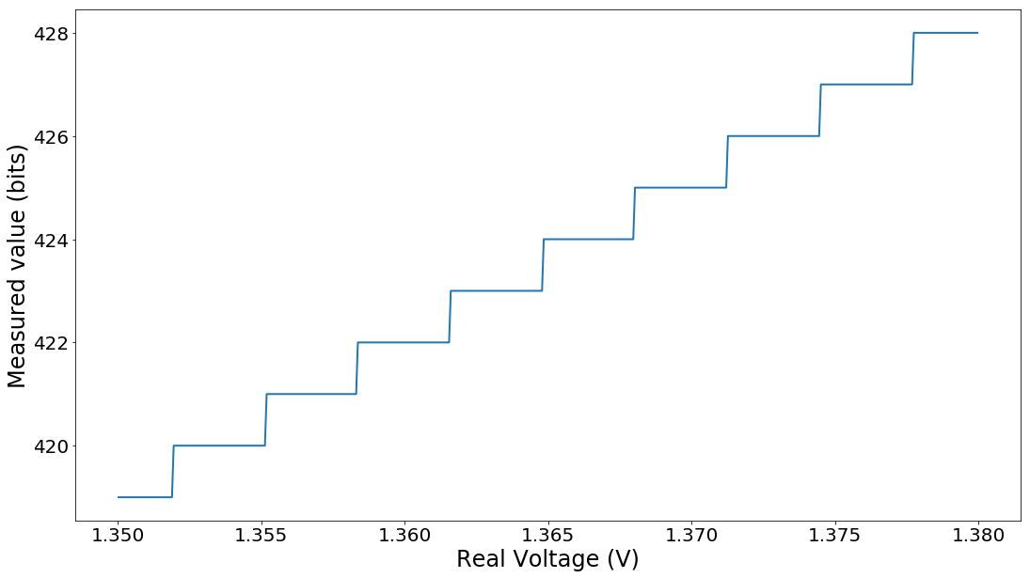
From Analog to Digital

Slide 57
How do you transform from integers to a real voltage?
And how do you transform from voltage to integers?
In the device driver that you have developed, change the way you return the value of an analog input to include its units.
Change the way you handle the setting of an analog output in order to account for real-world units.

Slide 58
Where to get the book
Where to get the code
Where to get more information
https://www.uetke.com/PFTL_v3.pdf
https://github.com/pftl
https://www.pythonforthelab.com
https://forum.pythonforthelab.com

Slide 59
Homework
Register an account on github.com
Register an account on gitlab.com
Windows users: https://gitforwindows.org/
MAC/Linux: probably already installed
  brew install git
  sudo apt install git

Slide 60
Homework
Add units to the read and set of analog voltages
With what you know up to now, can you measure the IV curve of a diode?

Slide 62
Quick intro to Python
Open a Terminal/Command Prompt
Create a virtual environment
Load the virtual environment
Trigger Python: $ python
Python 3.6.3 (default, Oct 3 2017, 21:45:48)
[GCC 7.2.0] on linux
Type "help", "copyright", "credits" or "license" for more information.
>>>

Slide 63
Creating Virtual Environments
$ pip install virtualenv
$ virtualenv MyProject
Optionally:
$ virtualenv MyProject --python=/path/to/python
Activate:
Git Bash:
$ source MyProject/Scripts/activate
Linux/Mac
$ source MyProject/bin/activate
PowerShell/CMD
> MyProject\Scripts\activate

Slide 64
Extra Step Power Shell
Run as administrator
Set-ExecutionPolicy Unrestricted

Slide 65
Why Virtualenvs
Be sure that the dependencies are isolated from each other
(MyProject) $ pip install pint
(MyProject) $ pip freeze
(MyProject) $ deactivate
$ pip freeze
It allows you to reproduce exactly the same environment in a different PC

Slide 66
About Virtualenvs
You can have as many virtual environments as you want
Ideally each project has one environment
Anaconda Users:
$ conda create -n yourenvname python=x.x anaconda

