Slide 1

Linear Regression Model on Interest Rate
Dai #5
Ashton, bob, Robert, yj

Slide 2
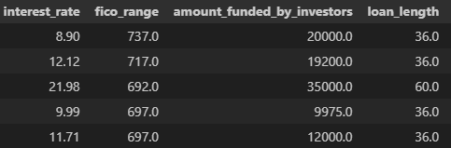
Linear Regression Case Study
(PROJECT GOAL) The dataset that the EDA was performed on was from a bank. The goal was to build a linear regression model to predict interest rates based on 'FICO score ranges' and assess how well the model generalizes to unseen data using cross-validation.
Null Hypothesis: There is no relationship between FICO scores and interest rates
Alternative Hypothesis: There is a relationship between FICO scores and interest rates

Slide 3
Describe the Data
The dataset comprised of 5 rows and 2498 columns
Column names: Interest Rate, FICO Range, Amount Requested, Amount Funded by Investors, Loan Length.
The target was the Interest Rates column
Three features were used: FICO Range, Amount Funded by Investors and Loan Length. These were all numerical
No data was missing. Categorized loan length in order to compare the alternate to the default. Loan length was separated into 2 different categories and compared with less entries to the category with more

Slide 4
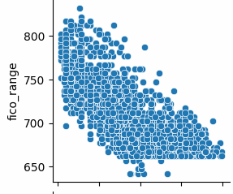
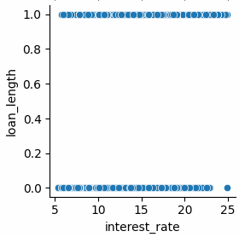
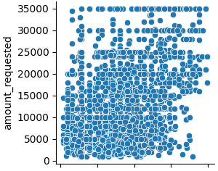
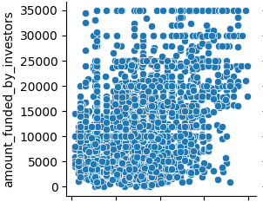
Describe the Data cont.
It was discovered that there were correlations with the FICO score and the interest rate based off our pair plot
Through our analysis there was no correlation observed between Interest Rates and other columns
Notes:
With given dataset, we analyzed relationships between dependent and independent variables with pair plot.
The result was quite interesting. As you can see on the graph, only FICO score range has some pattern of relationship with interest rate.
Meanwhile, other independent variables, such as loan length did not appear to have a clear relationship.
So, we focused on the FICO score range as our independent variable.

Slide 5
Steps To Build Our Model
Imported the dataset and displayed it to determine data type and features for the purpose of identifying
Converted FICO score data from an object to a numerical value for further analysis
Split the data into testing and train sets
Constructed a linear regression model
Fit the model to the training set in order to train the training set
Predicted the test set through the creation of prediction models
Evaluated the model with mean squared errors (MSE), coefficients(r2)
Performed a cross-validation and found the slope and intercept values
Plotted and compared linear regression models

Slide 6
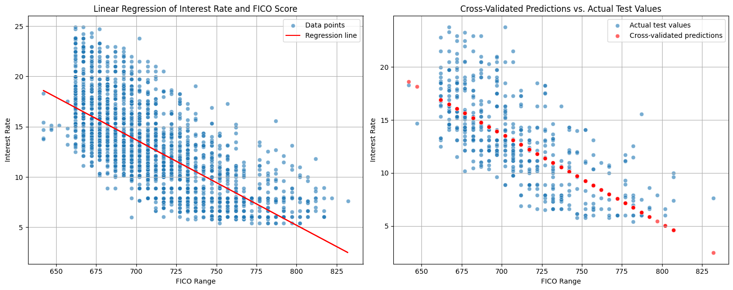
Cross Validation Prediction
Left Graph: Shows the linear trend of the interest rate and FICO range
Right Graph: Shows the predicted values against our actual values using that trend

Slide 7
Conclusion:
From our analysis we can reject our Null hypothesis as there is a clear trend with FICO score and interest rates. We can also recognize other underlying factors such as: loan length, and amount funded by investor.
With this information we can conclude if you want a lower interest rate you should have a high FICO score and a 36 month loan.

Slide 8
Contact Information:
Git Hub: https://github.com/wolfman1986/Build_a_Linear_Regression_Model
YJ Kim: princetonlaw@protonmail.com
Ashton Wolf: ashton.wolf@yahoo.com
Bob Ebend: robertebend@gmail.com
Robert Auer: rpauer3@gmail.com

