Slide 1
Getting started with machine learning
You can’t learn if you don’t try
Rudy 2020年04月10日11:38:26

Slide 2
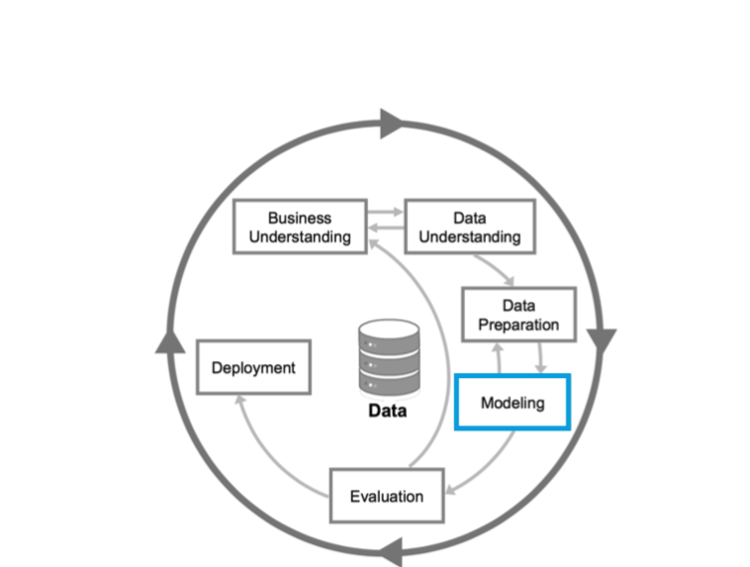
First part
First part introduce from six aspects below.

Slide 3
when should we use machine learning
When to use ml ? 1). Problem which is both large scale(which means a large amount of unconstructed cata) and complex in rules need to use ml 2). Task classification which depends on scale and complexity of rules: easy , rules-based , mannul,machine learning
Problem formulation 1). What is input ;what is output
Collection data
Regularities in the data 1). Machine learning learns regularities and patterns 2). sentiment prediction: 1) good excellent and so represent positive sentiment; 2) bad bitch ,ugly ,fuck and so on represent negative sentiment.
Representations and features（translate data into features，array and so on ) 1). Commonly: examples are represented as features；
Evaluating sucess

Slide 4
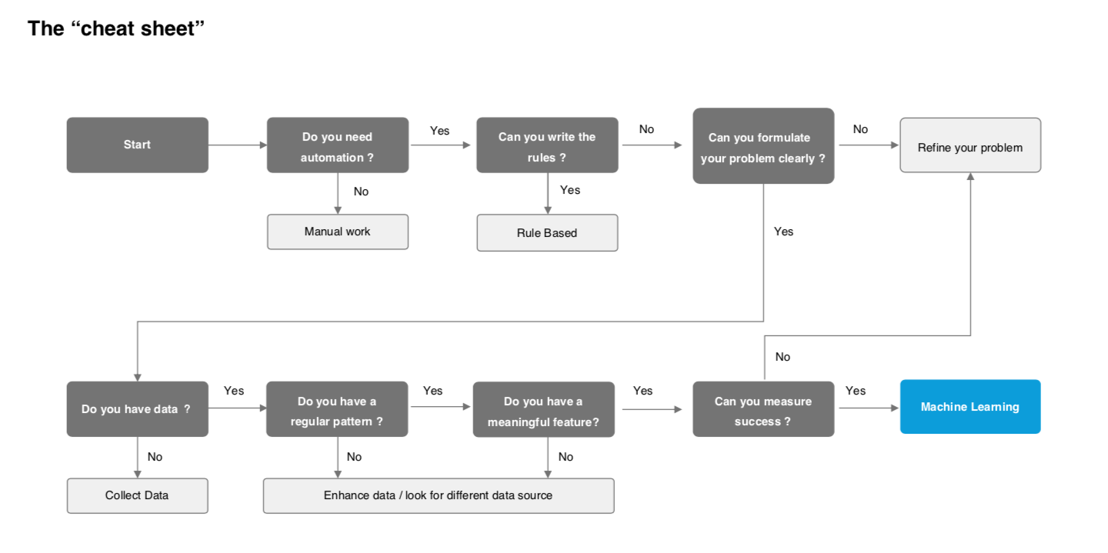
From business problem to machine learning

Slide 5
Understand the business
identifying your business goal
assessing your situation
defining your data mining goals
Producing your project plan

Slide 6
Reformulate your question
how you ask a question is a clue to which algorithm can give you an answer (how you ask a question helps you to choose one algorithm to answer the question)
For example:the question is to predict category of something .to answer it ,you should choose classification algorithm.the question “how much “ ,”how many “ ,”how long” predictes an amound .to answer it ,you should choose regression algorithm

Slide 7
The 5 questions data science can answer
Is A or B? (classification algorithm)
Is this weird （anomaly detection algorithm) 。 weird charges might be that alipay alert you when you transfer money to sisiter; weird charges might be that you purchase sth in one store which you do not normally shop .
How much or how money (regression algorithm)
How is the organized?(clustering algorithm):which viewers like the same types of movies? Notes: we do not know movie kinds,we just cluster persons who like same movies 。（how is the structure)
What should I do now?(reinforcement learning algorithm): what should a self-drived car do when meet a yellow light at a cross road . a robot vacuum should keep vacuuming or go back to charge.

Slide 8
Data understanding
Initial data analysis(is an essential part of nearly every analysis) 1. the structure of the data; 2. the quality of the data : errors ，missing observations，outliers 3. descriptive statics 4. graph
Exploration data analysis 1. we often use data visualization techniques 2. explore the data and formulate hypotheses that could lead to new data collection and experiments 3. in many inferencebook, eda seems to encompass ida.
Describe data 1. descriptive statitcs(it is similar to “describe”method of dataframe) 2. the structure of data
Varialbes: categorical variables;ordinal variable(which has order);continuous variable.

Slide 9
Data preparation——data preprocessing
Contains all activities to construct final dataset from initial raw data.
Data preparation may be likely to be preformed multiple times, and no t in any prescribed order
The most time-consuming.
Kinds of Dirty data : 1. invalid values , formats , attributes dependencies(if sb is not a teacher,he or she can not have students), uniqueness(id must special) , missing values , misspelling , misfiled values(city column can not be country)
Preprocess data 1. data cleaning : fill missing values , remove noisy/outliers data 2. data normalization : normalize data to reduce dimensions and noise. 3. data discretization : convert continuous attributes to categorical attributes for ease use of certain machine learning algorithm. 4. Text cleaning : remove embedded characters 5. data reduction: sample data or attributes

Slide 10
Data preparation ——data preprocessing
How to deal with missing datas 1. delete record that contains missing values 2. dummy replacement： none,unknown or 0 3. mean replacement 4. replace with the most frequent values 5. regression replacement

Slide 11
Data preparation ——data preprocessing
How to deal with outliers 1. keep :some outliers may be genuine observations 2. exclude: trimming or winsorising
Winsorising: assign outliers with next highest or lowest values(need to learn more about winsorising).

Slide 12
Data preparation ——data preprocessing
How to normalize data?:rescale data range to a specified range 1. min-max normalization：x-min/(max-min) 2. z-score normalization: (x-mean)/standard deviation 3. decimal scaling:move decimal point

Slide 13
Data preparation ——data preprocessing
How to discretize data ? : convert continuous values to categorical attributes.
1. equal-width binning
2. equal-height binning(by frequency)

Slide 14
Data preparation ——data preprocessing
How to reduce data ?
1. record sampling . Sample some record from all data
2. attibute sampling. A subset of the most important attribute
3. Aggregation. Divide data into groups。

Slide 15
Data preparation ——data preprocessing
How to clean text data （text is the data）
1. remove special characters
2. removing duplicate characters
3. removing user-defined
4. remove unmeaningful words (’a’ , ‘the’ eg）
2020年04月12日23:14:34

Slide 16
Data preparation—feature engineering
1. The more a data scientist interacts with the domain expertes , the better the feature engineering process.
2. feature is known as attrubutes.
3. feature engineering and selection can combine to make the learning more computationally tractable . it does so by enhancing and the reducing the number of featured needed to train the model. Mathmatically speaking ,the feature selected to train the model are a minimal set of independent variables the explain the patterns contained in raw data .
4. in google’s defination , feature engineering means transforming raw data into a feature vector ; in microsoft’s defination, feature engineering mainly foucs on feature construction.
5. two common kinds of feature enginerring : 5.1 feature/variables creation:split data variables into three variables like:day ,month ,year 5.2 dummy varialbes : convert categorical variables into numercal variables .for exampel convert gender into male and female variables ,when gender is female ,the value of male 0 and the value of female is 1.
6.

Slide 17
Data preparation——feature selection
1. Feature engineering is applied firstly,then feature selection is performed to eliminate irrelevant,redundant,or highly correlated features.
2. features selected to train the model are a minimal set of independent variables that explain the patterns in the data.
3. traditional method : 3.1 forward selection: variable numbers added from 0 to n which beyond 0 3.2. backward selection: variable numbers reduced from all to n which is less that all 3.3 stepwise regression: I can not see.
4. modern method: 4.1 filter : score each feature which is used to help set the threshold for keeping or eliminating a specific features. However, filter method does not consider the relationship between variables,so mainly used to pre-process steps 。（use statistics methods to evaluation subset features ,regardless of any models) 4.2 wrapper : a subset features train one model. (make the mode prone to overfitting),(models) 4.3 embedded method ： introduce additional constrians into the optimization of predictive algorithm. The most famous is LASSO and RIDGE regression（岭回归).(combine the qualities’ of filter and wrapper methods),(models)

Slide 18
Feature selection vs dimension reduction
Feature selection does reduce demension of data by extract a subset of original features,however does not changing them.
Dimension reduction changing them . three common methods : principal component analysis, canonical correlation analysis, and Singular Value Decomposition(奇异值分解）.

Slide 19
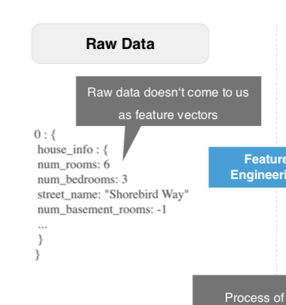
Recap from raw data to engineered and selected features
Data preprocess
Feature engineering
Feature selection
Raw data example: is not Similar to excel or dataFrame which I understood before.

Slide 20
model
Relationship between algorithm and model: algorithm learn from datas ,then output a model.
Training the model is an iterative process of finding the best parameters to minimise the error.
Hyperparameters : others parameters besides weights and biases in model
Classification , regression , anomaly detection , clustering
Machine learning : supervised ,unsupervised ,semi-supervised,reinforcement learing.
Selecting a machine learning algorithm is a process of trial and error(试错）
Selecting a machine learning algorithm varies depending on many factors.
Dimensionality reduction belongs to unsupervised algorithm
Recap : 1. what is a process of training a model ? Minimize the loss/error function , such as mean squared error(平均方差） 2. machine learing contains which algotithm? 3. selecting a fitted algorithm is a process of trial and error.

Slide 21
Model evaluation
What is a good model? Accurate , explainable , fast , scalable(可扩展的，这个不是特别清楚）
Fit ：拟合。underfit : 欠拟合；overfit : 过拟合。
Underfitting is often an result of excessively sample model;
Evaluate model 1. randomly splitting dataset into training dataset and test dataset heavily deep on which data point end up in training dataset and test dataset. step 1: we train a model with training dataset, then valid with test dataset. Step 2: If the test error is high or terrible, so we will adjust any parameters which can dream up ,then we well proceed step 1. step 3: we will not stop unitll the test error is low. Otherwise we will proceed step 2. so this method is no longer fair for test dataset. 2. there are three common methods to split dataset in order to solve the problem mentioned above? 2.1: hold-out validation: split dataset into three parts: such as training dataset , validation dataset, test dataset. If number of dataset is more than one million the ratio of this three parts is 98% :1% : 1% , if less than one million ,the ratio is 6:2:2. 2.2 : k-fold cross validation: the dataset is split into k subsets ,test dataset must be each of the subsets and other subsets are training dataset and validation.the disadvantage is time-consumed ,the advantage is that each dataset becomes test dataset and training and validation dataset. The variance is reduced as k is incresed. 2.3 : leave-one-out cross validation: the extreme condition of k-fold cross validation ,with k equals N which is the number of dataset. Each time one element is test dataset,and the other is training and validation dataset. The loocv is computationally intensive.
Which validation strategy should we use? 1. hold out validation: dataset is large especially in deep learing dataset.(note: the ration is not 8:1:1, is 98:1:1, 2. cross validation: dataset is small , k equal 10 is common . K can reduce if training cost too much time

Slide 22
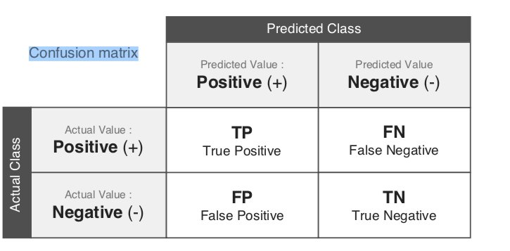
Model evaluations metrics
Different ml algorithm have different metrics
Classification: accuracy(准确度） , precission(精确度） , recall ,F1 score, roc ，auc , log loss.
Regression: mae (mean absolute error), mse, rmse, mape(mean absolute % error), R^2 (Coefficient of determination)
Confusion matrix (混淆矩阵）: TP,FN,FP,TN: 记住一点：后面的表示你的预测值，前面表示的判断情况，是否预测正确。比如：FP:你预测的positive，实际上是negative,所以你预测错误（修饰词F).之前在混淆矩阵中第一行第二列应该是：TN，当时的判断是后面表示预测值，前面是真实值。（牢记，牢记，牢记）

Slide 23
Model evaluations - accuracy , precision , recall
Accuracy = (TP+TN)/(TP+FP+TN+FN)
Precision = TP/(TP+FP) : 预测为positive中的正确率。
Recall = TP/(TP+FN) ： 发现positive 的能力，为阳且预测正确的个数占真正为阳的比率。
There is an inverse relationship between recall and precision. Which metrics to emphasize depend on the commercial demand. If we emphasize recall, it is necessary to reduce the threshold .because recall means that we can find all positive try our best, we only can consider sth as 。
recall = TP/(TP+FN) ,TP+FN 表示数据集中的positive 的数目，与阈值无关，所以值恒定。当threshold减小，判断为N且判断错误的情况肯定更少发生，所以TP增加，因为分母（TP+FN）不变，所以分子TP增加,recall 增加。
Precision = TP/(TP+FP) = 1/(1+FP/TP) ,当threshold 增加，因为标准严格，其中FP/P 减小，er TP/P是增大 ，FP/TP = (FP/P ) / (TP/P) 是减小的，所以precision 增大。
Recall 比较大，说明漏网至于比较少；precision 比较大，说明筛选出来的鱼大部分都是你想要的。如果高射炮防导弹，当然是希望recall 越大越好，这样能将所有的真导弹都判断出来。P’recion 当我们判断的垃圾邮件时：希望判断为垃圾邮件时，尽可能都是垃圾邮件。这样就会尽可能少的将有价值的邮件丢弃。

Slide 24
Model evalutions--F1 score,roc
F1 score = 2/(1/P+1/R) = 2PR/(P+R) F1越大，模型性能越好。
Roc curve ,一个增加率越来越慢的曲线，且此曲线在y = x 的直线上。描述的是增加

Slide 26
What is difference between parameters and hyperparameters
Hyperparameters is external to the model: learning rate,epoch, hidden layers, units, batch_size.
Parameters is also called as model parameters,so parameters is sure when model is choosen. Such as : weights，
Hyperparameters optimization algorithm: grid search(time and compute consumed) , random search (based on probability distribution,推荐), bayesian optimization(

Slide 27
Well-known algorithm
go on

Slide 28
supervised algorithm ---KNN
Used for classification
KNN is computationally expensive
The boundary becomes more smoother with the increasing of value k.
Advantage: simle and logical
Disadvantage: the choice of k has much influence on the result
Best used: 1. need a simple model 2. memory usage of trained model is a less concern 3. prediction speed of trained model is a less concern . 4. in binary classification , odd value of k is preferred/recommended

Slide 29
supervised algorithm ---support vector machine
Used for classification, regression, outlier detection
By finding hyperplane that separates all data points of one class from other classes
Best used 1. binary classification 2. for high-dimensional ,nonlinearly separate data 3. accurate, simple, easy to interpret
SVG: the simplest linear classifier
Points closet to hyper-plane is call support vectors(also call decision function)
Hyperplane is a set of planes that have some common characteristic, through one point ,separate some kinds of datas and so on .
A good separation is achieved by hyperplane that has the largest distance to the nearest pointes of any classes.

Slide 30
supervised algorithm ---support vector machine
The nonlinearly separable data --- kernal trick
SVM uses a kernal transform to transform the nonlinearly separable data into higher dimensions where a boundary can be found.
Non-linear SVM means the boundary doesn’t have to be a linear line.
Advantages
1. the major advantages is that training is very easy,no local optimal.
2. non-linear svm uses non-linear kernal which can capture more complex relationships between datas
3. have a regularization term which will avoid over-fitting.
4. uses a subset of training points ,so it is also memory efficient.
Disadvantage
Long time to train to large datasets
Choose a good kernal is a tricky
Parmeters of a trained model is hard to interpre
The SVM is only directly capable for two-class task, if you want to deal with multi-class classification, you could use one-versus-the-rest approach, and then use one-versus-the-rest approach which data source is the rest data of before .

Slide 31
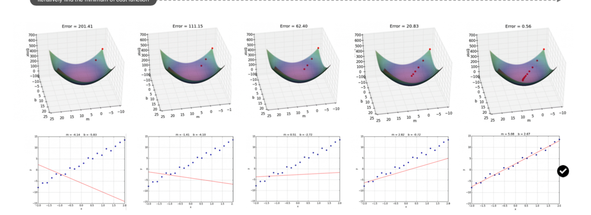
supervised algorithm --- linear regression
Two approaches to solve parameter in linear regression 1. normal equation（正规方程式）：大概记住直接用公式就可以求出AX = Y的A. it is useful for small features(<1000)，A = (X^T dot X)^(-1) dot X^T dot Y 2. gradient descent.
The colorful pic below denotes a relationship between error and (param1,param2).

Slide 32
supervised algorithm --- linear regression
梯度方向是函数增加最快的方向，所以使用梯度下降算法来求线性回归的参数是往梯度的反方向修改参数。至于为什么是梯度方向是函数增加最快的方向，有一篇文章讲的非常清楚，看过，但是忘记了。
The common value of alpha is： 0.001,0.003,0.01,0.03,0.1,0.3
对于凸函数，可以保证一定可以得到全局最小值，但是对于非凸函数（不一定是凹函数），例如马鞍形，由于起始点或者初始参数的差异，可能得到不同结果（局部最小值或者全局最小值），但是‘In practice converging to local minimum is not usually a huge’，所以不论何种情况，使用梯度下降算法就可以。
F(x） = SUM(g(x))，dF(x)/dx= SUM(d(g(x))/dx),求和会挪到求导的外面。

Slide 33
supervised algorithm --- linear regression
Feature scaling：也叫归一化,标准化，修改数据对象中的不同特征为相同范围。Two common kinds ,one is min-max normalization,the other is Z-score Normalization/standardization,
Convert categorical data into number: one-hot encoding
Multicolinearity(多重线性相关) causes the following two problems: 1. the coefficients estimates swing, 2. reduce the precision of coefficients.
But it doesn’t affect overall fit of model,so we do not need to concert it .

Slide 34
Nonlinear regression---logistic regression
the relationship between the dependent variable and a set of independent variables(因变量和自变量的关系）
线性回归，多变量线性回归，多项式回归（参数的次数不是1,多项式回归不是非线性回归，因为其参数还是线性，所以不能使用函数线是直线还是曲线来区分线性回归和非线性回归）
Logistic regression belongs to classification algorithm.
Although we can use linear regression to classify the dataset,but often it is not a good idea to do that ,the most import reason is linear regression’s output is a continuous value which beyond the range[0,1]
𝑷 ( 𝒚=𝟏 | 𝒙) = h(𝑥)=𝜎(x) 中P(y=1|x) 解释 ：输入是类别1的概率。
回归的误差函数是SE,指标是让估计SE大小值；分类的误差函数是交叉熵，指标是accuracy, precision, recall , F1SCORE, ROC(受试者工况曲线），auc等等
(二分类）交叉熵： J(theta) = -1/m* sum( (y^{i} * log p^{i} )+ (1-y^{i} ) * log (1-p^{i}) )。 J(theta) 表明参数是theta ,其隐藏在p中。 1. y^{i} 表示 第i条数据的类别值，如果是二分类其值要么是0要么是1， 2. p^{i} 表示 第i条数据预测概率。如果是2分类，后面1-y^{i} 就是0,这个求和函数的参数只有1项。 3. 对于多分类情况： sum 中的项数等于类别数。某项表示这条数据属于其中一类的概率乘以类别值。公式表示为： -1/m * sum( (y1^{i} * log p1^{i} + y2^{i} * logp2^{i} + ……)) 。 其中p是sigmod(theta dot X)
It is important to avoid overfitting of logistic regression 。L2 regularization and early stop are two common methods。

Slide 35
Nonlinear regression --- logistic regression
Use one-versus-the-rest to classify multiclass
逻辑回归中h(theta) = sigmod(theta dot x)
使用梯度下降求出让交叉熵函数取得最小值的参数。

Slide 36
NN
Single-layer perceptron(单层感知器：权重和外加激活函数），可以学习线性可分问题
Linearly separable problem(线性可分）：存在一条直线或者一个平面，将数据集完全正确的分成2部分，则说这个数据集是线性可分。
逻辑运算：and ，or 都是线性可分的，而xor: 不是。所以使用使用单层感知器可以实现逻辑and 和or 运算，但是不能实现xor.
单层感知器是一种最简单的神经网络（没有隐藏层）
多层感知器就可以实现线性不可分的问题。
激活函数（非线性，且使用反向传播算法最小化误差函数（error function）时最好是连续的)，如果激活函数也是线性的，那么神经网络就是一个线性模型，无法解决生活中的复杂问题（大多数都是非线性的）
Binary step function: 二元阶梯函数。（输出0和1，且是非连续的，而是跳跃的）
Sigmod :最大的问题是梯度消失问题。反向传播就是很多层及其激活函数相乘。如果有几个激活函数小于1，那么层数加深，小于1的数（0.01*0.01*0.01)连乘 ，最终梯度会消失。

Slide 37
NN
Tanh 阈值为[-1,1]，缺点也是梯度消失。
Relu: 计算简单（省计算资源），但是会存在神经坏死的现象。因为如果y = f(x)，其中f是激活函数，如果x<0,激活函数的导数为0，当进行反向传播时，在其之前层的函数都不能进行更新（前： 靠近输入层），因为会有一个前面的导数计算中都会有这个激活函数参与，任何与0相乘的数都为0，所以这个激活函数会发生严重节点死亡现象（无法训练）。函数表示max(0,x)
Lrelu : max (0.1x,x)
Prelu: param . Max(ax,x) 其中a 是一个超参数。
Softmax 用于多类分类。softmax(xi) = xi/sum(xi)
Method to reduce overfitting within nn 1. early stop 2. L1/L2 regularation 3. dropout
Batch gradient descent: use all data in one iteration ,it is not suitable for big dataset
Mini-batch gradient descent : preferable for big dataset, memory sensitive
SGD: stochastic gradient descent : a data for one iteration. Due to frequent change ,it is difficult to up to minimum
Mini-batch gradient descent takes the both of SGD and batch gradient descent. It trains as follows ： 1. 将一个mini-batch size的数据输入到网络中，然后进行forward 运算，得到一个j(theta), 2. 然后进行反向传播，根据公式计算一个平均偏移量w_new -= （alpha * 1/m* sum(( h(theta) – y ) * x ) 更新权重 3. 重复进行1和2，根据1描绘出来的曲线，决定什么时候 stop。
现在的SGD: 一般指mini-batch gradient descent.
SGD: 缺点：（mini-batch gradient descent):在局部最小点或者鞍点出，会小范围震动，而batch gradient descent 则不会，直接静止。由于每次mini-batch 的数据集不一样，所以每次的更新梯度是不一样的；不同参数，学习率一样。如果数据稀疏，我们希望出现次数少的特征，学习率大一点。

Slide 38
NN – optimization
EWA: exponentially weighted average.想要避免噪声对于趋势的判断，遂引入指数平均权重。当天的权重平均温度不仅与当天的温度有关，还与前一天的权重平均温度有关。
EWA(指数权重平均）的本质就是指数衰减与每天的气温的点积。公式如下v_100 = 0.9* theta_100+ 0.1* 0.9* theta_99+0.1*0.9^2* theta_98+ …… +0.1*0.9^m* theta_100-m+ 0.9^100*theta_0. 我们可以看出所以的系数都是指数衰减，意思是越靠近100的气温对于指数权重平均气温的影响越大。
而指数衰减到1/e 就没有了意思，而具体那一项衰减到了1/e，使用如下公式估算1/(1-beta) 其中这里的beta 这里取值为0.9 ，表示指数平均气温与10天的气温值有关。
momentum algorithm: v_t = beta* v_(t-1) + lr* theta’s derivative, theta_t = theta_( t-1) – v_t . 可以理解v_t 就是误差函数对于theta的导数的指数权重均值。当前的theta 等于老的theta 减去 theta的EWA。意思是theta的变化值等于之前的梯度（之前的epoch 计算的梯度）与beta的权重衰减的点积。而beta 越接近于1， 当前的theta 与越多的epoch 有关。
梯度作用： 如果当前的变化比较小，不至于变化特别小，因为有之前的累计；会使物体更快收敛，奔向最低点。

