Slide 1

數位語音處理概論
Introduction to Digital Speech Processing
4.0 More about Hidden Markov Models
References for 4.0 1. 6.1-6.6, Rabiner and Juang, 2. 4.4.1 of Huang
授課教師：國立臺灣大學 電機工程學系 李琳山 教授
【本著作除另有註明外，採取創用CC「姓名標示－非商業性－相同方式分享」臺灣3.0版授權釋出】

Slide 2
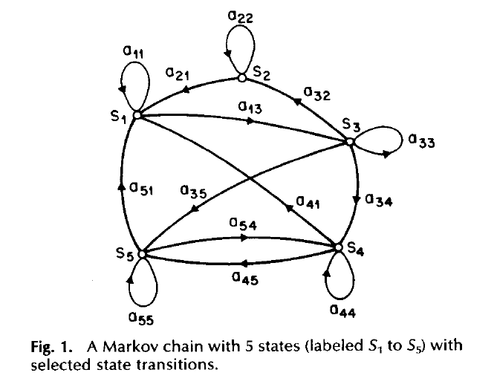
Markov Model
Markov Model (Markov Chain)
First-order Markov chain of N states is a triplet (S,A,π)
S is a set of N states
A is the NN matrix of state transition probabilities P(q_{t}=j|q_{t-1}=i, q_{t-2}=k, ……)=P (q_{t}=j|q_{t-1}=i) ≡ a_{ij}
π is the vector of initial state probabilities π_{j} =P(q₀=j)
The output for any given state is an observable event (deterministic)
The output of the process is a sequence
of observable events
A Markov chain with 5 states (labeled S₁ to S₅) with state transitions.

Slide 3
Markov Model
An example : a 3-state Markov Chain λ
State 1 generates symbol A only, State 2 generates symbol B only, and State 3 generates symbol C only
Given a sequence of observed symbols O={CABBCABC}, the only one corresponding state sequence is {S₃S₁S₂S₂S₃S₁S₂S₃}, and the corresponding probability is P(O|λ)=P(q₀=S₃) P(S₁|S₃)P(S₂|S₁)P(S₂|S₂)P(S₃|S₂)P(S₁|S₃)P(S₂|S₁)P(S₃|S₂) =0.10.30.30.70.20.30.30.2=0.00002268
0.6
s₁
A
0.3
0.3
0.3
0.1
0.7
s₂
0.2
s₃
0.7
0.2
B
C

Slide 4
Hidden Markov Model
HMM, an extended version of Markov Model
The observation is a probabilistic function (discrete or continuous) of a state instead of an one-to-one correspondence of a state
The model is a doubly embedded stochastic process with an underlying stochastic process that is not directly observable (hidden)
What is hidden? The State Sequence According to the observation sequence, we never know which state sequence generates it
Elements of an HMM {S,A,B,π}
S is a set of N states
A is the NN matrix of state transition probabilities
B is a set of N probability functions, each describing the observation probability with respect to a state
π is the vector of initial state probabilities

Slide 5
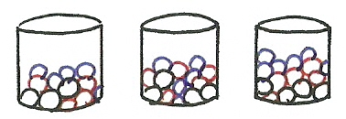
Simplified HMM
1
2
3
RGBGGBBGRRR……

Slide 6
Hidden Markov Model
Two types of HMM’s according to the observation functions
Discrete and finite observations :
The observations that all distinct states generate are finite in number V={v₁, v₂, v₃, ……, v_{M}}, v_{k}∈R^{D}
the set of observation probability distributions B={b_{j}(v_{k})} is defined as b_{j}(v_{k})=P(o_{t}=v_{k}|q_{t}=j), 1≤k≤M, 1≤j≤N o_{t} : observation at time t, q_{t} : state at time t ⇨ for state j, b_{j}(v_{k}) consists of only M probability values
Continuous and infinite observations :
The observations that all distinct states generate are infinite and continuous, V={v| v∈R^{D}}
the set of observation probability distributions B={b_{j}(v)} is defined as b_{j}(v)=P (o_{t}=v|q_{t}=j), 1≤j≤N ⇨ b_{j}(v) is a continuous probability density function and is often assumed to be a mixture of Gaussian distributions

Slide 7
Hidden Markov Model
An example : a 3-state discrete HMM λ
Given a sequence of observations O={ABC}, there are 27 possible corresponding state sequences, and therefore the corresponding probability is
0.6
s₁
{A:.3,B:.2,C:.5}
0.3
0.3
0.3
0.1
0.7
s₂
0.2
s₃
0.7
0.2
{A:.7,B:.1,C:.2}
{A:.3,B:.6,C:.1}

Slide 8
Hidden Markov Model
Three Basic Problems for HMMs
Given an observation sequence O=(o₁,o₂,…..,o_{T}), and an HMM
λ =(A,B,π)
Problem 1 : How to efficiently compute P(O| λ) ? ⇨ Evaluation problem
Problem 2 : How to choose an optimal state sequence q=(q₁,q₂,……, q_{T}) ? ⇨ Decoding Problem
Problem 3 : Given some observations O for the HMM λ , how to adjust the model parameter λ =(A,B,π) to maximize P(O| λ)? ⇨ Learning /Training Problem

Slide 9
Basic Problem 1 for HMM
1
2
N
λ
= (A, B,
π
)
O = o
1
o
2
o
3
……
o
t
……
o
T
observation sequence
q =
q
1
q
2
q
3
……
q
t
……
q
T
state sequence
․Problem 1:
Given
λ
and O,
find P(O|
λ
)=Prob[observing O given
λ
]
․Direct Evaluation: considering all possible state sequence q
all q
all q
P
(O
|
q,
λ
)
P(O|
λ
) =
∑
(
[b
(o
)
•
b
(o
)
•
……
b
(o
)]
•
q
1
1
q
2
2
q
T
T
all q
[
π
•
a
•
a
•
……
a
]
)
q
1
q
1
q
2
q
2
q
3
q
T
-
1
q
T
P(q|
λ
)
T
total number of different q : N
huge computation requirements

Slide 11
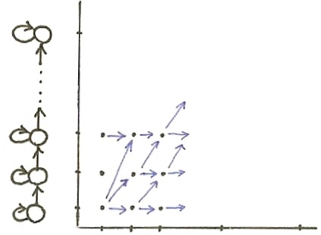
Basic Problem 1
$$i$$
$$N$$
3
2
1
$$t$$
2 3 ⋯ $t$ ⋯ $T$
$$o_{1}$$
$o_{2}$
$o_{3}$
⋯
⋯ $o_{t}$ ⋯ $o_{T}$

Slide 12
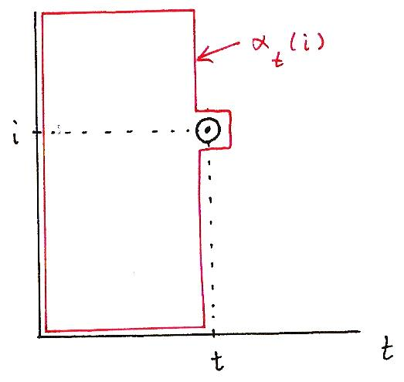
Basic Problem 1
$$i$$
α_{t}(i)
i
α_{t}(i) = P(o₁o₂……o_{t} , q_{t} = i|λ)
t
t

Slide 13
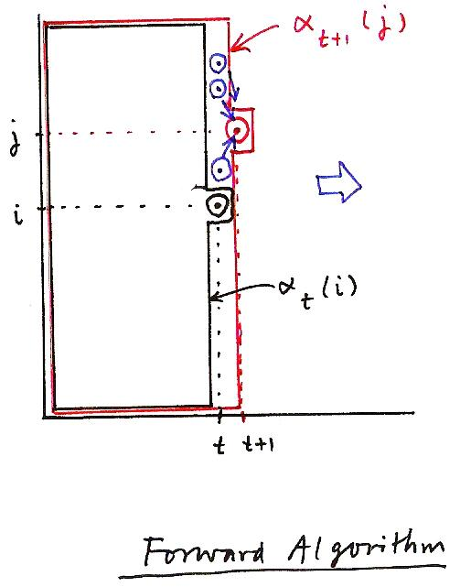
Basic Problem 1
α_{t+1}(j)
N
i = 1
α_{t+1}( j) = [ ∑ α_{t}(i)a_{ij} ] b_{j}(o_{t+1})
1 ≤ j ≤ N
1 ≤ t ≤ T−1
j
i
α_{t}(i)
t
t+1
Forward Algorithm

Slide 15
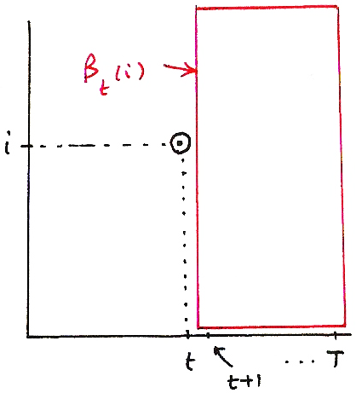
Basic Problem 2
β_{t}(i)
β_{t}(i) = P(o_{t+1} , o_{t+2} ,…, o_{T} |q_{t}= i, λ)
i
t
T
t+1

Slide 16
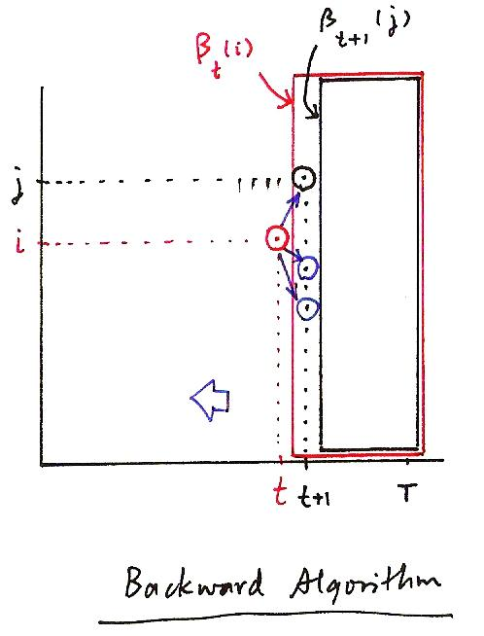
Basic Problem 2
N
j = 1
β_{t+1}(j)
β_{t}( i) = ∑ a_{ij} b_{j}(o_{t+1})β_{t+1}( j)
t = T−1, T−2,…, 2, 1, 1 ≤ i ≤ N
β_{t}(i)
j
i
t
t+1
T
Backward Algorithm

Slide 17
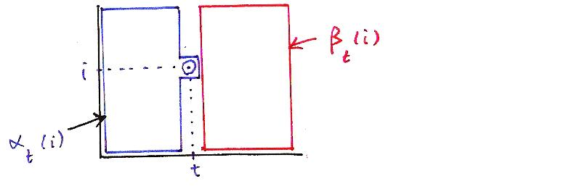
Basic Problem 2
β_{t}(i)
i
P(O, q_{t} = i |λ)
= Prob [observing o₁, o₂, …, o_{t} , …, o_{T} , q_{t} = i |λ ]
= α_{t}(i)β_{t}(i)
α_{t}(i)
t
$$A:(o_{1} o_{2} ⋯o_{t}\left|λ\right.)$$
$$B:(o_{t+1}, o_{t+2}, ⋯o_{T}\left|λ\right.)$$
$$C:(q_{t}=i\left|λ\right.)$$
$$P\left(A, B, C\right)=P\left(A, C\right) P(B\left|A, C\right.)$$
$$(B⊥A)$$
$$P(\overline{O},q_{t}=i\left|λ\right.)$$
$$α_{t}(i)$$
$$P(B\left|C\right.)$$
$$β_{t}(i)$$

Slide 18
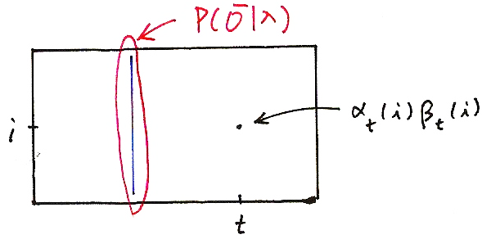
Basic Problem 2
N
i = 1
N
i = 1
P(O|λ) = ∑ P(O, q_{t} = i |λ) = ∑ [α_{t}(i)β_{t}(i)]
P(Ō|λ)
α_{t}(i)β_{t}(i)
i
t
N
i = 1
P(O|λ) = ∑ α_{T}(i)

Slide 19
Basic Problem 2 for HMM
․Approach 1 – Choosing state q
*
individually as the most likely state at time t
t
-
Define a new variable
γ
(i) = P(
q
= i | O,
λ
)
t
t
α
(i)
β
(i)
P(O, q
= i|
λ
)
γ
⎯
t
t
⎯
⎯
(i) =
t
⎯
⎯
=
⎯
⎯
⎯
⎯
⎯
t
N
λ
∑
α
(i)
β
(i)
P(O|
)
t
t
i = 1
-
Solution
q
γ
≤
≤
t
*
= arg max [
t
(i)], 1
t
T
1
≤
i
≤
N
in fact
q
*
= arg max [
P(O, q
= i|
λ
)
]
t
t
1
≤
i
≤
N
α
= arg max [
(i)
β
(i)
]
t
t
1
≤
i
≤
N
-
Problem
maximizing the probability at each time t individually
q*=
q
1
*
q
2
*
…
q
T
*
may not be a valid sequence
(e.g. a
q
*q
*
= 0)
t
t+1

Slide 21
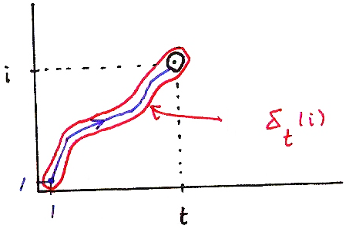
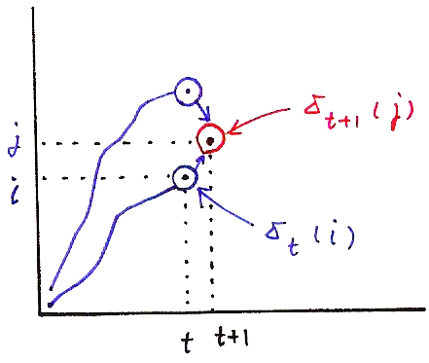
Viterbi Algorithm
δ_{t+1}( j) = max [δ_{t}(i)a_{ij}] • b_{j}(o_{t+1})
i
i
δ_{t+1}(j)
j
δ_{t}(i)
i
δ_{t}(i)
1
1
t
δ_{t}(i) = max P[q₁,q₂,…q_{t-1}, q_{t} = i, o₁,o₂,…,o_{t} |λ]
t
t+1
q₁,q₂,…q _{t-1}

Slide 22
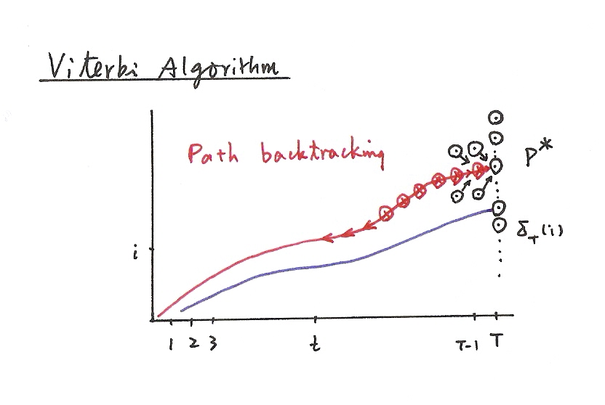
Viterbi Algorithm
Path backtracking

Slide 24
Basic Problem 2 for HMM
․Application Example of Viterbi Algorithm
- Isolated word recognition
.
.
.
observation
1
≤
i
≤
n
1
≤
i
≤
n
Basic Problem 1
Forward Algorithm
(for all paths)
Basic Problem 2
Viterbi Algorithm
(for a single best path)
The model with the highest probability for the most probable path
usually also has the highest probability for all possible paths.

Slide 26
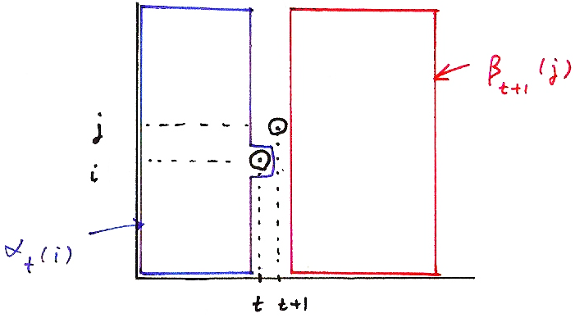
Basic Problem 3
α_{t}(i) a_{ij} b_{j}(o_{t+1})β_{t+1}( j)
β_{t+1}(j)
j
i
α_{t}(i)
t
t+1

Slide 27
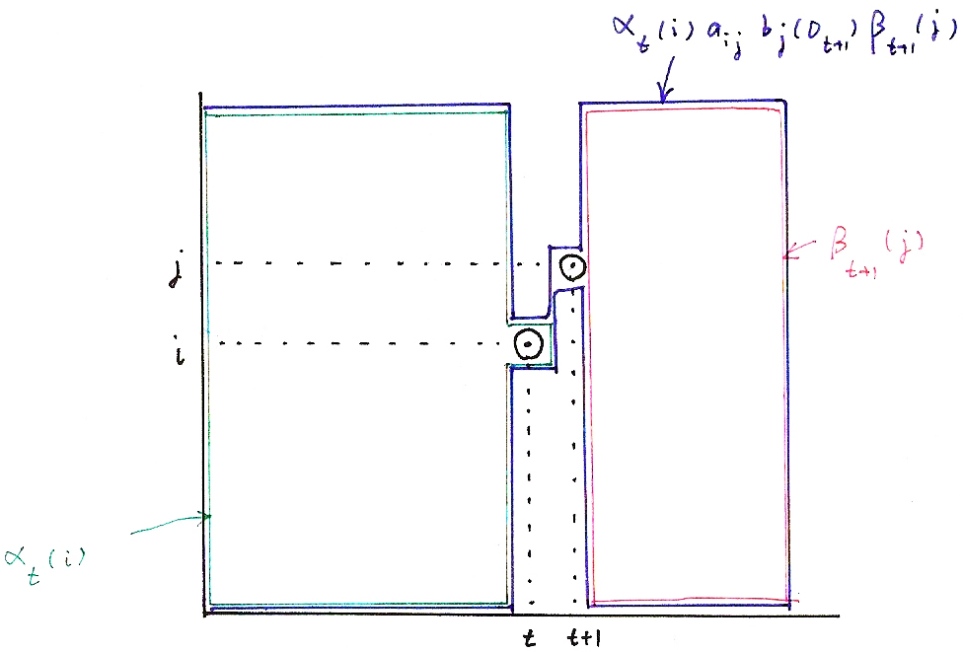
Basic Problem 3
α_{t}(i)a_{ij}b_{j}(o_{t+1})β_{t+1}(j)
β_{t+1}(j)
j
i
α_{t}(i)
t
t+1

Slide 28
Basic Problem 3
$$γ_{t}\left(i\right)=\frac{α_{t}\left(i\right) β_{t}(i)}{ }=\frac{P(\overline{O},q_{t}=i\left|λ\right.) }{P(\overline{O}\left|λ\right.) }=P(q_{t}=i\left|\overline{O},λ\right.)$$
$$\sum_{i=1}^{N}{{[α}_{t}\left(i\right) β_{t}(i)]}$$
$$ε_{t}\left(i,j\right)=\frac{{ α}_{t}\left(i\right) a_{ij} b_{j}\left(o_{t+1}\right) β_{t+1}\left(j\right) }{ }$$
$$\sum_{j=1}^{N}{}$$
$$\sum_{i=1}^{N}{α_{t}\left(i\right) a_{ij} b_{j}\left(o_{t+1}\right) β_{t+1}(j)}$$
$$=\frac{P(\overline{O},q_{t}=i,q_{t+1}=j\left|λ\right.) }{P(\overline{O}\left|λ\right.) }=P(q_{t}=i,q_{t+1}=j\left|\overline{O},λ\right.)$$

Slide 29
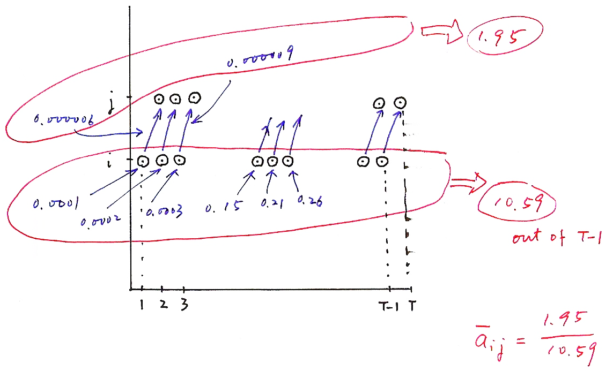
Basic Problem 3
T-1
∑
t =1
ε_{t}(i, j)/(T-1)
a _{ij}
= ⎯⎯⎯⎯⎯⎯⎯
T-1
∑
t =1
γ_{t}(i)/(T-1)
$${\overline{a}}_{ij}=\frac{1.95/69}{10.59/69}$$

Slide 31
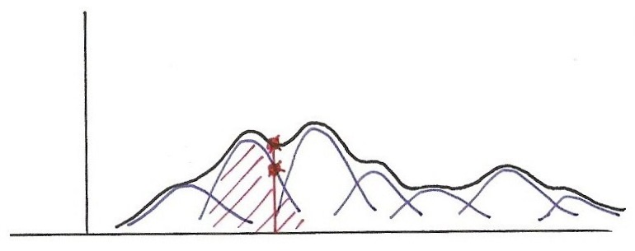

Slide 33
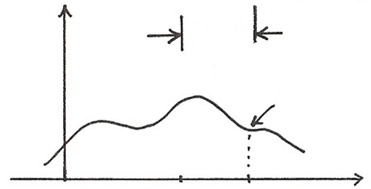
Basic Problem 3
$$\int_{−∞}^{∞}{x} f_{X}\left(x\right) dx=\overline{x}$$
$$\int_{−∞}^{∞}{ { (x−\overline{x})}^{2}} f_{X}\left(x\right) dx=σ_{x}^{2}$$
$f_{X}\left(x\right):$ prob. density function
$$σ_{x}^{2}$$
$$\left[\begin{aligned}\begin{aligned}o_{t_{1}}−μ_{{jk}_{1}} \\ o_{t_{2}}−μ_{{jk}_{2}}\end{aligned} \\ ⋮ \\ o_{t_{D}}−μ_{{jk}_{D}}\end{aligned}\right] \left[o_{t_{1}}−μ_{{jk}_{1}} o_{t_{2}}−μ_{{jk}_{2}}⋯o_{t_{D}}−μ_{{jk}_{D}}\right]$$
$$f_{X}\left(x\right)$$
$$x$$
$$\overline{x}$$
$$x$$

Slide 34
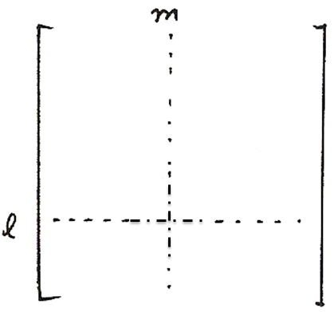
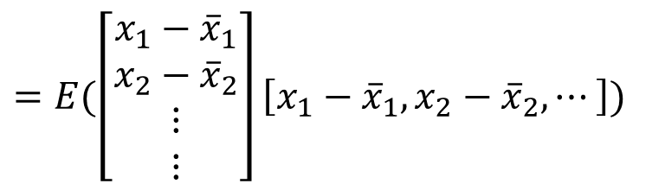


Basic Problem 3
$$m$$
$${\overline{u}}_{lm}$$
$$l$$

Slide 35
Basic Problem 3 for HMM
No closed-form solution, but approximated iteratively
An initial model is needed-model initialization
May converge to local optimal points rather than global optimal point
- heavily depending on the initialization
Model training
Model
Initialization:
Segmental K-means
Model
Re-estimation:
Baum-Welch

Slide 36
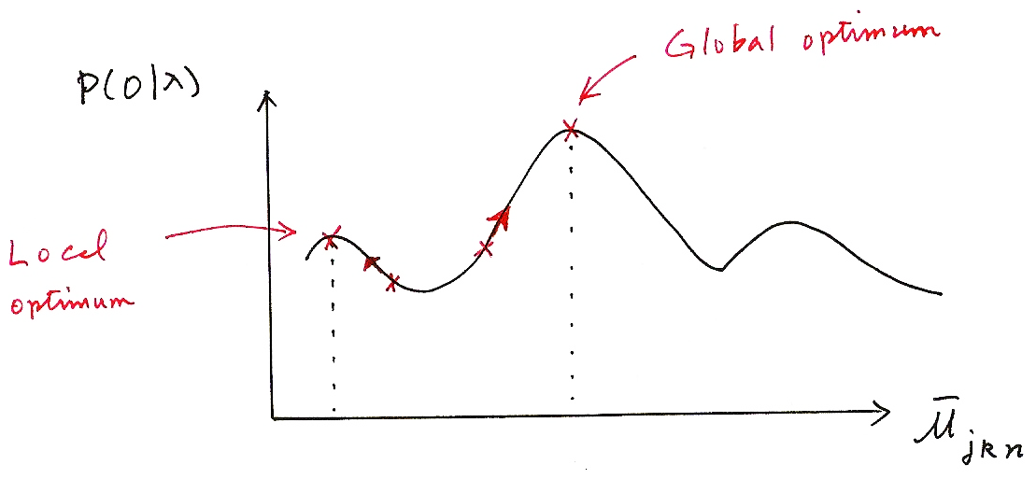
Basic Problem 3
Global optimum
P
P(O|λ)
Local
optimum
μ _{jkn}

Slide 37
Vector Quantization (VQ)
An Efficient Approach for Data Compression
replacing a set of real numbers by a finite number of bits
An Efficient Approach for Clustering Large Number of Sample Vectors
grouping sample vectors into clusters, each represented by a single vector (codeword)
Scalar Quantization
replacing a single real number by an R-bit pattern
a mapping relation
J_{k}
-A=m₀
v_{k}
A = m_{L}
S = J_{k} , V ={ v₁ , v₂ , …, v_{L} }
Q : S → V
Q(x[n]) = v_{k} if x[n] ∈ J_{k}
L = 2^{R}
Each v_{k} represented by an R-bit pattern
Quantization characteristics (codebook)
{ J₁ , J₂ , …, J_{L} } and { v₁ , v₂ , …, v_{L} }
designed considering at least
error sensitivity
probability distribution of x[n]

Slide 38
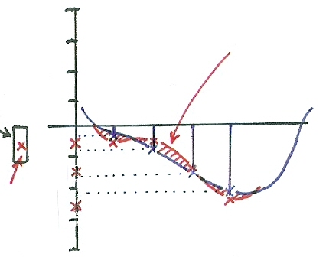
Vector Quantization
Scalar Quantization ：Pulse Coded Modulation (PCM)
0 1 1
quantization error
0 1 0
0 0 1
$$J_{k}$$
0 0 0
1 0 0
1 0 1
$$v_{k}$$
1 1 0
1 1 1
1 0 0
1 0 0
1 0 1
1 1 0

Slide 39
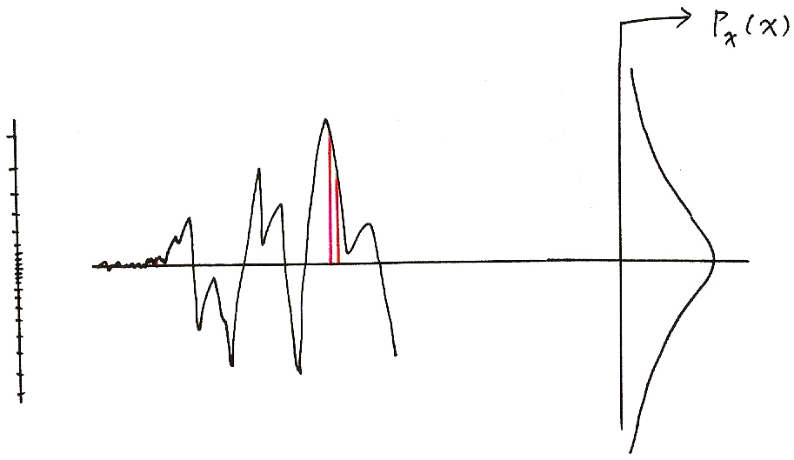
Vector Quantization
P_{x}(x)

Slide 40
Vector Quantization (VQ)
2-dim Vector Quantization (VQ)
Example:
x_{n} = ( x[n] , x[n+1] )
S ={x_{n} = (x[n] , x[n+1] ) ; |x[n]| <A,|x[n+1]|<A}
VQ
S divided into L 2-dim regions
{ J₁ , J₂ , …, J_{k} ,…J_{L} }
each with a representative
vector v_{k} ∈ J_{k}, V= { v₁ , v₂ , …, v_{L} }
Q : S → V
Q(x_{n})= v_{k} if x_{n} ∈ J_{k}
L = 2^{R}
each v_{k} represented by an R-bit pattern
Considerations
error sensitivity may depend on x[n], x[n+1] jointly
distribution of x[n] , x[n+1] may be correlated statistically
more flexible choice of J_{k}
Quantization Characteristics (codebook)
{ J₁ , J₂ , …, J_{L} } and { v₁ , v₂ , …, v_{L} }

Slide 41
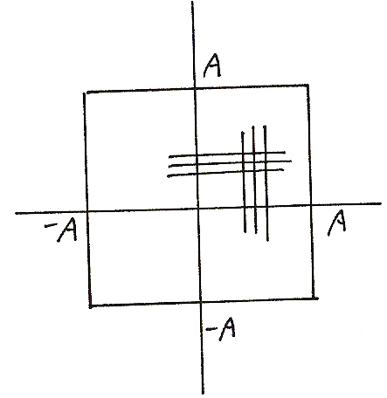
Vector Quantization
$$A$$
$$−A$$
$$A$$
$$−A$$

Slide 42
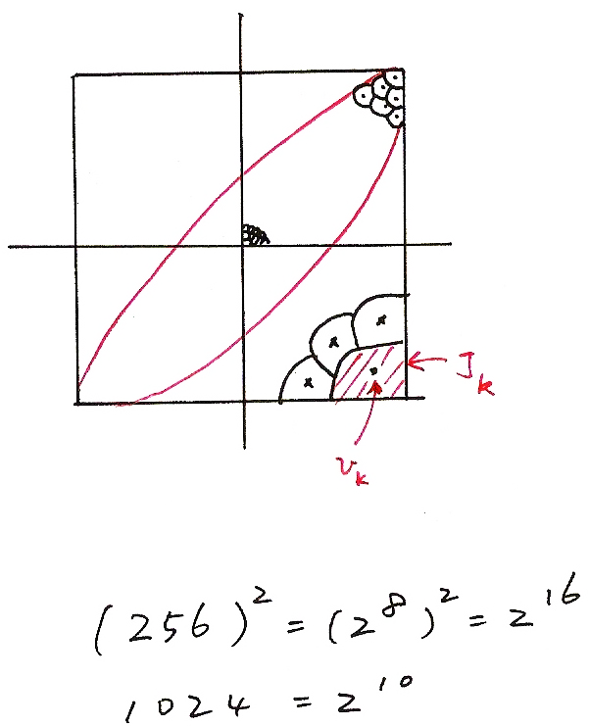
Vector Quantization
J_{k}
v_{k}
(256)²=(2⁸)²=2¹⁶
1024=2¹⁰

Slide 43
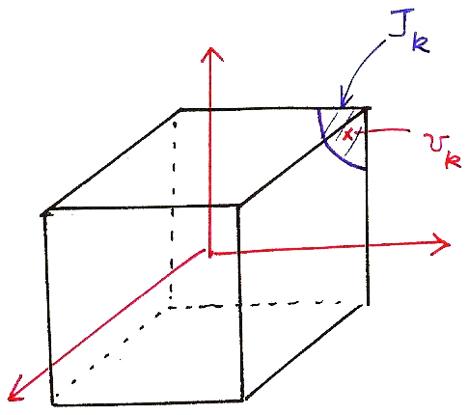
Vector Quantization
J_{k}
v_{k}

Slide 44
Vector Quantization (VQ)
N-dim Vector Quantization
x = (x₁ , x₂ , …, x_{N} )
S = {x = (x₁ , x₂ , …, x_{N}) ,
| x_{k} |< A , k = 1,2,…N}
V = {v₁ , v₂ , …, v_{L} }
Q : S → V
Q(x) = v_{k} if x ∈ J_{k}
L = 2^{R} , each v_{k} represented
by an R-bit pattern
Codebook Trained by a Large Training Set
˙Define distance measure between
two vectors x, y
d( x, y ) : S×S → R⁺ (non-negative
real numbers)
-desired properties
d( x, y ) ≥ 0
d( x, x ) = 0
d( x, y ) = d( y, x )
d( x, y ) + d( y, z ) ≥ d( x, z )
examples :
d( x, y ) = ∑ (x_{i} − y_{i})²
d( x, y ) = ∑ | x_{i} − y_{i} |
d( x, y ) = (x-y)^{t} ∑⁻¹(x-y)
Mahalanobis Distance
∑: Co-variance Matrix
i
i

Slide 45
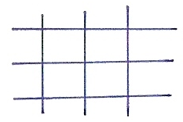
Distance Measures
$$d\left(\overline{x},\overline{y}\right)=\sum_{i}{\left|x_{i}−y_{i}\right|}$$
city block distance
$$d\left(\overline{x},\overline{y}\right)={(\overline{x}−\overline{y})}^{t} Σ^{−1} (\overline{x}−\overline{y})$$
Mahalanobis distance
$$\sum{=}\left[\begin{matrix}1 & ⋯ & 0 \\ ⋮ & ⋱ & ⋮ \\ 0 & ⋯ & 1\end{matrix}\right],d\left(\overline{x},\overline{y}\right)=\sum_{i}{{(x_{i}−y_{i})}^{2}}$$
$$\sum{=}\left[\begin{matrix}σ_{1}^{2} & ⋯ & 0 \\ ⋮ & & ⋮ \\ 0 & ⋯ & σ_{n}^{2}\end{matrix}\right],d\left(\overline{x},\overline{y}\right)=\sum_{i}{\frac{{(x_{i}−y_{i})}^{2}}{σ_{i}^{2}}}$$
$$σ_{2}^{2}$$
$$⋱$$

Slide 46
Vector Quantization (VQ)
K-Means Algorithm/Lloyd-Max Algorithm
(1)
Fixed { v₁ , v₂ , …, v_{L} }
find best set of
{ J₁ , J₂ , …, J_{L} }
(2)
Fixed { J₁ , J₂ , …, J_{L} }
find best set of
{ v₁ , v₂ , …, v_{L} }
(1) J_{k} = { x | d(x , v_{k} ) < d(x , v_{j}) , j ≠ k }
→ D = d(x , Q(x) ) = min
nearest neighbor condition
(2) For each k
→ D_{k} = d(x , v_{k}) = min
centroid condition
(3) Convergence condition
D =∑ D_{k}
after each iteration D is reduced, but D ≥ 0
| D^{(m+1)} − D^{(m)} | < ∈, m : iteration
L
k = 1
Iterative Procedure to Obtain Codebook from a Large Training Set

Slide 47
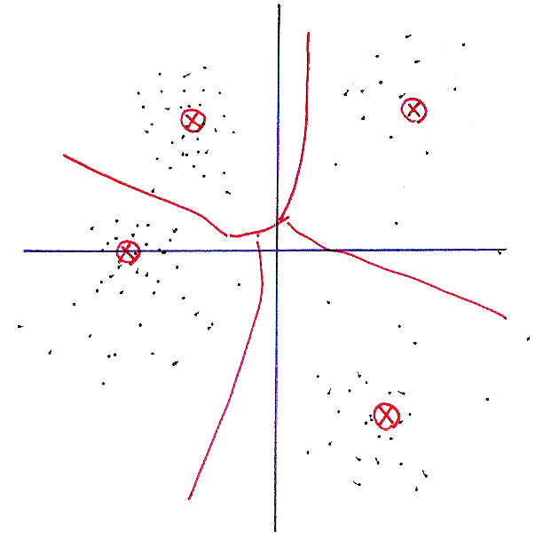
Vector Quantization

Slide 48
Vector Quantization (VQ)
K-means Algorithm may Converge to Local Optimal Solutions
depending on initial conditions, not unique in general
Training VQ Codebook in Stages― LBG Algorithm
step 1: Initialization. L = 1, train a 1-vector VQ codebook
step 2: Splitting.
Splitting the L codewords into 2L codewords, L = 2L
example 1
step 3: k-means Algorithm: to obtain L-vector codebook
step 4: Termination. Otherwise go to step 2
Usually Converges to Better Codebook
‧example 2
: the vector most
far apart

Slide 49
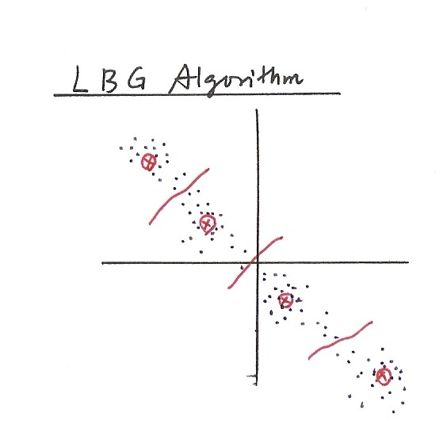
LBG Algorithm

Slide 50
Initialization in HMM Training
An Often Used Approach― Segmental K-Means
Assume an initial estimate of all model parameters (e.g. estimated by segmentation of training utterances into states with equal length)
For discrete density HMM
For continuous density HMM (M Gaussian mixtures per state)
Step 1 : re-segment the training observation sequences into states based on the initial model by Viterbi Algorithm
Step 2 : Reestimate the model parameters (same as initial estimation)
Step 3: Evaluate the model score P( |λ):
If the difference between the previous and current model scores exceeds a threshold, go back to Step 1, otherwise stop and the initial model is obtained

Slide 51
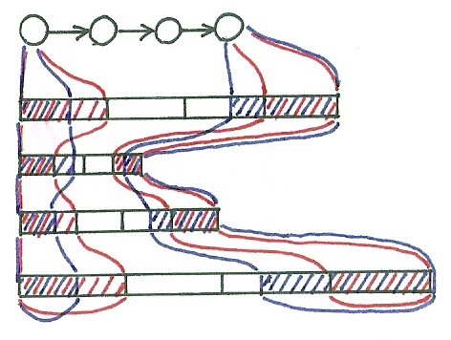
Segmental K-Means

Slide 52
Initialization in HMM Training
An example for Continuous HMM
3 states and 4 Gaussian mixtures per state
State
s₃
s₃
s₃
s₃
s₃
s₃
s₃
s₃
s₃
s₂
s₂
s₂
s₂
s₂
s₂
s₂
s₂
s₂
s₁
s₁
s₁
s₁
s₁
s₁
s₁
s₁
s₁
1 2 N
O₁
O₂
O_{N}
LBG
{μ₁₂,Σ₁₂,c₁₂}
{μ₁₁,Σ₁₁,c₁₁}
Global mean
Cluster 1 mean
Cluster 2mean
K-means
{μ₁₃,Σ₁₃,c₁₃}
{μ₁₄,Σ₁₄,c₁₄}

Slide 53
Initialization in HMM Training
An example for discrete HMM
3 states and 2 codewords
b₁(v₁)=3/4, b₁(v₂)=1/4
b₂(v₁)=1/3, b₂(v₂)=2/3
b₃(v₁)=2/3, b₃(v₂)=1/3
State
s₃
s₃
s₃
s₃
s₃
s₃
s₃
s₃
s₃
s₃
s₂
s₂
s₂
s₂
s₂
s₂
s₂
s₂
s₂
s₂
s₁
s₁
s₁
s₁
s₁
s₁
s₁
s₁
s₁
s₁
1 2 3 4 5 6 7 8 9 10
O₁
O₂
O₃
O₄
O₅
O₆
O₇
O₈
O₉
O₁₀
v₁
v₂

Slide 54
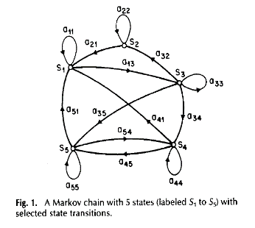
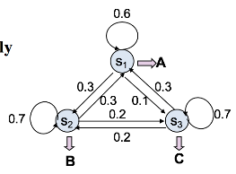
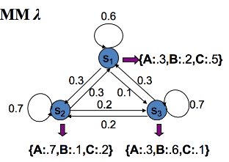
版權聲明
頁碼 | 作品 | 版權標示 | 作者 / 來源
2 |  |  | Lawrence Rabiner, Biing-Hwang Juang / FUNDAMENTALS OF SPEECH RECOGNITION Chap. 6, Sec. 6.2 Discrete-Time Markov Processes, page 323, Prentice-Hall International, Inc.
3 |  |  | 國立臺灣大學電機工程學系李琳山 教授。 本作品採用創用CC「姓名標示-非商業性-相同方式分享3.0臺灣」許可協議。
5 |  |  | 國立臺灣大學電機工程學系李琳山 教授。 本作品採用創用CC「姓名標示-非商業性-相同方式分享3.0臺灣」許可協議。
7 |  |  | 國立臺灣大學電機工程學系李琳山 教授。 本作品採用創用CC「姓名標示-非商業性-相同方式分享3.0臺灣」許可協議。

Slide 55
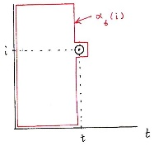
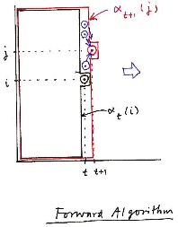
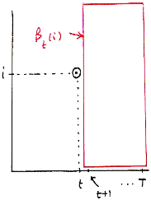
版權聲明
頁碼 | 作品 | 版權標示 | 作者 / 來源
11 |  |  | Lawrence Rabiner, Biing-Hwang Juang / FUNDAMENTALS OF SPEECH RECOGNITION Chap. 6, Sec. 6.2 Discrete-Time Markov Processes, page 323, Prentice-Hall International, Inc.
12 |  |  | 國立臺灣大學電機工程學系李琳山 教授。 本作品採用創用CC「姓名標示-非商業性-相同方式分享3.0臺灣」許可協議。
13 |  |  | 國立臺灣大學電機工程學系李琳山 教授。 本作品採用創用CC「姓名標示-非商業性-相同方式分享3.0臺灣」許可協議。
15 |  |  | 國立臺灣大學電機工程學系李琳山 教授。 本作品採用創用CC「姓名標示-非商業性-相同方式分享3.0臺灣」許可協議。

Slide 56
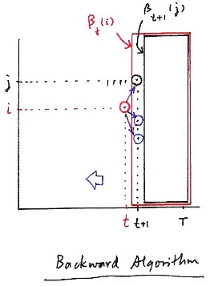
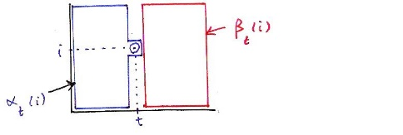
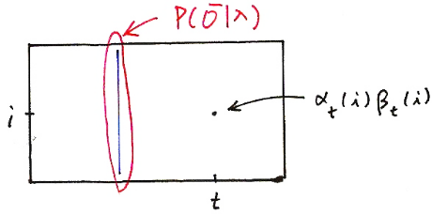
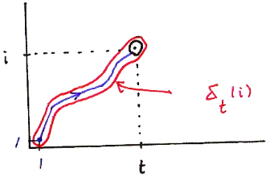
版權聲明
頁碼 | 作品 | 版權標示 | 作者 / 來源
16 |  |  | Lawrence Rabiner, Biing-Hwang Juang / FUNDAMENTALS OF SPEECH RECOGNITION Chap. 6, Sec. 6.2 Discrete-Time Markov Processes, page 323, Prentice-Hall International, Inc.
17 |  |  | 國立臺灣大學電機工程學系李琳山 教授。 本作品採用創用CC「姓名標示-非商業性-相同方式分享3.0臺灣」許可協議。
18 |  |  | 國立臺灣大學電機工程學系李琳山 教授。 本作品採用創用CC「姓名標示-非商業性-相同方式分享3.0臺灣」許可協議。
21 |  |  | 國立臺灣大學電機工程學系李琳山 教授。 本作品採用創用CC「姓名標示-非商業性-相同方式分享3.0臺灣」許可協議。

Slide 57

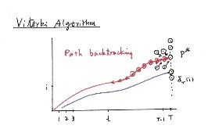
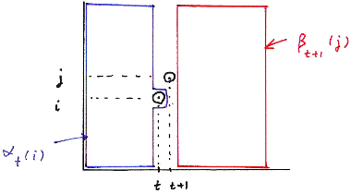
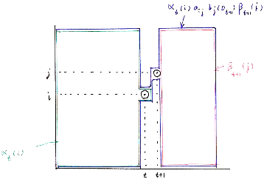
版權聲明
頁碼 | 作品 | 版權標示 | 作者 / 來源
21 |  |  | 國立臺灣大學電機工程學系李琳山 教授。 本作品採用創用CC「姓名標示-非商業性-相同方式分享3.0臺灣」許可協議。
22 |  |  | 國立臺灣大學電機工程學系李琳山 教授。 本作品採用創用CC「姓名標示-非商業性-相同方式分享3.0臺灣」許可協議。
26 |  |  | 國立臺灣大學電機工程學系李琳山 教授。 本作品採用創用CC「姓名標示-非商業性-相同方式分享3.0臺灣」許可協議。
27 |  |  | 國立臺灣大學電機工程學系李琳山 教授。 本作品採用創用CC「姓名標示-非商業性-相同方式分享3.0臺灣」許可協議。

Slide 58

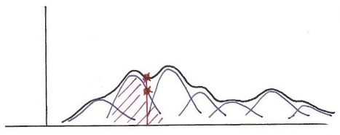
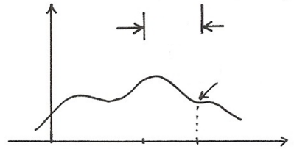

版權聲明
頁碼 | 作品 | 版權標示 | 作者 / 來源
29 |  |  | 國立臺灣大學電機工程學系李琳山 教授。 本作品採用創用CC「姓名標示-非商業性-相同方式分享3.0臺灣」許可協議。
31 |  |  | 國立臺灣大學電機工程學系李琳山 教授。 本作品採用創用CC「姓名標示-非商業性-相同方式分享3.0臺灣」許可協議。
33 |  |  | 國立臺灣大學電機工程學系李琳山 教授。 本作品採用創用CC「姓名標示-非商業性-相同方式分享3.0臺灣」許可協議。
34 |  |  | 國立臺灣大學電機工程學系李琳山 教授。 本作品採用創用CC「姓名標示-非商業性-相同方式分享3.0臺灣」許可協議。

Slide 59
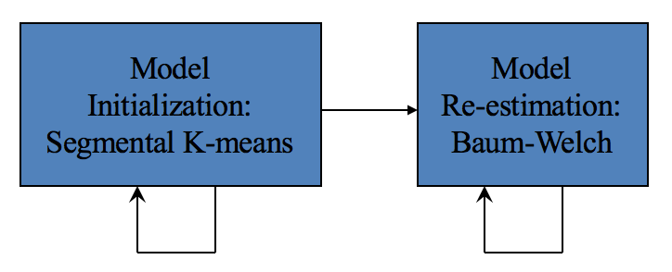
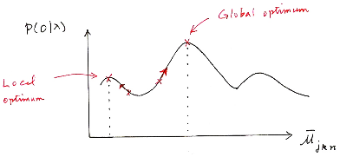

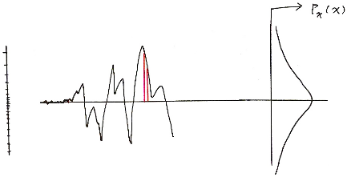
版權聲明
頁碼 | 作品 | 版權標示 | 作者 / 來源
35 |  |  | 國立臺灣大學電機工程學系李琳山 教授。 本作品採用創用CC「姓名標示-非商業性-相同方式分享3.0臺灣」許可協議。
36 |  |  | 國立臺灣大學電機工程學系李琳山 教授。 本作品採用創用CC「姓名標示-非商業性-相同方式分享3.0臺灣」許可協議。
38 |  |  | 國立臺灣大學電機工程學系李琳山 教授。 本作品採用創用CC「姓名標示-非商業性-相同方式分享3.0臺灣」許可協議。
39 |  |  | 國立臺灣大學電機工程學系李琳山 教授。 本作品採用創用CC「姓名標示-非商業性-相同方式分享3.0臺灣」許可協議。

Slide 60
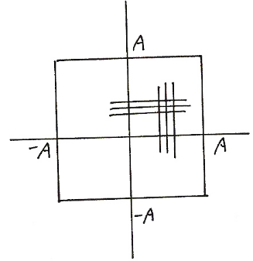
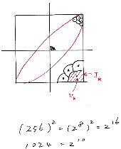

版權聲明
頁碼 | 作品 | 版權標示 | 作者 / 來源
41 |  |  | 國立臺灣大學電機工程學系李琳山 教授。 本作品採用創用CC「姓名標示-非商業性-相同方式分享3.0臺灣」許可協議。
42 |  |  | 國立臺灣大學電機工程學系李琳山 教授。 本作品採用創用CC「姓名標示-非商業性-相同方式分享3.0臺灣」許可協議。
43 |  |  | 國立臺灣大學電機工程學系李琳山 教授。 本作品採用創用CC「姓名標示-非商業性-相同方式分享3.0臺灣」許可協議。
45 |  |  | 國立臺灣大學電機工程學系李琳山 教授。 本作品採用創用CC「姓名標示-非商業性-相同方式分享3.0臺灣」許可協議。

Slide 61
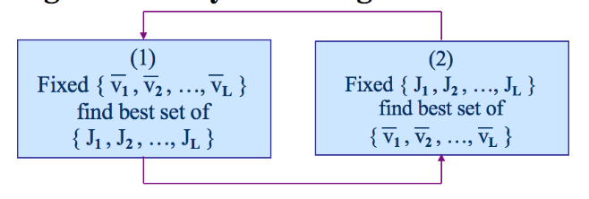



版權聲明
頁碼 | 作品 | 版權標示 | 作者 / 來源
46 |  |  | 國立臺灣大學電機工程學系李琳山 教授。 本作品採用創用CC「姓名標示-非商業性-相同方式分享3.0臺灣」許可協議。
47 |  |  | 國立臺灣大學電機工程學系李琳山 教授。 本作品採用創用CC「姓名標示-非商業性-相同方式分享3.0臺灣」許可協議。
49 |  |  | 國立臺灣大學電機工程學系李琳山 教授。 本作品採用創用CC「姓名標示-非商業性-相同方式分享3.0臺灣」許可協議。
51 |  |  | 國立臺灣大學電機工程學系李琳山 教授。 本作品採用創用CC「姓名標示-非商業性-相同方式分享3.0臺灣」許可協議。

Slide 62


版權聲明
頁碼 | 作品 | 版權標示 | 作者 / 來源
52 |  |  | 國立臺灣大學電機工程學系李琳山 教授。 本作品採用創用CC「姓名標示-非商業性-相同方式分享3.0臺灣」許可協議。
53 |  |  | 國立臺灣大學電機工程學系李琳山 教授。 本作品採用創用CC「姓名標示-非商業性-相同方式分享3.0臺灣」許可協議。

