Slide 1
Classifying Banking Transactions
IBM Advanced Data Science Capstone Project
Wolfram Laube https://github.com/wolfram-laube/ibm-ads-capstone

Slide 2
Use Case / Problem Statement
Periodically, each company needs to generate legally binding statements and analytical reports
Banking transaction are the very core data on basis of which to create these reports and statements
In order to be able to apply business intelligence to them, each transaction must be subjected to categorization.
Manually categorizing is time consuming and error prone
“Given a banking transaction journal entry, can we correlate it with a business category yielding an accuracy of at least 95%?”

Slide 3
Aspired Workflow and Context Embedding
Raw Data
Categorized Data
Aggregated Data
Banking TXs emerge
"05.12.2018";"Erste Bank Oesterreich";"AT052011140005191900";"GIBAATWWXXX";"40005191900";"20111";"-2.326,38";"EUR";"s Kreditkartenrechnung Nov. 2018 s Visa Card Business Gold Kartenendnummer 6011";"201111812032ALV-181203018387";"";"0";"05.12.2018";"";"";"";"";"170602ALV-270/72107807142";"AT68ZZZ00000004435"
ML pipeline transforms & classifies
['kreditkartenrechnung', 'nov', '2018', 'visa', 'card', 'busi', 'gold', 'kartenendnumm', '6011', 'erst', 'bank', 'oesterreich']
->
Business.Bank.Spesen
BI analyzes
#standardSQL select Buchungsdatum, 'Privat' as Konto, Partnername, Kategorie, Buchungstext, cast (Betrag as float64) as Betrag from banking_2018.konto_privat where Kategorie like '%Business.Bank.Spesen%'

Slide 4
Data

Slide 5
Data Description
The data originates from the banking institution’s internet banking platform.
It can be manually downloaded from there in JSON, CSV and Excel format; CSV was chosen.
For the authenticated user, no premium services are available. Thus, there was no option of performing data retrieval through API.

Slide 6
Data Quality Assessment
Completeness
Correctness
Adequateness
Data is excerpted for three consecutive years and all banking accounts of a single user
Data is procured by using intended retrieval method and interface procured by banking institution with no transformation in between
Data constitutes the basis for IRS income declaration statement and thus corresponds to project goal

Slide 7
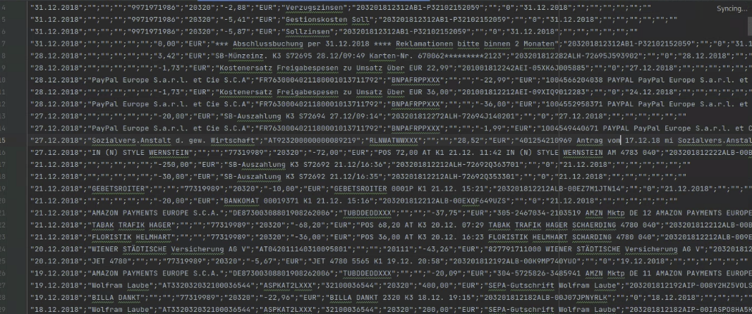
Data Exploration (I)
Type: CSV file, approx. 300 kB

Slide 8
Data Exploration (II)
Header:
"Buchungsdatum";"Partnername";"Partner IBAN";"Partner BIC";"Partner Kontonummer";"Partner Bank-Code (BLZ)";"Betrag";"Währung";"Buchungs-Info";"Buchungsreferenz";"Notiz";"Highlight";"Valutadatum";"Virtuelle Kartennummer";"Bezahlt mit";"App";"Zahlungsreferenz";"Mandats ID";"Creditor ID"

Slide 9
Data Exploration (III)
Caveats:
Encoding: UTF-16
Localization: German (date format, diacritic characters)

Slide 10
ETL / Feature Engineering

Slide 11
Labelling the Data (I)
Define target categories:
Business.Administration.Finanzamt Business.Administration.Sozialversicherung Business.Administration.Sozialversicherung.Andja Business.Administration.Sozialversicherung.Wolf Business.Administration.Steuerberatung Business.Administration.Tourismus Business.Administration.Wirtschaftskammer Business.Bank.Einlage Business.Bank.Entnahme Business.Bank.Spesen Business.Bank.Übertrag Business.Honorar Business.Infrastruktur.Geräte Business.Infrastruktur.Medien Business.Mobilität.Zug.Ausland Business.Mobilität.Zug.Inland Privat.Auto.Kraftstoff Privat.Auto.Kredit Privat.Auto.Instandhaltung Privat.Auto.Strafe Privat.Auto.Versicherung Privat.Gesundheit.Arzt Privat.Gesundheit.Heilbehelfe Privat.Haus.Garten Privat.Haus.Geräte Privat.Haus.Kredit Privat.Haus.Kredit.Versicherung Privat.Haus.Instandhaltung Privat.Haus.Strom Privat.Haus.Versicherung Privat.Haus.Wasser Privat.Leben.Hygiene Privat.Leben.Kirche Privat.Leben.Kleidung Privat.Leben.Nahrung Privat.Leben.Rauchen Privat.Leben.Schule Privat.Leben.Wirtshaus Privat.Medien

Slide 12
Labelling the Data (II)
Load data into pandas dataframe
semi-automatically pre-label using pandasql and a set of casuistic SQL statements
manually post-label inspecting and correcting erreneous or missing classifications

Slide 13
Feature Engineering
Step 1
Step 2
Step 3
Extract features
concatenate transaction text and partner name
strip off non-alphanumerical characters
lowercase resulting text
Create bag of words
using NLTK’s word_tokenizer
Post-process for higher performance
purge stop words
do Porter-stemming
"05.12.2018";"Erste Bank Oesterreich";"AT052011140005191900";"GIBAATWWXXX";"40005191900";"20111";"-2.326,38";"EUR";"s Kreditkartenrechnung Nov. 2018 s Visa Card Business Gold Kartenendnummer 6011";"201111812032ALV-181203018387";"";"0";"05.12.2018";"";"";"";"";"170602ALV-270/72107807142";"AT68ZZZ00000004435" -> ['kreditkartenrechnung', 'nov', '2018', 'visa', 'card', 'busi', 'gold', 'kartenendnumm', '6011', 'erst', 'bank', 'oesterreich']

Slide 14
Modelling

Slide 15
Modelling Steps
Define Model
Split & Train
Measure Performance
Gaussian Naive Bayes
Train / Test Ratio: 80% - 20%
KPI: accuracy

Slide 16
Choice of Model
Gaussian Naive Bayes (“Idiot’s Bayes”) was chosen because
classification is based on independent words
Gaussian NB is a widely used NLP classifier
it yields surprisingly good results
performs well on constrained resources

Slide 17
Train and Test
The labelled data was split into
Train set: approx. 3600 samples
Test set: approx. 700 samples
yielding a rough 80% - 20% quota ( ⅚ : ⅙ ).

Slide 18
Performance
The given training scenario yields the following metrics (for details as confusion matrix and classification report see accompanying detailed summary document):
accuracy: 0.96
F1 score: 0.96
The project goal of achieving a classification accuracy of 95%+ has thus been met

Slide 19
Further Resources
Due to brevity imperative and presentation constraints, not all information could be displayed here. Especially, performance details are omitted because they would not have fit. All resources necessary for grading are however available on https://github.com/wolfram-laube/ibm-ads_capstone/

