Slide 1
Control Structures
Control constructs:
1. do loop
2. if clause
3. case construct
4. go to statement
• the general form is a block construct
• key words at beginning and end of each block

Slide 2
if Statement and Construct
• if statement:
tests logical expression and executes single statement
• Form:
if (scalar logical expression) action-stmt
– Example:
if (a .gt. b) x=a

Slide 3
if Statement and Construct
• if construct:
allows the execution more than one statement, or the
execution of alternative statements depending on alternative
conditions.
• Form:
if (scalar logical expression) then
block
end if
• Example:
if (a .gt. b) then
cp = a
a = b
b=cp
endif
!exchange a and b

Slide 4
if Construct (cont’d)
• if then – else – endif
• Form:
if ( scalar logical expr ) then
block1
else
block2
endif

Slide 5
if Construct (cont’d)
• if then – elseif then – [elseif then] – [else] – endif
• Form:
if ( scalar logical expr ) then
block1
else if ( scalar logical expr ) then
block2
else
block3
endif

Slide 6
Nested if Construct
if constructs can be nested
Example: Calculate the square root of x/y
if (y .ne. 0.0) then ! Square root of x/y
if (x/y .ge. 0.0) then
sr = sqrt(x/y)
else
write(*,*) ‘Argument is negative’
endif
else
write(*,*) ‘You are dividing by zero!’
endif

Slide 7
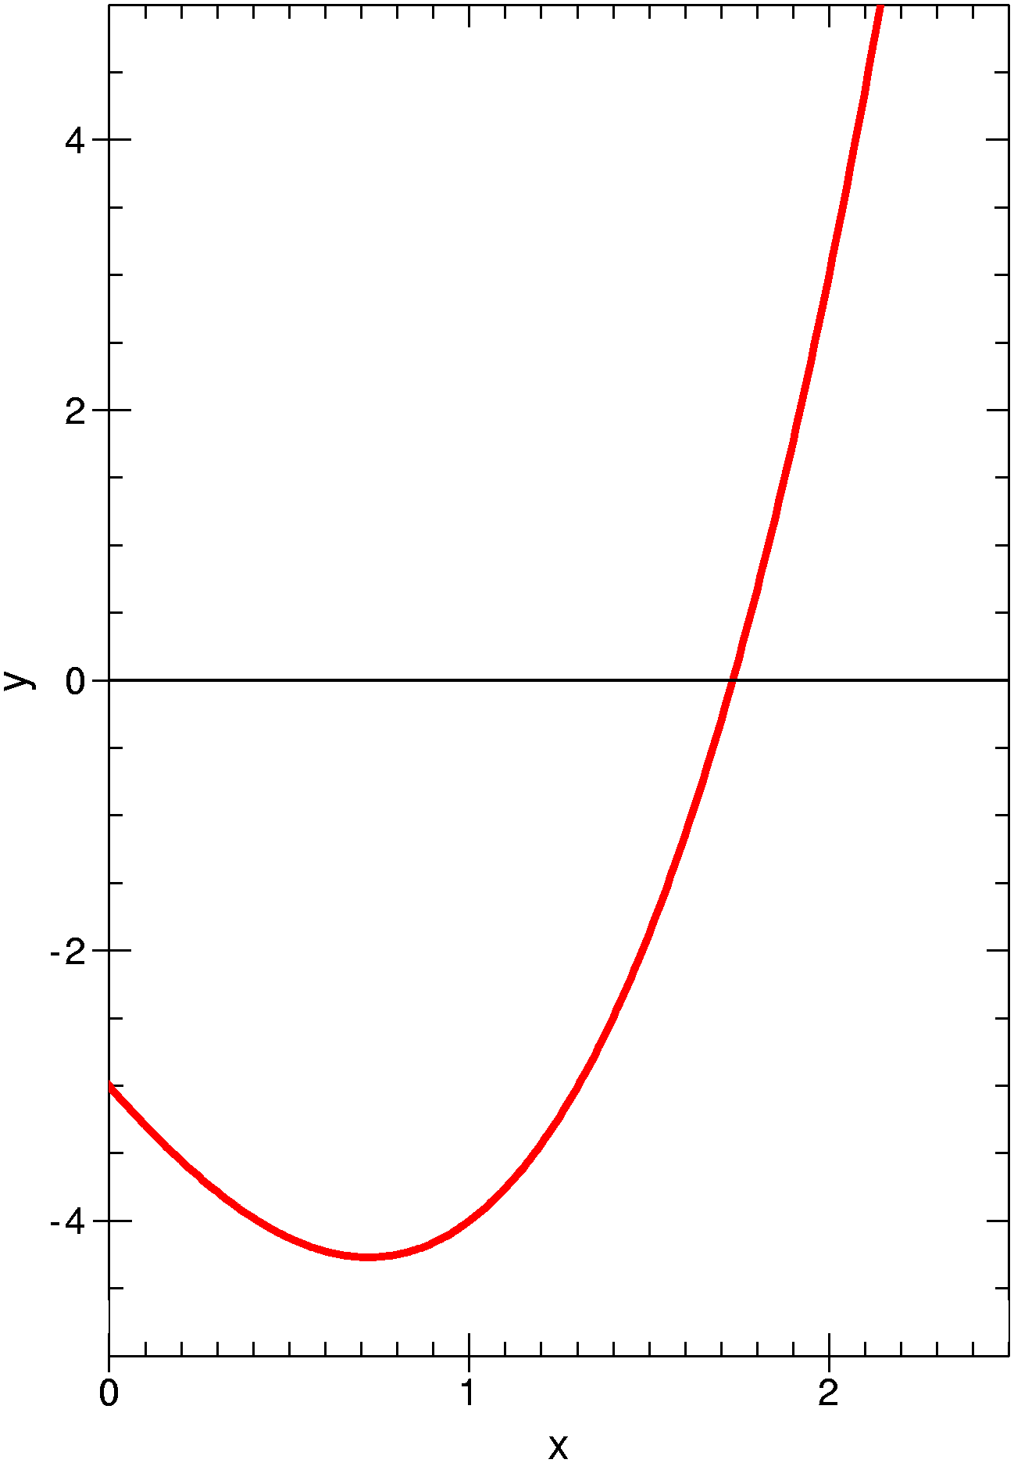
Example: Bisection Method
Consider a cubic function
Find the root of f(x) that is accurate
within a specified tolerance value
REPEAT
Set x₃ = (x₁ + x₂) /2.
IF f(x₃) * f(x₁) < 0.
Set x₂ = x₃
ELSE Set x₁ = x₃
ENDIF
UNTIL (|x₁ - x₂|) < Tol OR f(x₃) = 0

Slide 8
case Construct
The case construct is very similar to the if construct.
For the case construct only one expression is evaluated for testing
select case (case-expr)
case (1st case-selector)
things that need to be done for case 1
case (2nd case-selector)
things that need to be done for case 2
….
[case default]
end select [name]
case-expression must be a scalar and can be integer, logical, or character
case-selector must agree with the type of the case-expression

Slide 9
case Construct
Example
select case (color) !color is of type character
case (‘red’)
write(*,*) ‘STOP’
case (‘green’)
write(*,*) ‘GO’
case (‘yellow’)
write(*,*) ‘Be Careful’
case default
write(*,*) ‘Something is wrong. Check the traffic light’
end select [name]
case default selects all the other possible values of case-expression that are not included in the other selectors of the construct

Slide 10
case Construct
If the case-expression is of type integer, we can have:
case (1, 2, 5, 7:9, 12) ! selects the values 1, 2, 5, 7, 8 , 9, 12
case (:-1) ! all values below 0
case (0) ! only 0
case(1:) ! all values above zero
do
read(10,*, iostat = ios) xvalue
select case (ios)
case (-1) ; exit
case (1:) ; cycle
end select
write(*,*) xvalue
end do

Slide 11
goto Statement
• Statement: go to label
• Purpose: execution of program jumps to statement label label
• Example:
x = y + 3.0
goto 2
x = x + 2.0
2 write(*,*) x
• Note: A goto statement must never branch into a block construct, but it can be used to exit from a block construct.

Slide 12
Sub-Dividing a Program
Most programs are thousands of lines
Often you use similar code in several places
Often you want to test just a part of the code
Problem can often be broken up into natural steps
---> All programmers use procedures

Slide 13
Procedures
Each program must have a single main program
There are subroutines and functions that are collectively called procedures
Intrinsic procedures are defined by the language and don’t need to be defined or declared (sin, cos, exp, …)
External procedures can be located in separate files and have global scope
Internal procedures have a more limited access and can only appear in the main program or in an external procedure (host)
Module procedures can only be defined within a module unit and can only be accessed by the use statement

Slide 14
Procedures
A subroutine or a function is a procedure that can be called during the execution of a program
A subroutine is some out-of-line code.
There are very few restrictions on what it can do.
A function has the purpose to return a result.
There are restrictions on what it can do.

Slide 15
program scalar_product
implicit none
real :: u(3), v(3)
integer :: j
real :: a
!Initialize the two vectors
u = 1.0
v = 2.0
a = 0.0
do j = 1, 3
a = a + u(j)*v(j)
end do
write(*,*) 'The scalarproduct is:', a
stop
end program scalar_product
scapro_only_main.f90

Slide 16
functions
Purpose:
Functions are passed some arguments, and they return a result. They do not change their arguments.
Example: Scalar Product
program main
implicit none
real :: scapro, u(3), v(3), a
…
a = scapro(u, v)
…
end program main
FUNCTION SCAPRO (U, V)
IMPLICIT NONE
REAL :: SCAPRO
REAL, INTENT(IN) :: U(3),V(3)
INTEGER :: J
SCAPRO =0.0
DO J=1,3
SCAPRO=SCAPRO+U(J)*V(J)
END DO
RETURN
END FUNCTION SCAPRO

Slide 17
functions
Dummy Arguments
Example: Scalar Product
program main
implicit none
real :: scapro, u(3), v(3), a
…
a = scapro(u, v)
…
end program main
FUNCTION SCAPRO (U,V)
IMPLICIT NONE
REAL :: SCAPRO
REAL, INTENT(IN) :: U(3), V(3)
INTEGER :: J
SCAPRO =0.0
DO J=1,3
SCAPRO=SCAPRO+U(J)*V(J)
END DO
RETURN
END FUNCTION SCAPRO
Actual Arguments
U and V have explicit shape

Slide 18
functions
scalar_product_explicit-SF.f90
Example: Scalar Product
program main
implicit none
integer, parameter :: n=5
real :: scapro, u(n), v(n), a
…
a = scapro(u, v, n)
…
end program main
FUNCTION SCAPRO (U, V, N)
IMPLICIT NONE
REAL :: SCAPRO
INTEGER, INTENT(IN) :: N
REAL, INTENT(IN) :: U(N),V(N)
INTEGER :: J
SCAPRO =0.0
DO J=1, N
SCAPRO=SCAPRO+U(J)*V(J)
END DO
RETURN
END FUNCTION SCAPRO
U and V have explicit shape
but are also adjustable

Slide 19
functions
scapro_assumed_shape.f90
Example: Scalar Product
program main
implicit none
integer, parameter :: n=5
real :: scapro, u(n), v(n), a
…
a = scapro(u, v)
…
end program main
FUNCTION SCAPRO (U, V)
IMPLICIT NONE
REAL :: SCAPRO
REAL, INTENT(IN) :: U(:),V(:)
INTEGER :: J
SCAPRO =0.0
DO J=1, SIZE(U)
SCAPRO=SCAPRO+U(J)*V(J)
END DO
RETURN
END FUNCTION SCAPRO
U and V have assumed shape
An assumed-shape array is a dummy argument that assumes the shape of the corresponding actual argument.

Slide 20
Using Assumed-Shape Arrays
If a function (or a subroutine) has an argument that is an assumed-shape array, than its interface must be explicit in the program unit that calls the function.
There are two ways how this can be done:
1. The function (subroutine) is an internal part of the unit that calls it

Slide 21
Internal Functions
The function (subroutine) is an internal part of the unit that calls it:
program main
implicit none
integer, parameter :: n=5
real :: scapro, u(n), v(n), a
…
a = scapro(u, v)
…
contains
function scapro(u, v)
…
end function scapro
end program main
The internal part appears after the contains statement at the end of the program unit.
scapro_internal_SF.f90

Slide 22
Using Assumed-Shape Arrays
If a function (or a subroutine) has an argument that is an assumed-shape array, than its interface must be explicit in the program unit that calls the function.
There are two ways how this can be done:
1. The function (subroutine) is an internal part of the unit that calls it
2. External functions (subroutines) must be declared in an interface block. This will make the interface explicit.

Slide 23
Interface Block
program main
implicit none
integer, parameter :: n=5
real :: u(n), v(n), a
interface
function scapro(u,v)
implicit none
real, intent(in) :: u(:),v(:)
real :: scapro
end function scapro
end interface
…
a = scapro(u, v)
…
end program main
External functions (subroutines) that include assumed-shaped arrays must be declared in an interface block.
The interface block appears
in the declaration part of the program unit that calls the function.

Slide 24
Assumed Shape Arrays and Interface Blocks
program main
implicit none
integer, parameter :: n=5
real :: u(n), v(n), a
interface
function scapro(u,v)
implicit none
real, intent(in) :: u(:), v(:)
real :: scapro
end function scapro
end interface
…
a = scapro(u, v)
…
end program main
FUNCTION SCAPRO (U, V)
IMPLICIT NONE
REAL :: SCAPRO
REAL, INTENT(IN) :: U(:),V(:)
INTEGER :: J
SCAPRO =0.0
DO J=1, SIZE(U)
SCAPRO=SCAPRO+U(J)*V(J)
END DO
RETURN
END FUNCTION SCAPRO
scapro_assumed_shape.f90

Slide 25
Assumed Shape Arrays and Interface Blocks
program main
implicit none
integer, parameter :: n=5
real :: u(n), v(n), a
interface
function scapro(u,v)
implicit none
real, intent(in) :: u(:), v(:)
real :: scapro
end function scapro
end interface
…
a = scapro(u(1:3), v(2:4))
…
end program main
FUNCTION SCAPRO (U, V)
IMPLICIT NONE
REAL :: SCAPRO
REAL, INTENT(IN) :: U(:),V(:)
INTEGER :: J
SCAPRO =0.0
DO J=1, SIZE(U)
SCAPRO=SCAPRO+U(J)*V(J)
END DO
RETURN
END FUNCTION SCAPRO
scapro_assumed_shape.f90

Slide 26
Array-Valued Functions
So far the result of the function was a scalar (e.g., just one number).
Sometimes it would be useful if we could call a function and the result would be an array.
In this case the function is called an array-valued function.
Example: Adding two vectors together
If the result of a function call is array-valued, we must use an explicit interface (unless using “contains”).

Slide 27
Array-Valued Functions
program main
implicit none
integer, parameter :: n=5
real :: u(n), v(n), sum(n)
interface
function vec_sum(u,v)
implicit none
real, intent(in) :: u(:), v(:)
real, dimension(size(u)) :: vec_sum
end function vec_sum
end interface
…
sum = vec_sum(u, v)
…
end program main
FUNCTION VEC_SUM (U, V)
IMPLICIT NONE
REAL, INTENT(IN) :: U(:), V(:)
REAL, DIMENSION(SIZE(U)) :: VEC_SUM
INTEGER :: J
DO J=1, SIZE(U)
VEC_SUM(J) = U(J) + V(J)
END DO
RETURN
END FUNCTION VEC_SUM
vec_sum_function.f90

Slide 28
subroutines
Purpose:
Subroutines are program units that receive arguments, and can change them.
Example:
program main
implicit none
real :: x(5), y(5), sum(5)
…
call vec_sum(x,y,sum)
…
end program main

Slide 29
subroutines
subroutine vec_sum (x, y, sum)
implicit none
real, intent(in) :: x(:), y(:)
real, intent(out) :: sum(:)
integer :: j
do j=1, size(x)
sum(j) = x(j) + y(j)
end do
end subroutine vec_sum
Here we use again assumed-shape arrays
We either make the subroutine an internal part (use contains) or we need to use the explicit interface block.

Slide 30
subroutines
program main
implicit none
integer, parameter :: n=5
real :: u(n), v(n), sum(n)
interface
subroutine vec_sum(u,v,sum)
implicit none
real, intent(in) :: u(:), v(:)
real, intent(out) :: sum(:)
end subroutine vec_sum
end interface
…
call vec_sum(u, v, sum)
…
end program main
subroutine vec_sum (x, y, sum)
implicit none
real, intent(in) :: x(:), y(:)
real, intent(out) :: sum(:)
integer :: j
do j=1, size(x)
sum(j) = x(j) + y(j)
end do
end subroutine vec_sum
vec_sum_subroutine.f90

