Slide 1
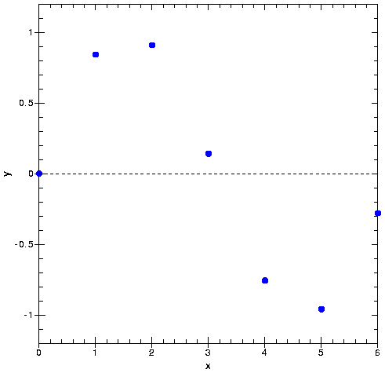
Interpolation
Let’s assume we have a set of measurements:
x | y
----------------------
0 | 0
1 | 0.8415
2 | 0.9093
3 | 0.1411
4 | -0.7568
5 | -0.9589
6 | -0.2794

Slide 2
Interpolation
Interpolation is a method to approximate a function, f, at a desired location, x, given a set of n+1 support points (x and y values)

Slide 3
Interpolation
Interpolation is a method to approximate a function, f, at a desired location, x, given a set of n+1 support points (x and y values)
Let’s consider a family of functions, Φ, that is characterized by n+1 parameters, c₀, c₁,….., c_{n} and our variable x
Interpolation tries to determine the coefficients c_{i}, so that

Slide 4
Types of Interpolation
Linear Interpolation: The function Φ depends linearly on the c_{i}’s
1. Polynominal: Φ = c₀ +c₁x +…+c_{n}x^{n}
2. Splines: nonlocal interpolation
3. Trigonometric: Φ = c₀ +c₁e^{ix} +…+c_{n}e^{inx}
(Fourier analysis, Fast Fourier Transforms)
Nonlinear Interpolation: Φ depends nonlinearly on the c_{i}’s
1. Rational Functions:
Rational functions are a good choice if the function that we want to interpolate has a pole in the region of interest.

Slide 5
Polynominal Interpolation
Linear Interpolation
A linear function interpolating between the first two values can be written as:

Slide 6
Polynominal Interpolation
We can easily see that the function P_{0,1} is of degree 1 and satisfies
We can rewrite this as:

Slide 7
Polynominal Interpolation
The functions L₀⁽¹⁾ and L₁⁽¹⁾ are examples of Lagrange interpolating polynominals. They have the property

Slide 8
Polynominal Interpolation
The slope between the 1st and 2nd and between the 2nd and 3rd data point dramatically changes.

Slide 9
Polynominal Interpolation
A better interpolation might be obtained by taking the change in the slope into account by selecting polynominals with curvature
A polynominal of degree 2 that passes through the points 0, 1, and 2 can be written as:

Slide 10
Polynominal Interpolation
Back to our example:
x | y
----------------------
0 | 0
1 | 0.8415
2 | 0.9093
3 | 0.1411
4 | -0.7568
5 | -0.9589
6 | -0.2794

Slide 11
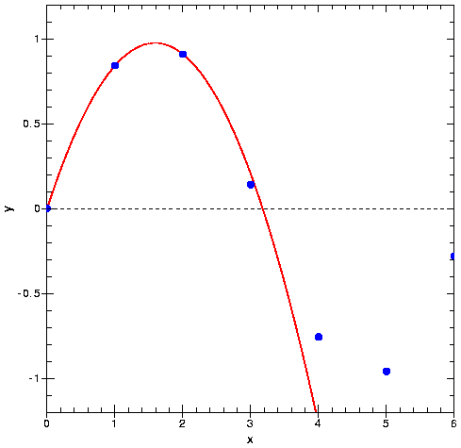
Polynominal Interpolation
A Parabola through the first three points

Slide 12
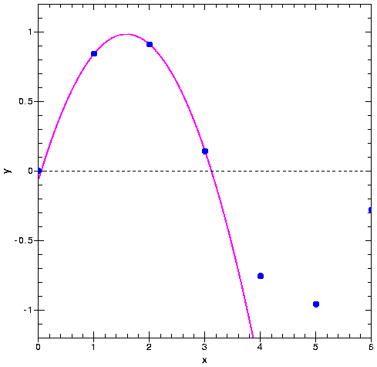
Polynominal Interpolation
A Parabola through point 1, 2, and 3

Slide 13
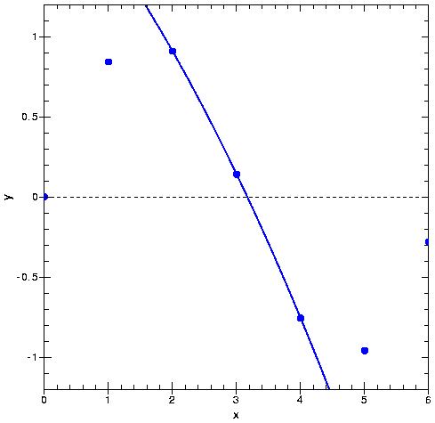
Polynominal Interpolation
A Parabola through points 2, 3, and 4

Slide 14
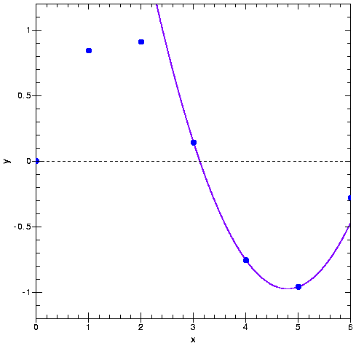
Polynominal Interpolation
A Parabola through points 3, 4, and 5

Slide 15
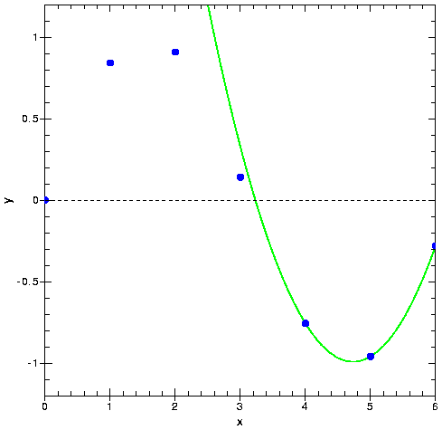
Polynominal Interpolation
A Parabola through the final three points

Slide 16
Polynominal Interpolation
Let’s include all n+1 points, which will result in a polynominal of degree n.
Construct this polynominal from higher degree Lagrange interpolation polynominals:
So far our Lagrange polynominals looked like:
First Order
Second Order
n^{th} Order:

Slide 17
Polynominal Interpolation
The higher order Lagrange Polynominals are
The final polynominal that passes through all n+1 points is than gives as:

Slide 18
Polynominal Interpolation
For our example with the seven points

Slide 19
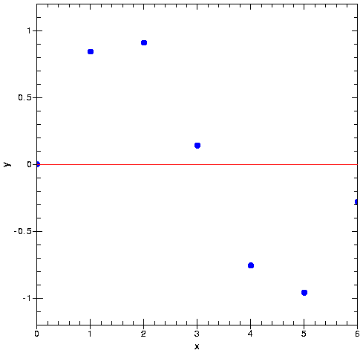
First Term
Back to our example:
x | y
----------------------
0 | 0
1 | 0.8415
2 | 0.9093
3 | 0.1411
4 | -0.7568
5 | -0.9589
6 | -0.2794

Slide 20
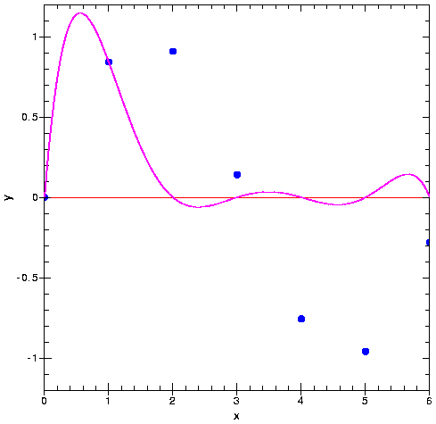
Interpolation
Back to our example:
2nd Term in Series
x | y
----------------------
0 | 0
1 | 0.8415
2 | 0.9093
3 | 0.1411
4 | -0.7568
5 | -0.9589
6 | -0.2794

Slide 21
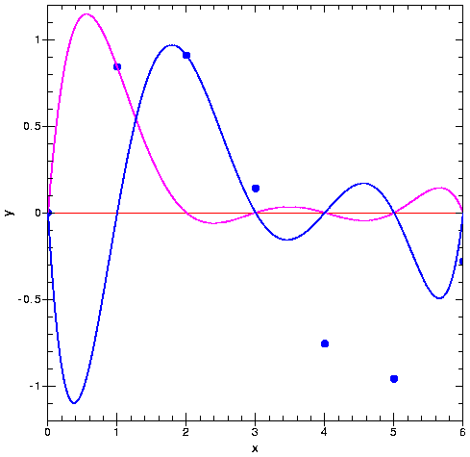
Interpolation
Back to our example:
3rd Term in Series
x | y
----------------------
0 | 0
1 | 0.8415
2 | 0.9093
3 | 0.1411
4 | -0.7568
5 | -0.9589
6 | -0.2794

Slide 22
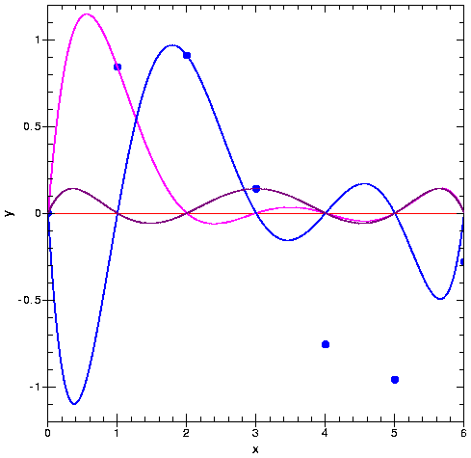
Interpolation
Back to our example:
4th Term in Series
x | y
----------------------
0 | 0
1 | 0.8415
2 | 0.9093
3 | 0.1411
4 | -0.7568
5 | -0.9589
6 | -0.2794

Slide 23
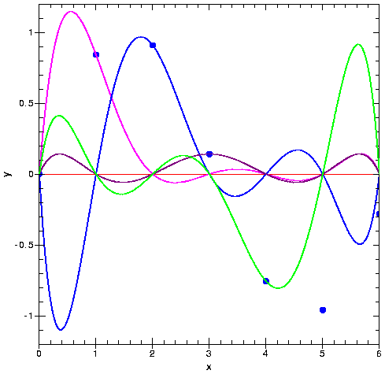
Interpolation
Back to our example:
5th Term in Series
x | y
----------------------
0 | 0
1 | 0.8415
2 | 0.9093
3 | 0.1411
4 | -0.7568
5 | -0.9589
6 | -0.2794

Slide 24
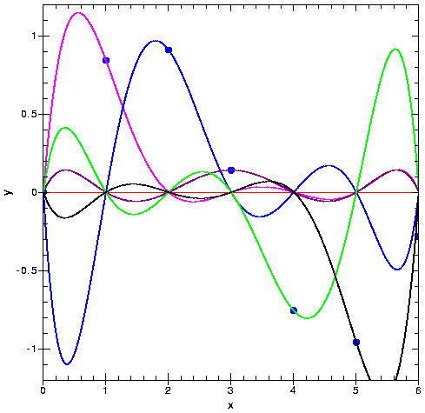
Interpolation
Back to our example:
6th Term in Series
x | y
----------------------
0 | 0
1 | 0.8415
2 | 0.9093
3 | 0.1411
4 | -0.7568
5 | -0.9589
6 | -0.2794

Slide 25
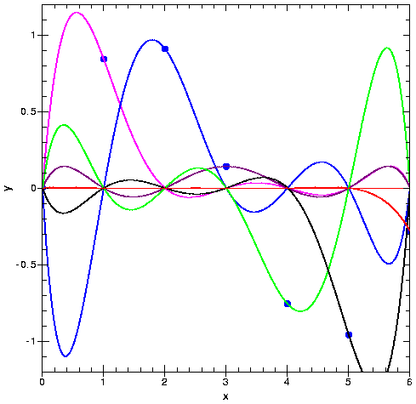
Interpolation
Back to our example:
7th Term in Series
x | y
----------------------
0 | 0
1 | 0.8415
2 | 0.9093
3 | 0.1411
4 | -0.7568
5 | -0.9589
6 | -0.2794

Slide 26
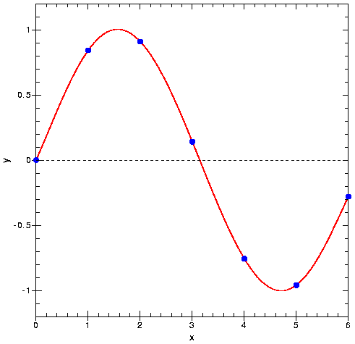
Interpolation
Back to our example:
All Terms added together
x | y
----------------------
0 | 0
1 | 0.8415
2 | 0.9093
3 | 0.1411
4 | -0.7568
5 | -0.9589
6 | -0.2794
P(x) = - 0.0001521*x⁶ - 0.003130*x⁵ + 0.07321*x⁴
- 0.3577*x³ + 0.2255*x² + 0.9038*x

Slide 27
Existence and Uniqueness
For n+1 arbitrary support points (x_{i}, y_{i}) where x₀ < x₁ <… < x_{n}, there exists a unique n-th order polynominal which satisfies
Existence: Construct the Lagrange polynominals as before
If we construct our polynominal as:
than this polynominal has in fact n-th order and satisfies

Slide 28
Existence and Uniqueness
Uniqueness: (show by method of contradiction)
Let’s assume that P₁ and P₂ are n-th order polynominals that both satisfy P(x_{i}) = y_{i} for 0 ≤ i ≤ n.
If we construct the polynominal P₃= P₁ - P₂ , than P₃ is at most an n-th order polynominal with at most n distinct roots z_{i}
(From complete factorization)
However,
Consequently, our assumption is wrong and P₃ can only be equal 0
---> P₁ = P₂

