Slide 1
Error Estimation
An interpolating polynominal, while passing through the support points used in its construction does not, in general, give exactly the correct values when used for interpolation.
The error that we make is given by
Error at support points is zero
Let’s look at an auxiliary function W(t), defined as:

Slide 2
Error Estimation
Let’s examine the zeros (roots) of W(t):
For t= x₀, x₁,…,x_{n} the function W(t) is zero: (n+1) times
For t= x the function W(t) is also zero.
---> W(t) is zero at least a total of n+2 times.
Let’s assume that W(t) is continuous and differentiable.
This assumption is true whenever the original function is also continuous and differentiable.

Slide 3
Error Estimation
Between each of the n+2 zeros of W(t) we find a zero of W’(t)
---> W’(t) has a total of at least n+1 zeros.
---> W’’(t) has a total of at least n zeros.
---> ……
---> W^{n+1}(t) has at least one zero in the interval that has x₀, x_{n}, or x as endpoints. Let’s call this value ξ.

Slide 4
Error Estimation
With this our error function becomes:
with ξ being in the interval that has x₀, x_{n}, or x as endpoints.

Slide 5
Error Estimation
Back to our example:
We had seven points ------> n+1 =7
The data looked suspiciously close to a sine-function
The seventh derivative of sin(x) is bounded by ± 1

Slide 6
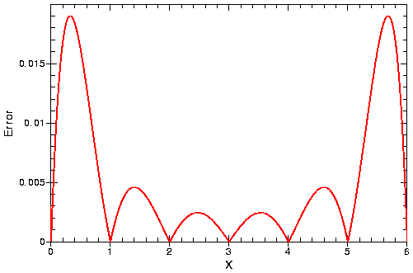
Error Estimation
Error for our approximation of the 7 sine-function data points
Estimated Error

Slide 7
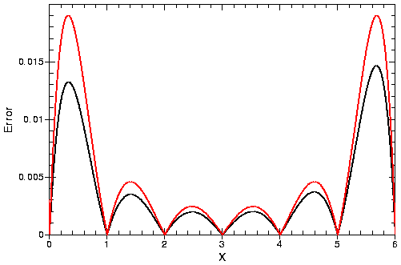
Error Estimation
Error for our approximation of the 7 sine-function data points
Estimated Error
Actual Error : P(x)-sin(x)

Slide 8
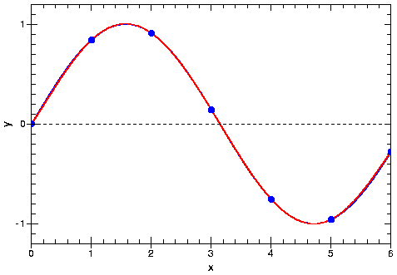
Error Estimation
Error for our approximation of the 7 sine-function data points
Estimated Error
Actual Error : P(x)-sin(x)

Slide 9
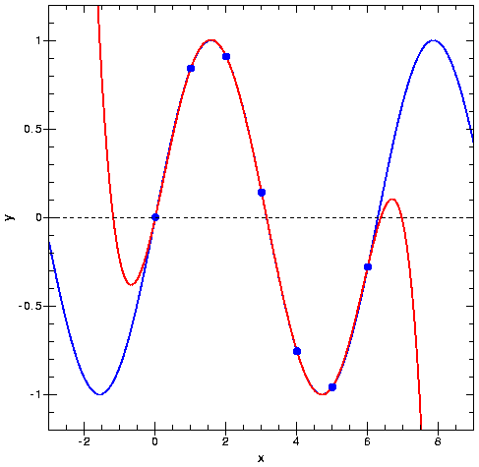
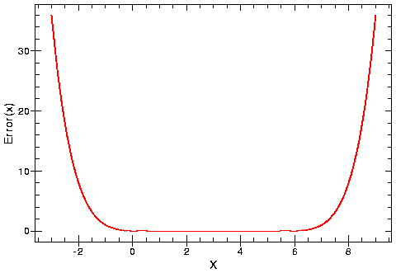
Extrapolation
We can use the interpolating polynominals to extrapolate outside of our original data area

Slide 10
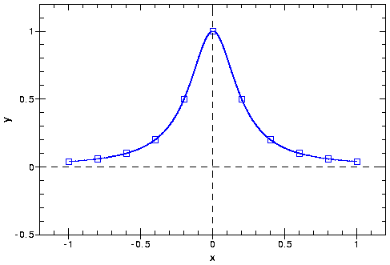
Difficult Data
The Runge Function:
11 Points
The Runge function is a smooth function.

Slide 11
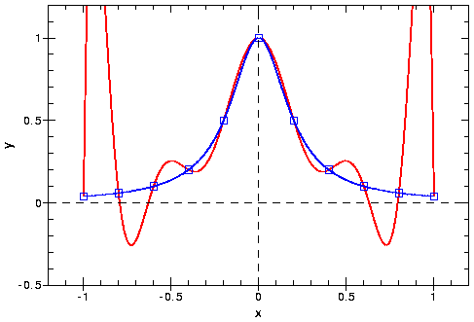
Difficult Data
The Runge Function:
11 Points
The interpolating polynominal oscillates toward the end of the interpolation interval.

Slide 12
Computer Program
The numerator is the product
And the denominator is the product

Slide 13
Computer Program
Tasks:
 Our Program should read n+1 data pairs from a file
 The Coefficients c_{n} need to be calculated and stored (in a vector)
 The Polynominal P(x) needs to be calculated at 101 points between x₀ and x_{n}
 The Results should be written out on the screen

Slide 14
PROGRAM LAGRANGE_INTERPOLATION
IMPLICIT NONE
INTEGER, PARAMETER :: MAXPOINTS=20
INTEGER :: ISTEP, NPOINTS
REAL :: X(MAXPOINTS), Y(MAXPOINTS) !ORIGINAL DATA SET
REAL :: XP, POLY !INTERPOLATED DATA
REAL :: XMIN, XMAX, DX, STEP
REAL, ALLOCATABLE :: LCOEF (:) !LAGRANGE COEFFICIENTS
INTERFACE
…..
END INTERFACE
!READ DATA FROM FILE DATA.DAT
……
!END READ DATA FRM FILE
!GET COEFFICIENTS FOR LAGRANGE POLYNOMINALS
!USE ARRAY_VALUED FUNCTION
ALLOCATE (LCOEF(NPOINTS))
LCOEF = CK (X, Y, NPOINTS)
!GET THE MINIMUM AND MAXIMUM X-VALUE
XMIN=MINVAL(X(1:NPOINTS))
XMAX=MAXVAL(X(1:NPOINTS))
!CALCULATE THE LAGRANGE POLYNOMINAL FROM
!XMIN TO XMAX IN 101 STEPS
…….
!END CALCULATE THE LAGRANGE POLYNOMINALS
STOP
END PROGRAM LAGRANGE_INTERPOLATION
lagrange_interp.f90

Slide 15
PROGRAM LAGRANGE_INTERPOLATION
IMPLICIT NONE
INTEGER, PARAMETER :: MAXPOINTS=20
INTEGER :: ISTEP,NPOINTS
REAL :: X(MAXPOINTS),Y(MAXPOINTS) !ORIGINAL DATA SET
REAL :: XP,POLY !INTERPOLATED DATA
REAL :: XMIN,XMAX,DX,STEP
REAL, ALLOCATABLE :: LCOEF(:)
INTERFACE
…..
END INTERFACE
!READ DATA FROM FILE DATA.DAT
……
!END READ DATA FRM FILE
!GET COEFFICIENTS FOR LAGRANGE POLYNOMINALS
!USE ARRAY_VALUED FUNCTION
ALLOCATE (LCOEF(NPOINTS))
LCOEF = CK (X, Y, NPOINTS)
!GET THE MINIMUM AND MAXIMUM X-VALUE
XMIN=MINVAL(X(1:NPOINTS))
XMAX=MAXVAL(X(1:NPOINTS))
!CALCULATE THE LAGRANGE POLYNOMINAL FROM
!XMIN TO XMAX IN 101 STEPS
…….
!END CALCULATE THE LAGRANGE POLYNOMINALS
STOP
END PROGRAM LAGRANGE_INTERPOLATION
INTERFACE
FUNCTION CK(X, Y, NPOINTS)
IMPLICIT NONE
REAL, INTENT (IN) :: X(:), Y(:)
INTEGER, INTENT(IN) :: NPOINTS
REAL, DIMENSION(NPOINTS) :: CK
END FUNCTION CK
FUNCTION LAGRANGE(XP, X, LCOEF, NPOINTS)
IMPLICIT NONE
REAL :: LAGRANGE
REAL, INTENT(IN) :: XP, X(:), LCOEF(:)
INTEGER, INTENT(IN) :: NPOINTS
END FUNCTION LAGRANGE
END INTERFACE

Slide 16
PROGRAM LAGRANGE_INTERPOLATION
IMPLICIT NONE
INTEGER, PARAMETER :: MAXPOINTS=20
INTEGER :: ISTEP,NPOINTS
REAL :: X(MAXPOINTS),Y(MAXPOINTS) !ORIGINAL DATA SET
REAL :: XP,POLY !INTERPOLATED DATA
REAL :: XMIN,XMAX,DX,STEP
REAL, ALLOCATABLE :: LCOEF(:)
INTERFACE
…..
END INTERFACE
!READ DATA FROM FILE DATA.DAT
……
!END READ DATA FRM FILE
!GET COEFFICIENTS FOR LAGRANGE POLYNOMINALS
!USE ARRAY_VALUED FUNCTION
ALLOCATE (LCOEF(NPOINTS))
LCOEF = CK (X, Y, NPOINTS)
!GET THE MINIMUM AND MAXIMUM X-VALUE
XMIN=MINVAL(X(1:NPOINTS))
XMAX=MAXVAL(X(1:NPOINTS))
!CALCULATE THE LAGRANGE POLYNOMINAL FROM
!XMIN TO XMAX IN 101 STEPS
…….
!END CALCULATE THE LAGRANGE POLYNOMINALS
STOP
END PROGRAM LAGRANGE_INTERPOLATION
!READ DATA FROM FILE DATA.DAT
OPEN(10, FILE = ’DATA.DAT', STATUS='OLD')
NPOINTS = 0
DO
NPOINTS = NPOINTS+1
IF (NPOINTS .GT. MAXPOINTS) THEN
WRITE(*,*) 'TOO MANY POINTS'
STOP
END IF
READ(10,*, END = 99) X(NPOINTS), Y(NPOINTS)
END DO
99 NPOINTS = NPOINTS - 1
CLOSE(10)

Slide 17
PROGRAM LAGRANGE_INTERPOLATION
IMPLICIT NONE
INTEGER, PARAMETER :: MAXPOINTS=20
INTEGER :: ISTEP,NPOINTS
REAL :: X(MAXPOINTS),Y(MAXPOINTS) !ORIGINAL DATA SET
REAL :: XP,POLY !INTERPOLATED DATA
REAL :: XMIN,XMAX,DX,STEP
REAL, ALLOCATABLE :: LCOEF(:)
INTERFACE
…..
END INTERFACE
!READ DATA FROM FILE DATA.DAT
……
!END READ DATA FRM FILE
!GET COEFFICIENTS FOR LAGRANGE POLYNOMINALS
!USE ARRAY_VALUED FUNCTION
ALLOCATE ( LCOEF(NPOINTS) )
LCOEF = CK (X, Y, NPOINTS)
!GET THE MINIMUM AND MAXIMUM X-VALUE
XMIN=MINVAL(X(1:NPOINTS))
XMAX=MAXVAL(X(1:NPOINTS))
!CALCULATE THE LAGRANGE POLYNOMINAL FROM
!XMIN TO XMAX IN 101 STEPS
…….
!END CALCULATE THE LAGRANGE POLYNOMINALS
STOP
END PROGRAM LAGRANGE_INTERPOLATION
!CALCULATE THE COEFFICIENTS
FUNCTION CK(X, Y, N)
IMPLICIT NONE
INTEGER, INTENT(IN) :: N
REAL, INTENT(IN) :: X(:), Y(:)
REAL, DIMENSION(N) :: CK
INTEGER :: I, K
REAL :: DK
DO K = 1, N
DK = 1.
DO I = 1, N
IF(I .NE. K) THEN
DK = DK*(X(K)-X(I))
END IF
END DO
CK(K) = Y(K)/DK
END DO
RETURN
END FUNCTION CK

Slide 18
PROGRAM LAGRANGE_INTERPOLATION
IMPLICIT NONE
INTEGER, PARAMETER :: MAXPOINTS=20
INTEGER :: ISTEP,NPOINTS
REAL :: X(MAXPOINTS),Y(MAXPOINTS) !ORIGINAL DATA SET
REAL :: XP,POLY !INTERPOLATED DATA
REAL :: XMIN,XMAX,DX,STEP
REAL, ALLOCATABLE :: LCOEF(:)
INTERFACE
…..
END INTERFACE
!READ DATA FROM FILE DATA.DAT
……
!END READ DATA FRM FILE
!GET COEFFICIENTS FOR LAGRANGE POLYNOMINALS
!USE ARRAY_VALUED FUNCTION
ALLOCATE (LCOEF(NPOINTS))
LCOEF = CK (X, Y, NPOINTS)
!GET THE MINIMUM AND MAXIMUM X-VALUE
XMIN = MINVAL(X(1:NPOINTS))
XMAX = MAXVAL(X(1:NPOINTS))
!CALCULATE THE LAGRANGE POLYNOMINAL FROM
!XMIN TO XMAX IN 101 STEPS
…….
!END CALCULATE THE LAGRANGE POLYNOMINALS
STOP
END PROGRAM LAGRANGE_INTERPOLATION
!CALCULATE THE INTERPOLATING POLYNOMINAL
FUNCTION LAGRANGE (T, X, COEF, NPOINTS)
IMPLICIT NONE
REAL :: LAGRANGE
INTEGER, INTENT(IN) :: NPOINTS
REAL, INTENT(IN) :: T, X(:),COEF(:)
INTEGER :: J, K
REAL :: NK
LAGRANGE = 0. ! INITIALIZE VALUE
DO J = 1, NPOINTS
NK = 1.
DO K = 1, NPOINTS
IF (J. NE. K) THEN
NK = NK*(T-X(K))
END IF
END DO
LAGRANGE = LAGRANGE + NK * COEF(J)
END DO
RETURN
END FUNCTION LAGRANGE
DX = (XMAX - XMIN)
STEP = DX/100.
XP = XMIN
DO ISTEP = 0, 100
POLY = LAGRANGE (XP, X, LCOEF, NPOINTS)
WRITE(*,*) XP, POLY
XP = XP + STEP
END DO

Slide 19
PROGRAM LAGRANGE_INTERPOLATION
IMPLICIT NONE
INTEGER, PARAMETER :: MAXPOINTS=20
INTEGER :: ISTEP,NPOINTS
REAL :: X(MAXPOINTS),Y(MAXPOINTS) !ORIGINAL DATA SET
REAL :: XP,POLY !INTERPOLATED DATA
REAL :: XMIN,XMAX,DX,STEP
REAL, ALLOCATABLE :: LCOEF(:)
INTERFACE
…..
END INTERFACE
!READ DATA FROM FILE DATA.DAT
……
!END READ DATA FRM FILE
!GET COEFFICIENTS FOR LAGRANGE POLYNOMINALS
!USE ARRAY_VALUED FUNCTION
ALLOCATE (LCOEF(NPOINTS))
LCOEF = CK (X, Y, NPOINTS)
!GET THE MINIMUM AND MAXIMUM X-VALUE
XMIN=MINVAL(X(1:NPOINTS))
XMAX=MAXVAL(X(1:NPOINTS))
!CALCULATE THE LAGRANGE POLYNOMINAL FROM
!XMIN TO XMAX IN 101 STEPS
…….
!END CALCULATE THE LAGRANGE POLYNOMINALS
STOP
END PROGRAM LAGRANGE_INTERPOLATION
INTERFACE
FUNCTION CK(X, Y, NPOINTS)
IMPLICIT NONE
REAL, INTENT (IN) :: X(:), Y(:)
INTEGER, INTENT(IN) :: NPOINTS
REAL, DIMENSION(NPOINTS) :: CK
END FUNCTION CK
FUNCTION LAGRANGE(XP, X, LCOEF, NPOINTS)
IMPLICIT NONE
REAL :: LAGRANGE
REAL, INTENT(IN) :: XP, X(:), LCOEF(:)
INTEGER, INTENT(IN) :: NPOINTS
END FUNCTION LAGRANGE
END INTERFACE

Slide 20
PROGRAM LAGRANGE_INTERPOLATION
USE LAGRANGE_INTERFACE
IMPLICIT NONE
INTEGER, PARAMETER :: MAXPOINTS=20
INTEGER :: ISTEP,NPOINTS
REAL :: X(MAXPOINTS),Y(MAXPOINTS) !ORIGINAL DATA SET
REAL :: XP,POLY !INTERPOLATED DATA
REAL :: XMIN,XMAX,DX,STEP
REAL, ALLOCATABLE :: LCOEF(:)
! INTERFACE
…..
! END INTERFACE
!READ DATA FROM FILE DATA.DAT
……
!END READ DATA FRM FILE
!GET COEFFICIENTS FOR LAGRANGE POLYNOMINALS
!USE ARRAY_VALUED FUNCTION
ALLOCATE (LCOEF(NPOINTS))
LCOEF = CK (X, Y, NPOINTS)
!GET THE MINIMUM AND MAXIMUM X-VALUE
XMIN=MINVAL(X(1:NPOINTS))
XMAX=MAXVAL(X(1:NPOINTS))
!CALCULATE THE LAGRANGE POLYNOMINAL FROM
!XMIN TO XMAX IN 101 STEPS
…….
!END CALCULATE THE LAGRANGE POLYNOMINALS
STOP
END PROGRAM LAGRANGE_INTERPOLATION
MODULE LAGRANGE_INTERFACE
INTERFACE
FUNCTION CK(X, Y, NPOINTS)
IMPLICIT NONE
REAL, INTENT (IN) :: X(:), Y(:)
INTEGER, INTENT(IN) :: NPOINTS
REAL, DIMENSION(NPOINTS) :: CK
END FUNCTION CK
FUNCTION LAGRANGE(XP, X, LCOEF, NPOINTS)
IMPLICIT NONE
REAL :: LAGRANGE
REAL, INTENT(IN) :: XP, X(:), LCOEF(:)
INTEGER, INTENT(IN) :: NPOINTS
END FUNCTION LAGRANGE
END INTERFACE
END MODULE LAGRANGE_INTERFACE
modules/lagrange_interface.f90

Slide 21
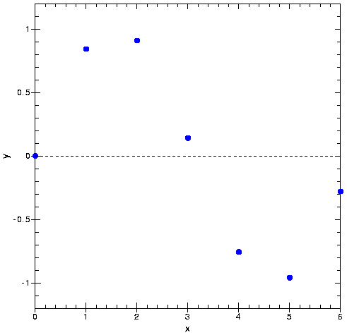
Polynominal Interpolation
Linear Interpolation
Linear interpolation between the first two values can be written as:

Slide 22
Polynominal Interpolation
Linear interpolation between the first two values can be written as:
Let’s look at the following term:

Slide 23
Polynominal Interpolation

Slide 24
Polynominal Interpolation
Interpolating Polynominals can be recursively calculated

Slide 25
Neville’s Algorithm

Slide 26
Neville’s Algorithm
1st Order Polynominal

Slide 27
Neville’s Algorithm
2nd Order Polynominal

Slide 28
Neville’s Algorithm
3rd Order Polynominal

Slide 29
Neville’s Algorithm
4th Order Polynominal

