Slide 1
Flood Prediction and Alert System
By
Subhajit Sahu (110EC0181)
Under the guidance of:
Prof. D. P. Acharya

Slide 2
Contents
How dangerous is it?
Worst floods in India
What causes a flood?
How can we reduce loss?
What and how to monitor?
What and how to predict?
How to alert?
What’s next?

Slide 3
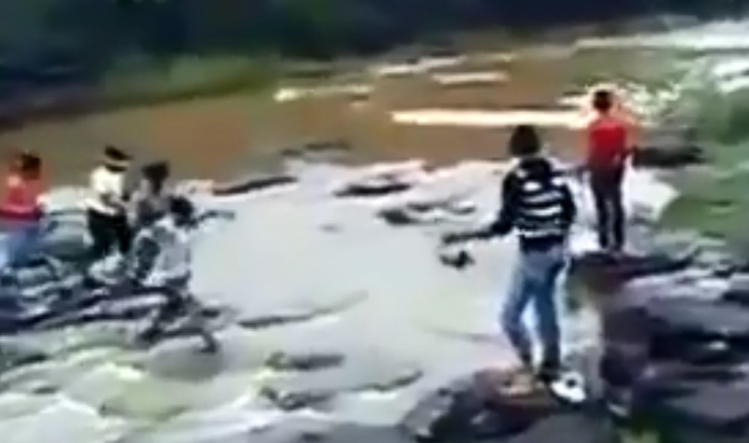
How dangerous is it?

Slide 4
Worst floods in India
Year | Flood | Causalties
2013 | Uttarakhand floods | > 5700 d, 934 lcl
2012 | Assam floods | > 120 d, > 540 an
2010 | Leh floods | > 200 d, > 9000 af
2008 | Bihar floods | > 400 d, 10^6 af
2005 | Mumbai, Gujrat floods | > 200 d
Flood is the #1 natural disaster in India

Slide 5
What causes a flood?
Heavy Rainfall
Snow melt
Saturated land
Land slide
Treeless Land

Slide 6
How can we reduce loss?
Monitor
Predict
Alert

Slide 7
What and how to monitor?
Temp.
Level
Rain

Slide 8
What and how to monitor?
Soil wetness
Ground Water
Wind
Humidity

Slide 9
What and how to predict?
Flood locations
Water flow modeling / simulation
Water level & flow rate
River bed structure at sensor location
Return time
Validation through satellite data
Arrival time
Humidity and rainfall modeling

Slide 10
How to alert?
TV
Radio
SMS
Local Alarm

Slide 11
What’s next?
Designing the monitoring system.
Setting up monitoring systems.
Testing various prediction models.
Validating with satellite data.
Setting up alert systems.
Predict any upcoming flood.

Slide 12
Thank you

