Slide 1
Flood Prediction and Alert System
By
Subhajit Sahu (110EC0181)
Pallabi Mishra (110EC0173)
Under the guidance of:
Prof. D. P. Acharya

Slide 2
Contents
Introduction
Why do we this?
Research Significance
Literature Review, Scope of this project
Structure of Monitoring system
How can we reduce loss?
What and how to monitor?
What and how to predict?
How to alert?
What’s next?

Slide 3
Literature Review
Li et al (2006). A Web-based flood forecasting system for Shuangpai region.
Balis et al (2011). The UrbanFlood Common Information Space for Early Warning Systems.
Demir et al (2013). Towards an Integrated Flood Information System: Centralized data access, analysis, and visualization.
Krzhizhanovskaya et al (2011). Flood early warning system: design, implementation and computational modules.
Al-Sabhan et al (2003). A real-time hydrological model for flood prediction using GIS and the WWW.
Gandla et al (2008). Design and FPGA Prototyping of a Flood Prediction System.

Slide 4
Introduction
The disaster management domain is characterised by: distributed control; uncertainty, ambiguity, imprecision and bias; multiple stakeholders with different aims and objectives; and limited resources which continually vary.
Multi-Disciplinary Approach:
Filtering and data fusion methods for estimating relevant details
Decision-making and machine learning methods for determining actions in response
Multi-agent systems and mechanism design methods to manage the interaction between multiple actors and to model collective behaviour
System architecture studies of different agent organisations and information exchange topologies

Slide 5
Why do we need this?
Save people’s lives
Reduce commodity loss of people
Reduce recue operation expenditure
₹ 1 spent in flood forecasting is ₹ 20 saved from flood loss

Slide 6
Scope of this project
This project is focused on the design and implementation of flood monitoring system for rivers in India.
This includes modules:
Testing of various sensors.
Developing OS for sensor-devices.
Designing Application Server platform.
Flood monitoring electronic-devices
Application and Web servers.
Platforms for Flood prediction.

Slide 7
Flood Detection
Non-WSN Systems:
Primitive technique of flood detection requiring trained personnel.
Mostly manual procedures and hence is expensive.
WSN Systems:
Low power, low cost, multi-hopping systems that are independent of external service providers, can form an extendable network without line of sight coverage; but have self-healing data paths.
Deployed more or less homogeneously in a geographical region using a two-tiered approach having clusters of short distance communicating nodes together with some nodes capable of communication over a wider range.

Slide 8
How can we reduce loss?
Monitor
Predict
Alert

Slide 9
ALGORITHM PARAMETERS
Time
Most commonly used parameter, giving an easily understood technique.
System supervisor decides a time interval after which a reading is to be taken, accordingly a sensor takes the time driven data as input. In our algorithm we use a time set instead of a specific interval.
Event
Refers to sudden change in a parameter affecting the desired output. Suppose the next time driven data is slated to be taken after an hour. But a dam has started discharging water at such a rate that flood may occur within the next 30 minutes.
Hardware interrupt has to override the time driven mechanism to get an instant event driven data and make a reliable prediction before the flood occurs.

Slide 10
ALGORITHM PARAMETERS
Query
Comes to effect if an administrator wants to see the immediate level and get an instantaneous prediction even when it’s not time to take a reading.
Hardware interrupt used get the instant query driven data.
System Interrupt
Internal, generated by a computational node or the office node itself when there is some corruption or loss of data during any phase of the communication process-data sensing or recording, transmission, accumulation or calculation.
Office node or computational nodes send a request to the sensor nodes to take another readings (or set of readings).

Slide 11
DECISION-MAKING
Difference in Water Level between Subsequent Readings
Say the water level has increased by an amount equal to 90% of flood line between two subsequent readings. Our predictor assumes the increase is not uniform over the interval, but may have happened in the last few moments. Thus it asks for another reading in the minimum possible time to see the gradient and make a better prediction.
Present Water Level
Say the water level has reached 90% of flood line. A little rain/discharge any moment can trigger a flood. So it is best to take readings as soon as possible and make accurate predictions. We define a time set containing different time intervals at which the sensor nodes can take readings. Based on the above discussion, the function decides which value of the time set is to be taken for a particular calculation.

Slide 12
DECISION-MAKING
Recalibration of time interval
Assume the next reading is scheduled to be after an hour. But our algorithm forecasts a flood within twenty minutes from now. Clearly, the time interval must be altered so that it is at least less than the time at which flood is predicted.
Consideration for node storage capacity
Our algorithm stores the regression coefficient values and frees the system memory by removing parameter values whenever there is a constraint on system memory. Effectively, nothing is lost as the single coefficient matrix is the result desirable from such enormous amounts of parameter data.

Slide 13
What and how to monitor?
Temp.
Level
Rain

Slide 14
What and how to monitor?
Soil wetness
Ground Water
Wind
Humidity

Slide 15
What and how to predict?
Flood locations
Water flow modeling / simulation
Water level & flow rate
River bed structure at sensor location
Return time
Validation through satellite data
Arrival time
Humidity and rainfall modeling

Slide 16
How to alert?
TV
Radio
SMS
Local Alarm

Slide 17
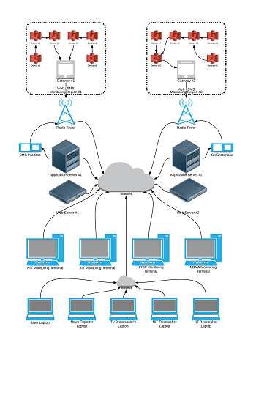
Structure of Monitoring system

Slide 18
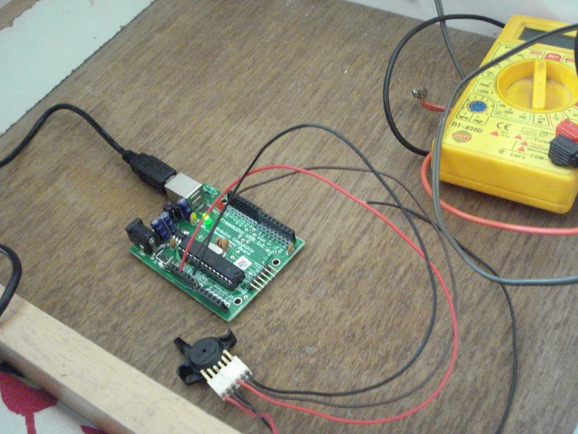
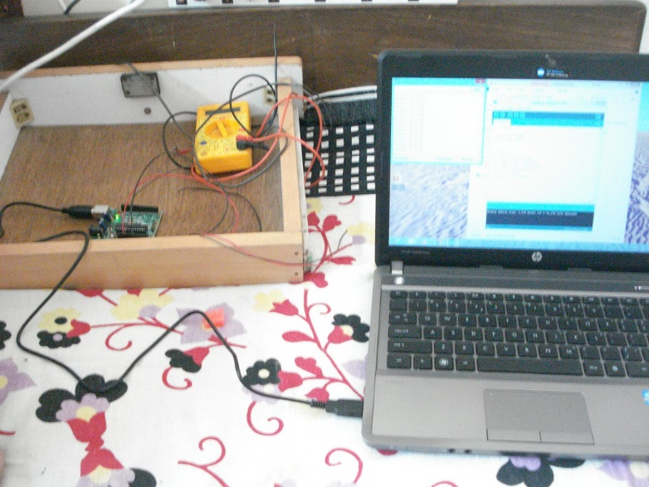
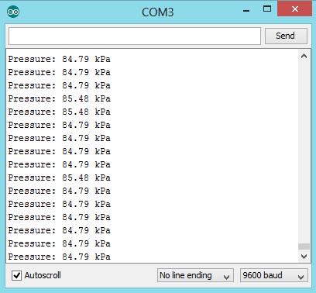
Sensor Testing

Slide 19
Sensor-device OS
std
Char
ExpInt
int
Event
EEPROM
ext
CC2500
MPX5700
List
Macro
Math
Mem
Reg
Str
Stream
Task
Type
Power
SPI
SIM900

Slide 20
Application Server Platform
Db
DbCmd
DbTask
Net
NetBuffer
NetTask
Std
KeyVals
ParDictionary
DbEventFnGroup
DbClnt
DbHostInfo
DbHost
NetEventFnGroup
NetPkt
NetClnt
NetHostInfo
NetHost
ParList

Slide 21
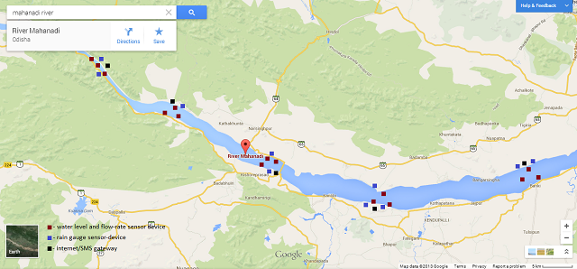
Wireless sensor systems setup

Slide 22
Sensor-device Block Diagram
Battery
Sensor 1
Sensor 2
Power supply unit
RF unit
Microcontroller
Energy harvesting unit
Sensor 3
Sensor 4

Slide 23
Gateway Block Diagram
High capacity Battery
RF unit
Sensor 1
Sensor 2
Power supply unit
Microcontroller
Energy harvesting unit
GSM/GPRS or Wi-Fi unit
Optional direct AC power supply

Slide 24
References
Xiang Yang Li, K. W. Chau, Chun Tian Cheng, Y. S. Li. A Web-based flood forecasting system for Shuangpai region.Advances in Engineering Software 37 (2006), 146-158.
Bartosz Balis, Marek Kasztelnik, Marian Bubak, Tomasz Bartynski, Tomasz Gubala, Piotr Nowakowski, Jeroen Broekhuijsen. The UrbanFlood Common Information Space for Early Warning Systems. Internaltional Conference on Computational Science, ICCS 2011.
Ibrahim Demir, Witold F. Krajewski. Towards an Integrated Flood Information System: Centralized data access, analysis, and visualization. Environmental Modeling & Software 50 (2013), 77-84.
V.V. Krzhizhanovskaya, G.S. Shirshov, N.B. Melnikova, R.G. Belleman, F.I. Rusadi, B.J. Broekhuijsen, B.P. Gouldby, J. Lhomme, B. Balis, M. Bubak, A.L. Pyayt, I.I. Mokhov, A.V. Ozhigin, B. Lang, R.J. Meijer. Flood early warning system: design, implementation and computational modules. International Conference on Computational Science, ICCS 2011.
W. Al-Sabhan, M. Mulligan, G.A. Blackburn. A real-time hydrological model for flood prediction using GIS and the WWW. Computers, Environment and Urban Systems 27 (2003), 9-32.
Design and FPGA Prototyping of a Flood Prediction System. Sandeep Gandla, Waleed K. Al-Assadi, Sahra Sedigh and Raghu A. R. Rao.

Slide 25
Future Study
Designing the monitoring system.
Setting up monitoring systems.
Testing various prediction models.
Validating with satellite data.
Setting up alert systems.
Predict the next upcoming flood.

Slide 26
Thank you

