Slide 1


Design of WASP-OS for AVR Microcontrollers
By Subhajit Sahu
Under the guidance of Prof. D. P. Acharya
Department of Electronics and Communication Engineering
National Institute of Technology, Rourkela

Slide 2
Operating System (OS)
An Operating system (OS) is nothing but a collection of system calls or functions which provides an interface between hardware and application programs.
It manages the hardware resources of a computer and hosting applications that run on the computer.
An OS typically provides multitasking, synchronization, Interrupt and Event Handling, Input/ Output, Inter-task Communication, Timers and Clocks and Memory Management.
Core of the OS is the Kernel which is typically a small, highly optimized set of libraries.

Slide 3
Real-time operating system (RTOS)
RTOS is therefore an operating system that supports real-time applications by providing logically correct result within the deadline required.
Basic Structure is similar to regular OS but, in addition, it provides mechanisms to allow real time scheduling of tasks.
Though real-time operating systems may or may not increase the speed of execution, they can provide much more precise and predictable timing characteristics than general-purpose OS.

Slide 4
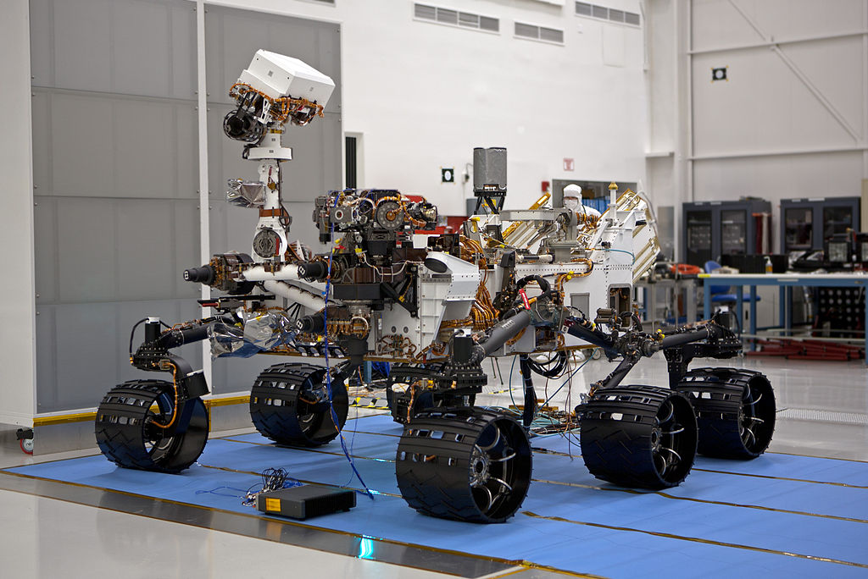
Applications of RTOS
The Mars Science Laboratory Curiosity rover uses VxWorks

Slide 5
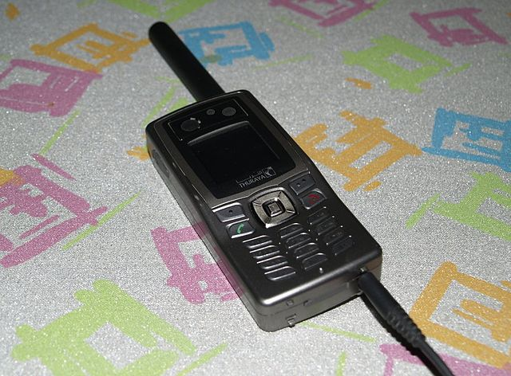
Applications of RTOS
The Thuraya SO-2510 satellite phone runs VxWorks

Slide 6
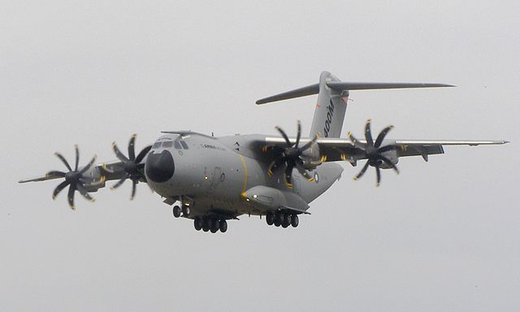
Applications of RTOS
The Airbus A400M Airlifter uses VxWorks

Slide 7
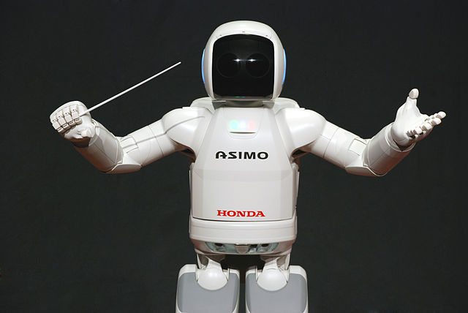
Applications of RTOS
The Honda Robot ASIMO uses VxWorks

Slide 8

Applications of RTOS
The Boeing F/A-18E/F Super Hornet uses VxWorks

Slide 9
AVR Microcontrollers
The AVR is a modified Harvard architecture 8-bit RISC single chip microcontroller which was developed by Atmel in 1996.
The AVR was one of the first microcontroller families to use on-chip flash memory for program storage, as opposed to one-time programmable ROM, EPROM, or EEPROM used by other microcontrollers at the time.

Slide 10
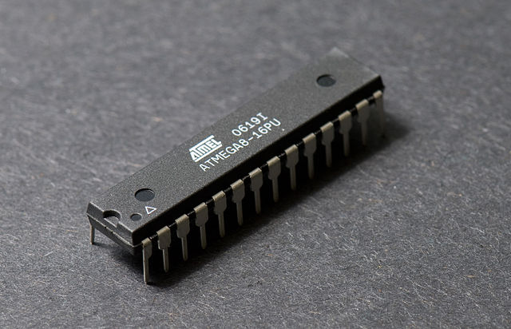
AVR Microcontrollers
Atmel ATmega8 in 28-pin narrow DIP

Slide 11
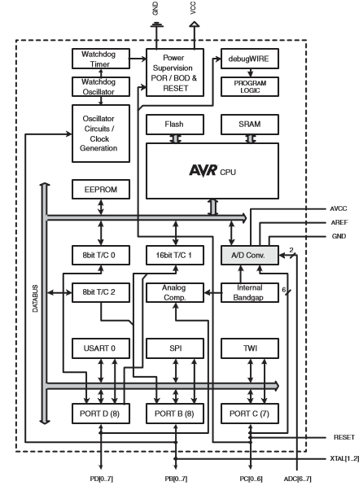
Block diagram of Atmel ATmega328P

Slide 12
EEPROM

Slide 13
Primitive data types : Size specified
Signed
int8
int16
Unsigned
uint8
uint16
int32
int64
uint32
uint64

Slide 14
Primitive data types : CPU Word size
Signed
int
word
Unsigned
uint
uword

Slide 15
Primitive data types : Named Types
Signed
sbyte
short
Unsigned
byte
ushort
long
float
double
ulong
char

Slide 16
Primitive data type Functions
Primitive datatype
Min
Max
MakeValue

Slide 17
Character-specific Functions
Character data type
IsLower
IsUpper
IsAlphabet
IsDigit
IsAplhabetOrDigit
IsBlank
IsSpace
IsControl
IsGraphical
ToLower
ToUpper

Slide 18
String Functions
String
Length
Compare
ToLower
ToUpper
Equals
Copy
Reverse
Concat
IndexOfChar
IndexOfChars
IndexOf
RemoveChar
RemoveChars
Remove

Slide 19
List Data Structure
List
(Data:Collection)
Count
(uword)
Size
(uword)
Value[Size]
(uint)

Slide 20
List Header
List Header
(2 bytes)
Count
(uword)
Size
(uword)

Slide 21
List Block Diagram
List<Size = 4>
Value Index | [0] | [1] | [2] | [3]
Value | 5 | 7 | 1 | 6
 | Count = 3
 | Size = 4

Slide 22
List Functions
List
Define
Init
Clear
GetAvail
HasAvail
GetFree
HasFree
IndexOf
Add
RemoveAt
Remove

Slide 23
Queue Data Structure
Queue
(Data:Collection)
Rear
(uword)
Front
(uword)
Value[Max + 1]
(uint)
Max
(uword, 2^x - 1)

Slide 24
Queue Header
Queue Header
(3 bytes)
Rear
(uword)
Front
(uword)
Max
(uword, 2^x - 1)

Slide 25
Block Diagram
Queue<Size = 4>
Value Index | [0] | [1] | [2] | [3]
Value | 5 | 7 | 1 | 6
Max = 3 |  | Front = 1 | Rear = 2

Slide 26
Queue Functions
Queue
Define
Init
Clear
GetAvail
HasAvail
GetFree
HasFree
Add
Peek
Remove

Slide 27
Task Reserved Sections
Task
Create
Request Join
Join
Accept
Host Memory
Map Memory
Server Req.
…
Firmware
Non-Volatile

