Slide 1
Simple Profiling
With C++14
Wolfram Rösler
https://gitlab.com/wolframroesler/Talks/raw/master/profiling.odp

Slide 2
„Premature optimization
is the root of all evil.“
– Donald Knuth

Slide 3
„Not knowing how your program performs
is the root of all evil.“
– Wolfram Rösler

Slide 4
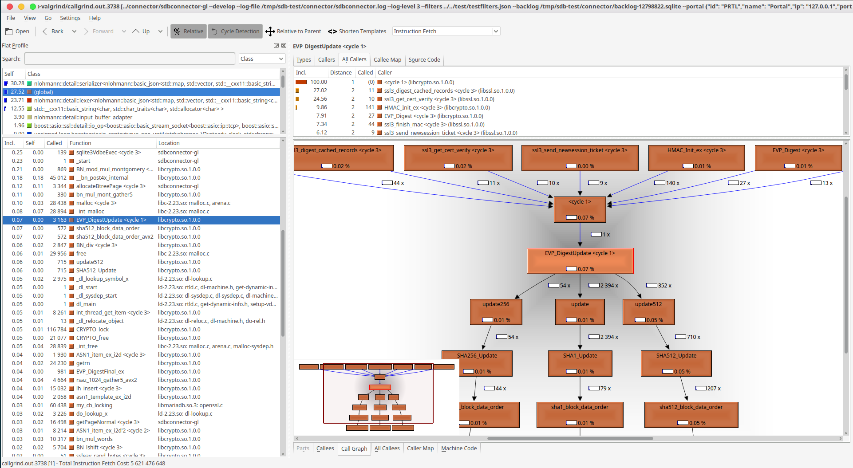
Profiling with Valgrind
$ valgrind --tool=callgrind --callgrind-out-file=callgrind.out ./myprogram
$ kcachegrind callgrind.out

Slide 5
A simple alternative:
C++ profiling class
#include <profiler.h>
void StartWebserver() {
PROFILE("StartWebserver");
…
}
Output:
# calls Total Min Max Avg StdDev | Call point
-------------------------------------------------------------+---------------------
2 13800 6900 6900 6900 0 | StartWebserver
1 6923 6923 6923 6923 0 | Total
58 2396 10 1016 41 132 | HandleRequest
58 1800 0 1006 31 132 | HandleURI
116 1170 10 10 10 0 | IsAuthorized
174 0 0 0 0 0 | Authorization
52 0 0 0 0 0 | RequestBody
All durations in milliseconds

