Slide 1
West const vs. East const –
Core Guidelines vs. Logic
Wolfram Rösler
https://github.com/wolframroesler/Talks/raw/master/const.odp

Slide 2
// "West const" // "East const"
const int w = 0; int const e = 0;

Slide 3
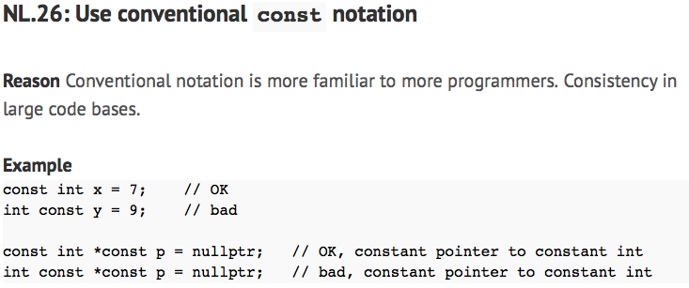
http://isocpp.github.io/CppCoreGuidelines/CppCoreGuidelines#Rl-const

Slide 4

http://isocpp.github.io/CppCoreGuidelines/CppCoreGuidelines#Rl-const

Slide 5
// "West const"
const int w = 0;
// "East const"
int const e = 0;

Slide 6
int x;
// "West const"
const int& w = x;
// "East const"
int const& e = x;

Slide 7
int x;
// "West const"
const int* const w = &x;
// "East const"
int const* const e = &x;

Slide 8
int x;
// "West const"
const int *const w = &x;
// "East const"
int const *const e = &x;
Another case of Core Guidelines vs. Logic ("NL.18: Use C++-style declarator layout")

Slide 9
class C {
// "West const"
const int* w() const;
// "East const"
int const* e() const;
};

Slide 10
typedef int* intptr;
int x;
// "West const" // "East const"
const intptr p=&x; intptr const p=&x;
int* const q=&x; int* const q=&x;
const int* r=&x; int const* r=&x;
// p and q have identical types (are const),
// r is different (*r is const, r is not)

Slide 11
Resources
C++ Core Guidelines http://isocpp.github.io/CppCoreGuidelines/CppCoreGuidelines
Bjarne Stroustrup's C++ Style/Technique FAQ
http://www.stroustrup.com/bs_faq2.html#constplacement
Stack Overflow Discussions
https://stackoverflow.com/questions/5503352/
https://stackoverflow.com/questions/1143262/
https://stackoverflow.com/questions/988069/
const T vs. T const
http://www.dansaks.com/articles/1999-02%20const%20T%20vs%20T%20const.pdf
A foolish consistency …
http://slashslash.info/2018/02/a-foolish-consistency/

