Slide 1
Test Driven Development
with Boost.Test
Wolfram Rösler
Slides: https://gitlab.com/wolframroesler/Talks/blob/master/tdd.pdf
Example code: https://gitlab.com/wolframroesler/boost-test-demo

Slide 2
The Software Development Workflow
a. k. a. the waterfall model
1. Have a specification
2. Implement it
3. Test it
4. Ship it
5. Be happy
6. Go to next project

Slide 3
The Software Development Workflow
what‘s it‘s like in reality
1. Have a rough idea what to do
2. Implement it because that‘s fun
3. No need to test because I‘m a genius
4. Ship it
5. Fix bugs and regressions
6. Go to 5

Slide 4
The Test Driven Development Workflow
in a nutshell:
TEST FIRST

Slide 5
The Test Driven Development Workflow
1. Write test program
2. Implement until it passes
3. Refactor
4. Make all tests pass

Slide 6
Benefits of TDD
Test coverage
Confidence
Less debugging
Few regressions
Release anytime
Pays out from the start

Slide 7
Downsides of TDD
Takes time
No quick changes
Requires dedication and effort
Who tests the test program?
False negatives
Not always easy

Slide 8
What You Need For TDD
1. Tools
Easy: cppunit, Boost.Test, Google Test, whatever
2. Processes
Less easy: Integrate TDD into dev workflows
3. Mindset
Difficult: Change habits

Slide 9
Test Granularity
Unit Test ← TDD happens here
the smallest testable thing
Module Test
module = many units
Integration Test
interaction between modules
System Test
everything

Slide 10
Test Organization
Test assertion A single comparison
Test case Several assertions
Test suite Several test cases
Test plan Several test suites

Slide 11
Anatomy of a Test Case
1. Set up
2. Do something
3. Validate
4. Tear down

Slide 12
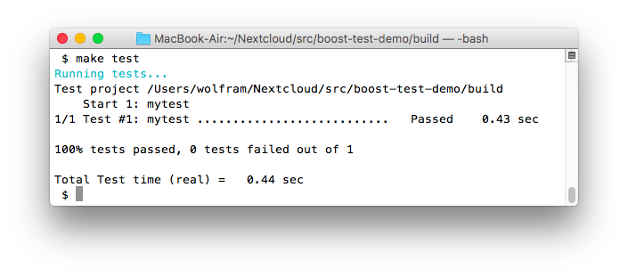
Live Demo: Boost.Test
https://gitlab.com/wolframroesler/boost-test-demo

Slide 13
Ways To Test Something
White-box Test You know it
Black-box Test You don’t know it
Boundary Test Edge cases
Regression Test Bugs
Fuzz Test Random input

Slide 14
Not Easily Testable
People
Databases
Web servers
Hardware
Concurrency

Slide 15
How To Test It Anyhow
Simulators
Mock-ups
Error simulation
Plenty of imagination

Slide 16
Cheat Sheet: Classical TDD Rules
Test first, then implement, finally refactor.
Implement until tests pass, but no further.
Write the simplest possible code to make a test pass, then refactor to improve code quality.
Implement until new tests pass, then refactor until old tests pass.
Unless refactoring, don’t change anything unless it’s required to make a failing test pass.

Slide 17
Cheat Sheet: Getting Started
Assume that the code you have is correct.
Establish TDD tools and processes.
The next time a feature is added, test first.
The next time a bug is found, reproduce it in a test case.
Add test cases for existing functionality as required.
Don’t modify any code unless the modification is covered by a test case.

Slide 18
Resources
https://en.wikipedia.org/wiki/Test-driven_development
https://en.wikipedia.org/wiki/Unit_testing
https://en.wikipedia.org/wiki/XUnit
http://wiki.c2.com/?TestDrivenDevelopment
https://www.boost.org/doc/libs/1_68_0/libs/test/doc/html/index.html
https://stackoverflow.com/questions/64333/disadvantages-of-test-driven-development
https://gitlab.com/wolframroesler/afl-demo – Fuzz test demo program

