Slide 1
Link-time Plug-ins
Wolfram Rösler
Code: https://gitlab.com/wolframroesler/linktimeplugin
Slides:https://gitlab.com/wolframroesler/Talks/blob/master/linktimeplugin.pdf

Slide 2

About me
Wolfram Rösler
Programming since age 15
Developing industry-grade software since 1989
… using Unix since before there was Linux
… using sh since before there was bash
… using vi since before there was vim
Software developer, former head of software development, former CTO
Open Source contributor (KeePassXC, civetweb, bash_unit, ...)
Currently Senior Software Engineer and Software Quality Architect at devolo AG
wolfram@roesler-ac.de • https://gitlab.com/wolframroesler • https://twitter.com/wolframroesler • https://www.linkedin.com/in/wolframroesler/

Slide 3
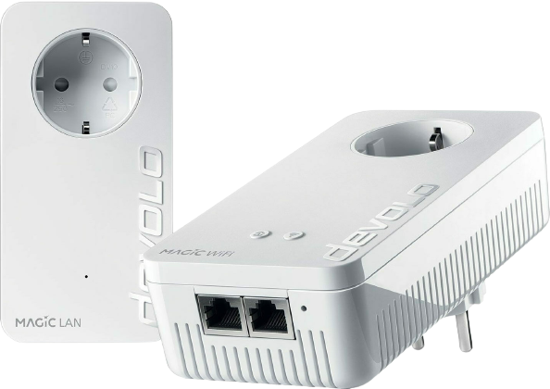
Example: API for Powerline Adapters

Slide 4
We have URLs for API endpoints
http://10.0.1.123/api/v1/set_device_name
http://10.0.1.123/api/v1/start_plc_pairing
http://10.0.1.123/api/v1/start_wifi_wps

Slide 5
How to run the endpoint handler?
int handleEndpoint(const std::string& name)
{
if (name==“set_device_name“) {
return setDeviceName();
} else if (name==“start_plc_pairing“) {
return startPLCPairing();
} else if (name==“start_wifi_wps“) {
return startWifiWPS();
} else {
return 404;
}
}

Slide 6
How to handle the endpoints?
int handleEndpoint(const std::string& name)
{
if (name==“set_device_name“) {
return setDeviceName();
}
#if HAS_PLC
if (name==“start_plc_pairing“) {
return startPLCPairing();
}
#endif
#if HAS_WIFI
if (name==“start_wifi_wps“) {
return startWifiWPS();
}
#endif
return 404;
}

Slide 7
But what we really want:
int handleEndpoint(const std::string& name)
{
for(auto& e : endpoints()) {
if (e.name()==name) {
return e.execute();
}
}
return 404;
}

