Slide 1
How to get out of vi
Part 2:
How to stay in vi and live
Wolfram Rösler
https://gitlab.com/wolframroesler/Talks/blob/master/vi.pdf

Slide 2
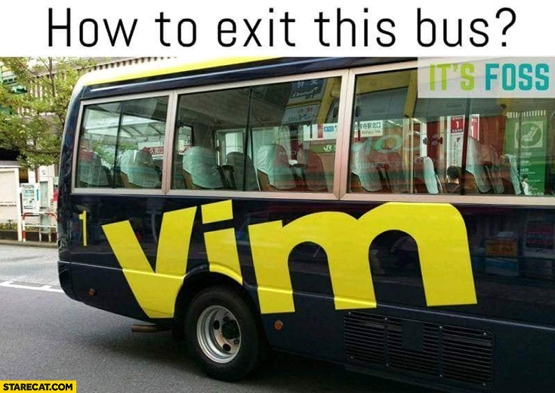
https://starecat.com/content/wp-content/uploads/vim-how-do-you-exit-this-bus.jpg

Slide 3
History
1969 Unix
1969 Apollo XI
1972 C
1976 vi
1977 Star Wars
1982 Compact Disc
1983 C++
1984 Macintosh
1991 Linux
1991 vim
2007 iPhone
2019 There are still people who don’t know how to exit vi

Slide 4
Resources
About vi https://en.wikipedia.org/wiki/Vi
About vim https://en.wikipedia.org/wiki/Vim_(text_editor)
vi cheat sheet https://duckduckgo.com/?q=vi+cheat+sheet&iax=1
vi Tutorial https://www.tutorialspoint.com/unix/unix-vi-editor.htm
5 Minute Introduction http://heather.cs.ucdavis.edu/~matloff/UnixAndC/Editors/ViIntro.html
Where vi came from https://twobithistory.org/2018/08/05/where-vim-came-from.html
Pro vim tips https://itsfoss.com/pro-vim-tips/

