Slide 1

Python & Ansible
Introduction to ansible.
Ansible Internals and requirements
What can be accomplished by ansible?
Use cases of Ansible.
Demo on few modules
1. Creating infrastructure with ansible and terraform
2. Running Flask web server on it
Q/A
By : Nik

Slide 2

About me
You should already know me

Slide 3



Introduction to Ansible
Ansible: An Open-source automation tool for intra service orchestration which is written in python .
Powerful tool - helps automate task in managing computer systems and infrastructure.
allow user to define desired state of their systems through playbooks,
software installation
Configuration
user management
+ more.
simple and human-readable language to define instructions using YAML
Ansible can execute them on computers using SSH or winrm.
Fully customizable in python

Slide 4

Why Ansible?
No agent – because it use SSH and WinRM, as long as the nodes is reachable
Idempotent – Only do things if they are needed that things are repeatable without side effects.
Declarative and Procedural – Ansible works by you writing a description of the state and then it takes steps to fulfill that descriptions.

Slide 5
What can be accomplished by ansible?
Configuration Management
Application Deployment
Orchestration
Provisioning
Continuous Integration/Continuous Deployment
Security and compliance
Cloud Management
Infra as Code (IaC)
Deployment automation
Network Automation
Security Automation

Slide 6
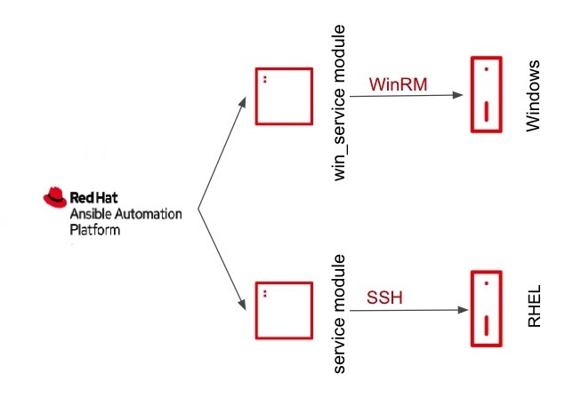
Ansible requirement
Ansible Core
>= Python 3
SSH or WinRM enabled on nodes
Controller can reach the nodes

Slide 7
Ansible Internals
Inventory: Manages host nodes on your infrastructure
Playbook: Lists of tasks that automatically execute against hosts
Modules: A code that can control System resources or execute commands
Plugins: Piece of code that augment Ansibles core Functionality
Nodes: Any device where the tasks are being executed or being managed
Controller: The Ansible itself is an automation controller allows users to automate the platforms to define, operate, scale and delegate automation across the enterprise
API: Ansible Python API to control nodes, you can extend Ansible to respond to various Python events, you can write plugins, and you can plug in inventory data from external data sources
Collection: a Distributed format for ansible content that include roles, playbook, modules and plugins

Slide 8
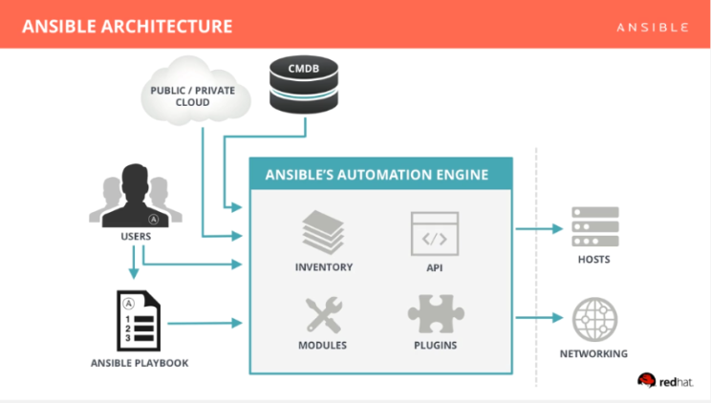

Slide 9
Ansible Internal – Inventory
A file defines the hosts and groups of hosts upon which commands, modules, and tasks in a playbook operate
Ansible inventory could be a dynamic inventory which can directly retrieve information from the Source of truth, Cloud or on prem inventory manager.
The file can be in one of many formats depending on your Ansible environment and plugins. Common
formats include INI and YAML
host1.example.net
[web]
webserver1.example.net
webserver2.example.net
[database]
dbserver1.example.net
dbserver2.example.net

Slide 10
Ansible Internal - Playbook
a file where users write Ansible code
describe a set of steps in YAML and jinja templating
an organized collection of scripts defining the Job

Slide 11
Ansible Internal - Module
units of code that can control system resources or execute system commands
Ansible-doc –l | grep <module name>
- name: Copy file with owner and permissions
copy:
src: /srv/myfiles/foo.conf
dest: /etc/foo.conf
owner: foo
group: foo
mode: '0644'
- name: Change file ownership, group and permissions
file:
path: /etc/foo.conf
owner: foo
group: foo
mode: '0644'

Slide 12
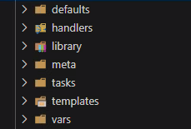
Ansible Roles
Default structure for create a role package to use it in a playbook

Slide 13
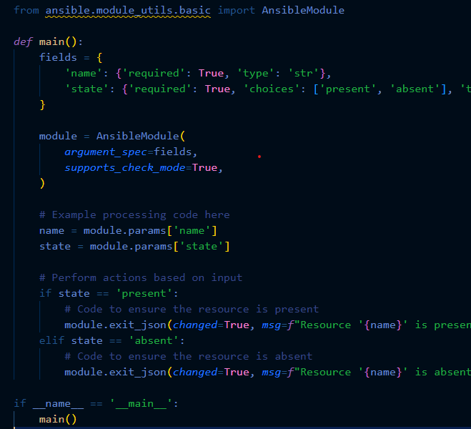
Integrating custom Python modules

Slide 14
Ansible Best Practices
Tasks are added into roles as a pack
Using of Custom variable as much as possible
Writing your python module and filters should be done only if the module isn’t available
Playbook should include the roles to avoid lengthy playbook files

Slide 15
Ansible Use Cases
More than 1200 use cases
Cloud | Virt & container | Windows/Linux | Network | Chat | Monitoring
AWS | ATOMIC | ACL’S | F5 | slack | NAGIOS
AZURE | CLOUDSTACK | FILES | PALO ALTO | IRC | NEW Relic
DIGITAL OCEAN | OPENSTACK | PACKAGES | OPENSWITCH | HipChat | Data dog
GOOGLE | OPENSHIFT | SERVERS | CISCO | Email | Airbrake
OPENSTACK | RHEV | REGEDITS | DELL |  | Zabbix
RACKSPACE | VMWARE | SHARES | FORTI
ORACLE | KVM | SERVICES | JUNIPER
 | HYPER-V | CONFIGS | BIGSWITCH
 | DOCKER | USERS | +More
 | K8 | DOMAINS
 | +More | +More

Slide 16
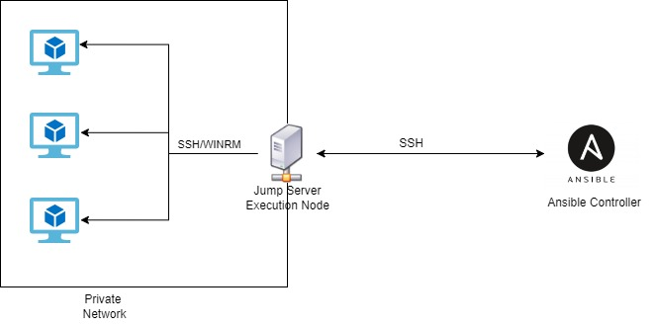
Enterprise Secure Architecture
Ways to Achieve Execution Env: - setting up venv separately which connecting it directly to the ansible tower
- Using Latest method of EE which is spawning of Containers to run the job

Slide 17
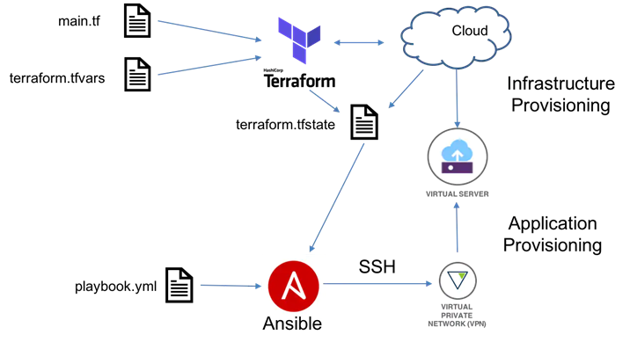
Configuration management and Provisioning with other tools

Slide 18
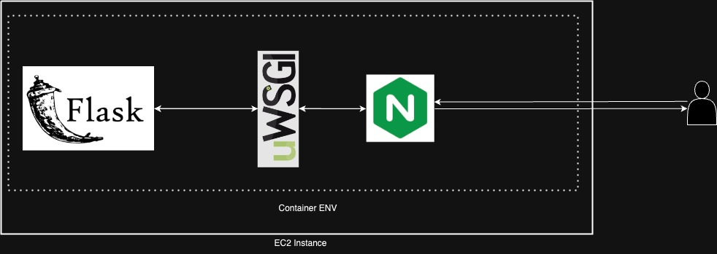
Our Demo Architecture Deployment

Slide 19
ANSIBLE DEMO Demo’s can go wrong too !

Slide 20
Q/A

