Slide 1
Appraisal Dispute
Jeremy Wolfson

Slide 2
The following analysis is performed and cited as: Jeremy Wolfson, Numerical Comparative Market Analysis, June 2026. Dataset source: Unlock MLS Residential Sales Records, Zillow, Williamson CAD, Federal Reserve, Service Link Auction, & Texas Tax Code, various analysis sites.
Texas Tax Code § 23.01(a), Appraisals Generally — taxable property shall be appraised at market value as of January 1
Texas Tax Code § 1.04(7), Definition of Market Value — defines market value as the price a property would transfer for cash in an open market transaction

Slide 3
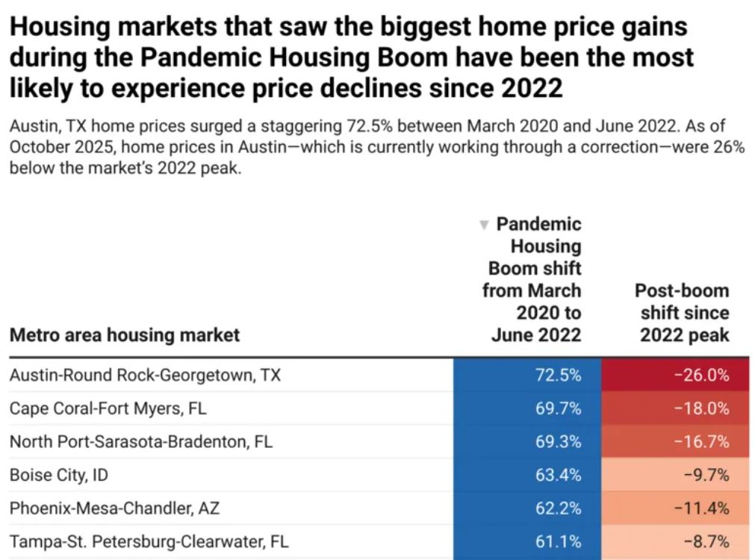
“At the end of October 2025, home prices in Austin—which is currently passing through a correction—were -26% below the market’s 2022 peak.”
https://www.resiclubanalytics.com/p/biggest-home-price-declines-hitting-housing-markets-that-overheated-most-during-the-pandemic-housing

Slide 4
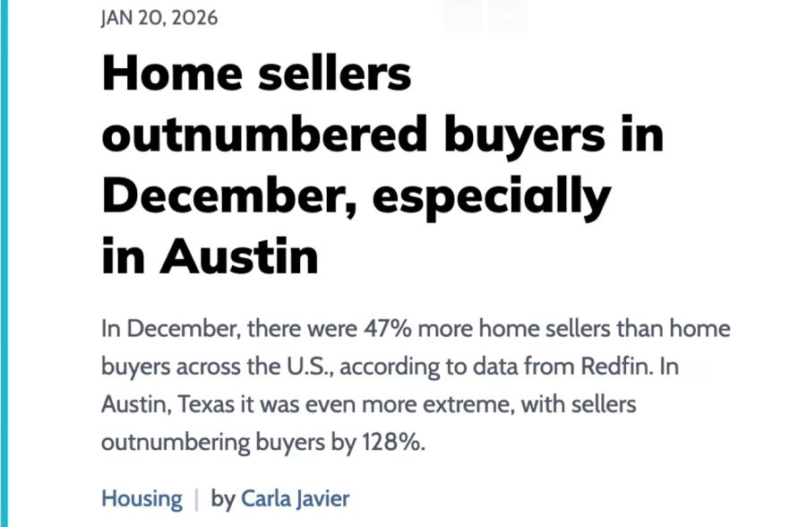
"There were an estimated 47.1% more home sellers than buyers in December 2025—the largest gap in records dating back to 2013.” “In Austin, TX, there were an estimated 128% more home sellers than buyers in December—the largest imbalance among the top 50 metros.”
https://www.marketplace.org/story/2026/01/20/home-sellers-outnumbered-buyers-in-december

Slide 5
Market Dataset 1

Slide 6
Average 2025 Housing Market
address | year_built | 2026 tax evaluation | 2025 tax evaluation | initial_ppsf | initial_price | update1_price | update2_price | update3_price | latest_date
100 Quarton Dr, Hutto, TX 78634 | 2018 | 317563 | 357582 | 179.58 | 316900 | 299000 | 289000 |  | 11/4/2025
102 Quail Hollow Dr, Hutto, TX 78634 | 2004 | 292763 | 317711 | 142.78 | 300000 | 282000 | 265000 | 240000 | 12/22/2025
104 Whirling Eddy Cv, Hutto, TX 78634 | 2003 | 305160 | 333994 | 155.08 | 320000 | 310000 |  |  | 12/31/2025
111 S Creek Bend Dr, Hutto, TX 78634 | 2012 | 318557 | 350343 | 132.26 | 319900 | 299000 | 295000 |  | 12/5/2025
113 Rochester Ln, Hutto, TX 78634 | 2020 | 355387 | 381738 | 174.48 | 350000 |  |  |  | 12/10/2025
114 Almquist St, Hutto, TX 78634 | 2005 | 300396 | 333931 | 143.7 | 315500 | 305500 | 305500 | 299900 | 12/31/2025
114 Brown St, Hutto, TX 78634 | 2003 | 290936 | 329105 | 148.1 | 330000 | 310000 | 295900 |  | 12/31/2025
120 Wegstrom St, Hutto, TX 78634 | 2004 | 284149 | 315140 | 146.54 | 319000 | 315000 | 279999 | 259999 | 11/25/2025
122 Mossy Rock Cv, Hutto, TX 78634 | 2007 | 351202 | 379958 | 137.89 | 365000 | 359900 |  |  | 12/31/2025
205 Stewart Dr, Hutto, TX 78634 | 2003 | 274147 | 340703 | 139.85 | 289000 | 279000 |  |  | 12/31/2025
207 Janis Mae Dr, Hutto, TX 78634 | 2000 | 326700 | 335178 | 158.24 | 335000 | 325000 |  |  | 10/30/2025
210 Rinehardt St, Hutto, TX 78634 | 2003 | 292939 | 305774 | 187.67 | 299000 |  |  |  | 6/16/2025
213 Bent Creek Dr, Hutto, TX 78634 | 2021 | 321987 | 342507 | 154.92 | 325000 | 299000 |  |  | 12/31/2025
223 Warner Bnd, Hutto, TX 78634 | 2001 | 316449 | 343583 | 140.14 | 280000 | 270000 |  |  | 12/31/2025
451 Swenson Dr, Hutto, TX 78634 | 2006 | 345530 | 351667 | 115.65 | 340000 | 300000 |  |  | 10/30/2025
506 Carol Dr, Hutto, TX 78634 | 2005 | 340766 | 356356 | 162.58 | 334999 | 320000 | 314999 |  | 11/15/2025
918 Estate Dr, Hutto, TX 78634 | 2005 | 314368 | 324617 | 152.98 | 299998 | 289000 |  |  | 12/31/2025
1006 Pembroke Ct, Hutto, TX 78634 | 2019 | N/A | 385610 | 165.84 | 345000 | 335000 | 329900 |  | 11/19/2025

Slide 7
Average 2025 Housing Market
address | year_built | initial_ppsf | latest_ppsf | latest_date | days_on_market
100 Quarton Dr, Hutto, TX 78634 | 2018 | 179.58 | 173.57 | 11/4/2025 | 68
102 Quail Hollow Dr, Hutto, TX 78634 | 2004 | 142.78 | 129.31 | 12/22/2025 | 156
104 Whirling Eddy Cv, Hutto, TX 78634 | 2003 | 155.08 | 155.08 | 12/31/2025 | 159
111 S Creek Bend Dr, Hutto, TX 78634 | 2012 | 132.26 | 132.26 | 12/5/2025 | 128
113 Rochester Ln, Hutto, TX 78634 | 2020 | 174.48 | 174.48 | 12/10/2025 | 149
114 Almquist St, Hutto, TX 78634 | 2005 | 143.7 | 143.7 | 12/31/2025 | 153
114 Brown St, Hutto, TX 78634 | 2003 | 148.1 | 148.1 | 12/31/2025 | 184
120 Wegstrom St, Hutto, TX 78634 | 2004 | 146.54 | 131.38 | 11/25/2025 | 180
122 Mossy Rock Cv, Hutto, TX 78634 | 2007 | 137.89 | 137.89 | 12/31/2025 | 72
205 Stewart Dr, Hutto, TX 78634 | 2003 | 139.85 | 139.85 | 12/31/2025 | 124
207 Janis Mae Dr, Hutto, TX 78634 | 2000 | 158.24 | 158.24 | 10/30/2025 | 17
210 Rinehardt St, Hutto, TX 78634 | 2003 | 187.67 | 187.67 | 6/16/2025 | 7
213 Bent Creek Dr, Hutto, TX 78634 | 2021 | 154.92 | 154.92 | 12/31/2025 | 158
223 Warner Bnd, Hutto, TX 78634 | 2001 | 140.14 | 135.14 | 12/31/2025 | 38
451 Swenson Dr, Hutto, TX 78634 | 2006 | 115.65 | 115.65 | 10/30/2025 | 105
506 Carol Dr, Hutto, TX 78634 | 2005 | 162.58 | 157.58 | 11/15/2025 | 3/8/1900
918 Estate Dr, Hutto, TX 78634 | 2005 | 152.98 | 152.98 | 12/31/2025 | 50
1006 Pembroke Ct, Hutto, TX 78634 | 2019 | 165.84 | 165.84 | 11/19/2025 | 1/23/1900

Slide 8
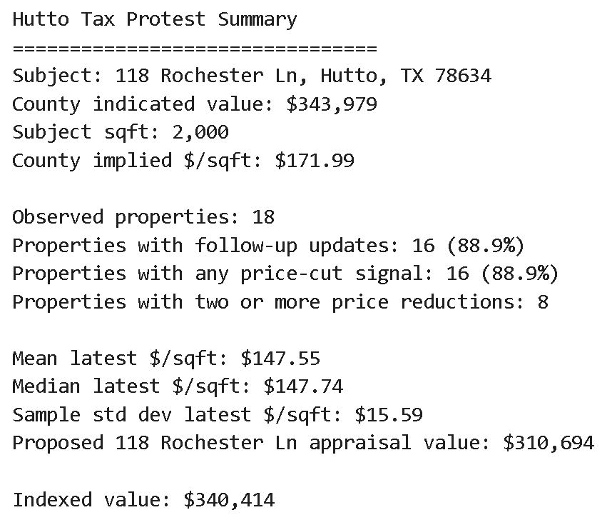
Dataset 1
Dataset 1 hosts 18 properties
16 dropped in price
8 dropped in price with extended DOM
The average PPSF = $147.64

Slide 9
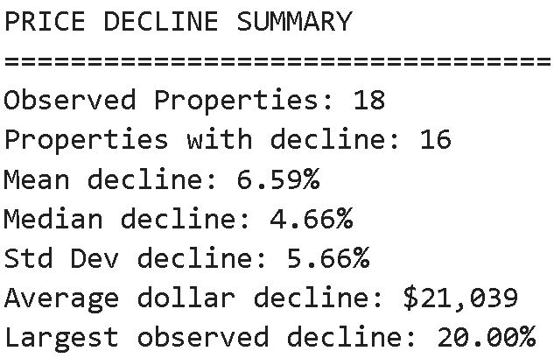
Dataset 1
Average $ decline per property was $21,039

Slide 10
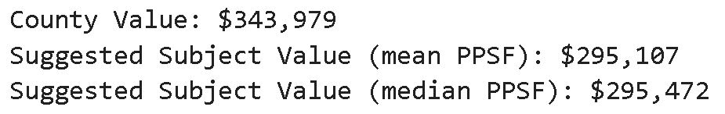
Dataset 1
Appraisal value PPSF average = $295,300
Proposed Appraisal Evaluation based on data set 1

Slide 11
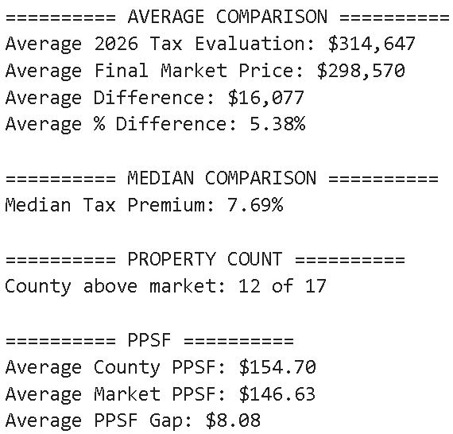
Dataset 1
Appraisal value PPSF average = $295,300 is within 1.2%, well within the appraisal PPSF margin of error

Slide 12
Market Dataset 2

Slide 13
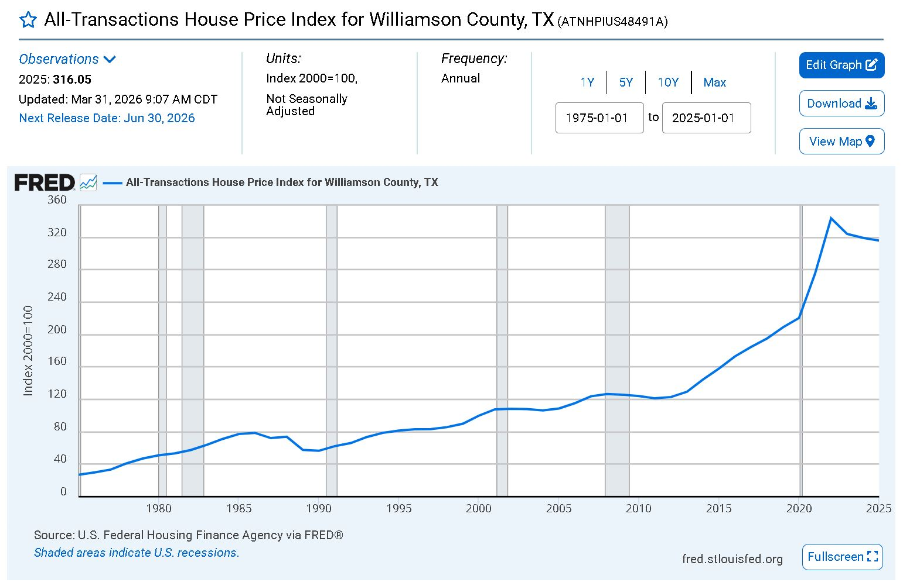
Dataset 2
https://fred.stlouisfed.org/series/ATNHPIUS48491A

Slide 14

Dataset 2
Indexed Value = $360,907
Proposed Appraisal Evaluation based on dataset 2

Slide 15
Dataset 2
Overevaluation
“the [area] … experienced at least one price reduction. That level of price adjustment is historically elevated and signals that original list prices are still overshooting what today’s buyers are willing or able to pay.”
Texas Tax Code § 1.04(7), Definition of Market Value — defines market value as the price a property would transfer for cash in an open market transaction.
https://teamprice.com/austin-daily-real-estate-briefing/2026-01-26

Slide 16
Market Dataset 3

Slide 17
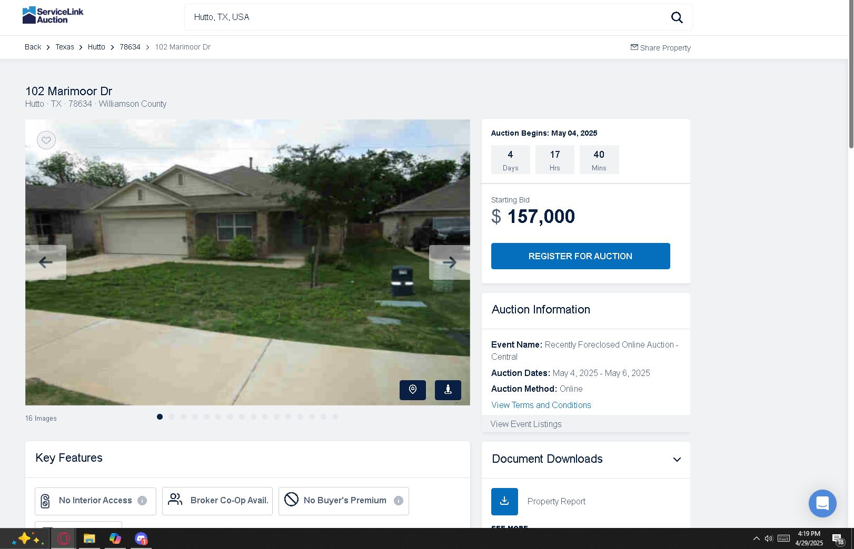

Slide 18
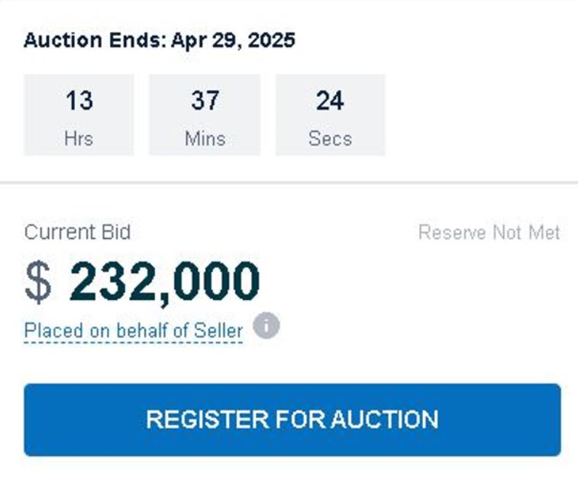
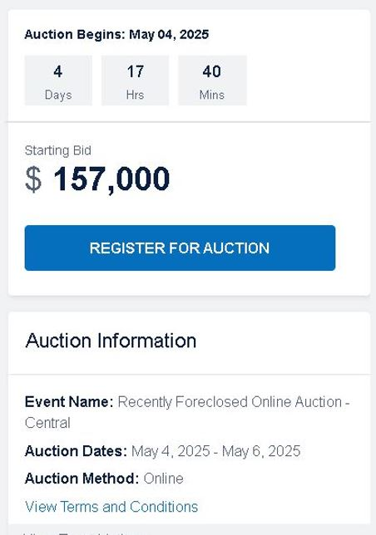
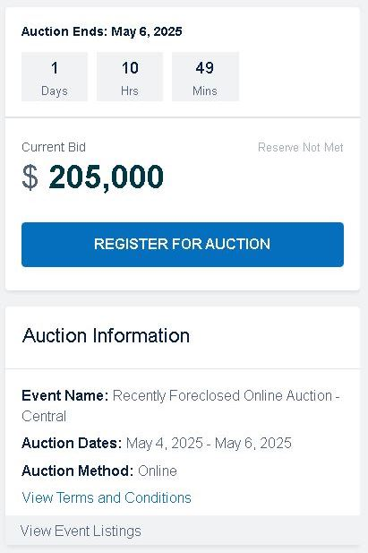
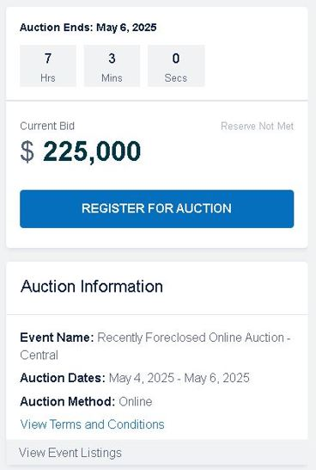
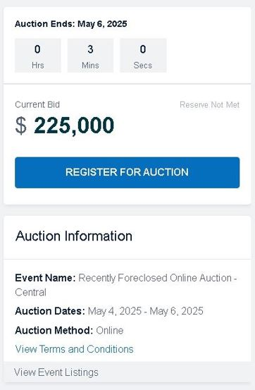
102 Marimoor Dr Auction Results
Dataset 3

Slide 19
Dataset 3
Going rate of foreclosures
“Foreclosed homes typically auction for 20-30% below market value with lenders being happy to recoup for 80 to 70 cents on the dollar of the home’s appraised value.”
https://realestate.alexcooper.com/real-estate-auction/how-much-do-foreclosed-homes-sell-for-at-auction
“On average, this ends up totaling about 15% below the home's actual value—and if you want to buy a foreclosure, you'll find it often sells for less than asking price.”
https://www.realtor.com/advice/buy/what-does-buying-a-foreclosed-home-entail/
“…auction buyers were willing to pay an average of 67.3 percent of estimated retail market value, up from 64.6 percent in Q4 2025 but down from 68.6 percent a year ago. That represented 102 percent of the Q1 2020 level.”
https://www.auction.com/lp/auction-market-dispatch

Slide 20
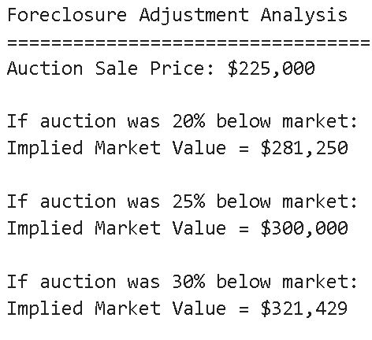
Dataset 3

Slide 21
Dataset 3
Auction Implied Market Value Average = $300,000
Proposed Appraisal Evaluation based on data set 3

Slide 22
Market Dataset 4

Slide 23
address | year_built | initial_ppsf | latest_ppsf | latest_date | days_on_market
112 Ghost Stories | 2025 | $163.67 | $163.93 | 5/30/2025 | 23
324 Twilight Breeze Way | 2025 | $170.33 | $163.93 | 3/27/2025 | 10
718 Luna Vista Dr | 2015 | $161.53 | $161.53 | 6/27/2025 | 69
721 Luna Vista Dr | 2015 | $161.03 | $161.03 | 8/7/2025 | 87
209 Twilight Breeze Way | 2025 | $161.37 | $158.88 | 11/25/2025 | 24
702 Luna Vista Dr | 2016 | $168.86 | $161.78 | 7/2/2025 | 164
106 Miglia St | 2025 | $185.75 | $151.05 | 10/20/2025 | 21
221 Twilight Breeze Way | 2025 | $164.73 | $162.10 | 11/17/2025 | 6
101 Acadia Cv | 2017 | $163.05 | $148.16 | 12/29/2025 | 25
807 Farm House Dr | 2015 | $153.30 | $156.36 | 7/8/2025 | 8

Slide 24
Dataset 4
Tax Appraisal Value average = 307,573
Average Sale Price = 311,920
43.7 Average DOM
23.5 Median DOM
1.85x DOM pressure ratio
Extended market exposure oscillated price reductions, 80% of comparable properties require price concessions before achieving their sold market value
There was an average of -6.48% reduction in home value from initial listing to final sale value (“market correction” that can be titled for DOM pressure and price reduction correlation”)

Slide 25
Miscellaneous Analysis

Slide 26
Property Repairs
Itemization | Cost
Repair drywall holes($135 labor + $15) | $150
Repair of Remaining Roof ($24505 full restoration- $3545 repaired)) | $20,959
Lawn restoration / landscaping (dead grass and trees)($135 labor + $66 plants) | $201
Interior Water Intrusion (Drywall and texture repair, ceiling finishing) | $3000
Sterilization | $600
Irreplicable damaged flooring | $40
Broken fence pieces with adjacent neighbors | $105
Irrigation issues | $900
Total cost to repair property to open market standards | $25,955

Slide 27
Property Repairs
Valuation Method | Value Before Repairs | Property Repairs | Indicated Value
County Appraisal | $343,979 | $25,955 | $318,024
Dataset 4 average sale | $315,000 | $25,955 | $289,045
Dataset 3 market estimate | $300,000 | $25,955 | $274,045
Dataset 2 F.R. Index | $360,903 | $25,955 | $334,948
Dataset 1 average listing | $298,570 | $25,955 | $272,615
Indicated Value Mean | Indicated Value Median
$297,735 | $289,045
The market-supported value currently contains deferred maintenance as a rental unit, has and will require further reducing market value by approximately $14,701.

Slide 28
Enclosing analysis

Slide 29
Combining factors
The datasets presented included comparable properties for market value on January 1 2026 that could meet open market values to sell during2025. This used an open market survey, a Federal Reserve Housing Market Index, identically matching properties under foreclosure in 2025, and comparable properties sold in 2025 with sales data
Over 90% of sale prices are below county appraisal, matching the pattern of property sale prices decreasing by 10% - 15% year over year since 2022
The investment is failing at current market rates, falling far below investment opportunity RoR
The property has cosmetic, functional, and safekeeping issues, costing a market value reduction of $14,701
The property faces the most extreme DOM pressure measure in the United States

Slide 30
Final Proposal
1. Combining adjustment, cost, and market pressure for a sale of the property: Appraisal from the county – Cost to Market Property– Market Correction (price adjustment avg)
[$343,979 - $25,955] - 6.48% = $297,416
2. Dataset 1 Listed homes failed to meet open market – Cost to Market Property – Market Correction
[$298,570 - $25,955] - 6.48% = $254,949
3. Dataset 2 Federal Reserve index fluctuation – Cost to Market Property – Market Correction
[$360,907 - $25,955] - 6.48% = $313,243
4. Dataset 3 Foreclosure Sale Price – Cost to Market Property – Market Correction
[$300,000 - $25,955] - 6.48% = $256,286
5. Dataset 4 Average Market Sale Price – Cost to Market Property – Market Correction
[$315,535 - $25,955] - 6.48% = $270,815
Mean Adjusted Value | Median Adjusted Value
$286,291 | $286,622

Slide 31
Final Proposal
1. Combining adjustment, cost, and market pressure for a sale of the property: Appraisal from the county – Cost to Market Property– Market Correction (price adjustment avg)
[$343,979 - $25,955] - 6.48% = $297,416
2. Dataset 1 Listed homes failed to meet open market – Cost to Market Property – Market Correction
[$298,570 - $25,955] - 6.48% = $254,949
3. Dataset 2 Federal Reserve index fluctuation – Cost to Market Property – Market Correction
[$360,907 - $25,955] - 6.48% = $313,243
4. Dataset 3 Foreclosure Sale Price – Cost to Market Property – Market Correction
[$300,000 - $25,955] - 6.48% = $256,286
5. Dataset 4 Average Market Sale Price – Cost to Market Property – Market Correction
[$315,535 - $25,955] - 6.48% = $270,815

Slide 32
Final Proposal
1. Combining adjustment, cost, and market pressure for a sale of the property: Appraisal from the county – Cost to Market Property– Market Correction (price adjustment avg)
[$343,979 - $25,955] - 6.48% = $297,416
2. Dataset 4 Average Market Sale Price – Cost to Market Property – Market Correction
[$315,535 - $25,955] - 6.48% = $270,815
Texas Tax Code § 23.01(a), Appraisals Generally — taxable property shall be appraised at market value as of January 1
Texas Tax Code § 1.04(7), Definition of Market Value — defines market value as the price a property would transfer for cash in an open market transaction
Average Open Market Value | Proposed Market Value disputed address
$286,622 | $286,622

