Slide 1
SIMU UVM capability

Slide 2
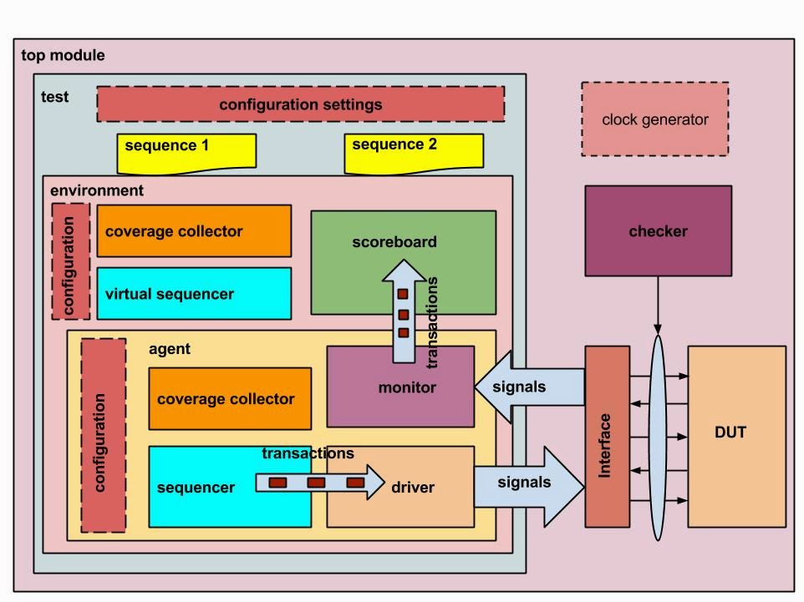
Universal Verification Method (UVM)
Standardized methodology to test and verify digital designs.
Built on top of SystemVerilog.
Flexible, reusable and portable .
Different classes for components and objects like agents, drivers, monitors, scoreboards, sequences, tests and ….
It supports mechanisms to communicate transactions, different phasing, messaging and reporting, configuration database and etc..
https://learnuvmverification.com/index.php/2015/05/14/uvm-environment-components/

Slide 3
SIMU code updates
Using –use_uvm switch when running a testcase.
Compiling all UVM files in a file list.
Modifying testcase and testbench files in the
`ifdef UVM_TESTBENCH .. `endif block.
>run_testcase ../testcases/tc_case/tc_case.tcl –use_uvm
if {$::CMD_ARG_UVM > 0}
simu_vlog -sv -incr -timescale $TCTIMESCALE -cover -f "$TCSUBDIR/uvm_filelist.txt"
simu_vlog -sv -incr -d UVM_TESTBENCH -timescale $TCTIMESCALE "$TCSUBDIR/tb.sv"
set TC_COMP_INVOCATION {simu_vlog -sv -incr -d UVM_TESTBENCH -timescale $TCTIMESCALE $TCSUBDIR/$TCFILENAME.sv }

Slide 4
Project setting
Copying all uvm files into uvm folder under the testcases/tc_xxx folder.
Updating tc_xxx.tcl file. (check whether it has the necessary updates)
Creating uvm_filelist.txt
Updating compile_all.tcl file (check whether it has the necessary updates)
Updating tb.sv and tc_xxx.sv files and adding your test scenario.
The above steps are in addition to the steps mentioned in : https://fidussys.atlassian.net/wiki/spaces/FPGARIPL/pages/2407333904/Adding+SIMU+to+your+project

Slide 5
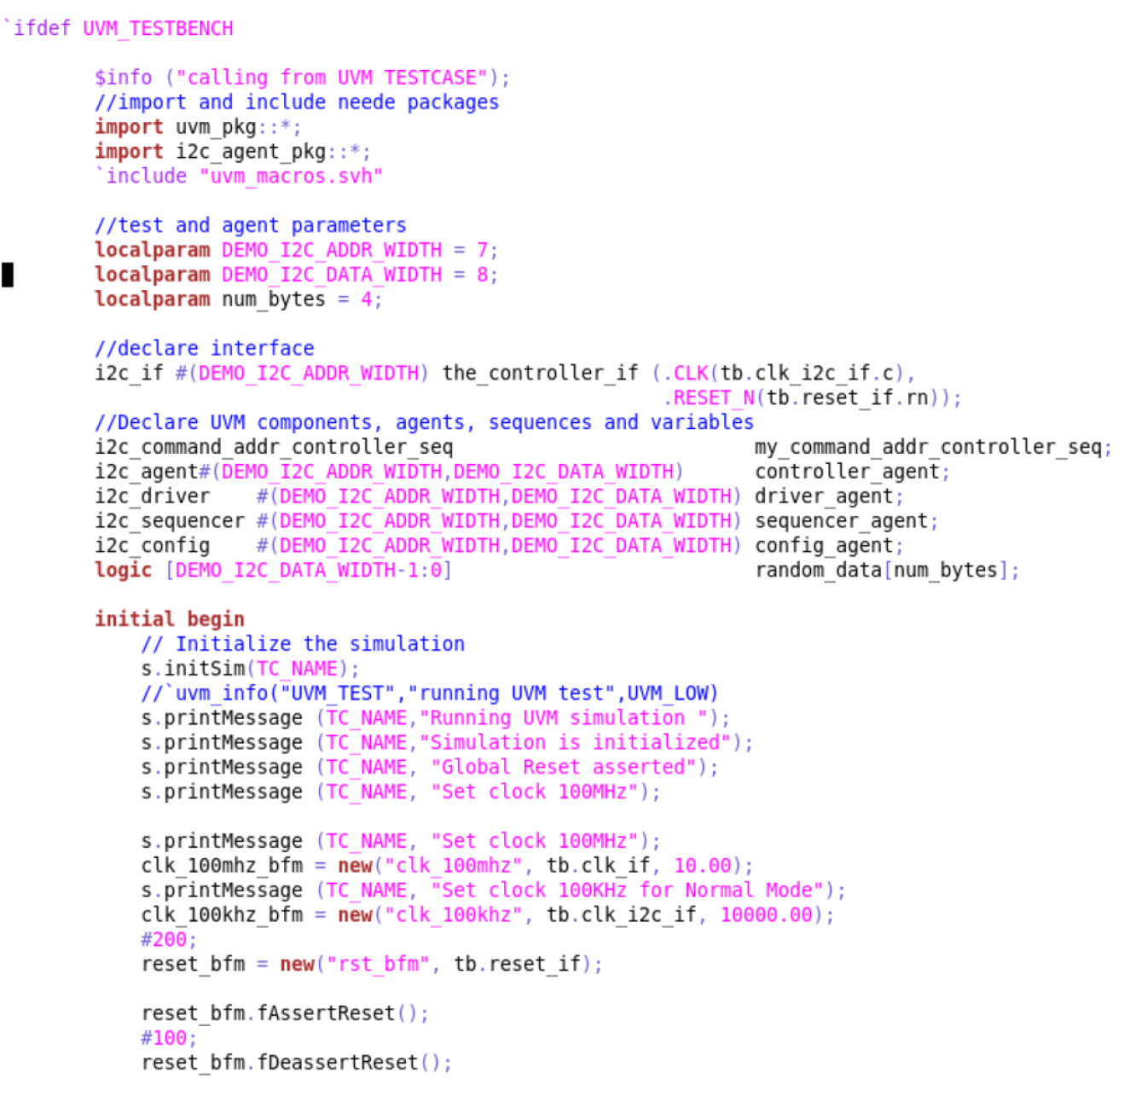
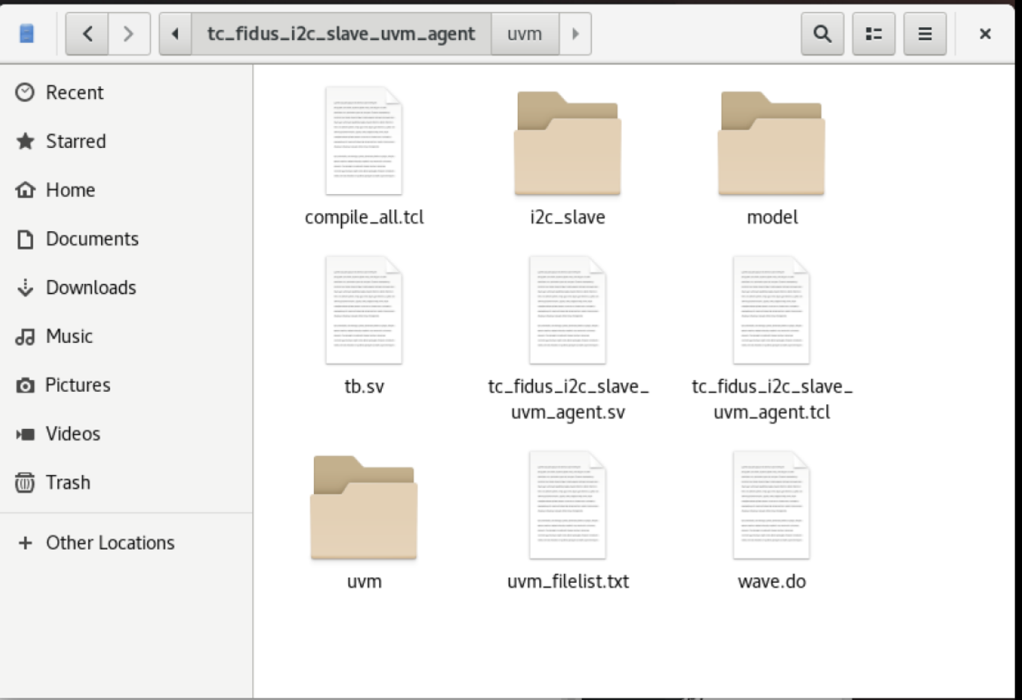
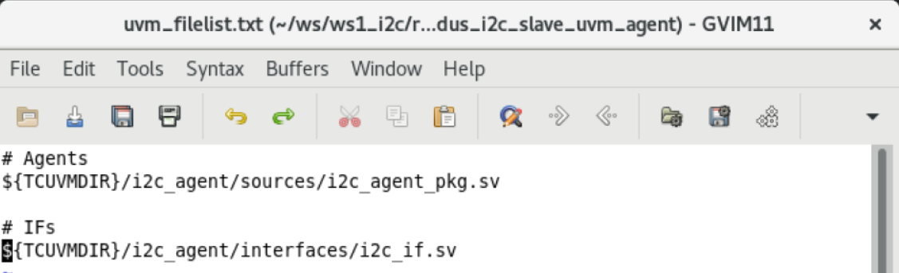
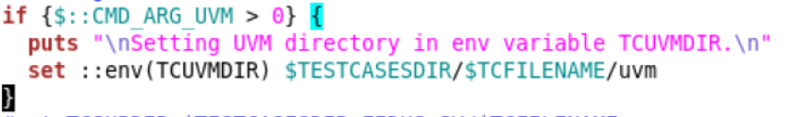
i2c_agent test example
testcases_envFidus_uvm_simMquesta/tc_fidus_i2c_slave_uvm_agent

Slide 6
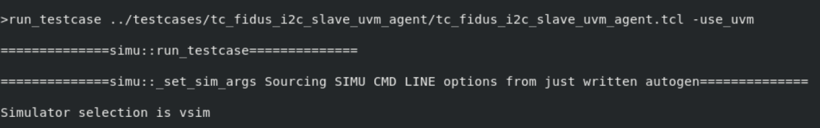
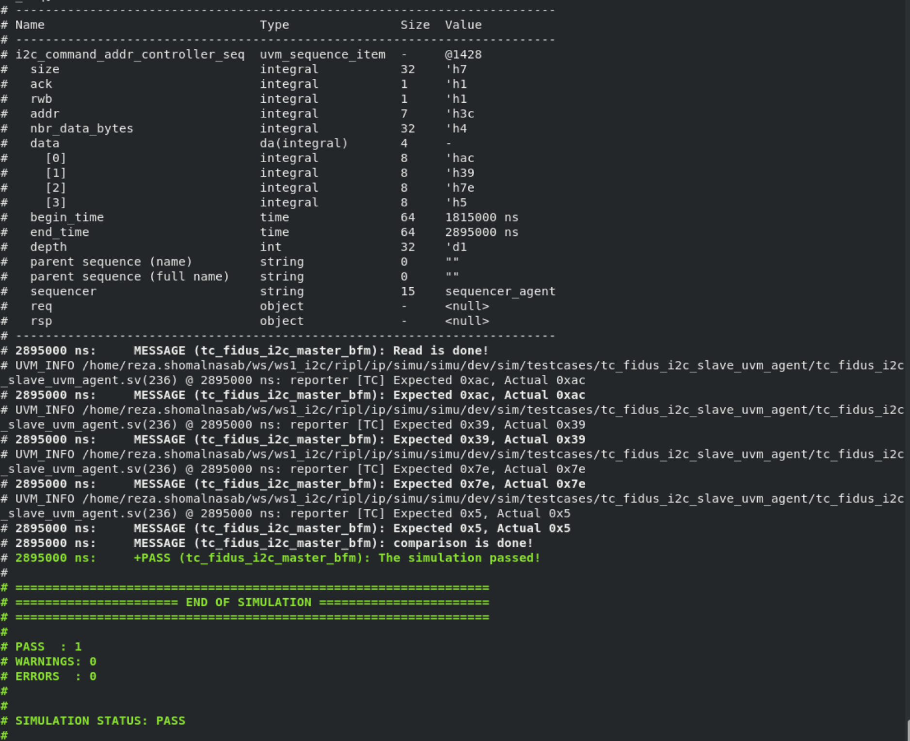
Result

