Slide 1
Expense Tracker Application
By Ankush Makhijani

Slide 2
TABLE OF CONTENTS
01
Features
02
Tech - Stack
03
Design Choice
04
How to Run

Slide 3
01
Features

Slide 4
CRUD OPERATIONS
JWT User Auth
Expense Trends

Slide 5
Crud Operations
Read
Delete
Create
Update
User Can fetch their own Transactions
Delete an Expense
Add a new Expense
Update an Existing expense

Slide 6


Expense Trends
By Date
By Category
By amount
Hybrid
User can filter and view Expenses by Date
User can filter and view Expenses by Category
User can sort and filter by amount
User can combine two or more operations

Slide 7
JWT Auth
This is a Multi User Application, all transactions are associated to a specific User. User creates an account with a specified Username and password, and upon logging in with these credential a user is granted token which is then used by all subsequent request made by user for Authentication and is unique to that login session.
Without the token a user will not be authorized and not permitted to access resources

Slide 8



TechStack
React + Vite
Java + Spring
Postgresql

Slide 9
Why React + Vite
High performance with virtual DOM
Rich ecosystem
Easy to integrate with APIs
Huge community and third-party library support
Allows rapid UI development with reusable
components.

Slide 10
Why Java + Spring?
Easy integration with databases (like PostgreSQL)
Built-in support for REST controllers, JWT security,
validation, and exception handling
Java is Object Oriented and following MVC Architecture makes code easy to read, understand, update, Integrate and scale
Large ecosystem and community support
Battle-tested for microservices and large apps

Slide 11
Why PostgreSQL?
Easy to scale for large Users
ACID-compliant and highly reliable
Strong data integrity enforcement
Support for advanced types (JSONB, arrays)
Free, open-source, and cloud-ready.

Slide 12
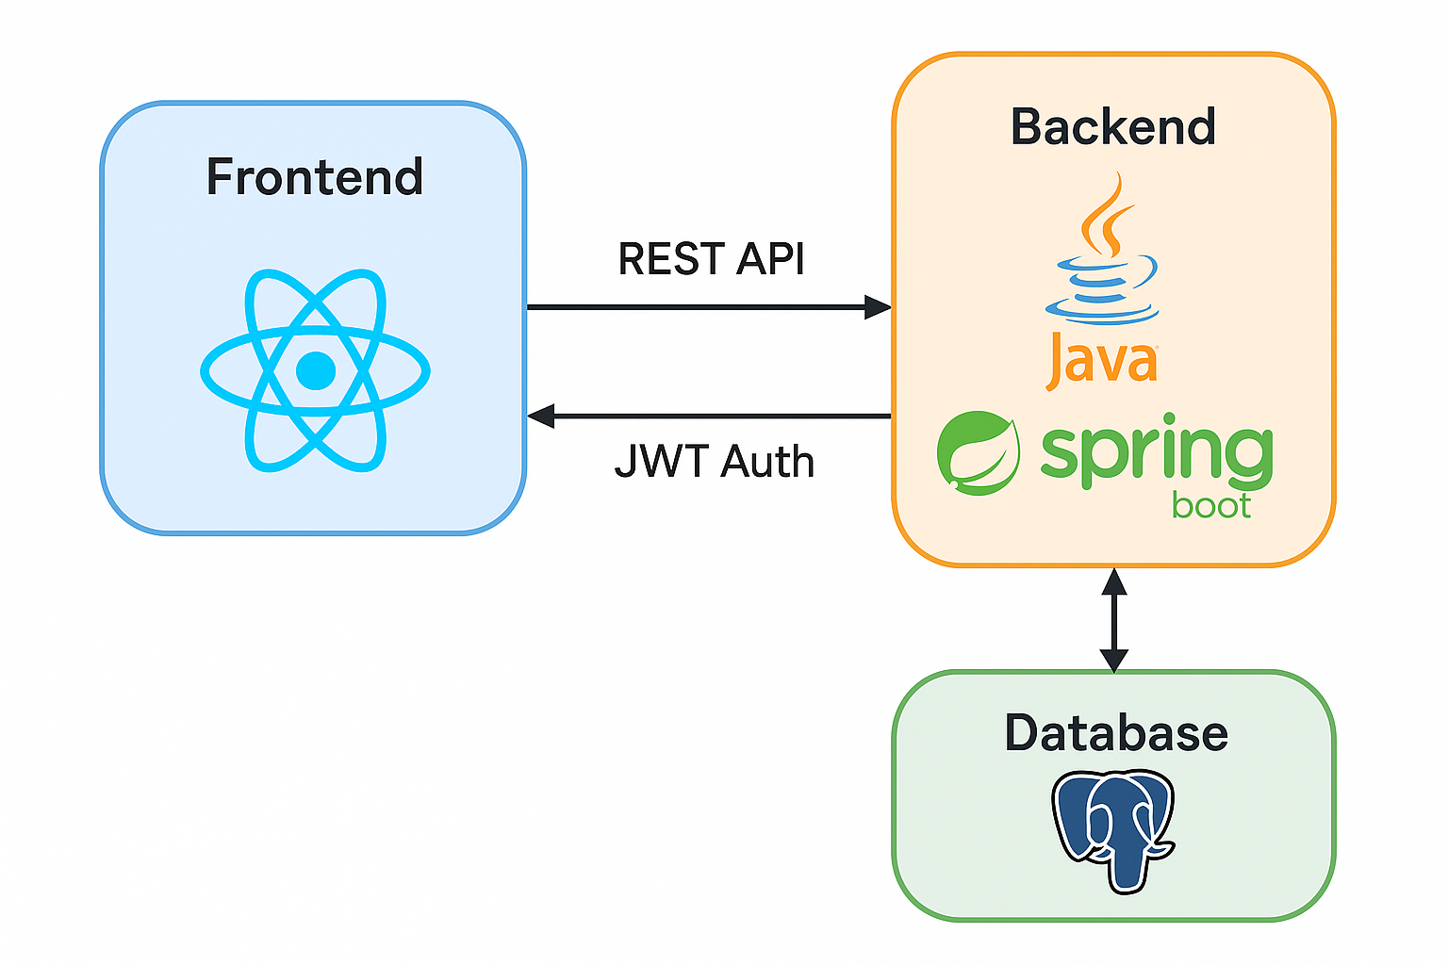
Architecture

Slide 13
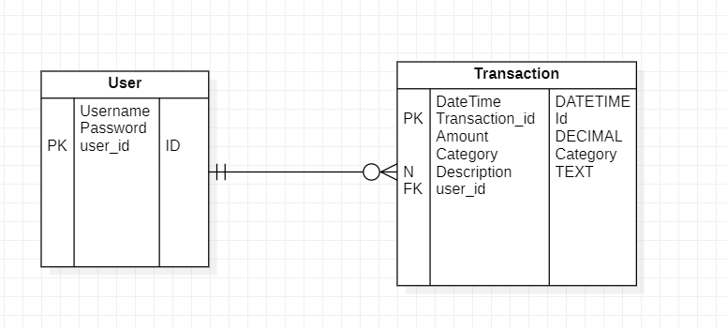
Database Schema

Slide 14

How to run?
Its easy with Docker

Slide 15
Follow the Steps
1. Clone the Repository
in bash
git clone https://github.com/wolfy5786/ExpenseTracker.git
cd ExpenseTracker
Set up the following environment variables
in docker-compose.yml,
POSTGRES_DB=expensetracker
POSTGRES_USER=postgres
POSTGRES_PASSWORD=password
SPRING_DATASOURCE_URL=jdbc:postgresql://db:5432/expensetracker
SPRING_DATASOURCE_USERNAME=postgres
SPRING_DATASOURCE_PASSWORD=password
JWT_SECRET=U9jM3LrT5pQsAxV8NnBxWz2KyReGvHdQ

Slide 16
Follow the Steps
3. Build
in bash
docker-compose up --build
4. Access and test
Access the App Frontend → http://localhost:3000
Backend if testing through postman → http://localhost:8080
5. To Stop
In bash
docker-compose down

Slide 17
THANK You
Do you have any questions or need troubleshoot?
makhijaniankush24@gmail
+1 8562631347
Please keep this slide for attribution

