Slide 1
Irish Whiskey
Clustering Analysis
Let’s open up a proper pub!

Slide 2
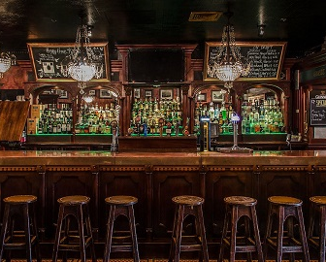
It’s Saint Patrick’s Day!
To celebrate the Saint, let’s open up a proper Irish pub!
We know we’ll need Irish Whiskeys, but which ones should we start with?
We’re in Iowa, so let’s look at what’s been selling that’s like what we enjoy as well as what the top sellers are to get started...

Slide 3
Data Source And Context
For this analysis I used a filtered data set of Irish Whiskies from the Iowa Liquor Sales dataset (publicly data available on kaggle).
Original Dataset link: Iowa Liquor Sales
Irish Whiskey Subset link: Irish Whiskies Iowa
Context: The Iowa Department of Commerce requires that every store that sells alcohol in bottled form for off-the-premises consumption must hold a class "E" liquor license.
Content: This dataset contains information on the name, kind, price, quantity, and location of sales of individual containers or packages of containers of alcoholic beverages filtered for Irish Whiskey category only.

Slide 4
Dataset - Overview
The dataset filtered for Irish Whiskeys has 87,747 rows of individual sales.
Columns include: Invoice Number, Date, store location columns, category related columns, vendor related columns, Item Description, and sale volume columns (in both quantities and dollars).
I removed the individual identification number columns, did some text clean up on the columns that needed it, and removed duplicates.

Slide 5
Columns - Numeric Variables
Zip Code - zip code where the sale was made
Pack - number of containers in the pack
Bottle Volume (ml) - volume of container in ml
Bottles Sold - number of bottles sold in the sale
Sale (Dollars) - total amount of sale (in dollars)
Year - year the sale was made
Month - month of the sale

Slide 6
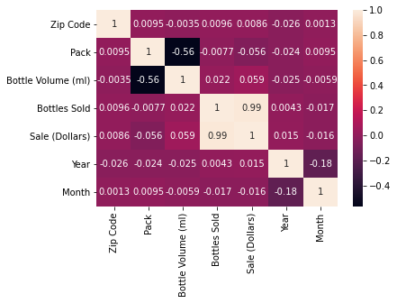
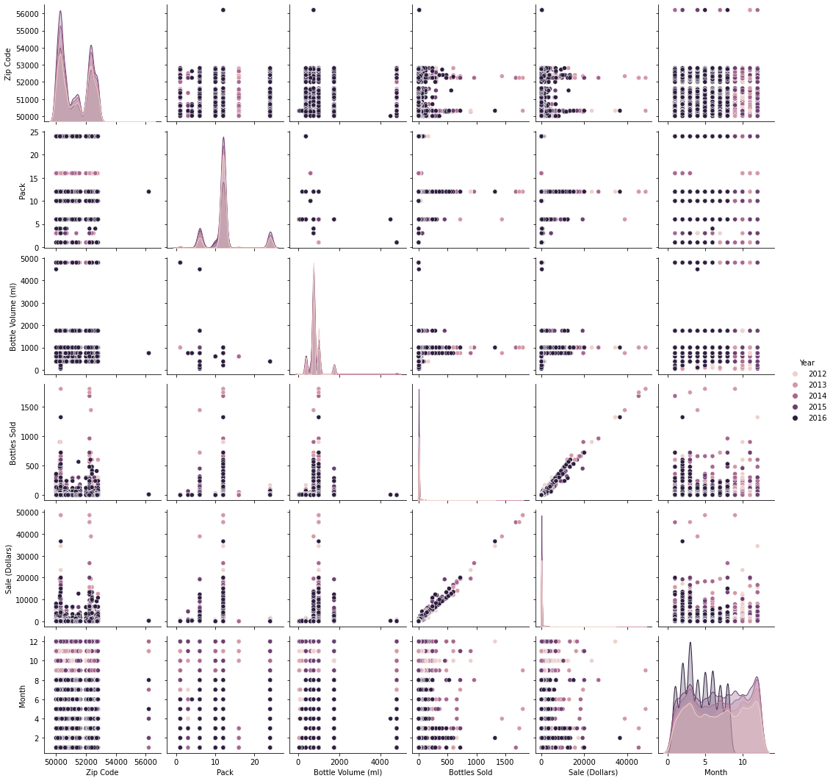
Columns - Numeric Variables
The most notable correlated relationships between the numeric columns aren’t a surprise:
Moderate correlation between Pack and Bottle Volume (ml)
High correlation between Bottles Sold and Sale (Dollars)
The grid plot is colored by year, but there aren’t any other discernible notable relationships between the variables.

Slide 7
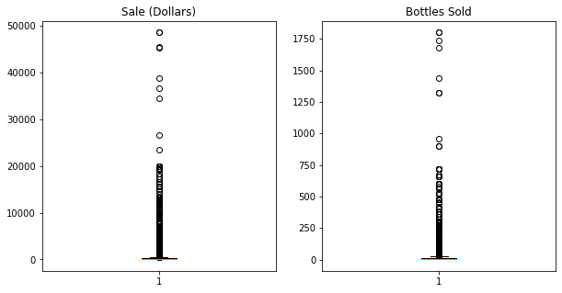
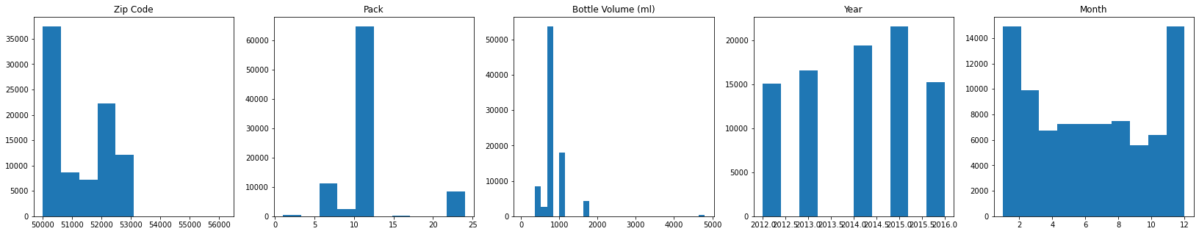
Columns - Numeric Variables
It can be easily argued that the two continuous variables are Sale (Dollars) and Bottles Sold.
As we can see, the continuous variables are not scaled nor normally distributed.
The other numeric columns can be argued as being categorical.

Slide 8
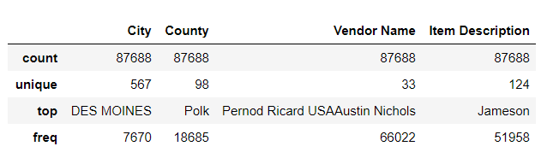
Columns - Categorical Variables
City - city where the sale was made
County - county where the sale was made
Vendor Name - the vendor name of the liquor
Item Description - the specific item description of the liquor

Slide 9
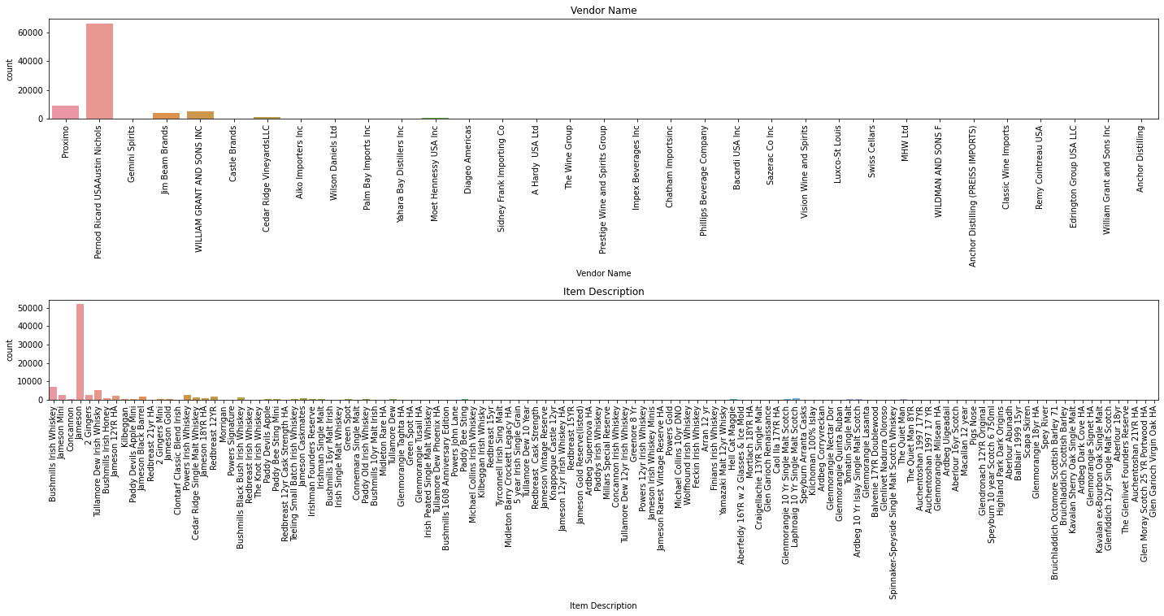
Columns - Categorical Variables
Most popular Item Descriptions:
Most popular Vendor Names:

Slide 10
Dimensionality Reduction

Slide 11
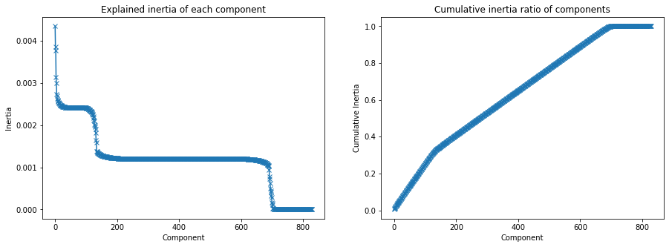
FAMD - Factor Analysis of Mixed Data
We have a good balance of categorical and numeric variables which works well for FAMD.
I’m going to use 150 components based on the Explained Inertia graph.

Slide 12
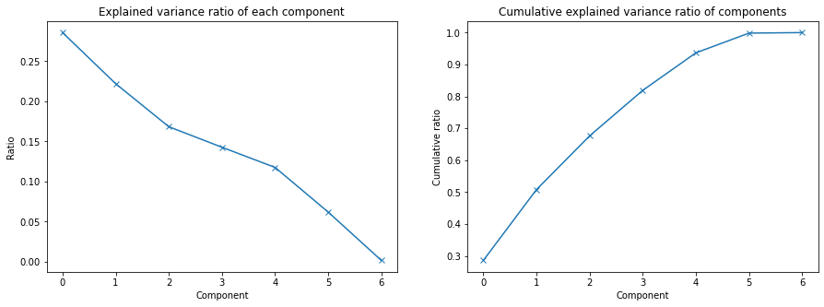
PCA - Principal Component Analysis
Although PCA is part of FAMD model, I want to see if there’s a better return for our model by focusing on the numeric variables and lowering the components even more.
For PCA, I’m going to use 2 components.

Slide 13
K-Means Clustering Models

Slide 14
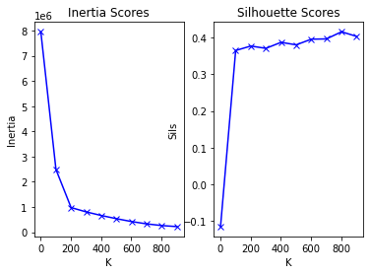
K-Means Clustering With FAMD Components
Using our FAMD components from earlier, how many clusters in the K-Means model should we use?
If we’re looking at the inertia scores and Silhouette Scores, it looks like 200 is a useful number of clusters.
With 200 clusters, the silhouette score of the k-Means solution is approximately 0.37.

Slide 15
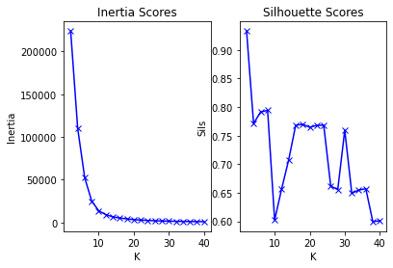
K-Means Clustering With PCA Components
Using our PCA components from earlier, how many clusters in the K-Means model should we use?
If we’re looking at the inertia scores and Silhouette Scores, it looks like 2 is a useful number of clusters.
With 2 clusters, the silhouette score of the k-Means solution is approximately 0.93.

Slide 16
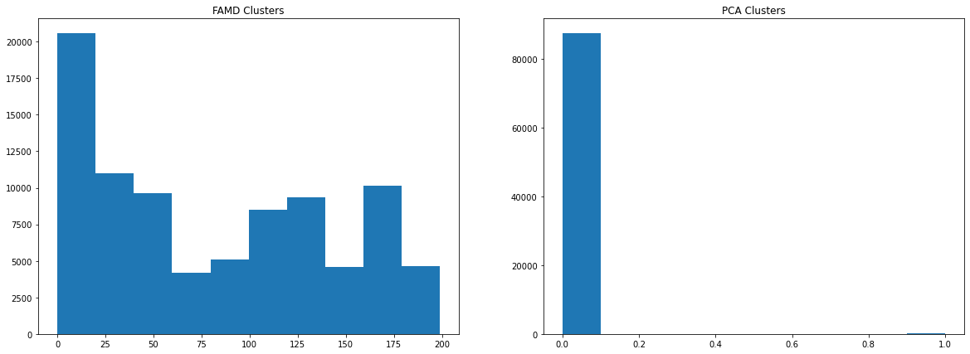
Which K-Means Model to Use?
The k-means clustering solution based on the FAMD components looks to be more evenly distributed across the original dataset.
Whereas, the k-means clustering solution based on the PCA components is heavily imbalanced. This could be a problem with consistently making suggestions for which liquors we should be choosing.

Slide 17
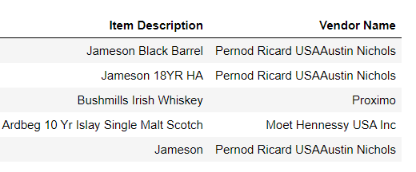
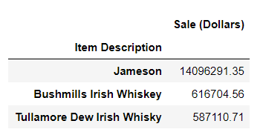
Irish Whiskey Recommendations
Given that there is such an imbalance on the PCA component based cluster set, I'm going to go with the FAMD component based cluster set. I'm also going to get a smaller subset of suggestions based on an Irish Whiskey that I know I like and a larger one based on larger volume of sales in Iowa.

Slide 18
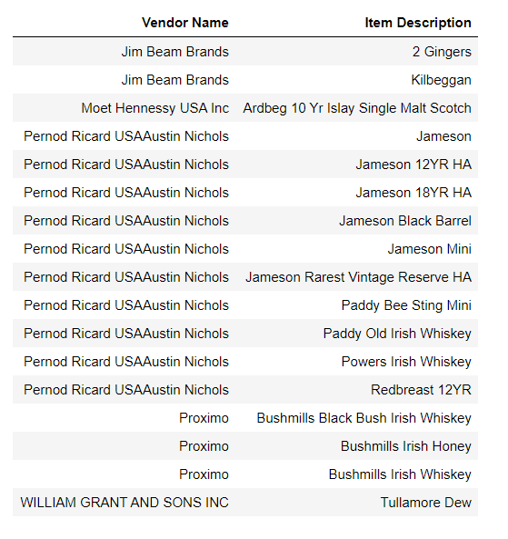
Irish Whiskey Recommendations
I personally enjoy Jameson Black Barrel, so I used the clustering model to see what 5 other recommendations would be similar.
Then appended that onto a dataframe of recommendations from the top 3 sellers in the state.
The list to the right is the list of Items by Vendor that we will be ordering to start our new pub with.

Slide 19
Other Considerations
There are several different ways I could have approached this question and considerations that I could have taken along the path including but not limited to the below, however this is a valid and relatively easy way to find like items based on past sales within a state in order to start up a proper Irish Pub.
I could have also:
Run an analysis of the highest selling whiskeys as a time series and predicted what would sell better in the coming months
Run different dimension reduction methods to find out what might have worked better than the two I chose
Run different clustering models to see if another clustering model and number of clusters would have worked better
Focused the analysis on City, County, and/or Zip to hone in on a location for where to put my pub as well as what to stock

Slide 20
Sláinte!

