Slide 1


SNAKE
黃建瑋 107502012
王均琦 107502545
曾專佩 107502015
朱殷露 107502001

Slide 2
分工
黃建瑋 – Base Of The Program
王均琦 – Mode Of The Game
曾專佩 – Menu and PPT
朱殷露 – Menu and PPT

Slide 3
遊戲玩法
Before start the game, firstly select the speed,level and mode.
Speed : Slow,Medium,Fast,Very Fast
Level : 1,2,3
Mode : Colorful or Normal
The player uses the arrow keys to move a "snake" around the board. As the snake finds food, it eats the food, and thereby grows longer, it also added the points. Every time the snake eats food, it’ll added 1 to the score. The game ends when the snake either moves off the screen or moves into itself. The goal is to make the snake as long as possible before that happens.

Slide 4
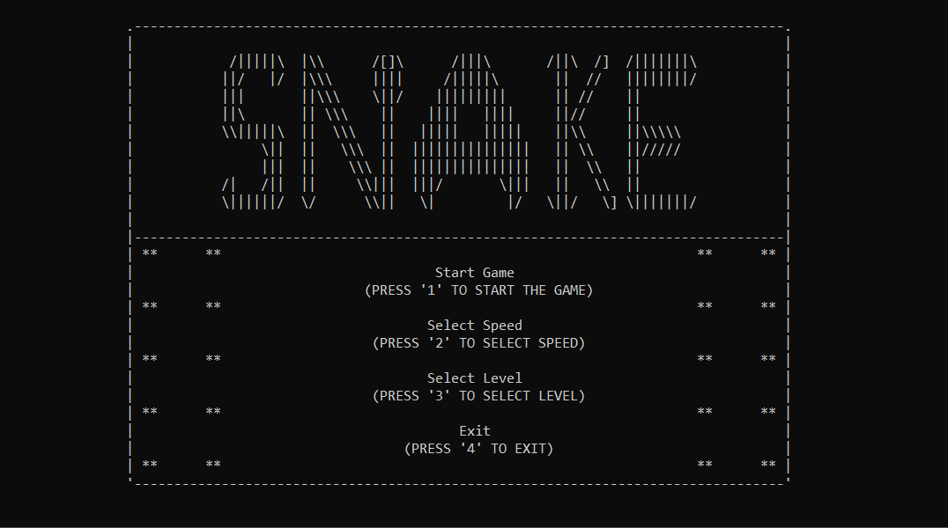
開始介面

Slide 5
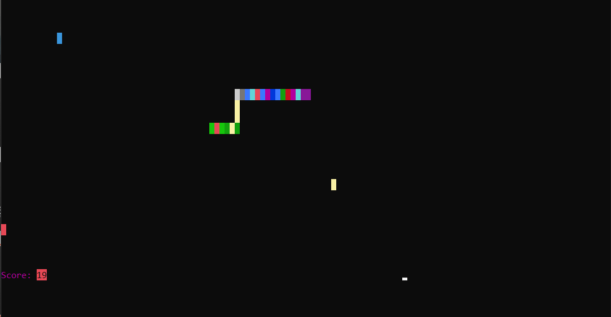
遊戲開始

Slide 6
THANK YOU FOR LISTENING ☺

