Slide 1


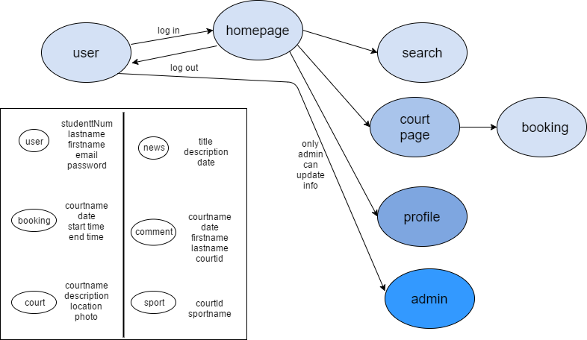
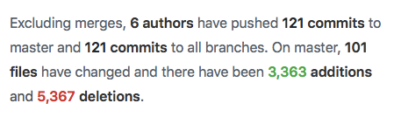
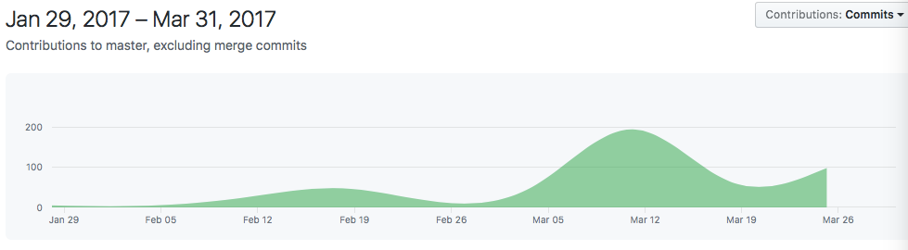
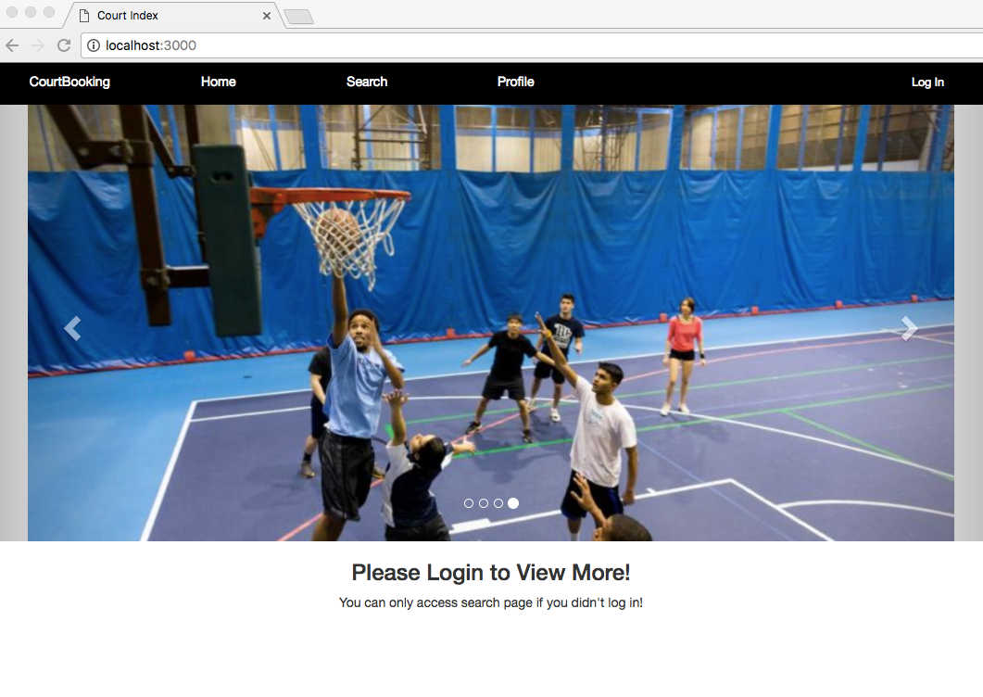
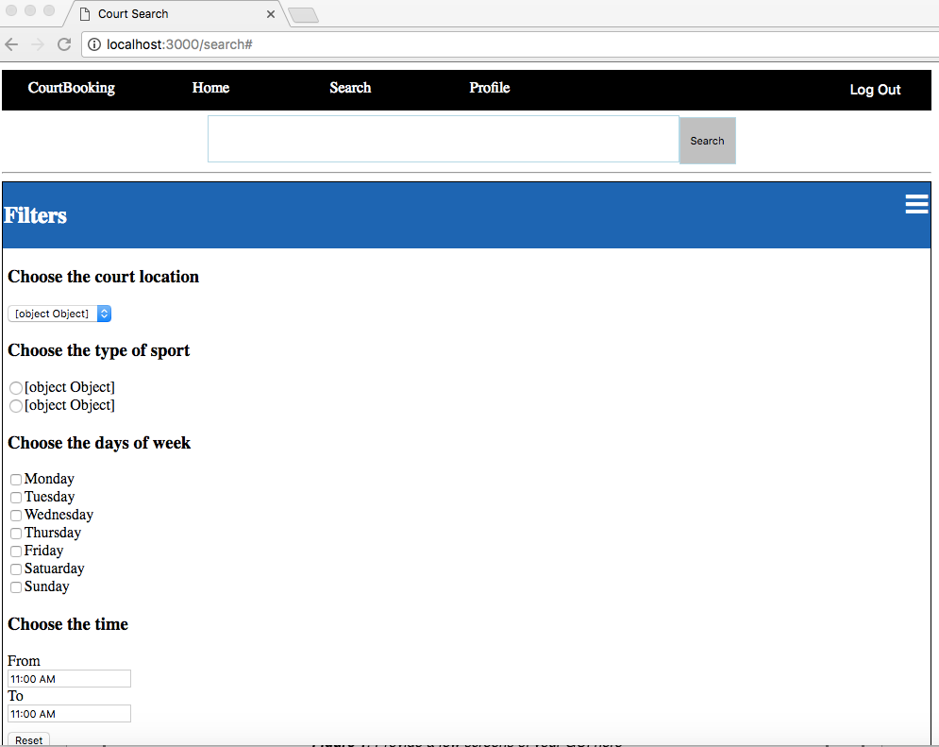
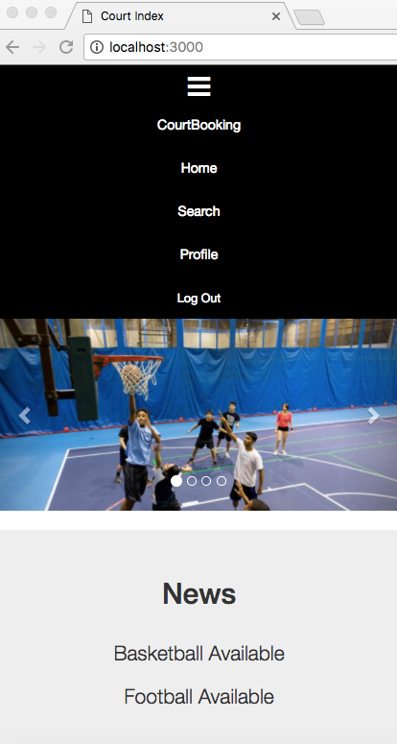
Team 10: CourtBooking
A sport court booking website
CSC309
Team Member 1 – Wendy Hu Email: wenxi.hu@mail.utoronto.ca
Team Member 2 – Yunhao Mao Email: yunhao.mao@mail.utoronto.ca
Team Member 3 – Meng Wei
Team Member 4 – Jiaxin Wu Email: jasminejx.wu@mail.utoronto.ca
1
Description & Requirements
4
Design
Provide a brief description of your project. You may want to specify the number of requirements that were identified and mention the most important ones with bullets.
CourtBooking is a website used to manage or book sport courts in the Athletic Centre.
Working staffs could use this website to update the current or future information and status of specific sport courts. U of T students or any registered members could use this website to book a court in advance individually or as a group.
2
Features
Figure 2. Show the design of your project (via UML Diagram, MVC, ER diagram, loop event, etc.)
Mention the features of your project (such as responsive design, using semantic html, RESTful, etc.) by using bullets.
5
Statistics
Header using ejs
Different dashboard appearance before and after login
Sliding display of featured court image
Responsive design
Semantic HTML
User can change icon picture
Mention statistics of your project such as how many man-hours it took to design and implement, how many lines of code you ended up with, the number of classes, the technologies you used, and the number of methods in your project, etc.
6
Future Work
3
Graphical User Interface
Talk about things that are missing from your project that should be implemented in the future, such as security, reliability and scalability aspects, etc.
Add friending features that allows users to add friends and send messages to each other
Improve booking flexibility
7
References
Mention any references used to complete your project, including books, online tutorials, laboratories, youtube videos, etc.
TutorialPoint:
https://www.tutorialspoint.com/nodejs/nodejs_express_framework.htm
w3schools:
https://www.w3schools.com
jQuery api:
http://api.jquery.com/jquery.ajax/
Figure 1. Provide a few screens of your GUI here
MongoDB Manual 3.4:
https://docs.mongodb.com/manual/reference/method/

